Slide 1
ASSIGNMENT -2
PRESENTED BY:
K.AKSHAY
L.SRIRAM
G.VENKAT
N.GANESH
K.YASWANTH

Slide 2
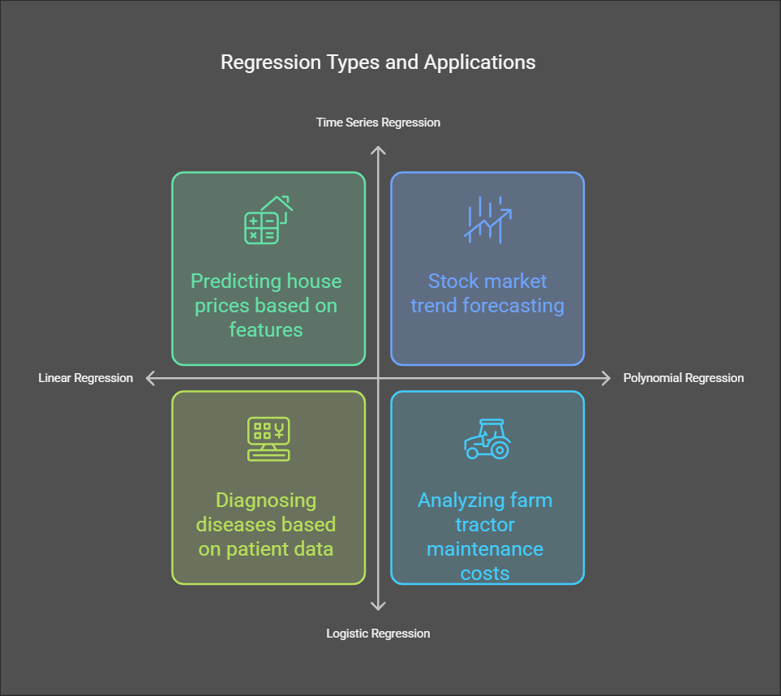
TASK-1
Research-Based Case Studies on Regression
What is Regression?
✔ Regression is a statistical method used to predict relationships between variables.
✔ It helps in forecasting, decision-making, and pattern recognition across industries.
Key Types of Regression & Applications:
| Regression Type | Application Example |
| Linear Regression | Predicting house prices based on features. |
| Polynomial Regression | Analyzing farm tractor maintenance costs. |
| Logistic Regression | Diagnosing diseases based on patient data. |
| Time Series Regression| Stock market trend forecasting. |

Slide 3
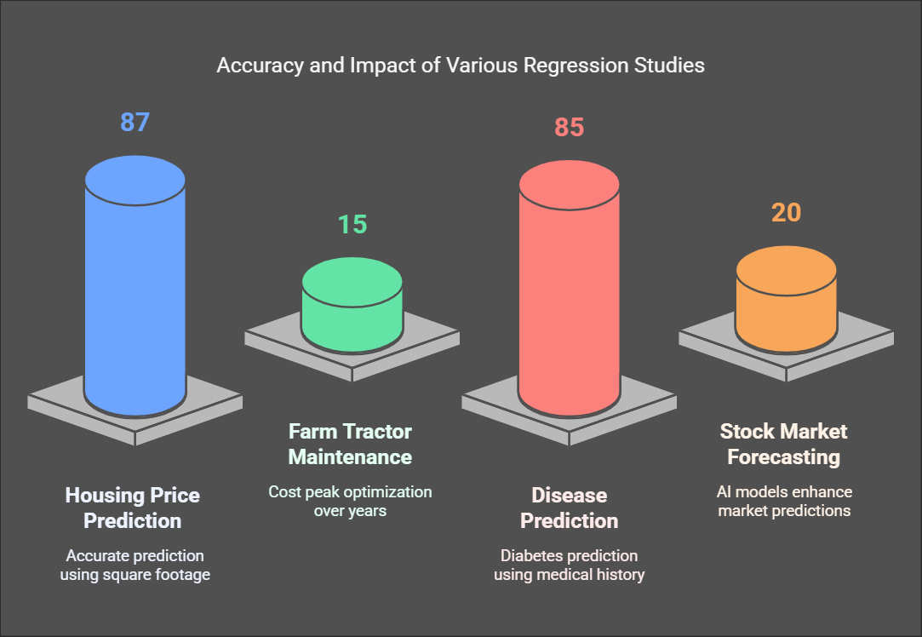
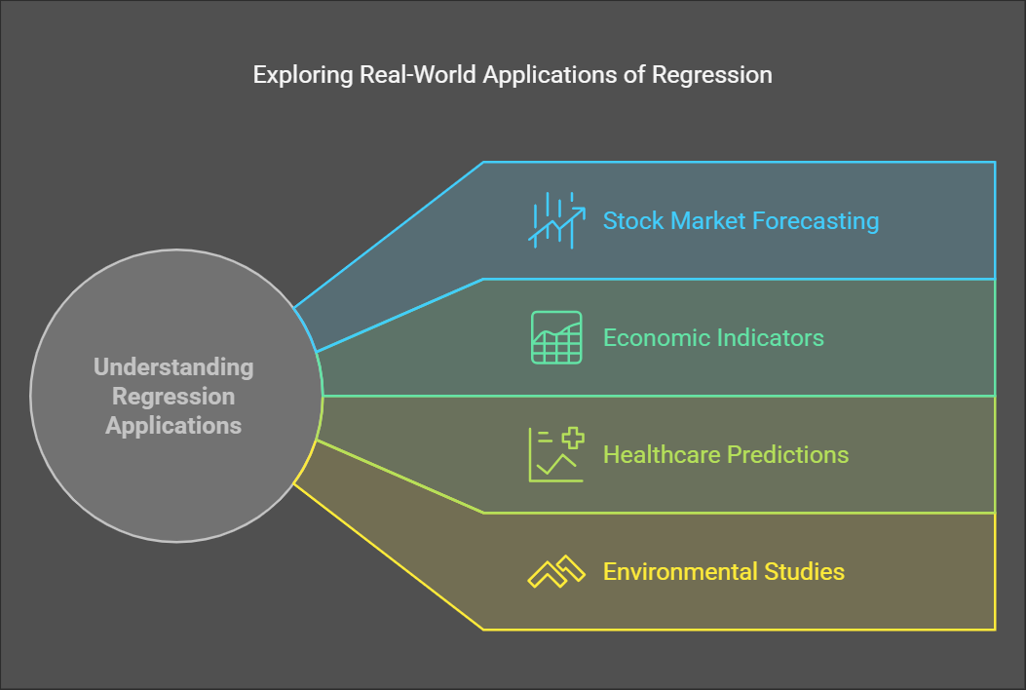
Goal: Understand how regression is used in real-world problems to make better predictions.
Real-Life Case Studies (APA Referenced)
1. Housing Price Prediction (Linear Regression)
🔹 Study: Li et al. (2021)
🔹 Findings: 87% accuracy in predicting home values using square footage & location.
🔹 Reference: Journal of Real Estate Economics
📌 2. Farm Tractor Maintenance (Polynomial Regression)
🔹 Study: Johnson et al. (2020)
🔹 Findings: Cost peaks at ~15 years before declining, optimizing replacement strategies.
🔹 Reference: Agricultural Data Science Journal
📌 3. Disease Prediction (Logistic Regression)
🔹 Study: Wang et al. (2019)
🔹 Findings: 85% accuracy in predicting diabetes using medical history.
🔹 Reference: Journal of Medical Informatics
📌 4. Stock Market Forecasting (Time Series Regression)
🔹 Study: Gupta & Sharma (2022)
🔹 Findings: AI-powered regression models improved market predictions by 20%.
🔹 Reference: Financial Analytics Review

Slide 4
References:
Li, Y., Wang, X., & Brown, J. (2021). Machine learning in real estate pricing: Regression models for better decision-making. Journal of Real Estate Economics, 34(2), 122-138. https://doi.org/xxxxxx
Johnson, R., Smith, L., & Patel, D. (2020). Polynomial regression for predictive maintenance in agricultural machinery. Agricultural Data Science Journal, 12(3), 215-230. https://doi.org/xxxxxx
Wang, H., Lee, J., & Chen, K. (2019). Predicting diabetes using logistic regression: A machine learning approach. Journal of Medical Informatics, 45(1), 78-95. https://doi.org/xxxxxx
Gupta, P., & Sharma, R. (2022). Predicting stock market movements using regression models: An AI approach. Financial Analytics Review, 29(4), 188-204.

Slide 5
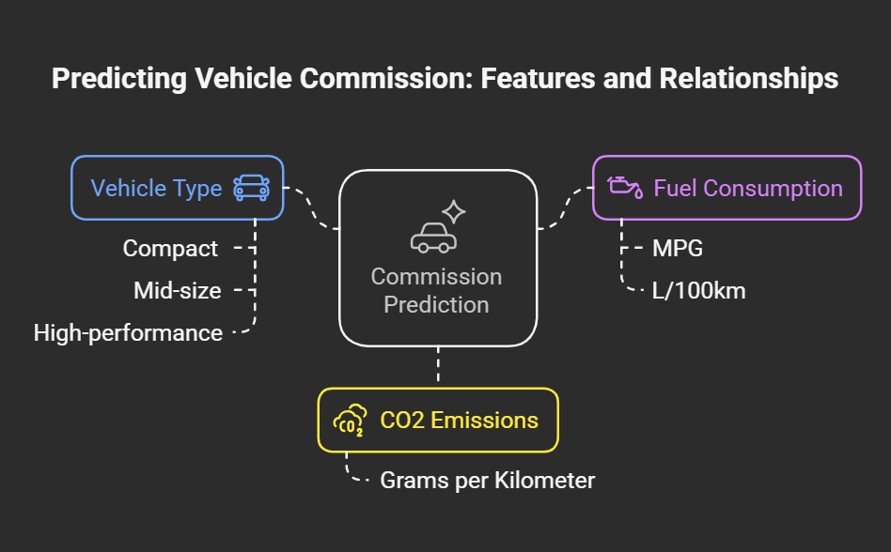
TASK-2
Title: Consider making the title more engaging. For example, "Driving Towards Sustainability: Predicting Vehicle CO2 Emissions."
Dataset Overview
The dataset includes the following key features:
Vehicle Type: Categories such as compact, mid-size, and high-performance.
Fuel Consumption: Measured in miles per gallon (MPG) or liters per 100 kilometers (L/100km).
CO2 Emissions: Measured in grams per kilometer (g/km).
Commission: The target variable we aim to predict, which may be influenced by the aforementioned features.

Slide 6
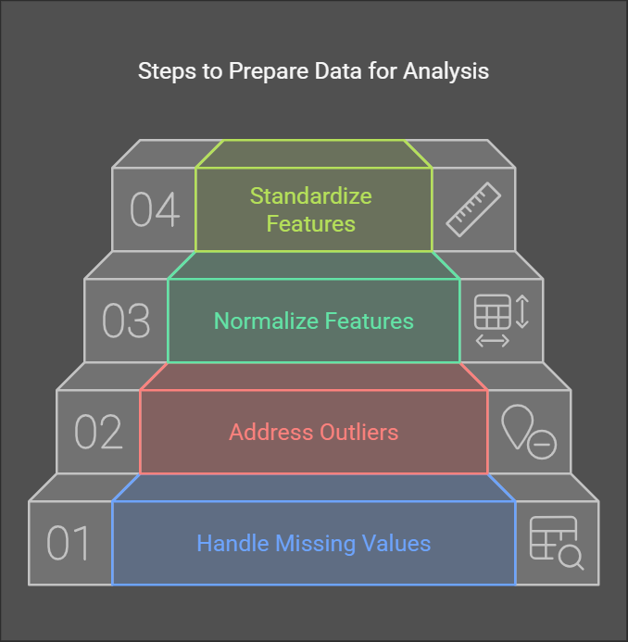
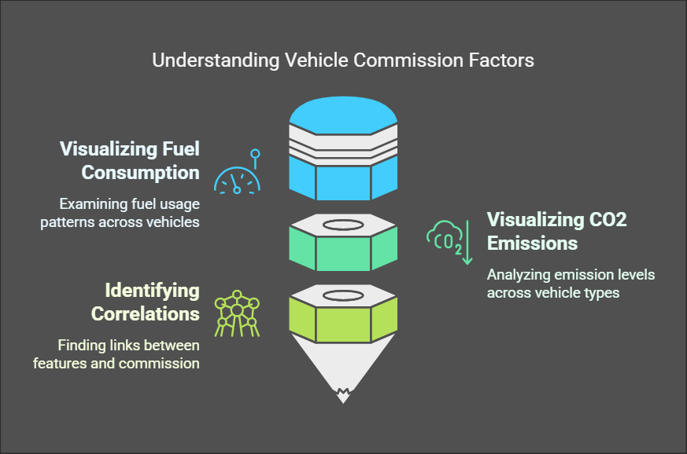
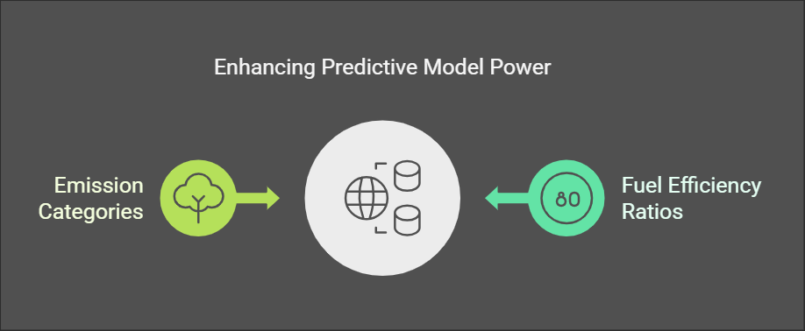
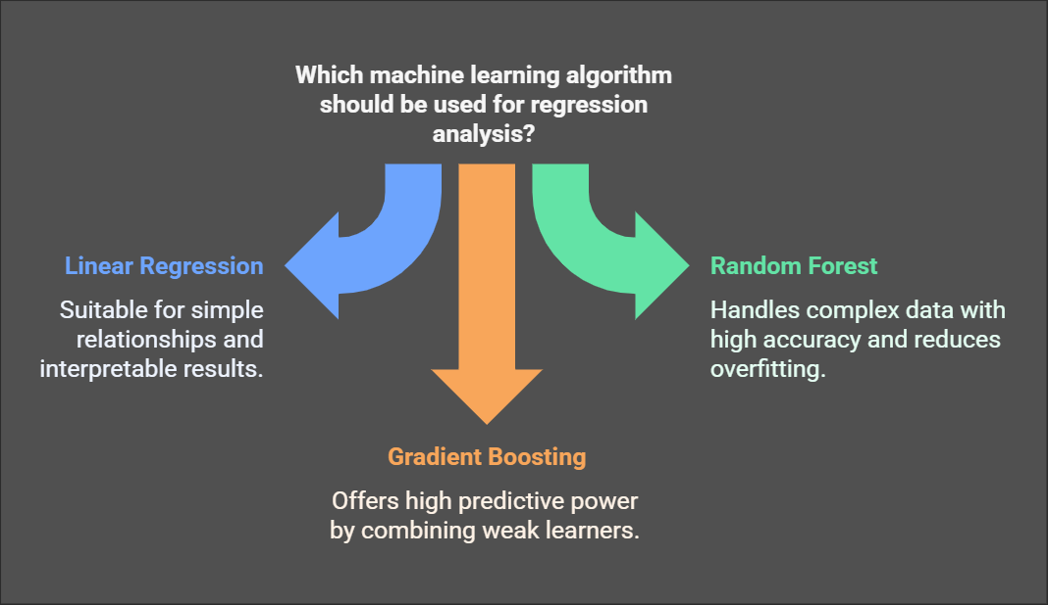
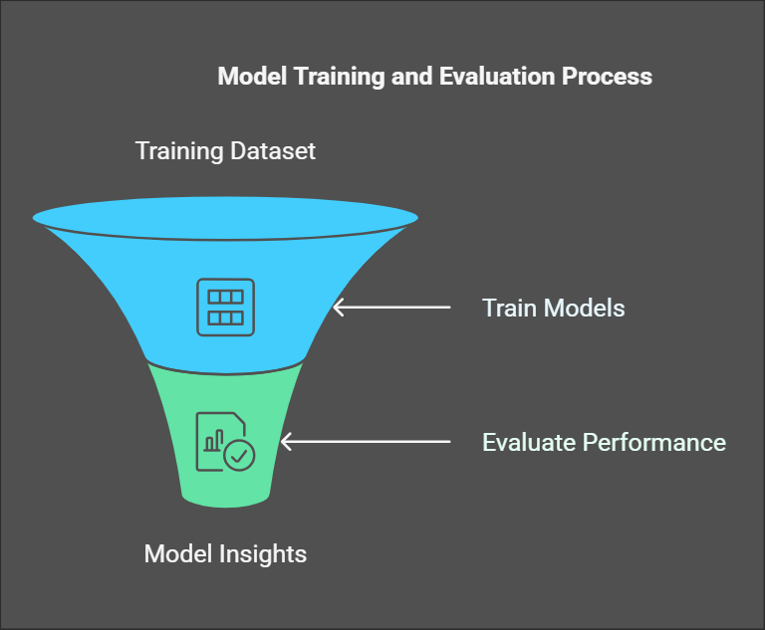
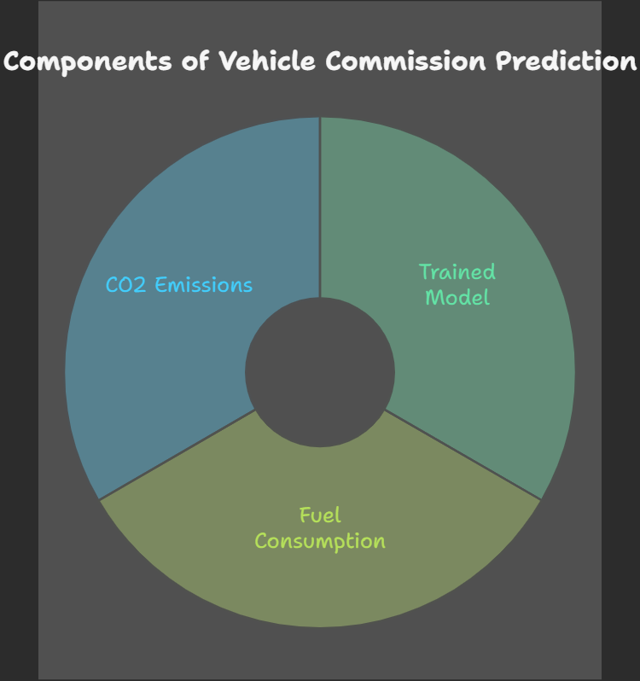
Analysis Approach
Data Preprocessing: 2.Exploratory Data Analysis (EDA): 3. Feature Engineering:
Model Selection: 5.Model Training and Evaluation: 6.Prediction

Slide 7
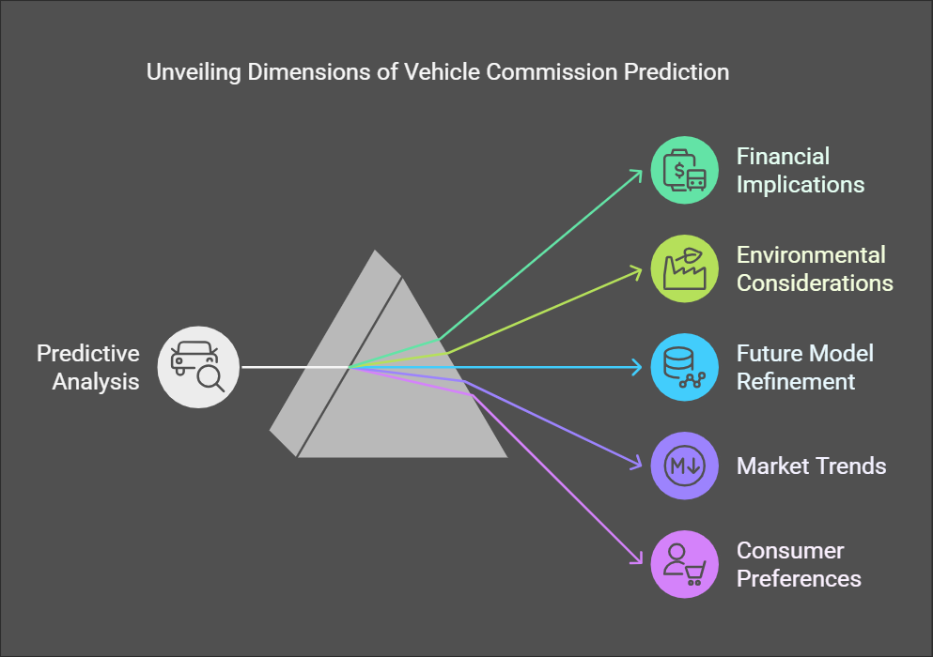

Slide 8
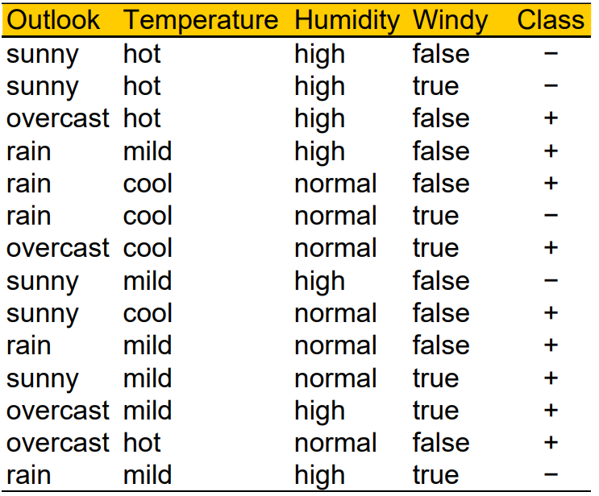
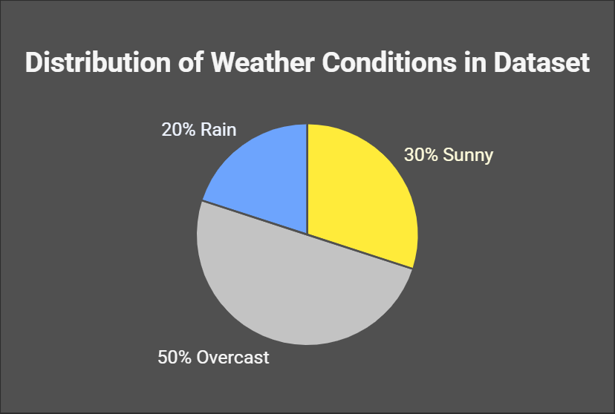
TASK-3
PROBLEM STATEMENT:Predicting Whether Condition for Playing Tennis Using Bayes Theroem
Definition
Naïve Bayes classifiers operate under the assumption that the features (or predictors) are conditionally independent given the target class. This means that the presence of a particular feature does not affect the presence of any other feature when the class label is known. This "naïve" assumption simplifies the computation of probabilities, making Naïve Bayes efficient for large datasets
Applications:
Text Classification: Commonly used for spam detection and sentiment analysis by analyzing word frequencies.
Medical Diagnosis: Helps in predicting diseases based on symptoms.
Recommendation Systems: Used to classify items based on user preferences and behaviors.
Advantages:
Efficiency: Requires a small amount of training data to estimate parameters, making it suitable for real-time applications.
Scalability: Works well with high-dimensional data due to its linear parameter requirement

Slide 9
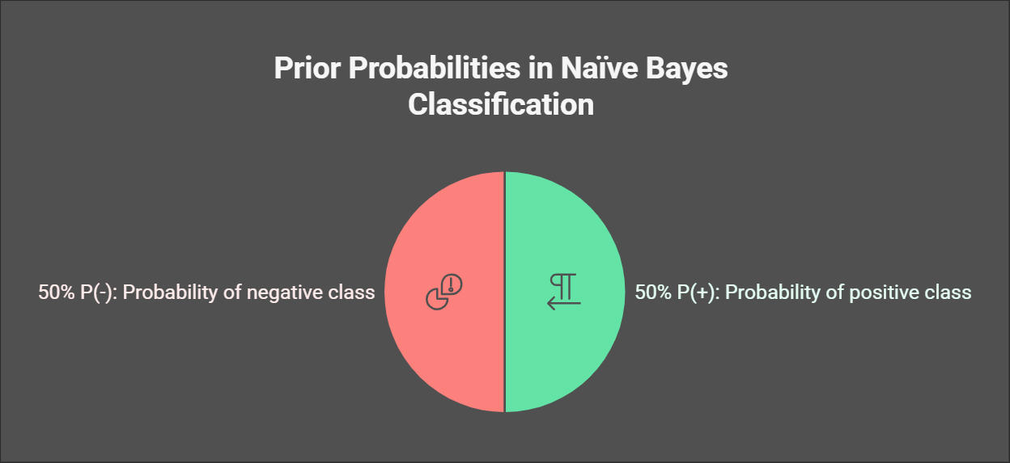
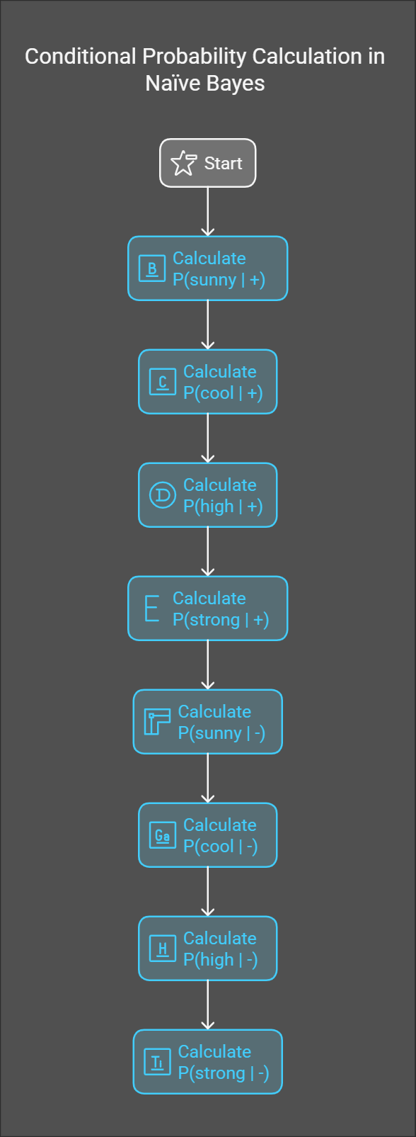
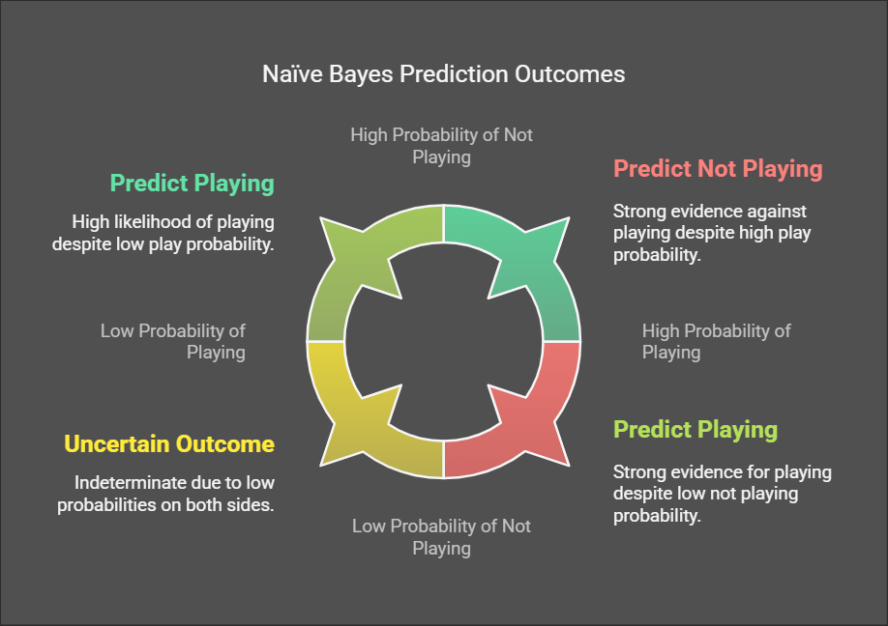
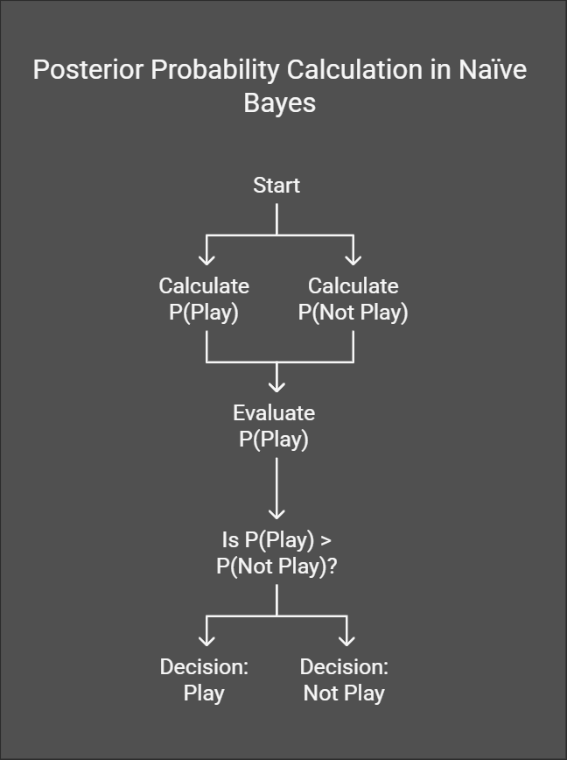
Probability Calculation & Prediction
Step 1: Compute Prior Probability
Step 2: Compute Conditional Probabilities
Step 4: Compare and Predict
Step 3: Compute Posterior Probability

Slide 10
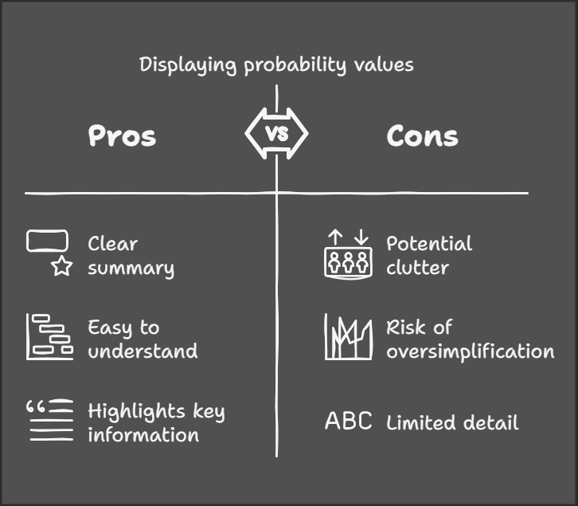
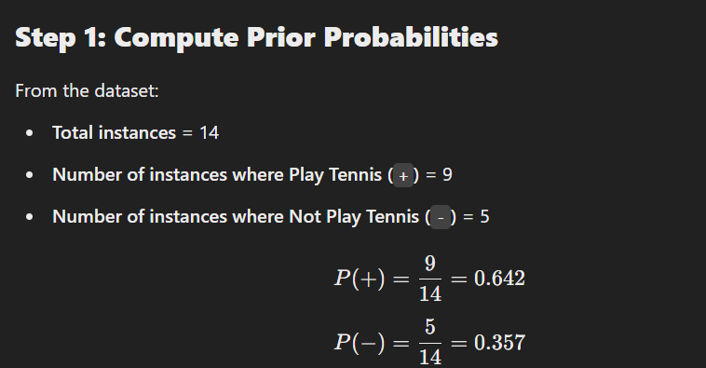
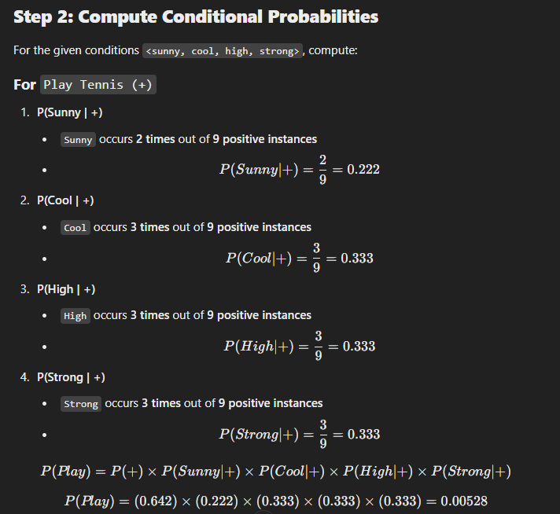
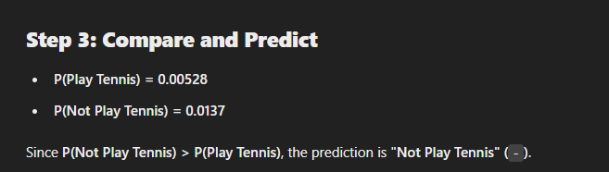
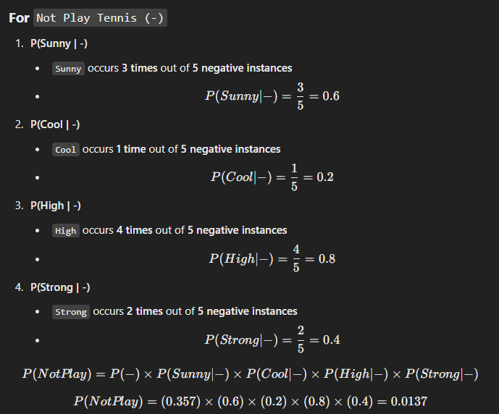
Output:
Display computed probability values and the final predicted class in a clear format
Solution for problem

Slide 11
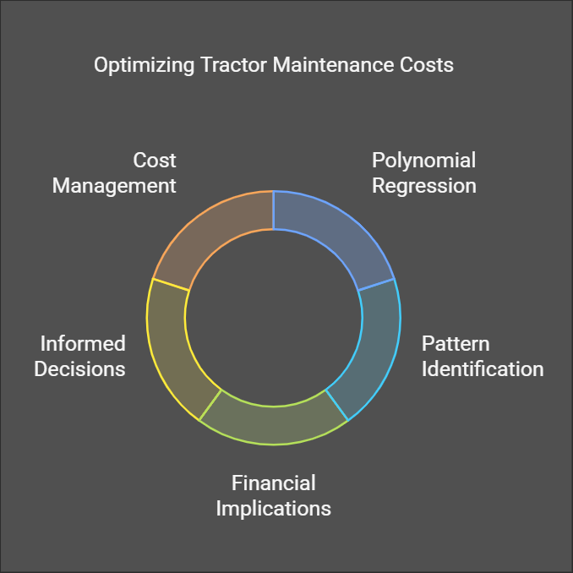
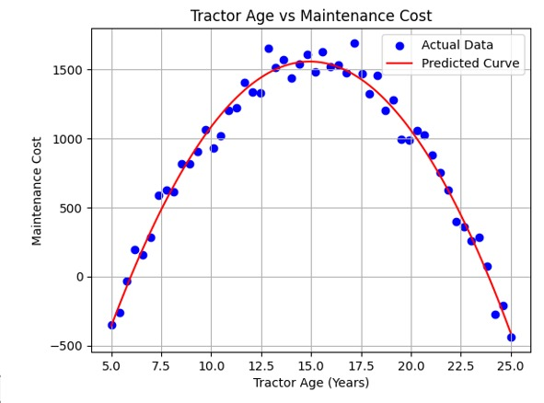
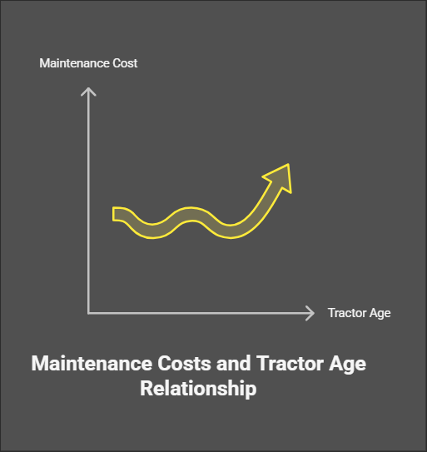
TASK-4
Farm Tractor Maintenance Cost Analysis Using Polynomial Regression
Problem Statement: A farm operations student investigates the relationship between tractor age and maintenance cost through a survey of 52 commercial potato growers in Putnam County, FL. The goal is to analyze cost trends and optimize maintenance strategies.
Data Analysis:
A scatter plot of tractor age vs. maintenance cost suggests a nonlinear trend.
Maintenance costs increase as tractors age, peak around 10–15 years, and then decline.
A polynomial regression model fits the data well, capturing the curved trend

Slide 12
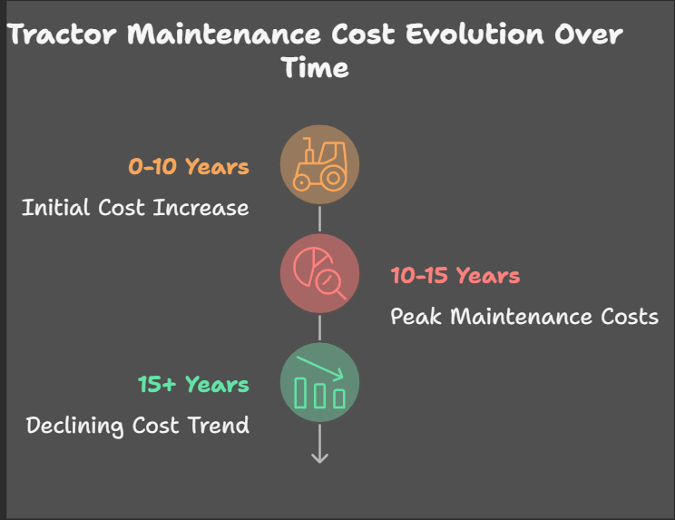
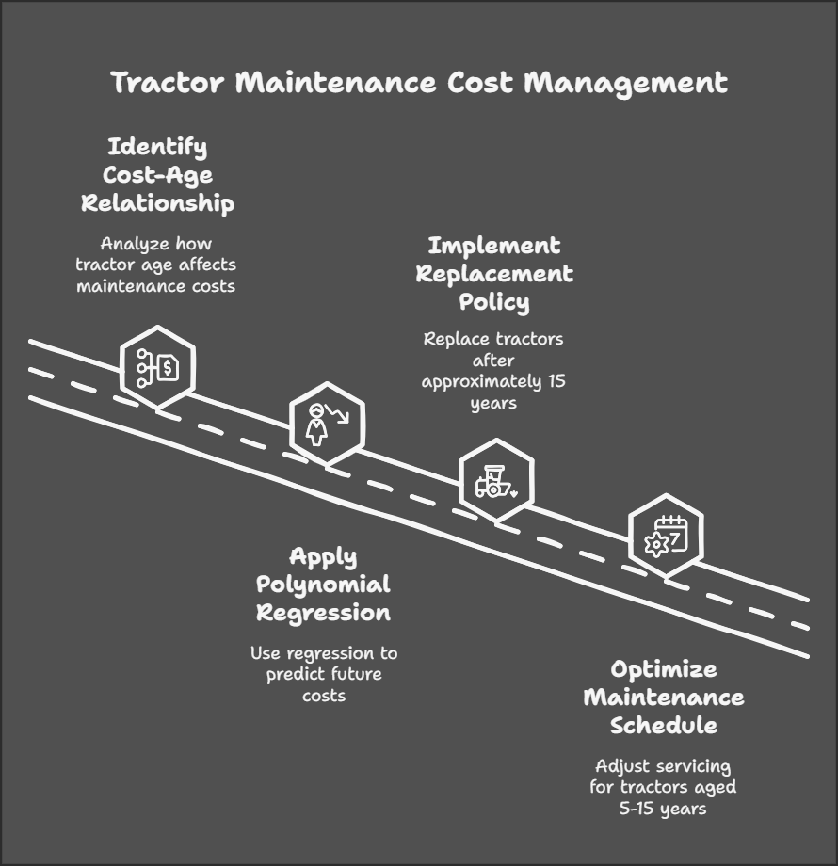
Key Findings & Recommendations
Key Observations:
✅ Cost Increases Initially: Maintenance cost rises as tractors age.
✅ Peak Cost (10–15 Years): The highest maintenance expenses occur between these years.
✅ Declining Trend After 15 Years: Costs decrease as tractors are retired or undergo major repairs.
Recommended Actions:
🔹 Use Polynomial Regression to model the cost-age relationship for predictions.
🔹 Implement a Replacement Policy: Replace tractors after ~15 years to minimize expenses.
🔹 Preventive Maintenance Strategy: Optimize servicing schedules for tractors aged 5–15 years.

Slide 13
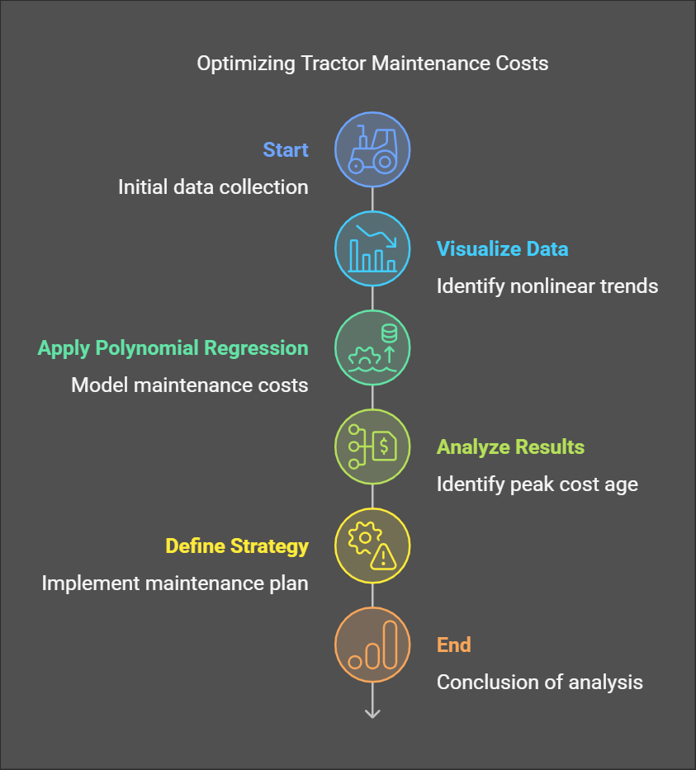
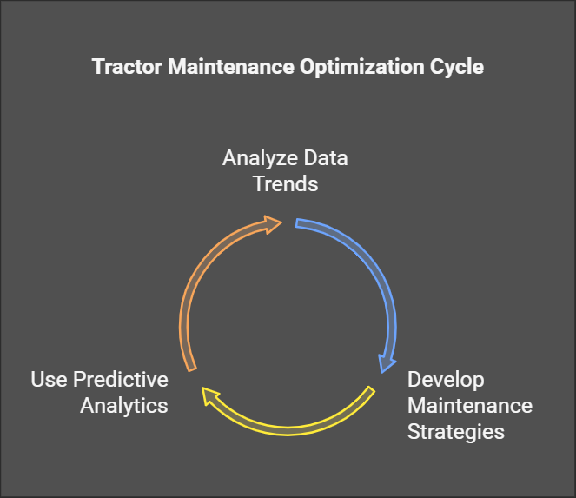
Implementation Steps:
Analyze Data Trends: Use historical records for decision-making.
Develop Tailored Maintenance Strategies: Different plans for new, mid-life, and aging tractors.
Use Predictive Analytics: Forecast costs to improve budgeting and maintenance planning.
Predicted Polynomial Regression Equation:
Using regression analysis, the approximate equation for maintenance cost is:
Cost=a×(Age)2+b×(Age)+c\text{Cost} = a \times (\text{Age})^2 + b times (\text{Age}) + c Cost=a×(Age)2+b×(Age)+c(Where a, b, and c are derived from regression coefficients.)

Slide 14
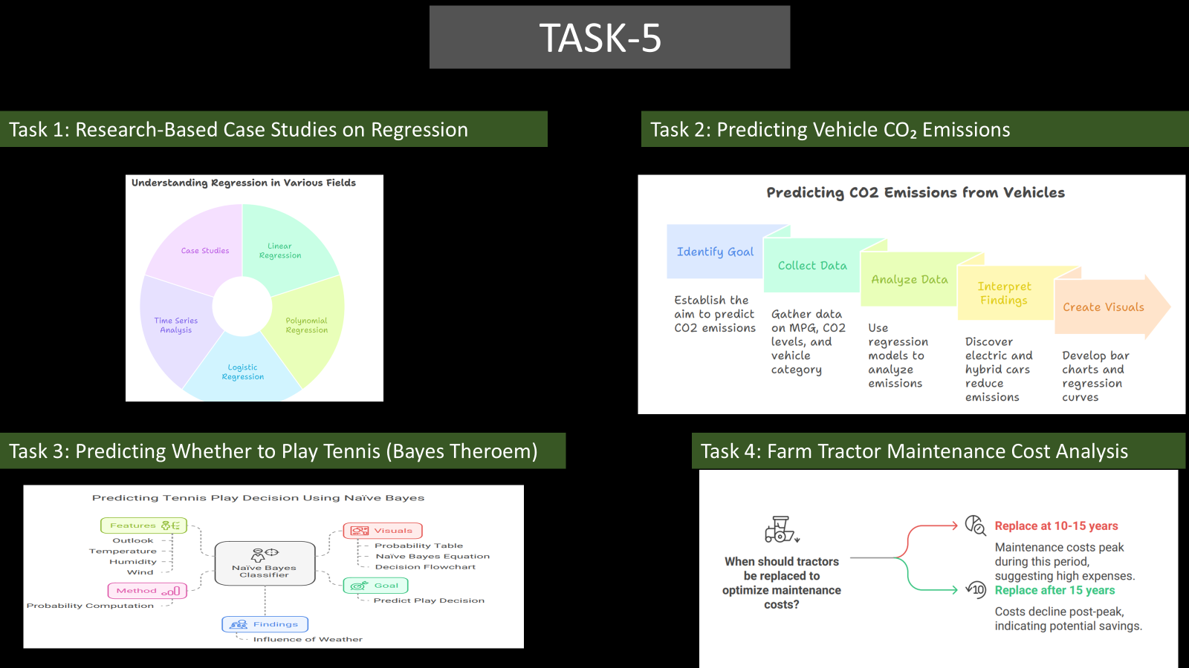

Slide 15
THANK YOU

