Slide 1
ATTENTION TO Emotions in Generative Models
-Sri Ram Pavan Kumar Guttikonda

Slide 2
Introduction
Objective: Investigate the interpretability of text-to-image models, focusing on their ability to attend to and represent emotional tones in textual prompts.
Significance: Emotional alignment is critical for applications like storytelling, content creation, and sentiment-driven designs, yet remains underexplored in generative AI.
Scope: Evaluate attention mechanisms and emotional fidelity using structured methodologies and interpretability metrics.

Slide 3


Problem Statement
Original Image
Generated Image
Caption: An exhilarating moment of freedom and Love as Rose spreads her arms like wings on the ship’s bow, her spirit soaring in Jack’s steady embrace from behind, against the endless horizon of the open sea

Slide 4
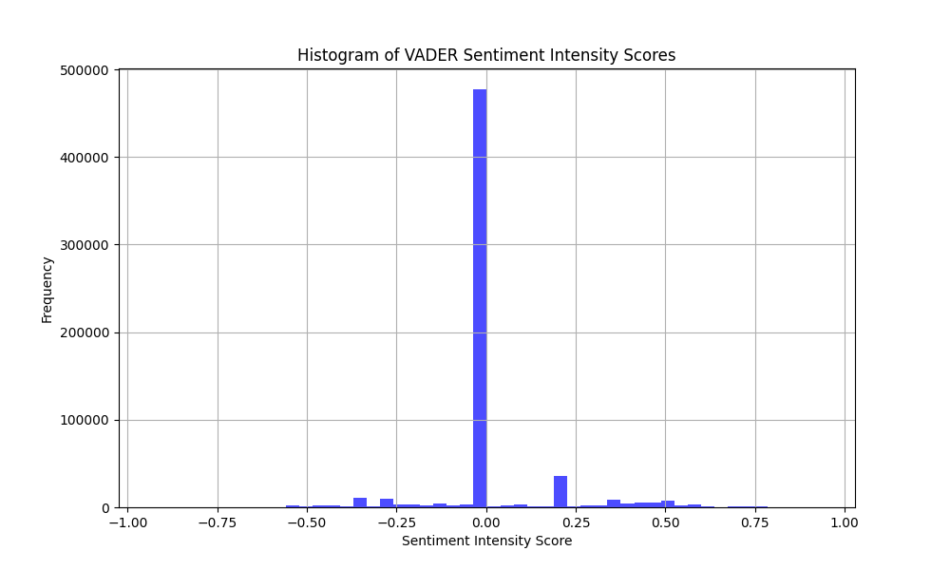
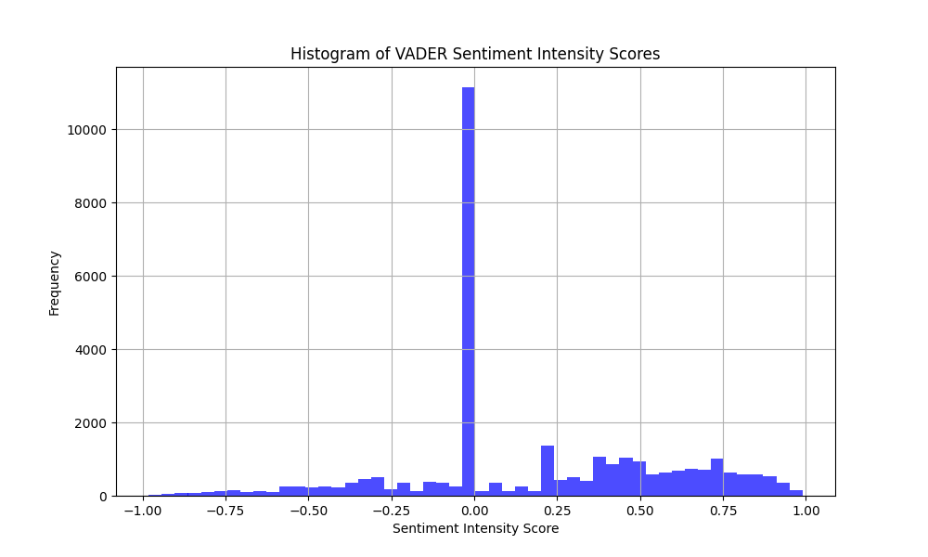
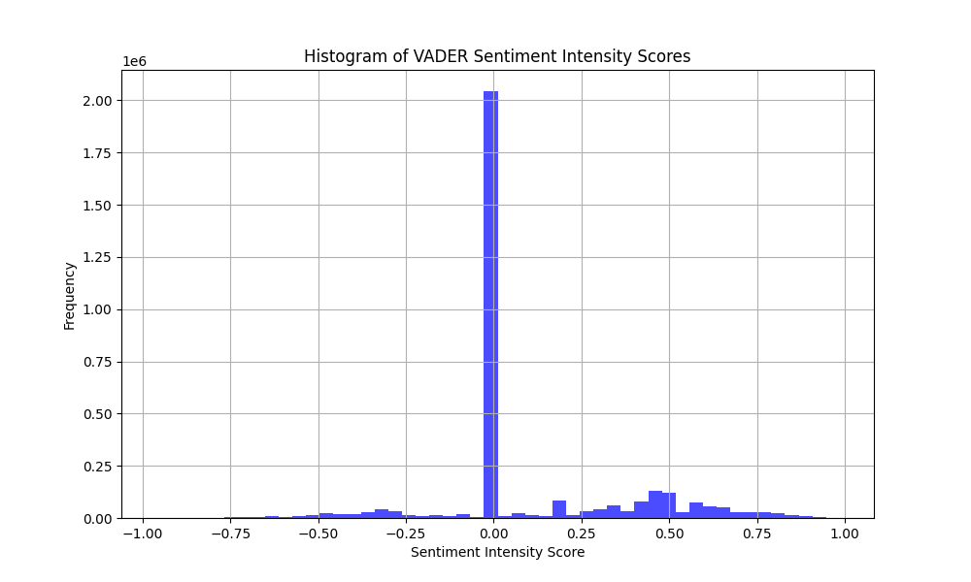
MS-COCO
Flickr
Conceptual Captions

Slide 5
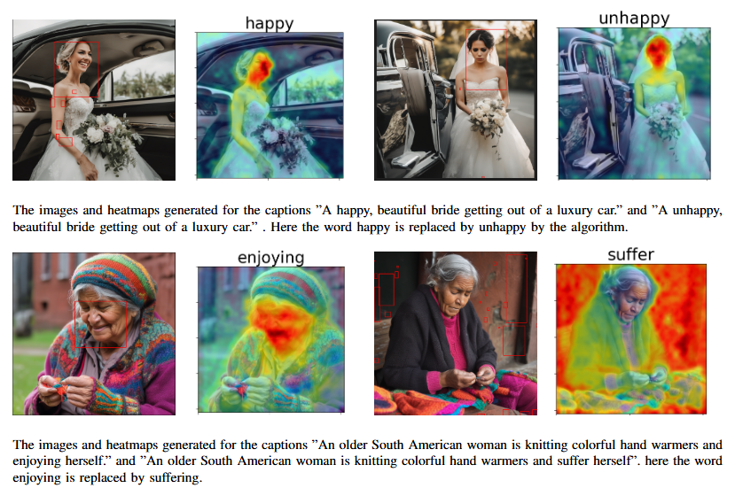
Method

Slide 6
Results
 | LLM Annotations | Sentiment Classification | HeatMap Similarity
MS-COCO | 70.63 | 3.6 | 71.6
Flickr | 73.31 | 8.1 | 72.1
Conceptual Captions | 72.19 | 4.4 | 75.8

