Slide 1
META REVIEW GENERATION
- G Sri Ram

Slide 2
About....
Idea is to develop a system capabale of generating Meta-Reviews given Peer-Reviews.
Research on ways to come up with an approach which gives results better than the exsisting baseline models.

Slide 3
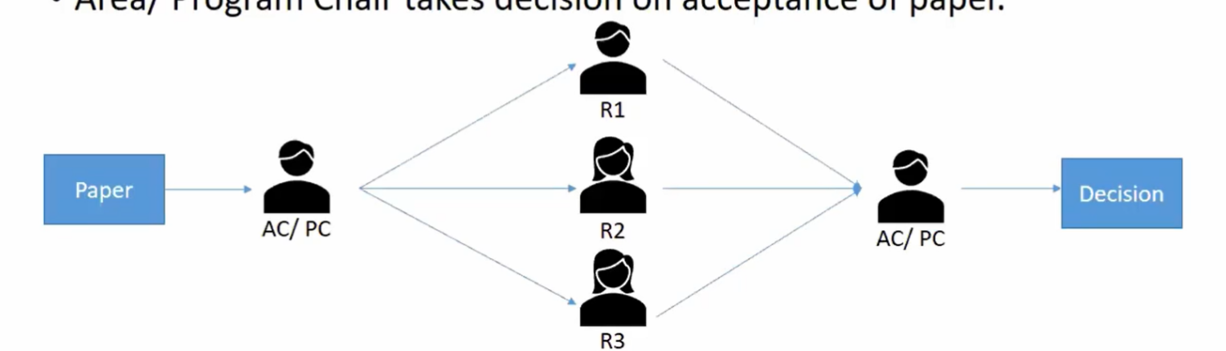
Peer-Review System
Author Submits the Paper to the Conference
Paper is sent to review to 3 Reviewers / Peers
Each Peer / Reviewer gives their review.
Program Chair takes decision on the paper and writedown comments.

Slide 4
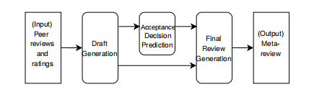
MetaGen
First generates an extractive draft and then uses fine-tuned UniLM (Unified Langauge Model) for predicting the acceptance de_x0002_cision and making the final meta-review in an abstractive manner.
Random Walk with Restart(RWR) is used to generate the Draft.
Darft is biased based on the training data.
Acceptance Decision is added to Final Review Generation, but is not explicitly used to alter the network.
https://dl.acm.org/doi/abs/10.1145/3397271.3401190#:~:text=In%20this%20video%2C%20we%20describe%20our%20short%20paper,or%20journal%20editor%20in%20writing%20the%20meta-review.%20mp4

Slide 5
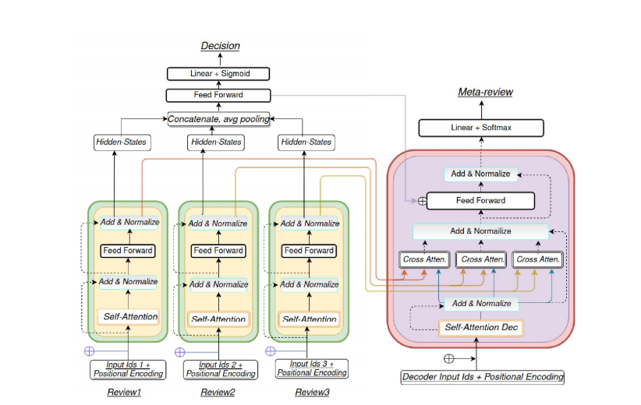
Decision-Aware Meta-Review
https://ieeexplore.ieee.org/abstract/document/9651825?casa_token=ujw-SHYj9OgAAAAA:VuQRj01_JhnK3gY8x2IwGRVvb9vsK-aSFiUdxd0ysgIAYODCKvFSiraIVi-VtdUSMgbHQIdW6A

Slide 6
cont....
A multi-encoder transformer network for peer-review decision prediction and subsequent meta-review generation.
Highly Desicion Dependent
other links:
https://link.springer.com/chapter/10.1007/978-3-031-16802-4_17#chapter-info
https://link.springer.com/chapter/10.1007/978-3-031-16270-1_23

Slide 7
Research Plan
Dataset:
No other standard datasets other than PeerRead
PeerRead crawler scripts are not upto date
Its very hard to scrape the OpenReview and get data
Only have limited data, might be able to get a dataset of 1000 datapoints.

Slide 8
cont.....
Methods:
Extractive Summarization
Text Rank
Lex Rank
LSA
Abstractive Summarization
Using SeqtoSeq Transformers like BART.

Slide 9
cont....
Hypothesis:
Meta-Review comprises mostly of common sentences and less uncommon sentences.
Generate a sequence consisting of common sentences and few uncommon sentences and give it to the seq2seq to get MetaReview
Study if Meta-Review need to be abstractive
Study if we require a decision predictor

Slide 10
cont.....
Evaluation
ROUGE is the common metric used in earlier works.
ROUGE is not semantic aware hence not good for evaluating the Meta-Review
BartScore can be used
Try to get human reviews if the generated meta review is acceptable

Slide 11
Thank You

