Slide 1

BUILDING A SMARTER AI-POWERED SPAM CLASSIFIER
team members:
G. GANESH GOPAL (821021104019)
S.ABDUR RAZZAK (821021104004)
K. SRI RAM (821021104044)
B. GANESH (821021104302)
K. SIVA PRAKASH (821021104305)

Slide 2
Phase 5: Project Documentation & Submission
Task:
Clearly outline the problem statement, design thinking process, and the phases of development.
Describe the dataset used, data preprocessing steps, and feature extraction techniques.
Explain the choice of machine learning algorithm, model training, and evaluation metrics.
Document any innovative techniques or approaches used during the development.
Dataset link:
https://www.kaggle.com/datasets/uciml/sms-spam-collection-dataset

Slide 3

• Introduction • Data set description • Train/Test Split • Models • Evaluation • Discussion • Conclusion • Future Work
SUMMARY of topics

Slide 4

Why do we need a spam classifier?
Introduction
E-mails have become the best way to communicate over the Internet because they are economical, flexible and reasonable. But we face the problem of spam because people have started sending unwanted emails to others (email spam). In electronic spam, irrelevant/ unrequested messages are sent by email. Many are commercial but may also contain disguised links that lead to phishing web sites or malware. They can also include viruses or any other risky files. To have effective communication we need to avoid such e-mails.
Hence the text-based spam classifier!

Slide 5
Problem statement :
Building A Smarter AI-Powered Spam Classifier Refers To The Process Of Developing A More Intelligent And Efficient System For Identifying And Filtering Out Spam Messages, Such As Unwanted Emails, Text Messages, Or Other Forms Of Unsolicited Content.
The Development Of An Advanced System That Effectively Identifies And Filters Out Spam Or Unsolicited Content From Legitimate Messages Using Artificial Intelligence (AI) And Machine Learning Techniques

Slide 6
Describing our dataset
Data set description
Our dataset of spam/ham messages had 5572 messages/records.
Each record had two columns: the raw text message, and the class label
Class label was categorical
Two categories: ham/spam
Source was Kaggle: https://www.kaggle.com/uciml/sms-spam-collection-dataset

Slide 7
Loading dependencies
We made use of :
NLTK for processing the messages
Sklearn for classification methods, feature extraction and score
Calculations
WordCloud, PIL, Seaborn and Matplotlib for data visualization
Pandas for loading data
NumPy for generating random probabilities for train-test split and heatmaps

Slide 8
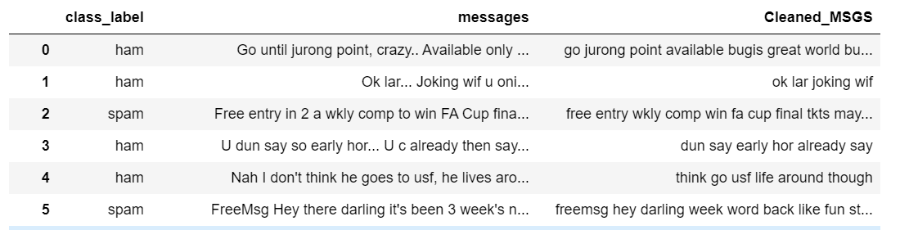
Data pre-processing
Text Cleaning is a very important step in machine learning because your data may contains a lot of noise and unwanted character. Some standard procedures that we used were converting all letters to lower/upper case, removing punctuation, removing stop words, tokenization and lemmatization. The figure below show a part of our cleaned data. Moreover, we used the built in preprocessing capabilities of CountVectorizer and Tfidf Vectorizer as well.

Slide 9
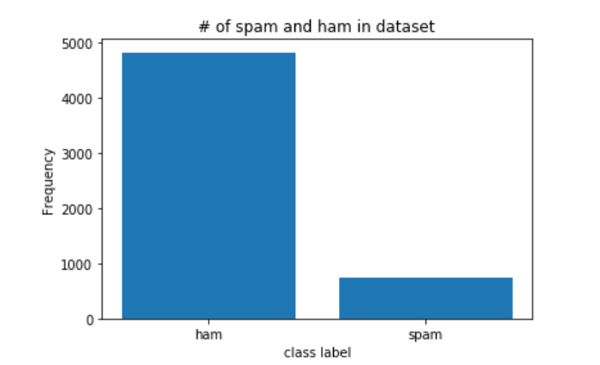
Exploratory Data Analysis: Bar Chart
Data visualization
Our dataset was unbalanced
We had 747 spam messages, and 4825 ham messages

Slide 10
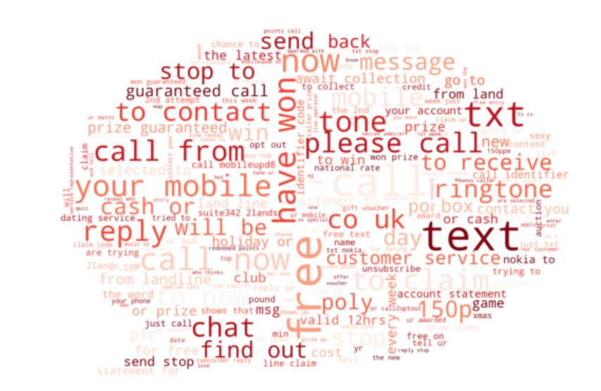
Word Cloud: Spam Messages
Most frequently used words/phrases as seen are:
Have won
Free
Text
Please call
Call from

Slide 11
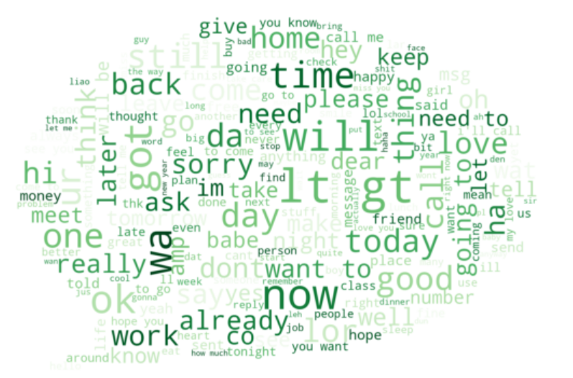
Word Cloud: Ham messages
Most frequently used words as seen are:
Will
Time
Sorry
Now
Good
Got

Slide 12
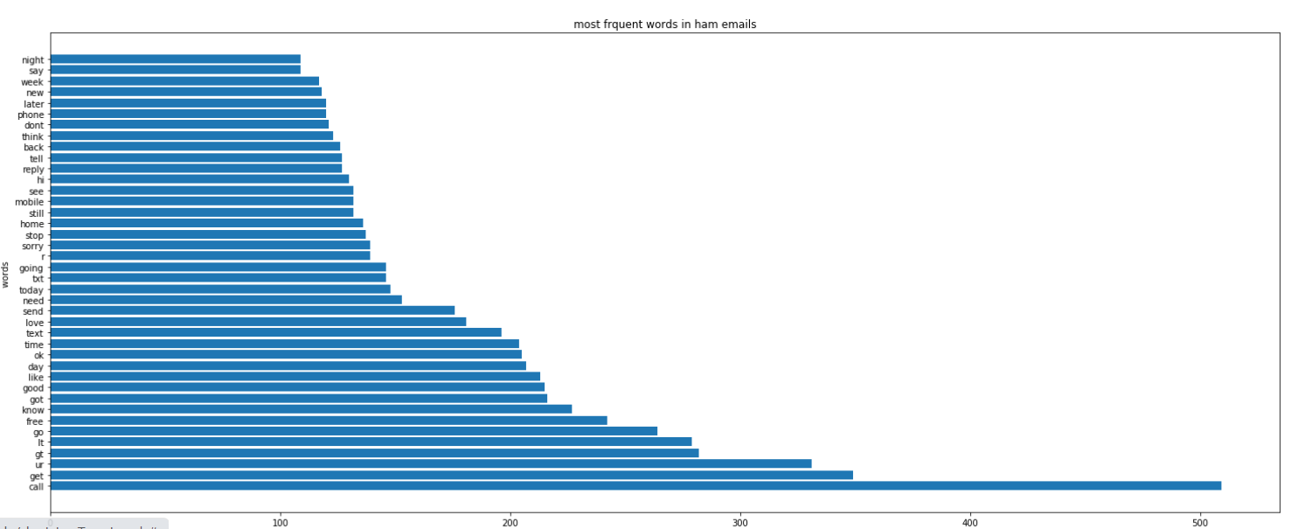
Word Count Plot for ham messages

Slide 13
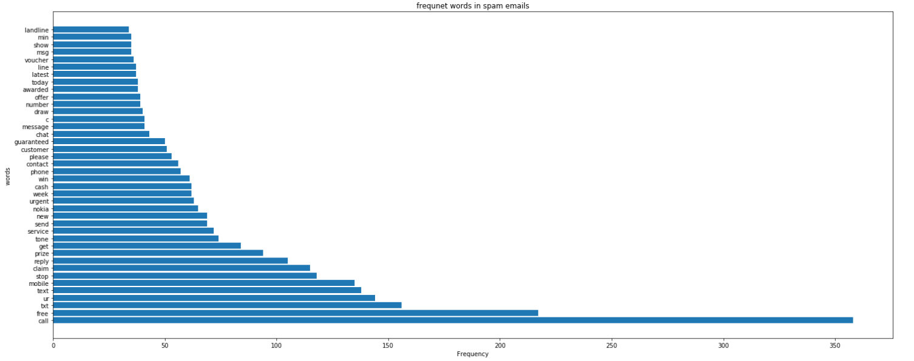
Word Count Plot for spam messages

Slide 14
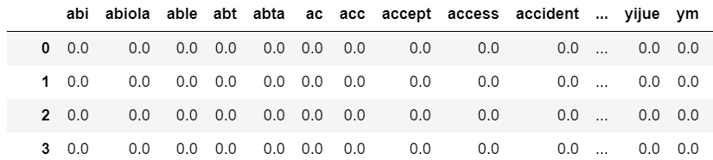
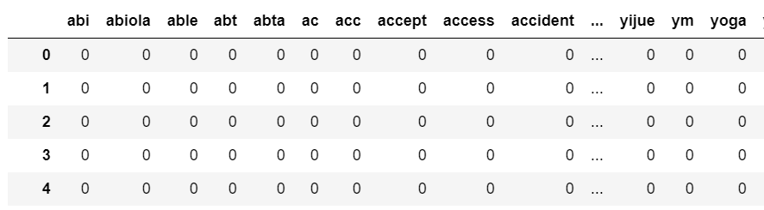
Feature Extraction
In this process we analyze the data (emails in our case) minutely to find out the features(i.e. words) which would be most useful in the classification. Then these features would be further used to train the classifier. For this purpose, we used the methods known as TF-IDF and Count Vectorizer. These can be defined as a numerical statistic which is intended to reflect how crucial a word is to a document present in a corpus. The values are directly proportional to the number of times a word appears in a document. Below are part of our these vectorizer matrix,
For TF-IDF
For CV

Slide 15
Train/Test Split
Split Ratio was 30:70
Selection of this 70% of the training data is uniformly random.
Although when doing the train test split it is said to make sure the distribution of the data between the training set and testing set are similar in many of our e-learning sources for this project. What it means in this context is that the percentage of spam email in the training set and test set should be similar.
Also keeping with the fact that our dataset is imbalanced. For that We contributed to compare the unsampled , up-sampled data along with stratified cross validation techniques. You'll see the performance comparisons in the future slides

Slide 16
Machine Learning Algorithm Used
Naive Bayes
Decision Tree
The first approach that we took was to use the( TfidfVectorizer and Count vectorizer ) as a feature extraction tools and Naive Bayes algorithm to do the prediction. Using Naive Bayes library provided by sklearn.
The second approach that we took was to use the( TfidfVectorizer and Count vectorizer ) as a feature extraction tools and decision tree algorithm to do the prediction. Using tree library provided by sklearn.

Slide 17
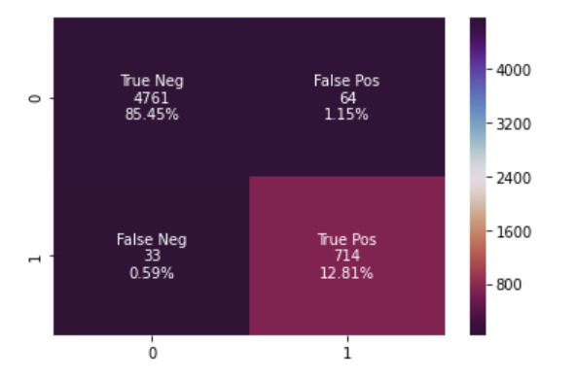
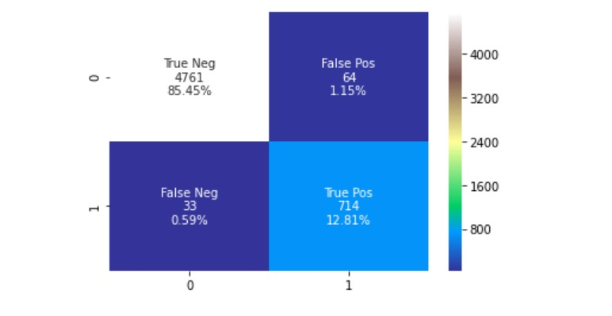
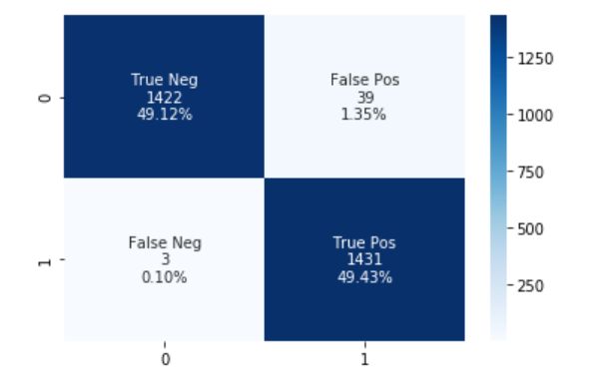
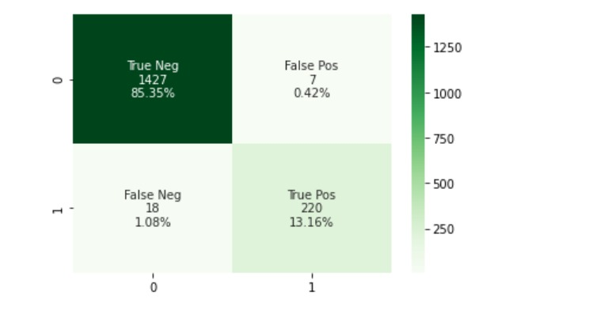
Performance Analysis:
The performance of the classifier model is based on the parameters True Positive (TP) and True Negative (TN). TP is the condition where the emails provided are spam emails and identified as a spam while TN is the condition where the emails provided are legitimate and identified as legitimate mails. Confusion matrix were used for this purposes and for its visualization these are some heatmaps of some of our models .
Naïve Bayes
Cross-validation with TF-IDF
Naïve Bayes
Cross-validation with Count vectorizer
Decision tree
Up-sampling with count vectorizer
Naïve Bayes un-sampled with TF-IDF

Slide 18
Accuracy and F-score Evaluation
We achieved pretty high accuracy in most of our models here. But accuracy is not solely the metrics to evaluate the performance of an algorithm. Therefore we implemented other scoring metric that is F-Score that made us understand thoroughly how well which model is doing. These statistical result here show clearly that TF-IDF feature extraction method have(ie not low ), but lesser f-score compared to the accuracy. This feature extraction method worked well with Decision Tree up-sampled with f-Score of 0.973.

Slide 19
Accuracy and F-score Evaluation
With Count vectorizer feature extraction procedure we also achieved pretty high accuracy in most of our models here. These statistical result here show clearly that Count Vectorizer feature extraction method have higher f-Score, compared to TF-IDF. This worked well with most of the model giving f-scores greater than the range of 0.90.
Hence, we reached the point that CV works well for this classifier model

Slide 20
Conclusion
Disadvantages of accuracy and imbalanced data
When it comes to evaluation of our models’s performance, it can be seen from the bar graphs in the previous slides that sometimes accuracy may not be the best indicator. Using accuracy might not give us enough confidence to understand the algorithm’s performance as all the models had high accuracy.
Moreover imbalanced class does not effect our models that much as most of them have high f-Score . But it do give higher f-score compared to rest. Decision tree up sampled data had highest f-Score of all that was 0.986.
Final point : imbalanced data does not effect the models at high extent and accuracy is not the best indicator for our models

Slide 21
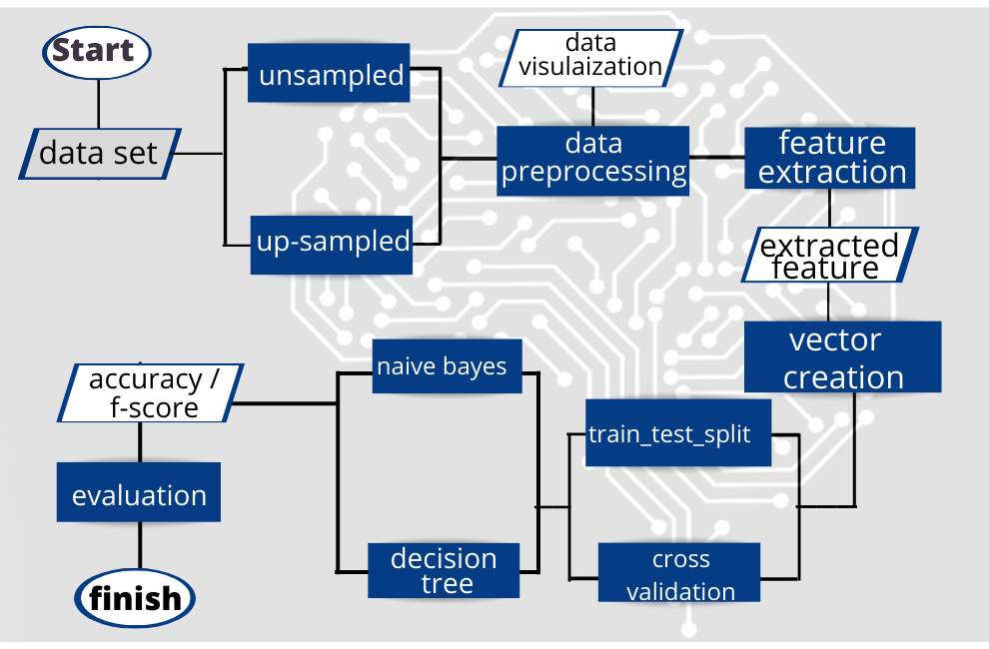
In this project we have showed you all the necessary steps we took in designing a spam detection algorithm.
Just a brief recap:
Explore and understand your data
Visualize the data at hand to gain a better intuition — Wordcloud,bar charts
Text Cleaning
Feature Extraction — Count Vectorizer, Tfidf Vectorizer
Splitting datatrain test_split , Cross validation
Algorithm — Naive Bayes, Decision tree
Scoring & Metrics — Accuracy,f-score
System Architecture

Slide 22
Future works
Here concludes the part of demonstration in model for spam detection algorithm.
Based on the results obtained from the performance analysis, the legitimacy of the email will be determined. A threshold value will be set which will be used for comparison between the obtained results and the set threshold. Thus, the email will be classified as spam or legitimate email. The proposed system will work as an WebApp that'll detect the spam emails sent and received and will give notification to the respective user. Also we plan to routinely updated the dataset so that it detects new type of spams and notifies the user.

Slide 23
THANK YOU!

