Slide 1
BUILDING A SMARTER AI-POWERED SPAM CLASSIFIER
TEAM MEMBERS G. GANESH GOPAL (821021104019) S. ABDUR RAZZAK (821021104004) K. SRI RAM (821021104044) B. GANESH (821021104302) K. SIVA PRAKASH (821021104305)

Slide 2
PHASE 3 : DEVELOPMENT PART 1 TASK : Building Project By Loading And Preprocessing The Dataset. Dataset link: https://www.kaggle.com/datasets/uciml/sms-spam-collection-dataset

Slide 3
Problem statement:
Creating An Advanced System That Effectively Identifies And Filters Out Unwanted Or Unsolicited Messages, Such As Spam Emails, Texts, Or Other Forms Of Digital Communication
Introduction:
Email Has Become The Most Often Utilized Formal Communication Channel. In Recent Years, There Has Been A Surge In Email Usage, Which Has Exacerbated The Problems Presented By Spam Emails. Spam, Often Known As Junk Email, Is The Act Of Sending Unsolicited Mass Messages To A Large Number Of People.
Install the necessary Python libraries:
You will need to install the following Python libraries.
a) NumPy
b) Pandas
c) Scikit-learn

Slide 4
The General Process Of Building A Project For Spam Detection Using Tensorflow
Data Collection.
Data Preprocessing.
Data loading.
Text Preprocessing.
Splitting the Data.
Building the Model.
Training the Model.
Model Evaluation.
Deployment.
Monitoring and Maintenance.

Slide 5
IMPORTANCE OF LOADING AND PREPROCESSING DATASET:
Pre-processing helps to improve the accuracy, reduce the time and resources required to train the model, prevent overfitting and improve the interpretability of the model.
Loading the data is the data that we need to load for starting any of the ML project. With respect to data, the most common format of data for ML projects is CSV (Comma separated Values).

Slide 6
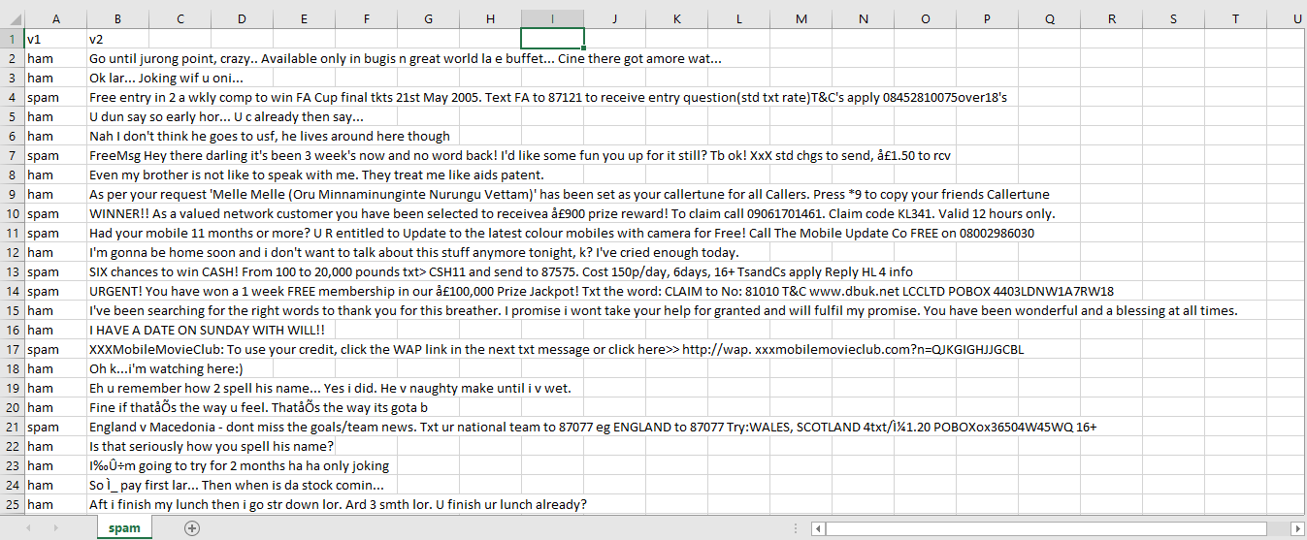
The Csv File Dataset

Slide 7
PROGRAM
In [1]:
In [2]:
import numpy as np
import pandas as pd
import matplotlib.pyplot as plt
import seaborn as sns
import tensorflow as tf
from tensorflow import keras
from tensorflow.keras import layers
from sklearn.model_selection import train_test_split
from sklearn.feature_extraction.text import TfidfVectorizer
from sklearn.naive_bayes import MultinomialNB
from sklearn.metrics import classification_report,accuracy_score
from sklearn.metrics import confusion_matrix
from tensorflow.keras.layers import TextVectorization
from sklearn.metrics import precision_score, recall_score,f1_score
import tensorflow_hub as hub
#loading the dataset
path = '/kaggle/input/sms-spam-collection-dataset/spam.csv'
df = pd.read_csv(path, encoding = 'latin-1')
df.head()

Slide 8
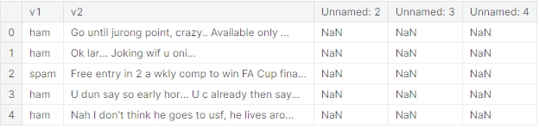
Out [2]: In [3]: In [4]: In [5]: In [6]:
df = df.drop(['Unnamed: 2', 'Unnamed: 3', 'Unnamed: 4'], axis = 1)
df.columns = ['label', 'text']
df['label_enc'] = df.label.map({'ham': 0, 'spam': 1})
sns.countplot(x = df.label)

Slide 9
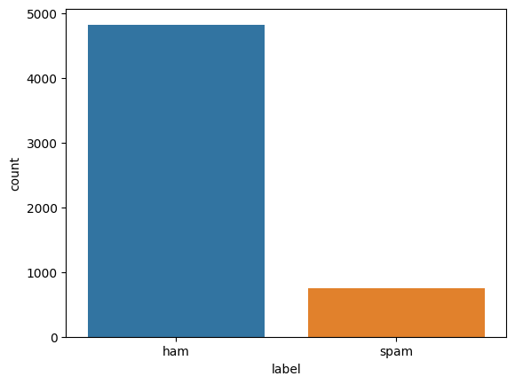
Out [6]: In [7]: Out [7]:
<Axes: xlabel='label', ylabel='count'>
avg_words_len=round(sum([len(i.split()) for i in df['text']])/len(df['text']))
avg_words_len
15

Slide 10
In [8]: Out [8]: In [9]: Out [9]:
s = set()
for sent in df['text']:
for word in sent.split():
s.add(word)
total_words_length=len(s)
print(total_words_length)
15585
X, y = np.asanyarray(df['text']), np.asanyarray(df['label_enc'])
new_df = pd.DataFrame({'text': X, 'label': y})
X_train, X_test, y_train, y_test = train_test_split(new_df['text'], new_df['label'], test_size=0.2, random_state=42)
print(X_train.shape, y_train.shape, X_test.shape, y_test.shape)
((4457,), (4457,), (1115,), (1115,))

Slide 11

In [10]: Out [10]: In [11]:
tfidf_vec = TfidfVectorizer().fit(X_train)
X_train_vec,X_test_vec = tfidf_vec.transform(X_train),tfidf_vec.transform(X_test)
baseline_model = MultinomialNB()
baseline_model.fit(X_train_vec,y_train)
y_pred = baseline_model.predict(X_test_vec)
nb_accuracy = accuracy_score(y_test, y_pred)
print(nb_accuracy)
print(classification_report(y_test, y_pred))

Slide 12
Out [11]: In [12]: Out [12]: In [13]:
0.9623318385650225
precision recall f1-score support
0 0.96 1.00 0.98 965
1 1.00 0.72 0.84 150
accuracy 0.96 1115
macro avg 0.98 0.86 0.91 1115
weighted avg 0.96 0.96 0.96 1115
confusion_matrix(y_test, y_pred)
array([[965, 0],[ 42, 108]])
MAXTOKENS=total_words_length
OUTPUTLEN=avg_words_len
text_vec =TextVectorization(max_tokens=MAXTOKENS,
standardize='lower_and_strip_punctuation',
output_mode='int',output_sequence_length=OUTPUTLEN)
text_vec.adapt(X_train)

Slide 13
In [14]: In [15]: In [16]:
embedding_layer = layers.Embedding(input_dim=MAXTOKENS,
output_dim=128,embeddings_initializer='uniform',
input_length=OUTPUTLEN)
input_layer = layers.Input(shape=(1,), dtype=tf.string)
vec_layer = text_vec(input_layer)
embedding_layer_model = embedding_layer(vec_layer)
x = layers.GlobalAveragePooling1D()(embedding_layer_model)
x = layers.Flatten()(x)
x = layers.Dense(32, activation='relu')(x)
output_layer = layers.Dense(1, activation='sigmoid')(x)
model_1 = keras.Model(input_layer, output_layer)
model_1.compile(optimizer='adam', loss=keras.losses.BinaryCrossentropy(
label_smoothing=0.5), metrics=['accuracy'])
model_1.summary()

Slide 14
Out [16]:
Model: "model"
_________________________________________________________________
Layer (type) Output Shape Param #
=================================================================
input_1 (InputLayer) [(None, 1)] 0
text_vectorization (TextVec (None, 15) 0
torization)
embedding (Embedding) (None, 15, 128) 1994880
global_average_pooling1d (G (None, 128) 0
lobalAveragePooling1D)
flatten (Flatten) (None, 128) 0
dense (Dense) (None, 32) 4128
dense_1 (Dense) (None, 1) 33
=================================================================
Total params: 1,999,041
Trainable params: 1,999,041
Non-trainable params: 0
_________________________________________________________________

Slide 15
In [17]: Out [17]: In [18]:
history_1 = model_1.fit(X_train, y_train, epochs = 5, validation_data = (X_test, y_test),
validation_steps = int(0.2*len(X_test)))
Epoch 1/5
140/140 [==============================] - 5s 25ms/step - loss: 0.6034 -
accuracy: 0.9109 - val_loss: 0.5772 - val_accuracy: 0.9749
Epoch 2/5
140/140 [==============================] - 3s 24ms/step - loss: 0.5698 -
accuracy: 0.9886 - val_loss: 0.5733 - val_accuracy: 0.9830
Epoch 3/5
140/140 [==============================] - 3s 25ms/step - loss: 0.5656 -
accuracy: 0.9960 - val_loss: 0.5725 - val_accuracy: 0.9848
Epoch 4/5
140/140 [==============================] - 4s 27ms/step - loss: 0.5641 -
accuracy: 0.9987 - val_loss: 0.5723 - val_accuracy: 0.9830
Epoch 5/5
140/140 [==============================] - 4s 26ms/step - loss: 0.5634 -
Accuracy: 0.9996 - val_loss: 0.5724 - val_accuracy: 0.9821
pd.DataFrame(history_1.history).plot()

Slide 16
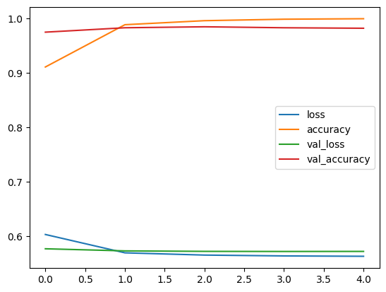
Out [18]:
<Axes: >

Slide 17
In [19]:
def compile_model(model):
model.compile(optimizer=keras.optimizers.Adam(),
loss=keras.losses.BinaryCrossentropy(),
metrics=['accuracy'])
def fit_model(model, epochs, X_train=X_train, y_train=y_train,
X_test=X_test, y_test=y_test):
history = model.fit(X_train,
y_train,
epochs=epochs,
validation_data=(X_test, y_test),
validation_steps=int(0.2*len(X_test)))
return history
def evaluate_model(model, X, y):
y_preds = np.round(model.predict(X))
accuracy = accuracy_score(y, y_preds)
precision = precision_score(y, y_preds)
recall = recall_score(y, y_preds)
f1 = f1_score(y, y_preds)
model_results_dict = {'accuracy': accuracy,
'precision': precision,
'recall': recall,
'f1-score': f1}
return model_results_dict

Slide 18
In [20]:
input_layer = layers.Input(shape=(1,), dtype=tf.string)
vec_layer = text_vec(input_layer)
embedding_layer_model = embedding_layer(vec_layer)
bi_lstm = layers.Bidirectional(layers.LSTM(64, activation='tanh', return_sequences=True))(embedding_layer_model)
lstm = layers.Bidirectional(layers.LSTM(64))(bi_lstm)
flatten = layers.Flatten()(lstm)
dropout = layers.Dropout(.1)(flatten)
x = layers.Dense(32, activation='relu')(dropout)
output_layer = layers.Dense(1, activation='sigmoid')(x)
model_2 = keras.Model(input_layer, output_layer)
compile_model(model_2)
history_2 = fit_model(model_2, epochs=5)
Epoch 1/5
140/140 [==============================] - 19s 71ms/step - loss: 0.0714 -
accuracy: 0.9800 - val_loss: 0.1010 - val_accuracy: 0.9821
Epoch 2/5
140/140 [==============================] - 8s 59ms/step - loss: 0.0028 -
accuracy: 0.9991 - val_loss: 0.0975 - val_accuracy: 0.9848
Epoch 3/5
140/140 [==============================] - 9s 61ms/step - loss: 1.7884e-04 -
accuracy: 1.0000 - val_loss: 0.1252 - val_accuracy: 0.9830
Epoch 4/5
140/140 [==============================] - 8s 59ms/step - loss: 5.3545e-05 -
accuracy: 1.0000 - val_loss: 0.1336 - val_accuracy: 0.9830
Epoch 5/5
140/140 [==============================] - 8s 59ms/step - loss: 2.9867e-05 -
accuracy: 1.0000 - val_loss: 0.1400 - val_accuracy: 0.9830

Slide 19
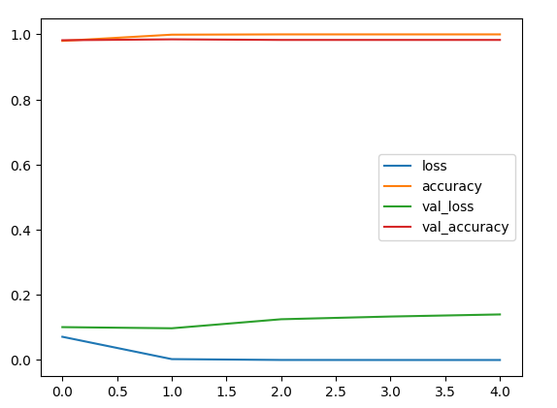
In [21]: Out [21]:
pd.DataFrame(history_2.history).plot()
<Axes: >

Slide 20
In [22]:
model_3 = keras.Sequential()
use_layer = hub.KerasLayer("https://tfhub.dev/google/universal-sentence-encoder/4",trainable=False,input_shape=[],dtype=tf.string,name='USE')
model_3.add(use_layer)
model_3.add(layers.Dropout(0.2))
model_3.add(layers.Dense(64, activation=keras.activations.relu))
model_3.add(layers.Dense(1, activation=keras.activations.sigmoid))
compile_model(model_3)
history_3 = fit_model(model_3, epochs=5)
Epoch 1/5
140/140 [==============================] - 7s 24ms/step - loss: 0.3379 -
accuracy: 0.8999 - val_loss: 0.1279 - val_accuracy: 0.9695
Epoch 2/5
140/140 [==============================] - 3s 19ms/step - loss: 0.0879 -
accuracy: 0.9760 - val_loss: 0.0734 - val_accuracy: 0.9749
Epoch 3/5
140/140 [==============================] - 2s 17ms/step - loss: 0.0577 -
accuracy: 0.9843 - val_loss: 0.0591 - val_accuracy: 0.9794
Epoch 4/5
140/140 [==============================] - 3s 20ms/step - loss: 0.0475 -
accuracy: 0.9865 - val_loss: 0.0570 - val_accuracy: 0.9812
Epoch 5/5
140/140 [==============================] - 3s 20ms/step - loss: 0.0423 -
accuracy: 0.9868 - val_loss: 0.0513 - val_accuracy: 0.9821

Slide 21
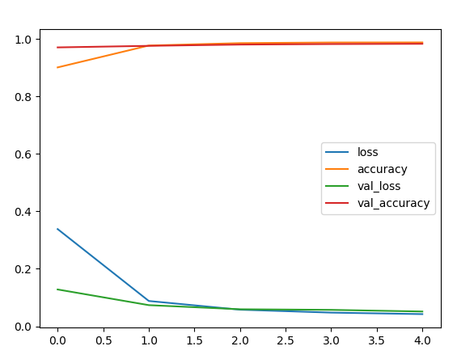
In [23]: Out [23]:
pd.DataFrame(history_3.history).plot()
<Axes: >

Slide 22
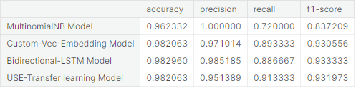
In [24]: Out [24]:
baseline_model_results = evaluate_model(baseline_model, X_test_vec, y_test)
model_1_results = evaluate_model(model_1, X_test, y_test)
model_2_results = evaluate_model(model_2, X_test, y_test)
model_3_results = evaluate_model(model_3, X_test, y_test)
total_results = pd.DataFrame({'MultinomialNB Model':baseline_model_results,
'Custom-Vec-Embedding Model':model_1_results,'Bidirectional-LSTM Model':model_2_results,'USE-Transfer learning Model':model_3_results}).transpose()
total_results
35/35 [==============================] - 0s 2ms/step
35/35 [==============================] - 2s 11ms/step
35/35 [==============================] - 1s 9ms/step

Slide 23
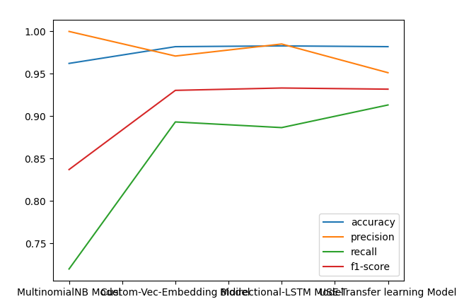
In [25]: Out[25]:
total_results.plot()
<Axes: >

Slide 24
THANK YOU

