Slide 1


Layout Design
UDC Layout

Slide 2
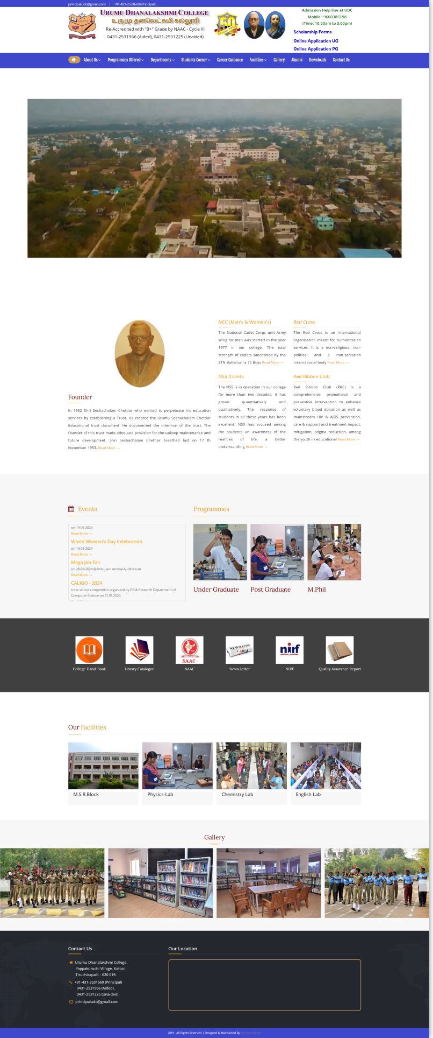
Layout Design
Containers
Total number of Containers
Parent Container for Any website
Number of Components in Coffee Shop Website
1. header
1.navBar
2. main
2.heroSection
3. footer
3.foundere
4.evevts
5.approvals
6.facilities
7.gallery
8.contactUs

Slide 3
Layout Design
Containers
Total number of Containers
Containers
1. header
1.navBar
2.heroSection
2. main
3.founder
4.events
5.approvals
6.facilities
7.gallery
3. footer
8.contactUs

Slide 4
Layout Design
Containers
How to Group the Components to Parent Containers
1.navBar
1. header
2.heroSection
3.founder
4.events
2. main
5.approvals
6.facilities
7.gallery
3. footer
8.contactUs

Slide 5
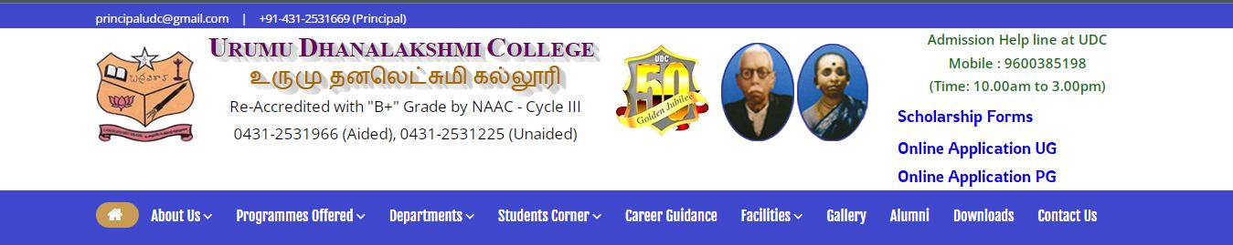
Layout Design
Containers
1.navBar

Slide 6
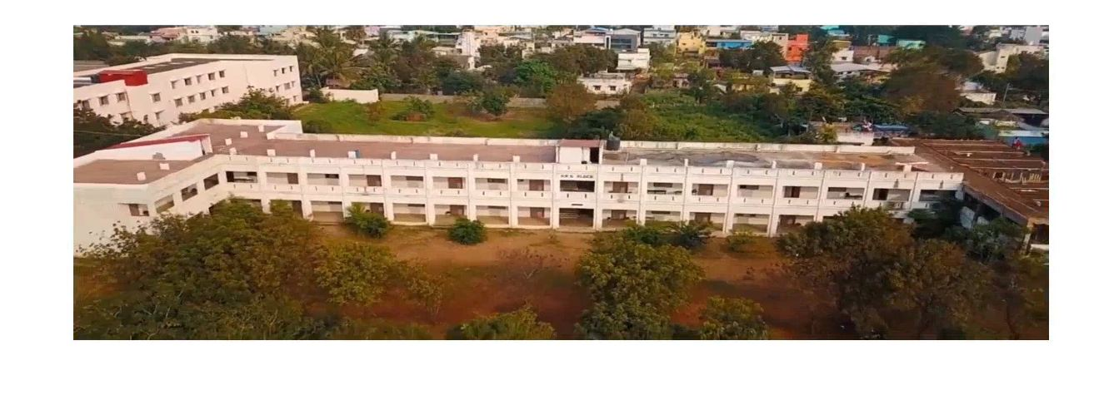
Layout Design
Containers
2.heroSection

Slide 7
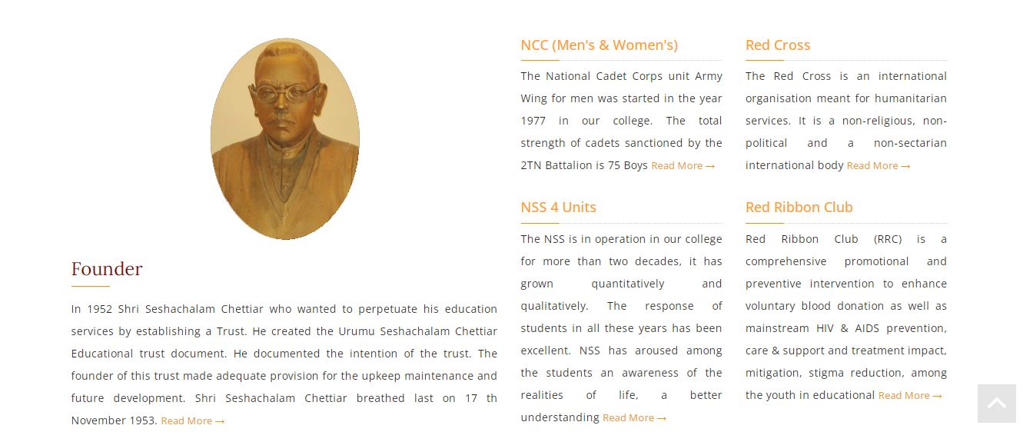
Layout Design
Containers
3.founder

Slide 8
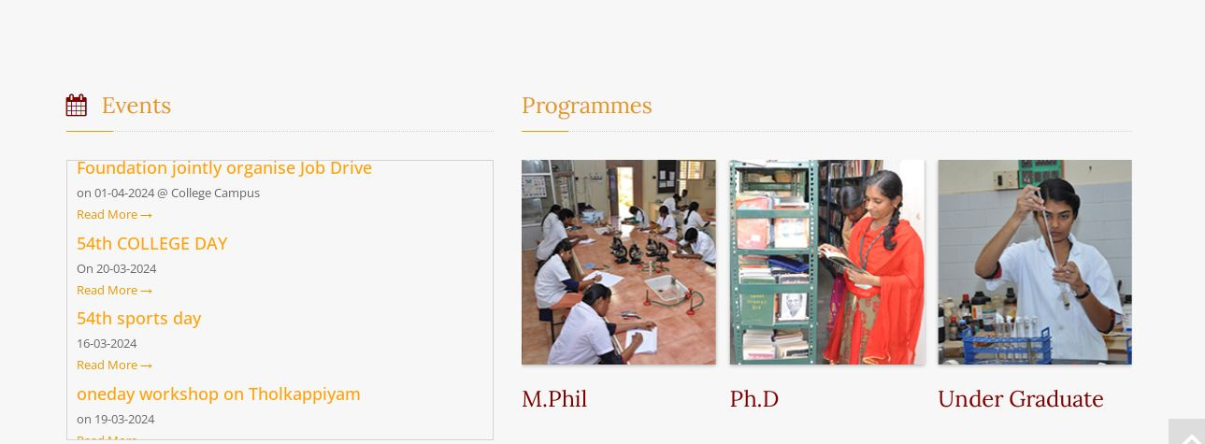
Layout Design
Containers
4.events

Slide 9

Layout Design
Containers
5.approvals

Slide 10
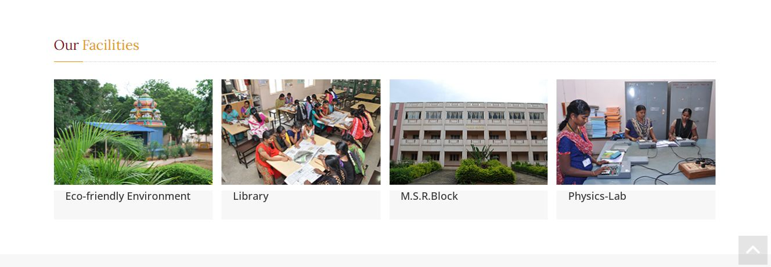
Layout Design
Containers
6.facilities

Slide 11
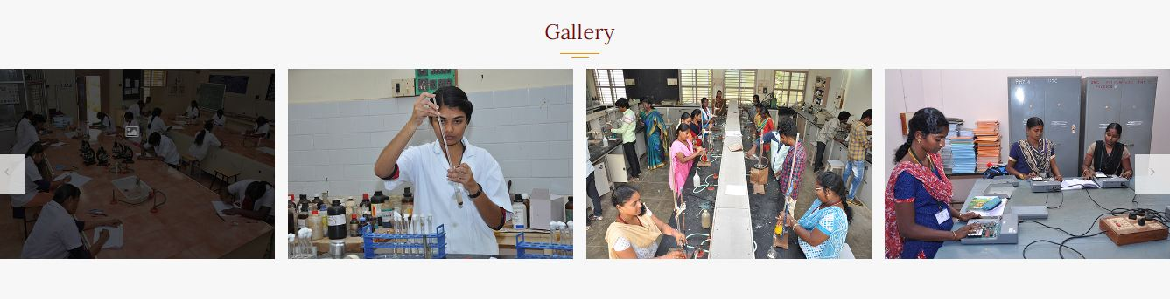
Layout Design
Containers
7.gallery

Slide 12
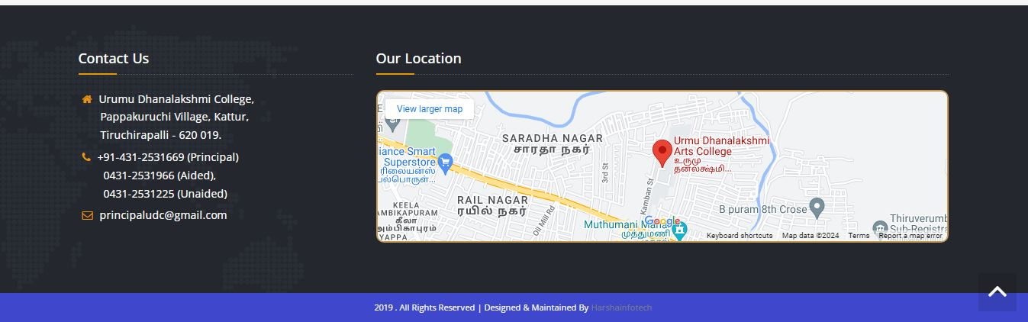
Layout Design
Containers
8.contactUs

