Slide 1
Browser Agent

Slide 2
What is Browser-use Agent
"Browser-Use" is an open-source tool designed to facilitate seamless interaction between AI agents and web browsers. It enables AI models to navigate and manipulate web content, making websites accessible for AI-driven tasks.
Key Features:
Visual Recognition and HTML Extraction: Allows AI agents to interpret and extract information from web pages effectively.
Automated Multi-Tab Management: Enables handling multiple browser tabs simultaneously, enhancing task efficiency.
Customizable Actions: Supports the addition of user-defined actions, such as saving data to files, database interactions, and obtaining human input.
Self-Correction Mechanism: Empowers agents to identify and rectify errors autonomously during task execution.
Parallel Agent Execution: Facilitates running multiple AI agents in parallel, optimizing performance for large-scale operations.

Slide 3
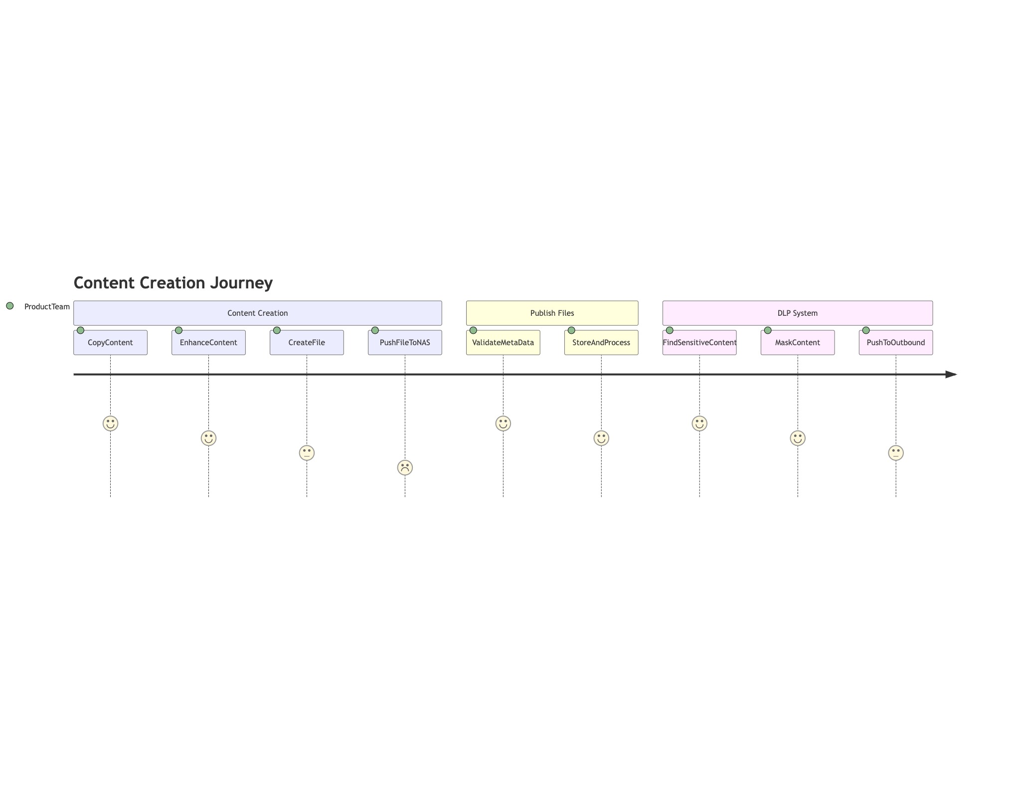
Content Creation Journey

Slide 4
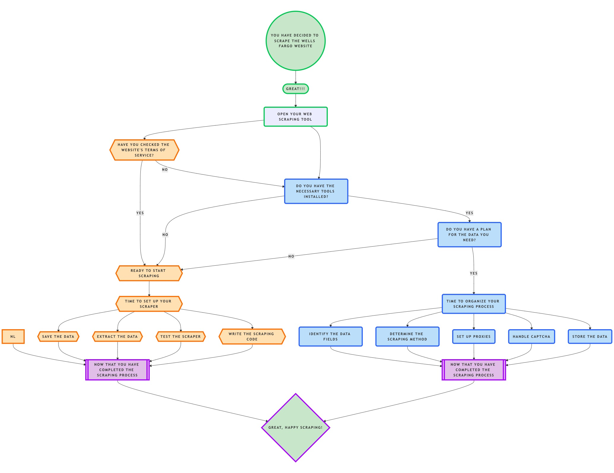
Automation Content Creation

Slide 5
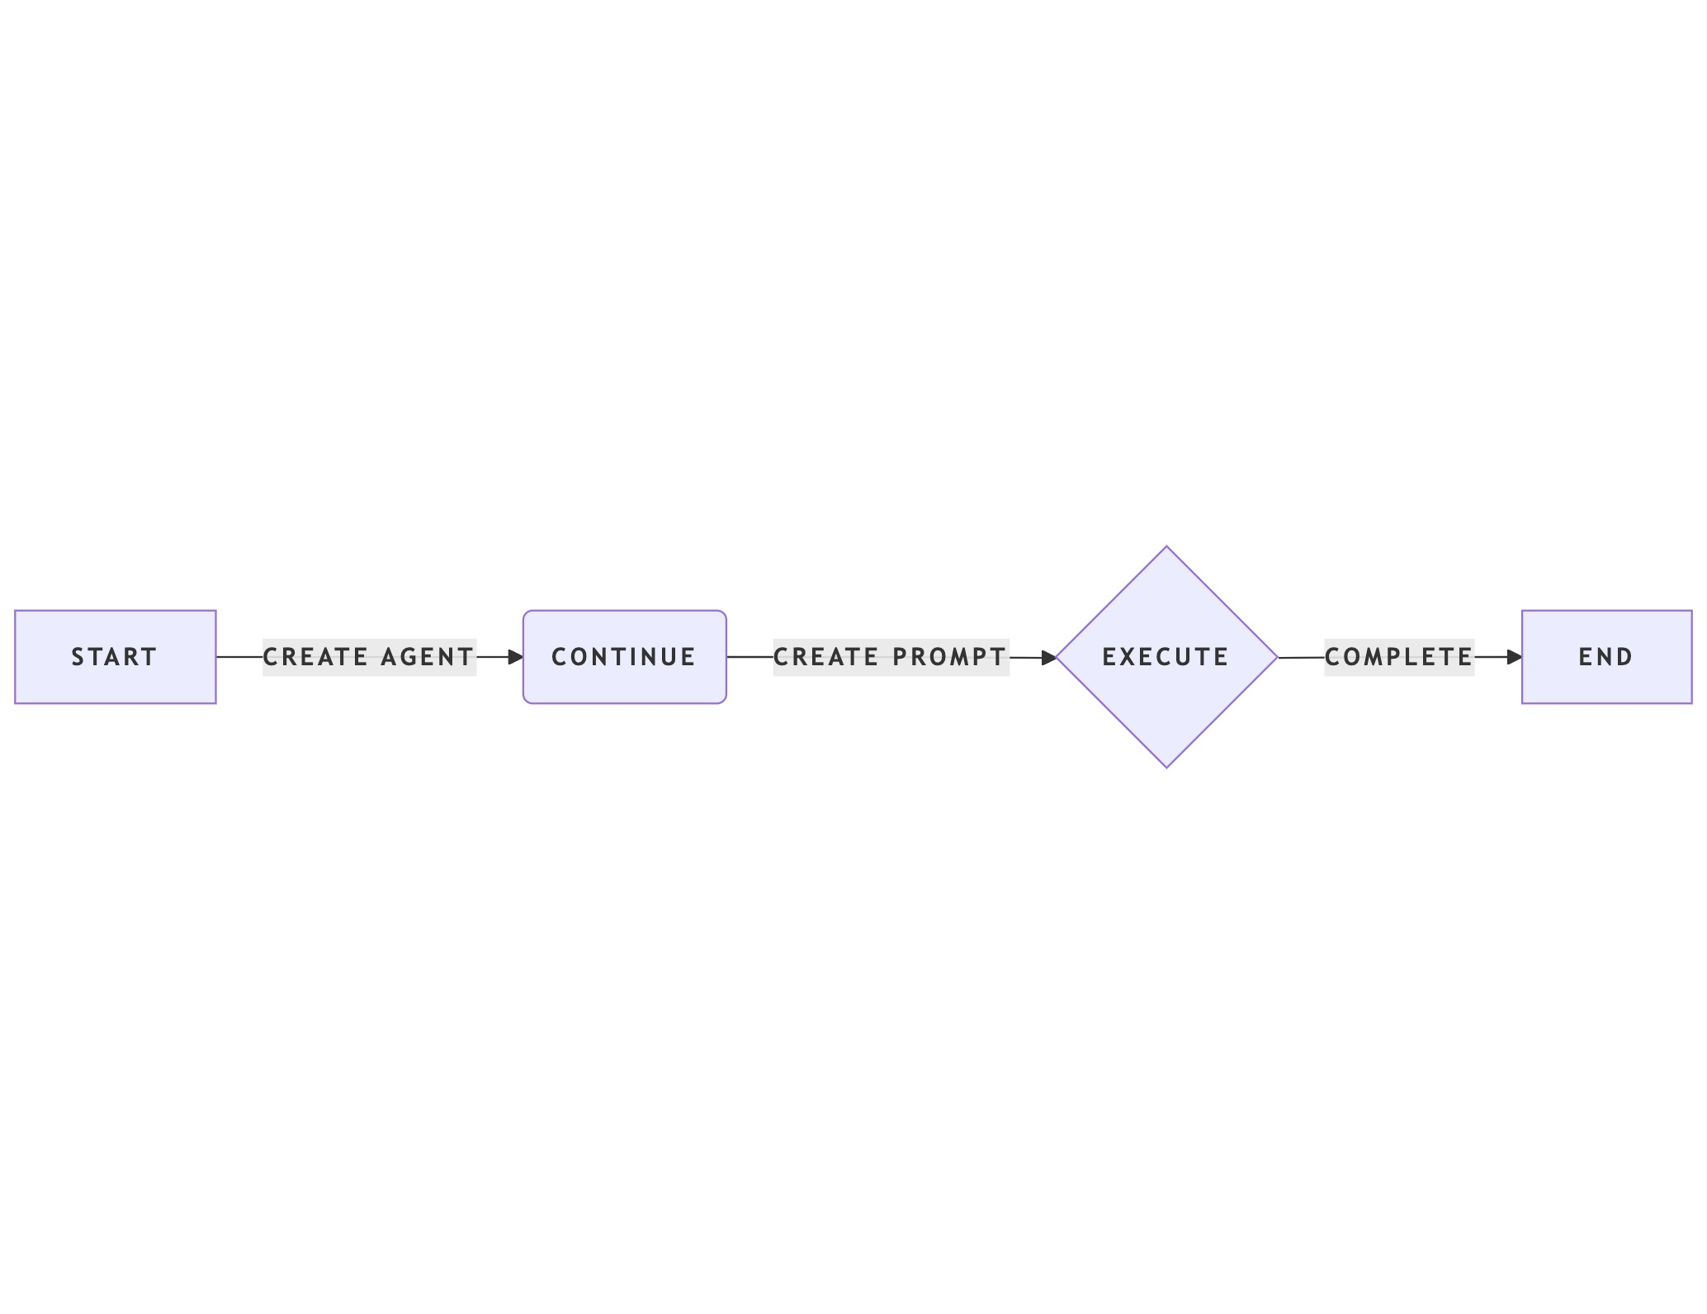
Browser Agent Flow

