Slide 1


AIRLINE BOOKING
SYSTEM

Slide 2
2510030305 | Snikitha
2510030283 | Nandini
2510030400 | Varshitha
2510030374 | SriHarini
2510080059 | Deekshitha
2510030035 | Anushka
2510030173 | Naga Sreeja
2510080025 | Varna
Team Members

Slide 3
Project Abstract
Defining Goals for the Booking System
The main objectives include: enhancing user experience through intuitive design, providing efficient flight management, and implementing effective algorithms for searching and sorting flight data seamlessly.

Slide 4
Flight Management Module
Stores flight details (Flight No, From, To, Time, Airline, Date, Cost, Seats)
Uses Singly Linked List
Functions:
Add Flight
Display Flights
Convert list to array (for sorting)
Booking Management Module
Stores passenger booking details
Uses Doubly Linked List
Functions:
Add Booking
Display Bookings
Check-in Queue Module
Manages passenger check-in process
Uses Queue (FIFO)
Functions:
Join Queue
Process Check-in
Display Queue
Modules

Slide 5
Searching Module
Uses Generic Binary Search
Searches flights efficiently
Based on Comparable interface
Sorting Module
Quick Sort
Sorts flights by flight number
Merge Sort
Sorts flights by departure time
File Handling Module
Reads & writes data to files:
flights.txt
bookings.txt
queue.txt
Ensures data persistence
Advanced Search Module
Search flights by:
Source & Destination
Date Range (± days)
Uses Date & Time calculations

Slide 6
Description of modules
Flight Management Module
This module handles all flight-related operations in the system. It stores details like flight number, source, destination, departure time, airline, date, cost, and available seats. A singly linked list is used to manage flight records dynamically.
Users can add new flights, view all flights in a structured table format, and convert the list into an array for sorting purposes. This module forms the core data storage of the system.
Booking Management Module
This module manages passenger bookings. It stores the passenger name and corresponding flight number using a doubly linked list, allowing easy traversal in both directions.
Users can add new bookings and view all existing bookings. This structure helps efficiently maintain and organize booking records.

Slide 7
Check-in Queue Module
This module simulates the airport check-in process using a queue (FIFO principle). Passengers are added to the queue when they arrive for check-in and are processed in order.
It includes operations like joining the queue, processing check-in, and displaying the current queue. This ensures fair and real-time handling of passengers.
Searching Module
This module uses a generic binary search algorithm to efficiently search flight records. It works on sorted data and reduces search time compared to linear search.
It is implemented using Java generics, making it reusable for different data types.

Slide 8
Sorting Module
Sorting is implemented using two algorithms:
Quick Sort: Sorts flights based on flight number
Merge Sort: Sorts flights based on departure time
These algorithms improve data organization and help users view flights in a structured manner.

Slide 9
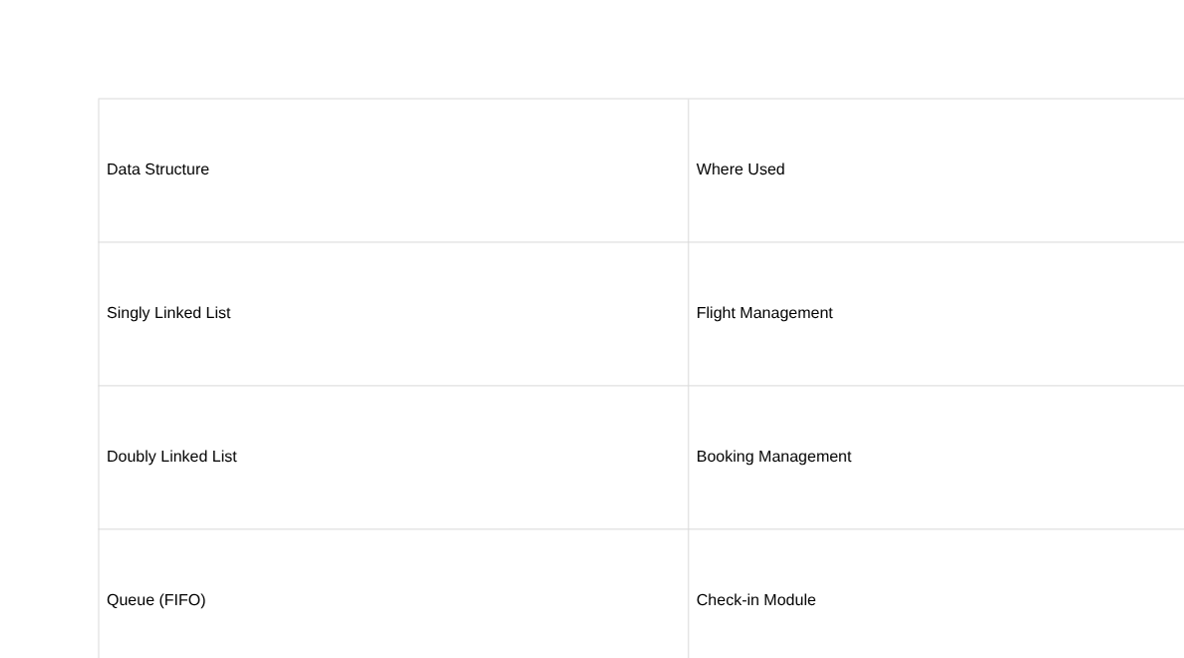
Data structures used

Slide 10
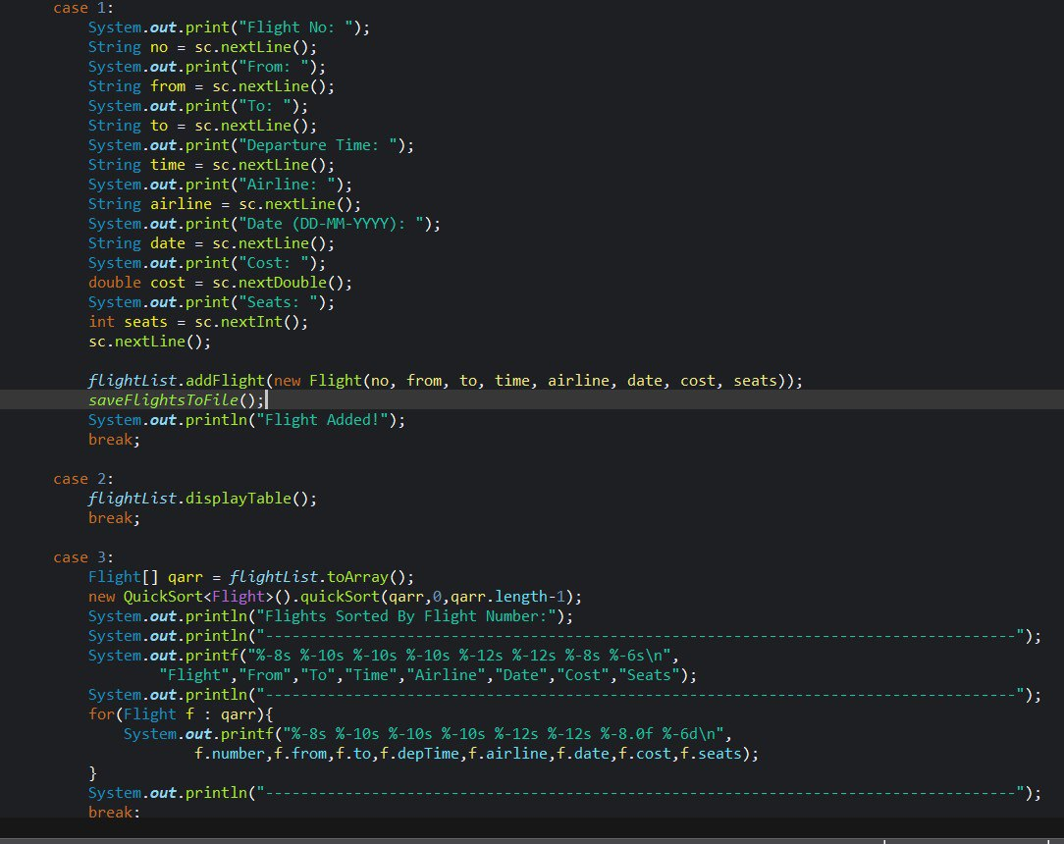

Slide 11
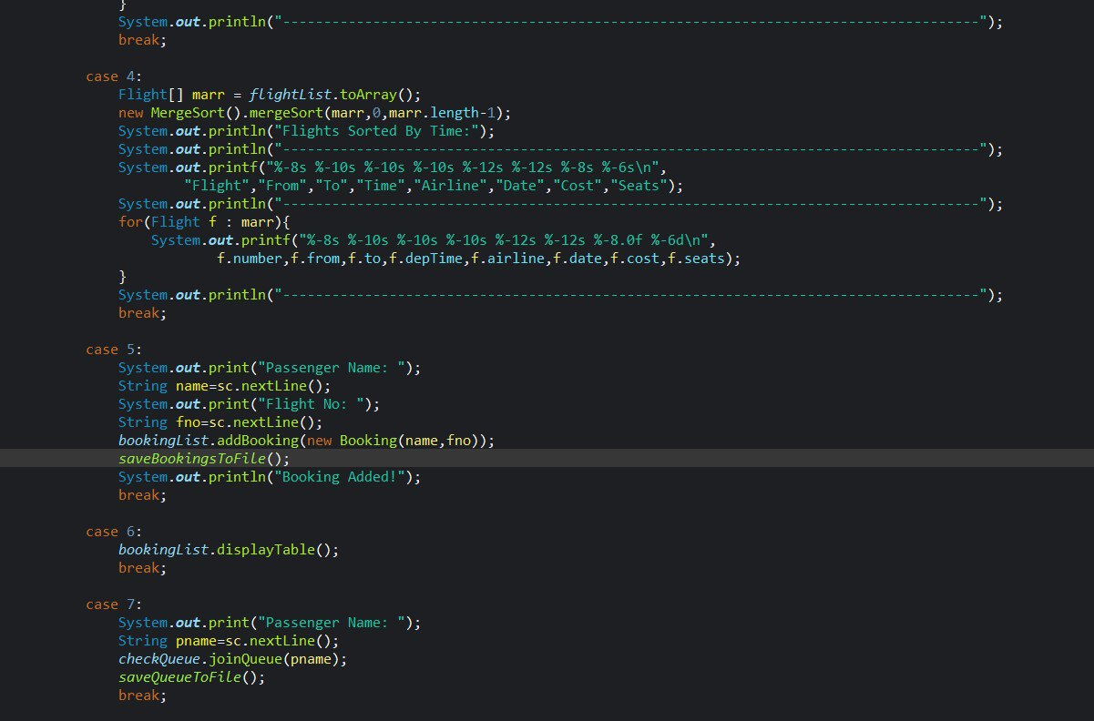

Slide 12
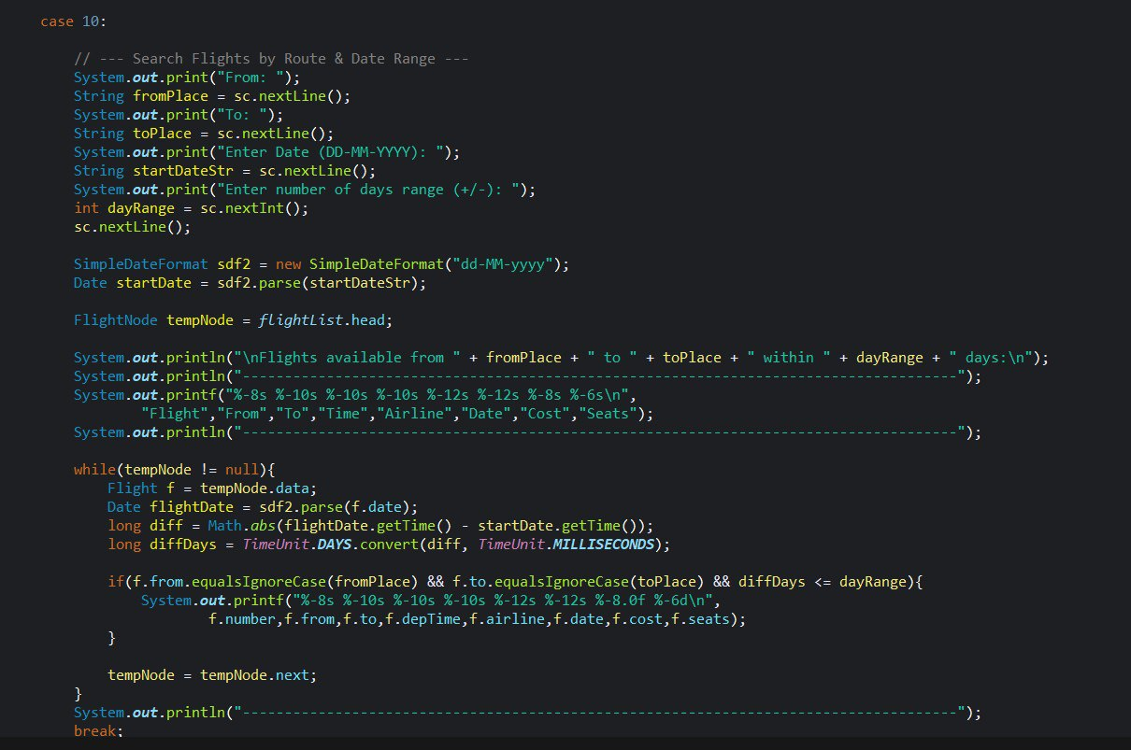

Slide 13
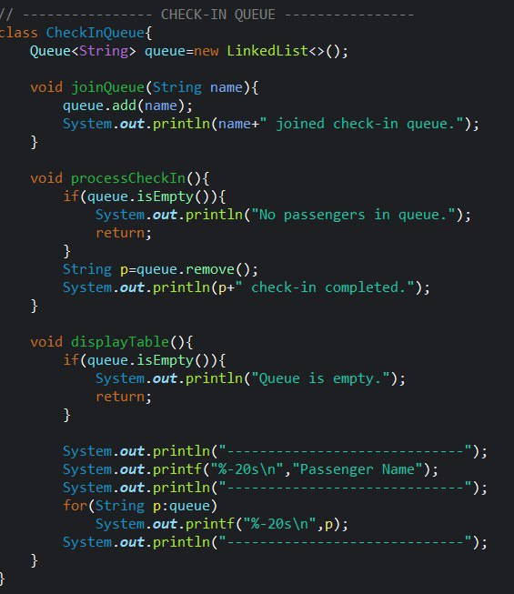

Slide 14
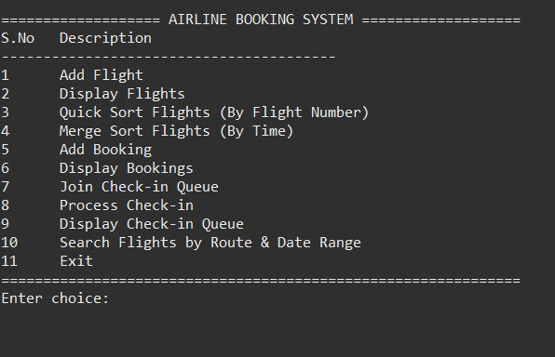
sample output

Slide 15
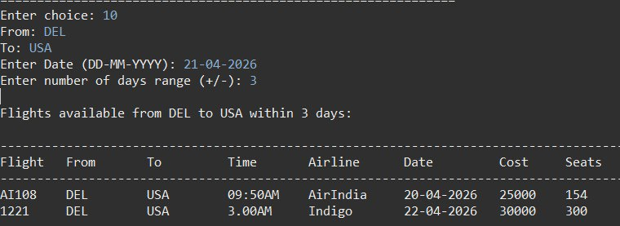

Slide 16
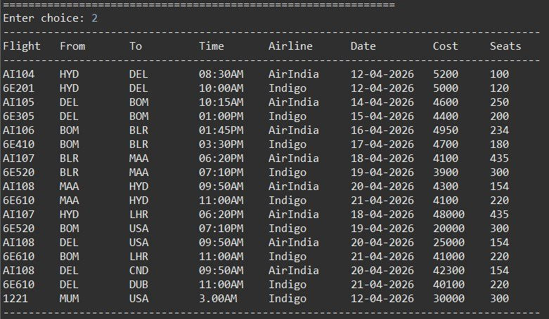
Display

Slide 17
What we learned?
Through this project, we gained practical knowledge of applying data structures and algorithms in real-world applications.
We learned how to use different data structures like linked lists, queues, and arrays to efficiently manage and organize data.
We understood the implementation of sorting algorithms (Quick Sort, Merge Sort) and searching techniques (Binary Search) to improve performance.
We also gained experience in file handling, which helped us store and retrieve data permanently.
Additionally, we improved our skills in problem-solving, logical thinking, and code organization.
Working as a team helped us develop communication, collaboration, and project management skills.

Slide 18
Future Analysis
This project can be further improved by adding more advanced features and technologies.
Graphical User Interface (GUI): Replace console-based system with a user-friendly interface using JavaFX or web technologies.
Database Integration: Use databases like MySQL instead of text files for better data security and scalability.
User Authentication: Add login/signup system for passengers and admin.
Online Booking System: Enable real-time booking through a web or mobile application.
Seat Selection Feature: Allow users to choose seats visually.
Payment Integration: Add online payment options for booking confirmation.
Advanced Search & Filters: Include filters like price range, airline, and time.
Notifications: Send booking confirmations via email or SMS.

Slide 19
Thank you.
We also extend our heartfelt thanks to our faculty members for their valuable suggestions and constant motivation, which helped us improve and successfully complete this project.

