Slide 1
MobX

Slide 2
MobX
MobX is not a framework. It is a State management Library
MobX is a simple state management solution used in ReactJS.
It is alternative to Flux & Redux
Mobx can also use RxJs
mobx and mobx-react can be used in React Native in.
The latter is imported “mobx-react/native”.
Mobx can also be used with other fraworks and Jquery

Slide 3
State
The state is the data that drives the application.
Domain-specific states like to-do lists , as well as view states like currently selected elements.
The state is like an excel table with data.

Slide 4
Derivations
Anything that comes from the state and does not have any further interaction is derived.
Derivatives exist in many forms:
User Interface
Derived data , such as the number of remaining to-do items.
Back-end integration , such as sending changes to the server.

Slide 5
Mobx Derivatives
Computed values – These are values that can always be derived from the current observable state using a pure function.
Reactions – Reactions are side effects that need to occur automatically when the state changes.

Slide 6
Actions
An action is any piece of code that can change state. ->event Handler
User events, backend data pushes, scheduled events, and more.
The action is similar to the user entering a new value in the excel cell.
Actions can be explicitly defined in MobX, which can help you organize code more clearly.

Slide 7

Mobx Principle
MobX supports one-way data flow, which is the action change state , and the state change updates all affected views .
All derived defaults are synchronous updates.
Means , action can safely check the calculated value directly after changing the state .
All calculated values should be pure . They should not be used to change state .

Slide 8
MobX
Any value can be observable
Any component can be an observer
Components (observers) will automatically
re-render when observable values change
MobX uses Observer Design Pattern

Slide 9
MobX

Slide 10
MobX

Slide 11
MobX

Slide 12
MobX

Slide 13
MobX Principle
Actions -> State -> Derivations + Reactions
State - the state of the application (similar to Redux’s store).
Derivations - Value that can be computed automatically from the state.
Reactions - automatically to perform some task like changing the DOM when the state changes. (React Components)
Actions - functions that change the state. (Event Handlers)
mobx-react - A library that binds mobx with react.

Slide 14
Why MobX
It is very simple to use and therefore speeds up development considerably.
With MobX, you do not need to normalize data.
Modifying state is very straightforward.
MobX automatically tracks changes between states and derivations.

Slide 15
MobX Decorators
Mobx (and mobx-react) can be used with regular JS functions or with ES7 decorators.
Mobx decorators:
@observable - turn a property into an observable, observers will be notified and react to changes in those properties. The properties types can be objects, arrays or references.
@computed - values that will be derived automatically when relevant data is modified.

Slide 16
MobX Decorators
@observer (mobx-react) - make react component reactive to the state change. It calls the component’s render function when the state changes.
@action - a method that changes the state.
Provider and @inject - inject the store to the component (like connect in Redux).
.

Slide 17
MobX

Slide 18
MobX

Slide 19
MobX

Slide 20
MobX

Slide 21
MobX – Best Practises
The stores represent the ui state – So store state in file to load at later time
Separate rest calls from the stores - (else hard to test)
Keep your business logic in stores - Don’t ever write business logic in your components.
Don’t create global store instances -instead use provider to inject to into components using props (for testability with mock)
Only the store is allowed to change its properties - Never change a store’s property directly in a component by invoking method from store with action.

Slide 22
MobX – Best Practises
Always annotate each component with @observer- allows each component to update on store prop changes.
Use @computed – for repeated computations
You probably don’t need react router - keep current displayed view in a property in one of stores then have one component that just renders what the property says.

Slide 23
MobX – Setup
$ npm install -g yo
$ npm install generator-mobx-react -g
$ md mobx-app
$ cd mobx-app
$ yo mobx-react
answer all questions to crate project
$ npm start (In browser , visit localhost:8080)

Slide 24
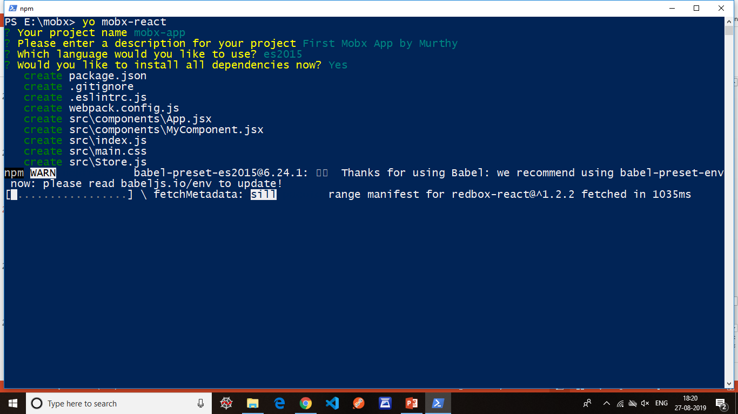
MobX – Setup

Slide 25
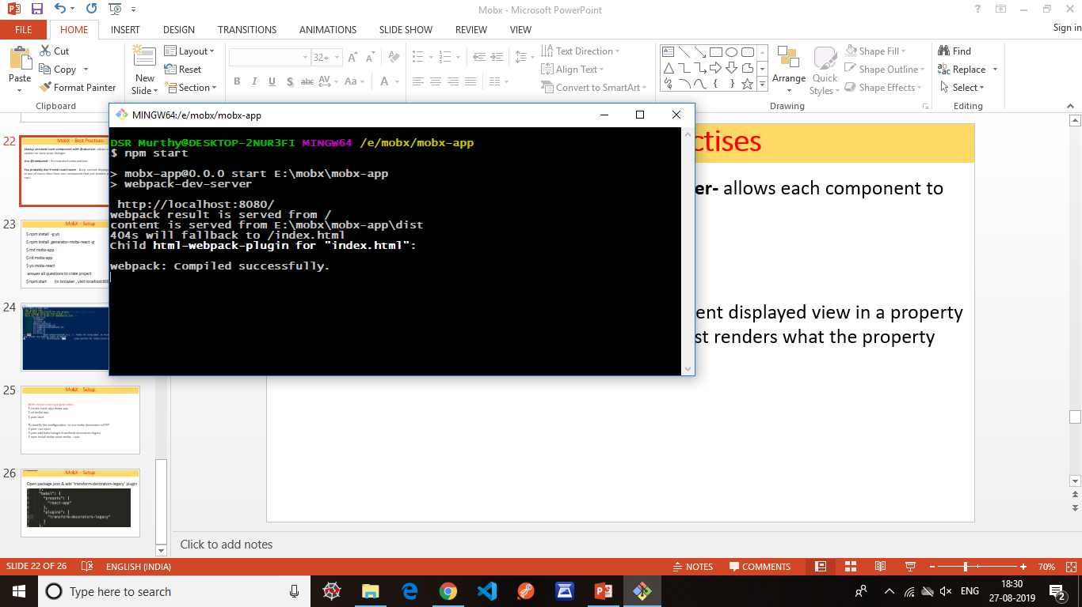
MobX – Setup

Slide 26
MobX – Setup Another way
With create-react-app generator:
$ create-react-app mobx-app
$ cd mobx-app
$ yarn start
To modify the configuration to use mobx decorators of ES7
$ yarn run eject
$ yarn add babel-plugin-transform-decorators-legacy
$ npm install mobx-react mobx --save

Slide 27
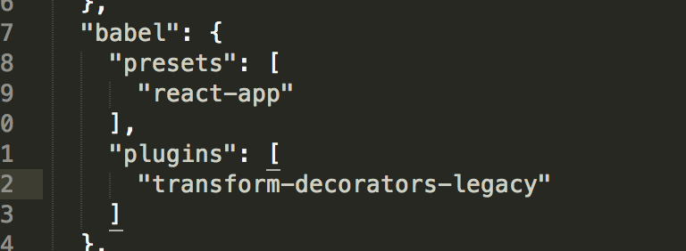
MobX – Setup
Go to package.json
Open package.json & add ‘transform-decorators-legacy’ plugin

