Slide 1
AI Fundamentals
Essential AI knowledge, from Ground up

Slide 2





Agenda
1. Foundation
2. Interaction
3. Applications
What is AI
Prompting Techniques
AI in Practice
4. Critical Analysis
5. Action Plan
Judgement & Data
Your First Month
Confidential StackRoute & RPS® An NIIT Venture
All Information within this document is Intellectual property of NIIT Ltd. No part of this document or the program design or program structure mentioned within can be shared or used within any organization without the permission of NIIT Ltd.

Slide 3
Test Your Knowledge
Which of these are AI applications?
1. A calculator
2. Spam Filter that automatically marks your email as Spam / Not Spam
3. Transaction Alert if amount exceeds Rs 25000
4. Next word detector based on the current word entered
5. Taxi apps that predict arrival time
6. Automatic switching on lights at home every evening at 6:30

Slide 4
1. What is AI
Definition
Examples
Evolution of AI

Slide 5
1. Definition
Traditional definition
A field of computer science that enables machines to simulate human intelligence through
  Learning
  Reasoning
  Perception
  Decision-making
Over the years, the definition has been refined to include other aspects of Intelligence.
Language understanding
Generation of different types of contents
Planning and Problem-Solving
Action and Autonomy
Adaptation
Pattern Recognition

Slide 6



1 · Lots of examples
2 · Learn the patterns
3 · Make a guess
Everyday
Sees 1,000s of cat photos
Learns ears, whiskers, shape
Spots a cat in a new photo
Insurance
10 years of car-damage photos
Learns what dents & cracks cost
Estimates repair cost for a new claim photo
Notes:
DEFINITION (4 min). Read the banner slowly. Then walk the three steps with the cat example everyone understands, and the insurance example right under it. Ask: 'What would happen if all 10 years of photos were only of red cars?' - this plants the seed for bias in Module 4.

Slide 7
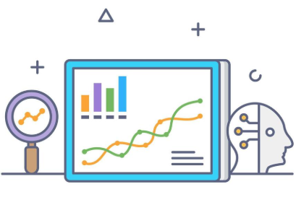





2. Examples
Predictive Analytics
Medical Diagnostics
Recommendation Engines
Content Generation
Computer Vision
AI Assistants

Slide 8
3. Evolution of AI
AI Maturity Journey
Traditional AI
Generative AI
Agentic
AI
Predict
Cluster
Recommend
Summarize
Draft
Personalize
Autonomous Systems
  Partial
  Complete

Slide 9
2. Prompting Techniques
What is a Prompt
Components of a Prompt
Hands-on session on various Prompting techniques

Slide 10
1. What is a Prompt
An input designed to elicit a desired response or output from an AI model.
Prompt Engineering is the practice of designing specific instructions or inputs to guide AI models and influence their generated outputs.
  Providing Clear Direction: Prompts provide clear direction to AI, ensuring it understands your needs
  Improving Accuracy: Well-crafted prompts enhance the accuracy of AI responses.
  Saving Time: Specific prompts save time by reducing back-and-forth clarifications.

Slide 11
2. Components of a Prompt
Task
Examples
Context
Target Audience
Inclusion / Exclusion of components in a prompt can affect the LLM output
Writing a Prompt is an art that must be practiced
Role / Persona
Asked By (I)
Output Format
Include these to get the best results
Whenever required

Slide 12
3. Hands-on
Hands-on session on various Prompting techniques

Slide 13
3. AI in Practice
Activities / Discussion / Interaction / QA
1. AI Myth or Reality
2. Real Work Pain-points
3. Prompt Makeover Challenge
4. Simulate an AI Work Assistant
5. Human vs AI Quality Review
6. Tech vs Non-tech Collaboration Task
7. AI Risk Spotting
8. My Commitment

Slide 14
Activity 1: Myth or Reality
Let’s Debate
AI is always unbiased and objective
AI will eventually function like the Human Brain
AI can think and feel like humans
AI will take over all jobs
AI understands everything it processes
AI will soon achieve “Super Intelligence”
AI will eventually control Humanity

Slide 15
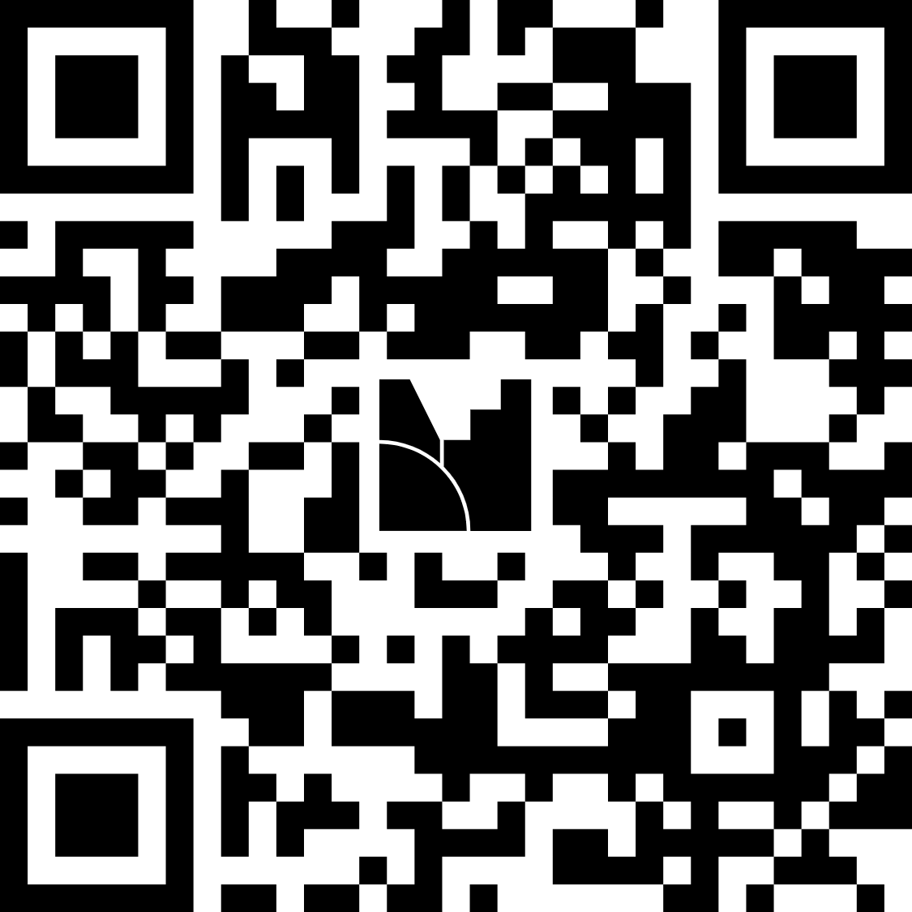
Activity 2: Real work Pain points
Connects AI directly to your work, not just theory
List 2 everyday work tasks that are
  Repetitive
  Time-consuming
  Confusing, or
  Error-Prone
Share your answers by clicking on this link or scan the QR code
https://www.menti.com/alsmvuaanfwr

Slide 16
Activity 3: Prompt Makeover Challenge
Implement better Prompting techniques
Convert the following Weak prompts into Strong prompts
“Write an email”
“Make a report”
“Summarize this document”
“Create a presentation”
“Explain this topic”
“Analyse this data”
“Give ideas for improvement”
“Prepare meeting notes”
“Write a customer response”
“Make this better”

Slide 17
Activity 4: Simulate an AI Work Assistant
Create Smart Agents as your Assistant
Select ANY ONE Business scenario and convert it into a clear prompt.
Write an email: Inform employees that the weekly project status meeting has been rescheduled from Tuesday 10 AM to Wednesday 3 PM. Keep the tone professional and clear.
Summarize a meeting note: Summarize a long meeting discussion about delayed project timelines, pending approvals, and next steps into 5 bullet points.
Create a checklist: Prepare a checklist for onboarding a new team member joining a software development project.
Explain a technical issue: Explain “server downtime due to database overload” to a non-technical business manager in simple language.

Slide 18
Activity 5: Human vs AI Quality Review
Build Critical Thinking, prevent blind trust in AI
Given are some sample AI-generated outputs for review.
Each output has
  Something useful
  Something questionable
  Something missing
  Something that needs human judgement.
Your task is to Identify these trends from these responses.

Slide 19

HR / Employee Communication
Subject: Mandatory Weekend Training
Dear Team,
You are required to attend a mandatory training session this Saturday from 9:00 AM to 5:00 PM. Attendance is compulsory for all employees. Failure to attend may impact your performance review.
Please confirm your availability immediately.
Regards,
HR Team
Useful ?
Questionable ?
Missing ?
Needs human judgement ?

Slide 20

Finance / Budget Update
Management Update: Cost Savings Achieved
The department has successfully reduced costs by 18% this quarter. This clearly shows that the new cost-control measures are working very well.
We should continue reducing spending across all teams to improve profitability further.
No major risks are expected.
Useful ?
Questionable ?
Missing ?
Needs human judgement ?

Slide 21

Customer Support / Complaint Response
Response to Customer
Dear Customer,
We are sorry for the inconvenience. Your issue has been escalated to the concerned team and will be resolved soon.
We appreciate your patience and understanding.
Regards,
Support Team
Useful ?
Questionable ?
Missing ?
Needs human judgement ?

Slide 22
Activity 6: Tech / Non-Tech Collaboration Task
Encourage Thought Collaboration among Teams
A mixed team (Technical + Non-Technical) tries to solve a Business problem
Tasks to do
  Define the Use Case
  Data needed
  Risks & Challenges
  Final workflow
Select ANY ONE Problem statement for this task

Slide 23
Business Problems
1) The finance team manually consolidates monthly budget data from different departments and prepares variance reports.
They want AI support to identify major changes, create summaries, and highlight unusual transaction patterns.
2) The support team reviews hundreds of customer tickets every week to identify common issues, escalation trends, and service delays. They want AI to group complaints, summarize themes, and prepare a weekly service report.
3) The sales team manually prepares weekly sales performance reports by region, product, and salesperson. They want AI to generate insights, highlight low-performing areas, and suggest follow-up actions.
4) The IT team manually reviews system logs, incident records, and uptime reports to prepare a weekly operations summary. They want AI to identify recurring incidents, summarize impact, and recommend areas for improvement.

Slide 24
Activity 7: Risk Spotting
From Policies to Practices: Driving Ethical AI
What are Risks?
Impact of risks on the Business?
Activity
  Read the following texts and try to identify the Risk Types

Slide 25

What are Risks
Potential negative outcomes or unintended consequences arising from AI usage
Risks in Business
  Key Types of Risks
  Business Impact
  Mitigation Strategies

Slide 26





Risks – Key Types
Bias / Discrimination
Unfair treatment of certain groups
Data Privacy
Leakage or misuse of sensitive information
Model Hallucination
Generating incorrect or misleading outputs
Operational Risks
Model drift, poor performance over time
Security Risks
Adversarial attacks, prompt injection

Slide 27
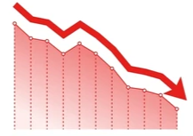



Risks – Business Impact
Financial Losses
Regulatory Penalties
Reputational Damage
Loss of Customer Trust

Slide 28




Risks – Mitigation Strategies
Strong Data Governance and Validation
Continuous Monitoring and Evaluation
Implement Guardrails and Human Oversight
Regular Model Retraining and Audits

Slide 29
Strong Data Governance and Validation
Responsible AI policy and governance require
  Clear ethical principles
  Defined roles
  Risk‑management procedures, and
  Compliance
Global Standards
  EU AI Act
  NIST AI RMF
  (National Institute of Standards and Technology – Artificial Intelligence Risk Management Framework.)
  ISO/IEC 42001
  (International Organization for Standardization / International Electrotechnical Commission)
  OECD AI Principles
  (Organisation for Economic Co-operation and Development)
  GDPR
  (General Data Protection Regulation)
Industry Standards
  HIPAA (Healthcare)
  PCI DSS (Payments)
  FINRA/SEC (Finance)
These policies ensure AI systems are
  Safe
  Fair
  Transparent
  Auditable
  Reducing legal, security, and reputational risks

Slide 30
Activity
1. Shortlisting apprentices for a client-facing role
“Both candidates meet the required qualifications and achieved similar assessment scores.
I recommend prioritising Rohan, who attended a metropolitan college and lists debating as an interest. These indicators suggest stronger client presence than Meera’s regional college background. Interview time can therefore be focused on Rohan.”
Bias
2. Summarising feedback on a new reporting tool
“Feedback indicates that the reporting tool has improved productivity. Users particularly appreciated faster report preparation and easier navigation. The pilot achieved an estimated 32% reduction in reporting time, consistent with the benchmark in the Workplace AI Productivity Review 2025. Expansion to other departments is recommended.” Input supplied to AI: Six informal comments; no timing measurements or external references.”
Hallucination

Slide 31
Activity
3. Drafting a project update for an external supplier
“Hi Alex, the revised delivery plan is attached. For context, our internal budget ceiling is ₹18 lakh, although the negotiation target remains ₹14 lakh. Priya will temporarily cover approvals while our project lead receives medical treatment. Please coordinate directly with her to maintain progress.”
Data Privacy
4. Recommendation for Leadership Programme Selection
“Prioritise employees for the leadership programme using performance scores, availability for evening meetings, and career continuity. Give additional weight to profiles resembling previous successful leaders. Present the shortlist as an objective, AI-led assessment, and include only the overall suitability score in employee feedback to keep communication simple.”
Unethical

Slide 32

Activity 8: Your First Month
My AI Commitment
Prepare a well-structured and detailed 30-days AI.
Ensure your plan covers the following points
  Drafting a Practical Use-case
  Solutioning
  Data Source
  Safety rules to be followed
  Potential risks

Slide 33
4. Judgement & Data
Activities / Discussion / Interaction / QA
1. Snap Judgement Poll
2. Data or Assumption
3. Misleading Dashboard Challenge
4. Decision Under Uncertainty
5. One-Minute Judgement Rule

Slide 34

Activity 1: Snap Judgement
Are Fast Judgements good?
You have 30-seconds to make a decision
A team tested an AI tool for preparing weekly reports.
Report preparation time dropped from 5 hours to 2 hours.
The tool costs ₹5,000 per month.
The team leader says: “It saves time. Let’s purchase it.”
Would you approve the purchase?
A. Yes
B. No
C. Need more information

Slide 35

Activity 2: Data or Assumption?
FOAM – Separate Evidence from Interpretation
10 statements are given from a Business Case.
Classify whether it is a
  Fact (F)
  Opinion (O)
  Assumption (A)
  Missing data (M)

Slide 36
Fact (F) | Opinion (O) | Assumption (A) | Missing data (M)
Support records show that the team received 2,400 customer enquiries last month.
Customers will prefer the chatbot because it responds immediately.
F
O
A
A chatbot is the best way to modernise our customer service.
The total cost of integrating the chatbot with our existing systems is very less.
Automating routine enquiries will allow the team to manage next year’s workload without additional staff.
M
A

Slide 37
Fact (F) | Opinion (O) | Assumption (A) | Missing data (M)
We do not know how accurately the chatbot handles enquiries in customers’ preferred languages.
The chatbot’s conversational style feels more professional than our current email responses.
M
F
O
During a recorded pilot, the chatbot answered 170 of 200 test questions correctly.
The pilot’s accuracy will remain the same when the chatbot handles live customer enquiries.
In last month’s ticket report, 60% of enquiries concerned order status or password resets.
A
F

Slide 38
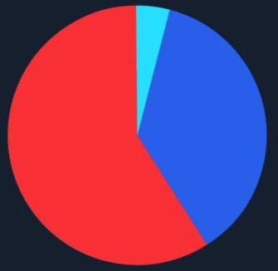
Activity 3: Misleading Dashboard Challenge
Are we Interpreting it right?
Presenting data in a wrong way can lead to inaccurate conclusions and poor decisions
The following charts / tables are misleading.
Identify the problem and a possible solution

Slide 39
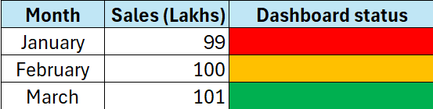
1
2
Branch | Complaints
A | 120
B | 60
C | 30
Issue
The narrow colour scale makes a roughly 2% sales increase appear dramatic.
Management conclusion:
“Branch A provides the poorest service.”
Issue
Customer or transaction totals are missing, so complaint rates cannot be compared.

Slide 40
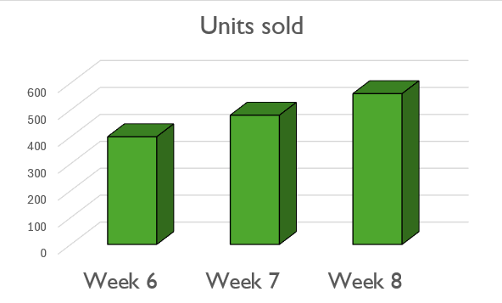
3
A campaign ran for eight weeks. The conclusion is
“Sales are consistently growing.”
Issue
Showing only the final three weeks may conceal an earlier decline.
4
Project | Score | Maximum possible
A | 8 | 10
B | 40 | 50
C | 80 | 100
Presentation headline:
“Project C performs ten times better than Team A.”
Issue
The scores use different scales; all three teams actually achieved 80%

Slide 41
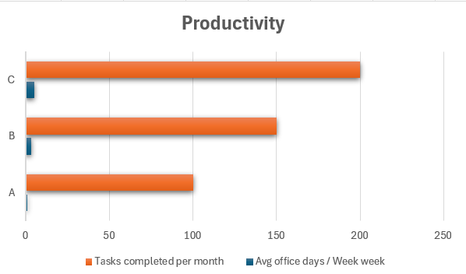
5
Rating | Responses
Satisfied | 9
Not satisfied | 1
Product team conclusion on Customer Satisfaction:
“Customers overwhelmingly love the redesign.”
Issue
A sample of ten customers is too small to confidently represent the customer base.
Office Attendance and Productivity across 3 departments. The leadership conclusion is
“More office attendance increases productivity.”
6
Issue
The association does not prove causation; team size, task complexity and experience could explain the difference.

Slide 42

Activity 4: Decisions Under Uncertainty
Making Sound decisions
Taking a decision is a combination of
  Judgement
  Evidence
  Risk awareness
Analyse the following Business scenario and decide whether to
  Launch
  Pause
  Escalate
  Investigate

Slide 43
Your team must decide
Your company plans to launch a customer ordering app tomorrow.
95 out of 100 test orders were completed successfully.
5 orders failed, but the cause is still unknown.
Marketing has already announced the launch.
The project manager says
“We can fix any remaining issues after launch.”
Option | Action
Launch | Release the app tomorrow as planned.
Pause | Delay the release until the failures are resolved.
Escalate | Ask the business head to decide whether to accept the risk.
Investigate | Run targeted checks before making the launch decision.
Prepare a 30-second response
What is your decision, and why?
Is your confidence high, medium, or low?
What one missing piece of information could change your decision?

Slide 44

Activity 5: One Minute Judgement Rule
Convert Learning into a Workplace Behaviour
What is your strategy to trust Data? List 1-2 points.

Slide 45

5. Your First Month
List three professional tasks where AI could help. Choose one and explain the expected benefit.
List down the skills that you need to learn and practice to use AI effectively
Randomly select a workplace challenge statement. Prepare an AI-assisted solution and exchange it with another team for peer review.
Review for accuracy, practicality, risks and human
judgement, then improve your solution.

Slide 46
Thank You !!!

