Slide 1


SQL (Structure Query Language)
PRESENTED BY
SRIRAM M

Slide 2

What is SQL ? Why it is Used ? SQL(Structured Query Language)Is a domain-specific language used for managing and
Querying relational databases.
It facilitates tasks like
retrieving, inserting, updating, and deleting data, ensuring efficient and structured data management.

Slide 3


What is Query?
An SQL query is a command used to retrieve, manipulate, or manage data in a database. It specifies which data to retrieve, how to retrieve it, and any conditions to filter the results.
What is the Bank Management? Bank management involves overseeing financial operations, customer accounts, transactions, loans, and employees within a bank. It aims to ensure smooth, secure, and efficient banking services while maintaining regulatory compliance.

Slide 4

Introduction
1. Database Design and Creation:
2. Security and Compliance:
3. Employee Management:
4. Customer and Account Management:
5. Loan Management:

Slide 5

1. Database Design and Creation:
Define the database schema, including tables for customers, accounts, transactions, loans, employees, and more.
Establish relationships between tables to represent the bank's business logic accurately.

Slide 6



3. Employee Management:
Maintain records of bank employees, including their roles, contact information, and access permissions.
Implement authentication and authorization mechanisms to restrict access to sensitive data and functionalities.

Slide 7




4. Customer and Account Management:
Customer management is more focused on increasing customer satisfaction and achieving product-related goals , while account management is more focused on identifying new business opportunities and increasing the revenue stream.

Slide 8


5. Loan Management:
Design a module to manage loans, including personal loans, mortgages, and business loans.
Calculate and track interest payments, loan balances, and payment schedules.
A loan management system is a digital platform that helps automate every stage of the loan lifecycle, from application to closing

Slide 9


ADVANTAGES OF BANK MANAGEMENT
Financial Stability
Risk Management
Customer Satisfaction
Profitability
Compliance and Regulation
. Systemic Stability

Slide 10
Simple Query
CREATE TABLE ACCOUNTS(ACCOUNT_ID INT PRIMARY KEY,
ACCOUNTER_NAME VARCHAR(50), MIN_BALANCE DECIMAL(10,2),
ACCOUNT_TYPE VARCHAR(30), MAX_BALANCE DECIMAL(10,2));
INSERT INTO ACCOUNTS(ACCOUNT_ID, ACCOUNTER_NAME,
MIN_BALANCE, ACCOUNT_TYPE, MAX_BALANCE) VALUES
(101,"SRIRAM M",500.00, "SAVINGS", 5000.80),
(102,"RAHUL N",500.00, "CHECKING", 4000.00);
(102,"VISHWA K",500.00, "SAVINGS", 10000.00);
(102,"NILAVAN N",500.00,"SAVINGS",8000.00);
SELECT * FROM ACCOUNTS;
ACCOUNT_ID | ACCOUNTER_NAME | MIN_BALANCE | ACCOUNT_TYPE | MAX_BALANCE
101 | SRIRAM M | 500.00 | SAVINGS | 5000.80
102 | RAHUL N | 500.00 | CHECKING | 4000.00
103 | VISHWA K | 500.00 | SAVINGS | 10000.00
104 | NILAVAN N | 500.00 | SAVINGS | 8000.00

Slide 11
Simple Bank Accounts Table
Query :
CREATETABLE Bank_Accounts (Account_Number INT PRIMARY KEY, Account_Holder_Name VARCHAR(50),
Account_Balance DECIMAL(10,2), Account_Type
VARCHAR(30), Account_Status VARCHAR(40));
INSERT INTO Bank_Accounts (Account_Number,
Account_Holder_Name, Account_Balance,
Account_Type, Account_Status)VALUES (67890, 'SRIRAM M', 10000.00, 'SAVINGS',ACTIVE'), (67879, 'RAHUL N', 50000.00, '' CHECKING, 'ACTIVE'),
(60978,'VISHWAK',80000.00,'SAVINGS','ACTIVE'),
(68790, 'NILAVAN N', 12000.00, 'SAVINGS', 'ACTIVE');
Account_ID | Account_Holder_Name | Account_Balance | Account_Type | Account_Status
67890 | SRIRAM M | 10000.00 | SAVINGS | ACTIVE
67879 | RAHUL N | 50000.00 | CHECKING | ACTIVE
60978 | VISHWA K | 80000.00 | SAVINGS | ACTIVE
68790 | NILAVAN N | 12000.00 | SAVINGS | ACTIVE

Slide 12
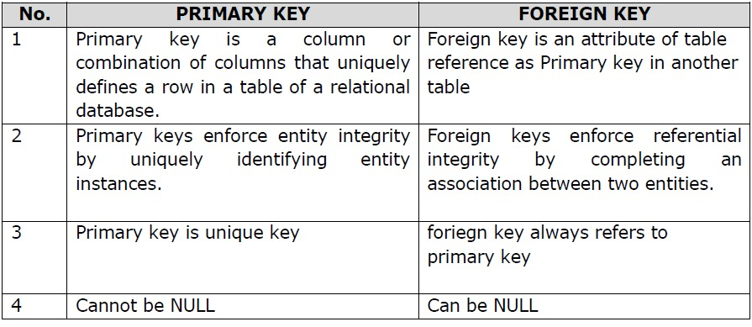
PRIMARY KEY
Query: CREATE TABLE BANK_MANAGEMENT(MANAGER_ID INT PRIMARY KEY,MANAGER_F_NAME CHAR(50), MANAGER_LAST_NAME CHAR(50),MANAGER_DEPT VARCHAR(50),MANAGER_ACCOUNT_NO INT , MANAGER_BRANCH VARCHAR(50), BRANCH_ID INT);
INSERT INTO BANK_MANAGEMENT(MANAGER_ID, MANAGER_F_NAME, MANAGER_LAST_NAME, MANAGER_DEPT, MANAGER_ACCOUNT_NO, MANAGER_BRANCH,BRANCH_ID) VALUES
(1001,"SRIRAM","M","ACCOUNTER",9876089,"INDIAN BANK",76545),
(1002,"CHANDRU","M","FINANCIAL",4567654,"STATE BANK OF INDIA",23432),
(1003, 'John', 'Doe', 'Finance', '123456789', 'New York', 101);
SELECT* FROM BANK_MANAGEMENT;
Query: CREATE TABLE EMPLOYEE (EMP_ID INT PRIMARY KEY, FIRST_NAME CHAR(50), LAST_NAME CHAR(50), EMPLOYEE_BANK VARCHAR(50),EMPLOYEE_AC_NO INT,EMPLOYEE_BRANCH VARCHAR(30), EMAIL_ID VARCHAR(50),PHONE_NO DOUBLE,MANAGER_ID INT,FOREIGN KEY(MANAGER_ID) REFERENCES BANK_MANAGEMENT(MANAGER_ID));
INSERT INTO EMPLOYEE (EMPLOYEE_ID,FIRST_NAME,LAST_NAME,EMPLOYEE_BANK,EMPLOYEE_AC_NO, EMPLOYEE_BRANCH,EMAIL_ID,PHONE_NO)VALUES
(1, "SRI","RAM","INDIAN BANK", 123456, "branch2", sriramb5@gmail.com , 7654567898),
(2, "RAM","CHARN","BANK OF BARODA", 234543, "branch9", "ramcharn22@gmail.com", 98764324578),
(3, "SIVA", "KARTHIK", "Bank OF BARODA", "576755555", "Branch3", "sivaram78@gmail.com", 9855512155);
SELECT * FROM EMPLOYEE;
A primary key is used to ensure that data in the specific column is unique. A column cannot have NULL values. It is either an existing table column or a column that is specifically generated by the database according to a defined sequence
FOREIGN KEY
A foreign key is a column or group of columns in a relational database table that provides a link between data in two tables. It is a column (or columns) that references a column (most often the primary key) of another table.

Slide 13
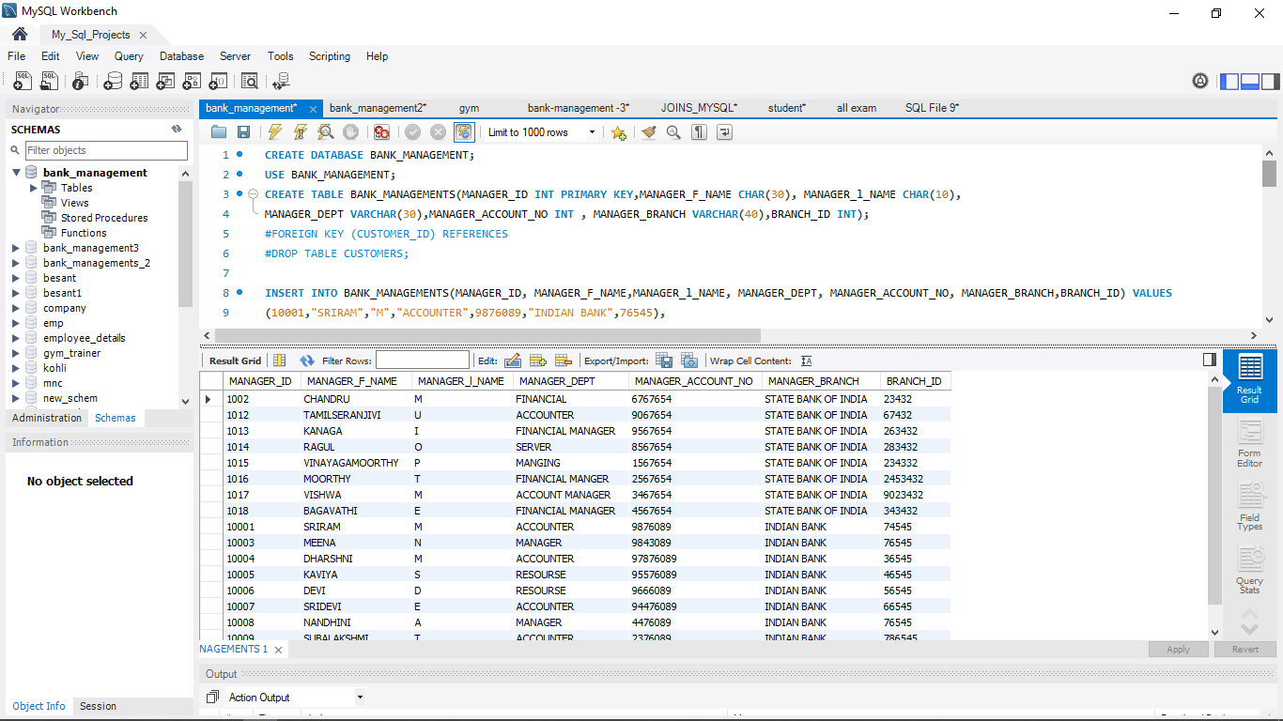
CREATE TABLE BANK MANAGEMNT INSERT THE VALUES
Deploy strategic networks with compelling e-business needs
Planning
Making code
Bank Management
Foster holistically superior methodologies
Launch
Strategy

Slide 14
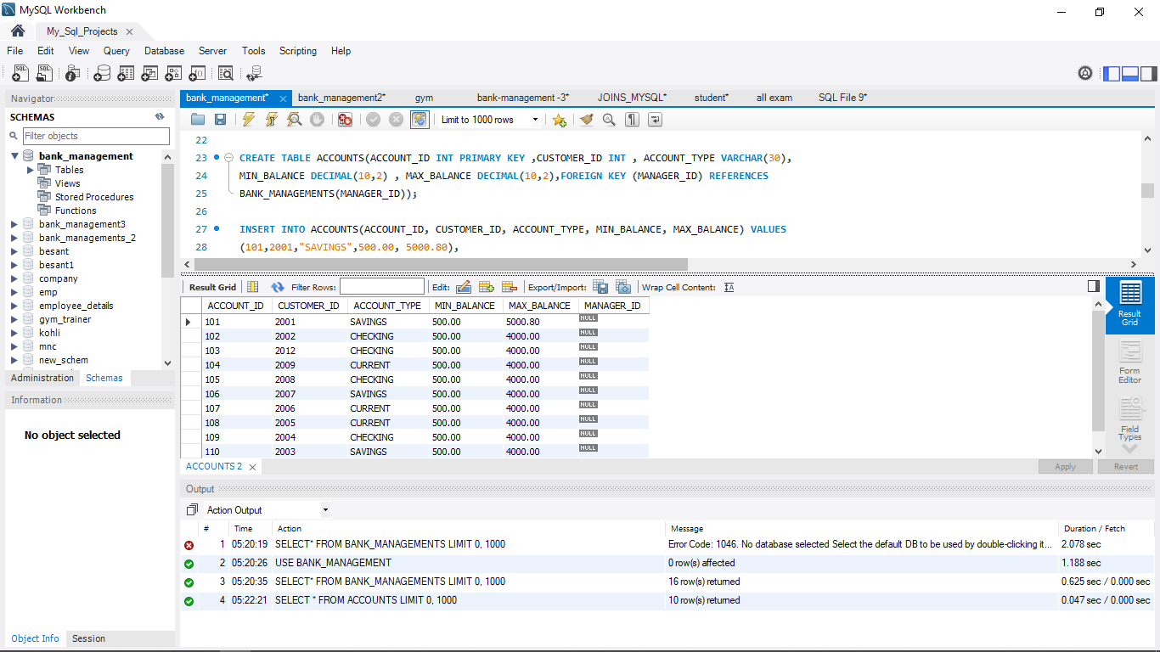
CREATE TABLE ACCOUNTS INSERT THE VALUES
Deploy strategic networks with compelling e-business needs
Planning
Making code
Bank Management
Foster holistically superior methodologies
Launch
Strategy

Slide 15
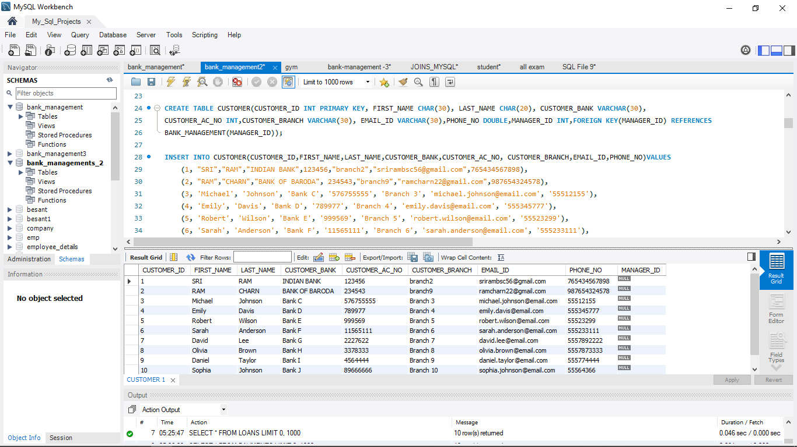
CREATE TABLE CUSTOMERS INSERT THE VALUES
Deploy strategic networks with compelling e-business needs
Planning
Making code
Bank Management
Foster holistically superior methodologies
Launch
Strategy

Slide 16
ER DIAGRAM : THE ER MODEL DOES NOT USE FOREING KEYS TO REPRESENT RELATIONSHIP
BANK_MANAGEMENT_ID
BANK_MANAGEMENT
BANK_MANAGEMENT_ID
EMPLOYEE
BANK_MANAGEMENT_ID
CUSTOMERS
BANK_MANAGEMENT_ID
LOANS
BANK_MANAGEMENT_ID
ATM
(PRIMARY KEY)
(FOREIGN KEY)
(FOREIGN KEY)
(FOREIGN KEY)
(FOREIGN KEY)

Slide 17
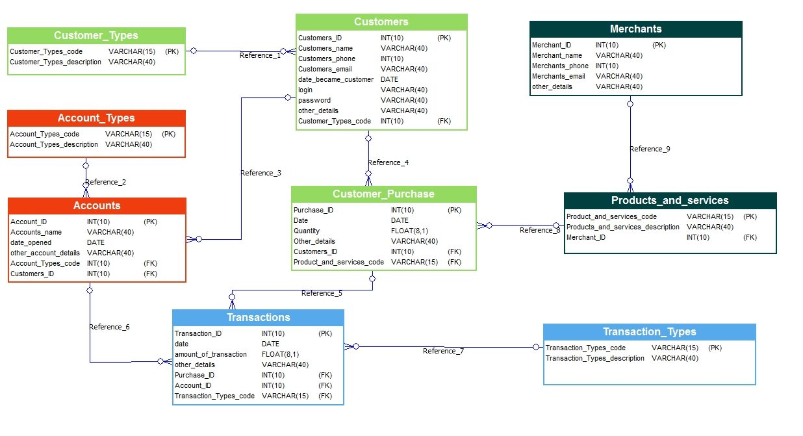
ENTITY RELATIONSHIP DIAGRAM
ER DIAGRAM MODEL DESCRIBES THE STRUCTURE OF A DATABASE WITH THE HELP OF A DIAGRAM

Slide 18
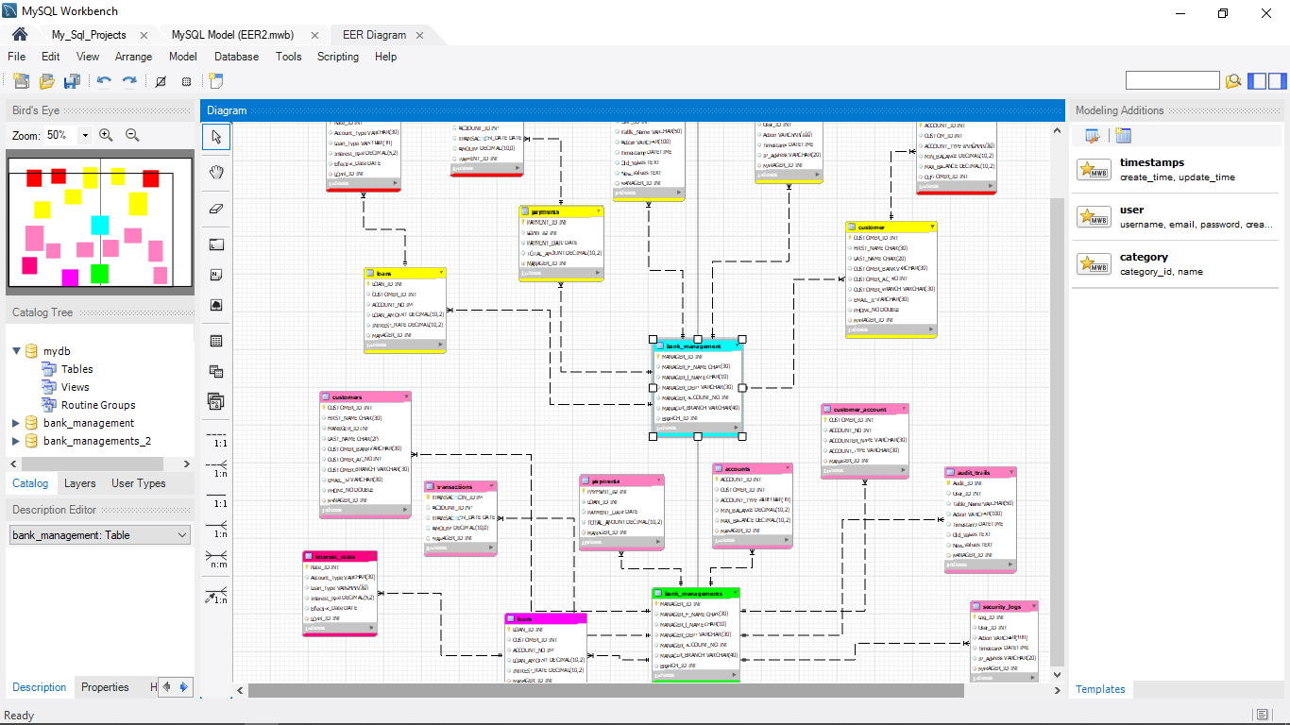
ENTITY RELATIONSHIP DIAGRAM
ER DIAGRAM MODEL IS A DESIGN OR BLUEPRINT OF A DATABASE THAT CAN LATER BE IMPLEMENTED AS A DATABASE

Slide 19
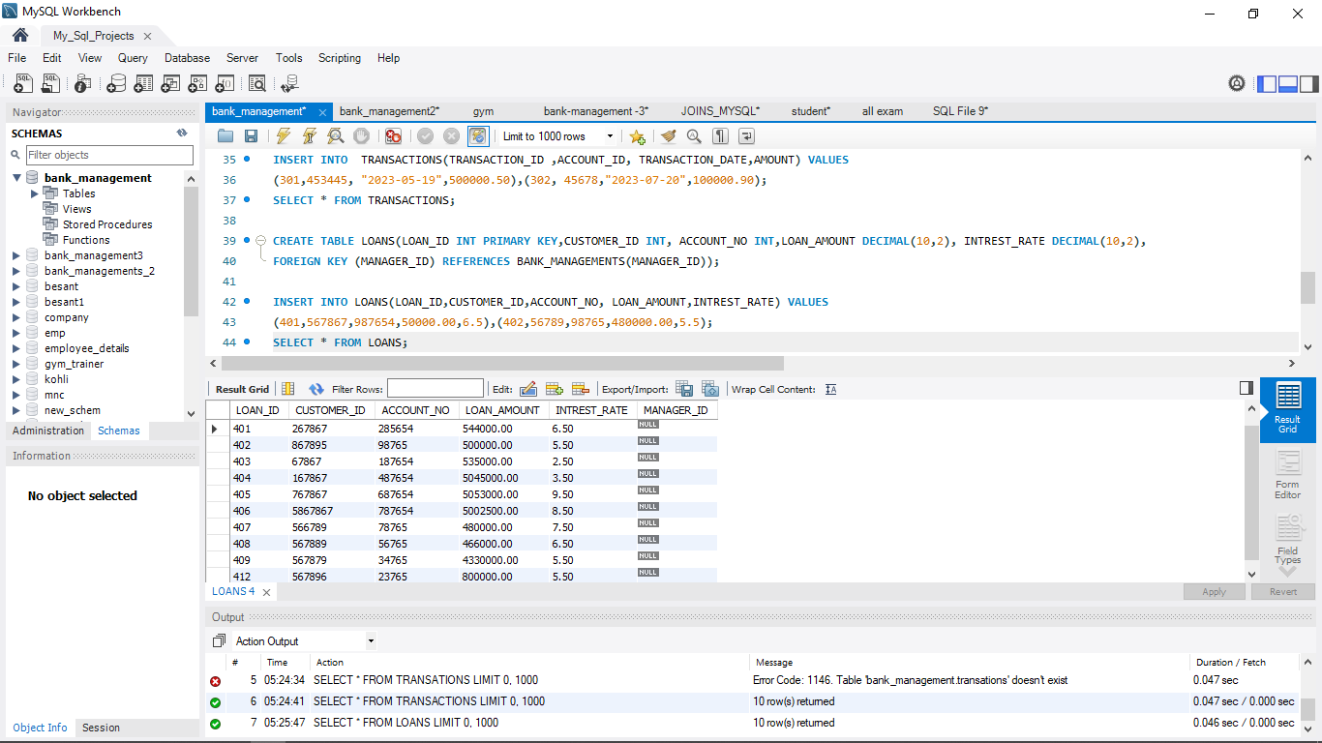
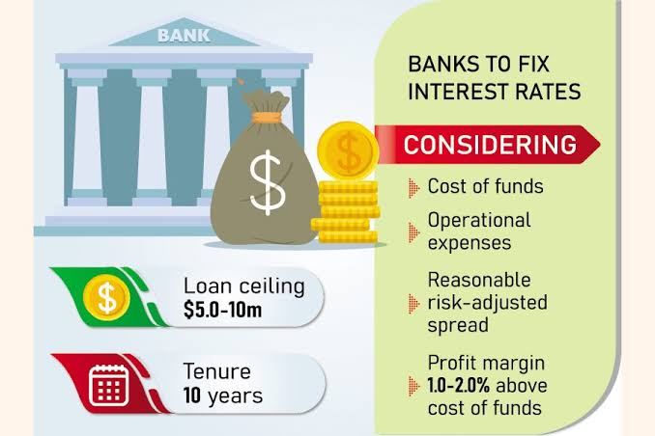
LOAN AMOUNT AND INTEREST
VERY LOW INTEREST RATES

Slide 20
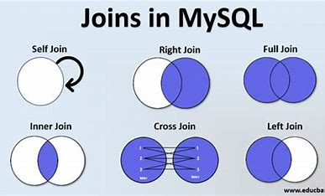
SQL JOINS
Table:
EXAMPLE:
Q: Retrieve the customer with the highest total balance across all accounts.Display their customer ID, name, and the total balance ?
SELECT c.customer_id, c.customer_name, SUM(a.balance) AS
total_balance FROM customers as c INNER JOIN bank_accounts as a ON
c.customer_id = a.customer_id GROUP BY c.customer_id, c.customer_name
ORDER BY total_balance DESC LIMIT 10;
customer_id customer_name total_balance
1 Sri ram 25000
2 Siva Karthick 22000
3 Alice Johnson 18000
4 Bob Brown 15000
5 Emily Wilson 14000
6 James Lee 12000
7 Sarah Davis 11000
8 Michael Clark 9000
9 Laura Adams 8000
10 David White 7000

Slide 21
Thank you
SRIRAM M
srirambsc03@gmail.com

