Slide 1
JShell

Slide 2
JShell: Intro
JShell - Java Shell interactive tool
Since Java SE 9
Read-Evaluate-Print-Loop (REPL)
Eases learning Java for students/developers/architect
Exploring Java APIs
Trail and Error

Slide 3
JShell: Why use
Java program development involves following
Write complex program
Compile and fix any errors
Run the program
Figure out what is wrong with it
Edit the program
Repeat the steps
Helps to perform all above in ENTER

Slide 4
JShell: What can/can’t
Can
evaluates declaration, statements, expression
try out different variant of methods
experiment with unfamiliar APIs
Can’t use as
top level / package statements
static block
IDE

Slide 5
JShell: Get started

Slide 6
JShell: Trying out
declaration
statement
expression

Slide 7
JShell: Trying out…
Create class
Declare method
Create object

Slide 8
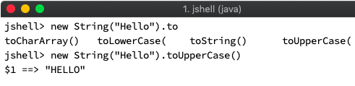
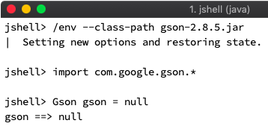
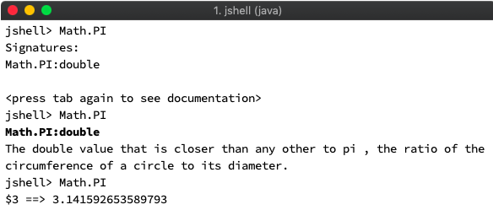
JShell: Helper features
Auto completion
External library
Java API documentation

Slide 9
JShell: Helper commands
/set
/reset
/reload
/env
/exit
/help
/?
/history
/!
/id
Session commands
Helper commands
/edit
/open
/save
/list
/types
/methods
/imports
/vars
Editor commands
Snippet commands

Slide 10
Demo

Slide 11
Q&A

Slide 12
Reference:
https://docs.oracle.com/javase/10/jshell/toc.htm
https://docs.oracle.com/javase/9/jshell/JSHEL.pdf
https://docs.oracle.com/javase/9/tools/jshell.htm

