Slide 1
Understanding Global Climate Change: Exploring Socio-Economic Factors and Environmental Effects
Team Members: Srihith Reddy Gaddam, Sriram Chowdary Vundavalli, Sri Durga Viswa Challagali

Slide 2
Introduction
Domain: Climate Science & Socio-Economic Analysis
Objective: Analyze global temperature trends and correlate them with geographic/socio-economic factors.
Global Challenge: Rising temperatures linked to human activity (CO₂ emissions, GDP growth).
Focus of Project 1:
Visualize temperature trends (land/ocean).
Identify hottest/coldest regions (Top 10 lists).
Lay groundwork for socio-economic integration in Project 2.

Slide 3
Problem Statement
Context:
Global temperatures have risen by ~1.1°C since the pre-industrial era, with profound impacts on ecosystems, economies, and human health. While climate change is a well-documented phenomenon, regional disparities in temperature trends and their links to socio-economic factors remain under-explored in public discourse.
Problem Gap:
Existing temperature datasets are often:
Static or non-interactive, limiting public engagement.
Disconnected from socio-economic drivers (e.g., CO₂ emissions, GDP).
Focused on aggregates, masking critical regional extremes (e.g., Arctic amplification, urban heat islands).
Our Focus:
Project 1 addresses these gaps by:
Mapping spatial/temporal trends (2000–2015) to identify "hotspots" and "coldspots."
Highlighting anomalies (e.g., why Mali is 5°C hotter than global averages).
Laying groundwork for Project 2’s integration of human activity data (CO₂, GDP).
Why It Matters:
Policymakers need granular visuals to prioritize mitigation.
Public needs accessible storytelling to understand climate urgency.

Slide 4
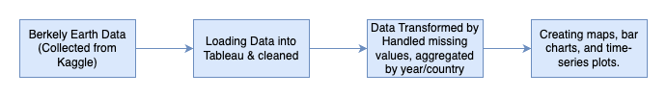
Methodology
Flow Diagram
Data Collection: Berkeley Earth (Kaggle) → Cleaned in Tableau.
Data Transformation: Handled missing values, aggregated by year/country.
Visualization: Created maps, bar charts, and time-series plots.
Analysis: Extracted top 10 hottest/coldest regions and trends.
Tools: Tableau (Primary).

Slide 5
Data Abstraction
Primary Dataset: Global Land Surface Temperatures (Berkeley Earth).
Attributes: Country, Year, Avg. Temperature, Uncertainty.
Time Frame: 2000–2015 (aligned with socio-economic data for Project 2).
Size: ~577K records; filtered for manageability.
Dataset URL: Link

Slide 6
TASK ABSTRACTION
Target:
Identify spatial/temporal temperature patterns.
Highlight extremes (e.g., coldest states: Taymyr, Sakha).
Actions:
Aggregated data by country/year.
Calculated averages for land/ocean temperatures.
Sorted and filtered for Top 10 rankings.

Slide 7
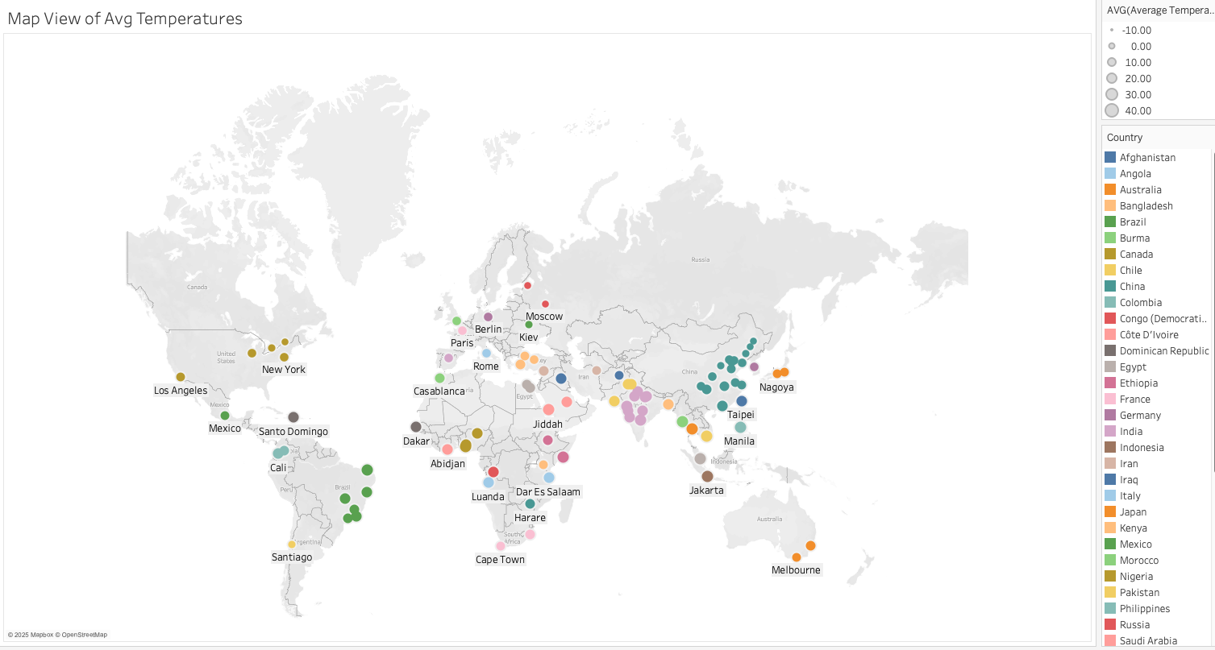
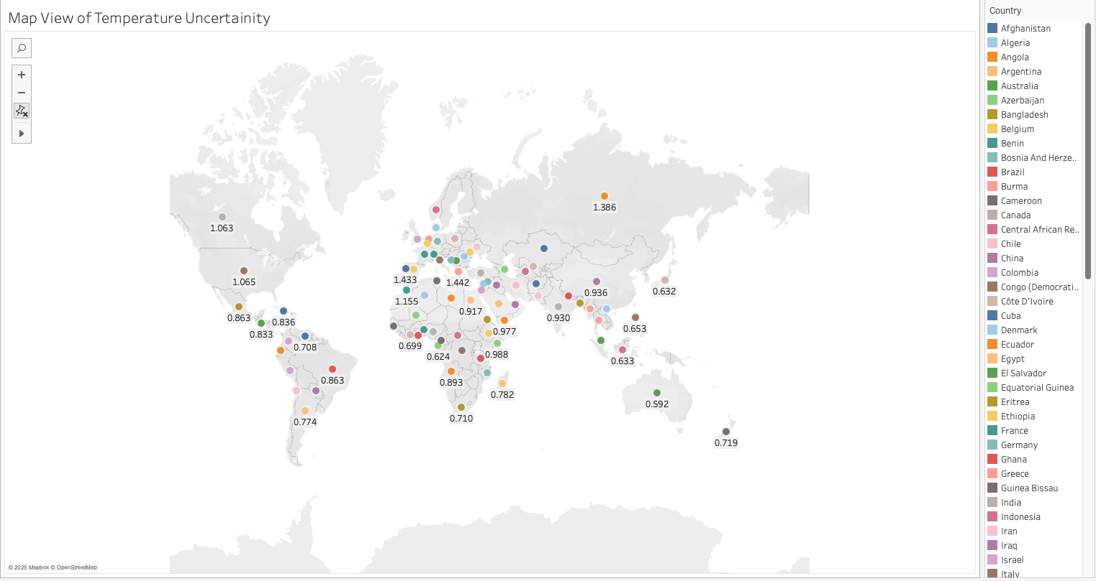
Visualisation & Results
Team Member 1 - Srihith:
Figure 1: Map View of Avg. Temperatures (Los Angeles → Cape Town).
Insight: Equatorial regions (e.g., Jakarta) are hotter; polar/colder regions (e.g., Berlin) are cooler.
Figure 2: Map View of Temperature Uncertainty Across Countries
Insight: Higher temperature uncertainties are observed in northern and central Europe, and parts of Asia, indicating variability in climate models or data collection. Lower uncertainties appear in southern hemisphere regions like Australia and Madagascar, suggesting more stable temperature trends or consistent measurements.

Slide 8
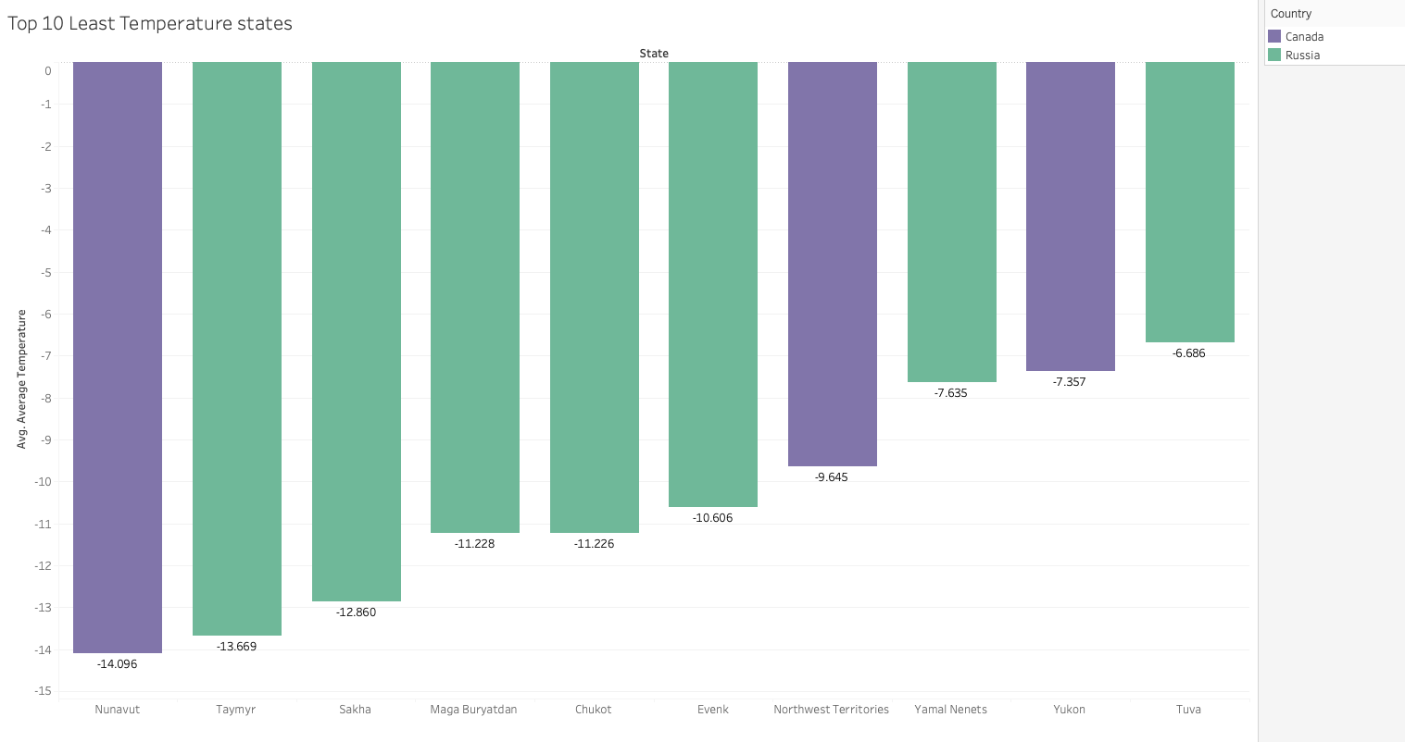
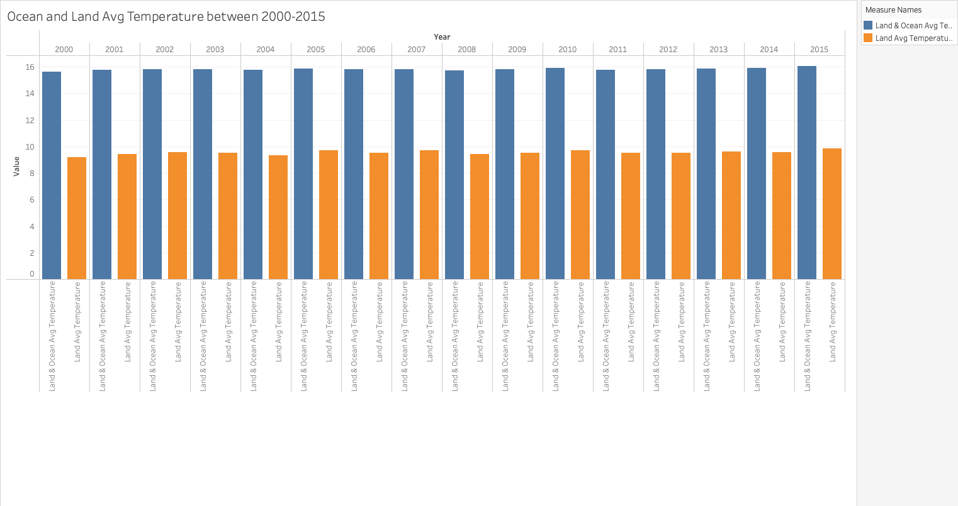
Results and Key Findings
Team Member 2 - Sriram:
Figure 3: Top 10 Least Temperature States (e.g., Taymyr at -13.669°C).
Insight: Russia/Canada dominate coldest regions.
Figure 4: Ocean vs. Land Temp (2000–2015).
Insight: Land temps rise faster than ocean temps.

Slide 9
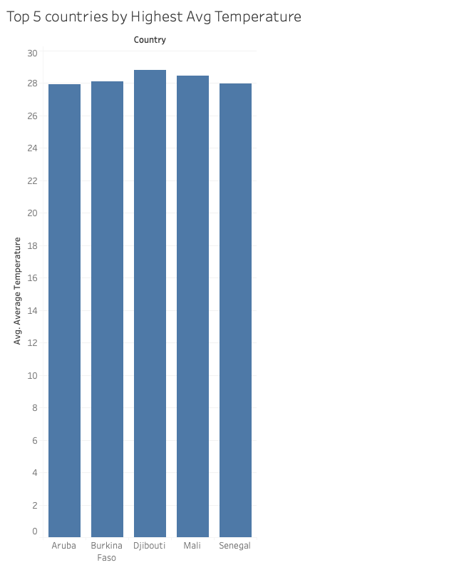
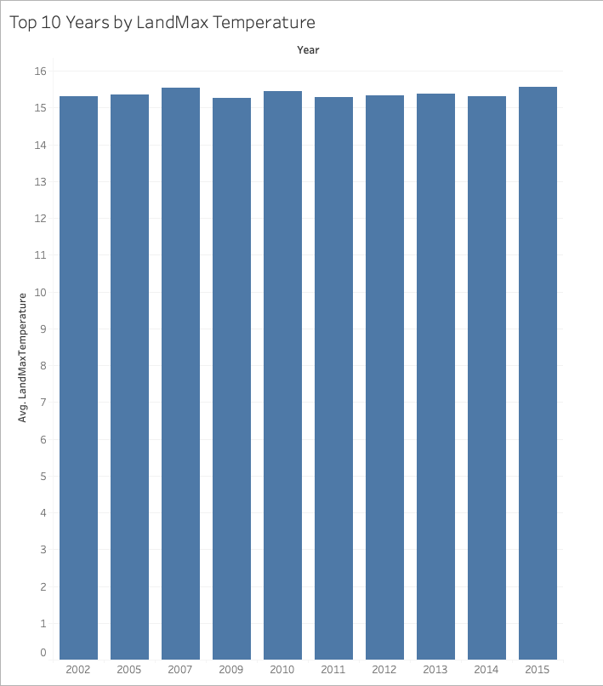
Results and Key Findings
Team Member 3 (Durga):
Figure 5: Top 5 Hottest Countries (Aruba, Burkina Faso, Mali).
Insight: African nations and small islands have highest avg. temps.
Figure 6 : Top Years by LandMax Temp (2002, 2005, 2015).
Insight: Recent years show increasing peaks.

Slide 10
Analysis & Work Management
Key Findings:
Polar Amplification: Arctic states (Russia/Canada) are warming rapidly.
Urban Heat Islands: Cities like Mexico City show higher temps.
Ocean Buffering: Ocean temps rise slower than land (heat capacity).
Limitations: Missing socio-economic data (addressed in Project 2).
Contributions:
Srihith: 33% (Data cleaning, map visualization).
Sriram: 33% (Correlation tests, time-series analysis).
Durga: 33% (Top 10 rankings, PPT design).
Challenges:
Data gaps in older years (pre-2000).
Tableau formatting for large datasets.

Slide 11
Next Steps
Interactive Dashboard:
Use Python (Plotly/Dash) to integrate CO₂ emissions/GDP data.
Add filters (country/year) and tooltips.
Advanced Stats:
Regression models (temperature vs. emissions).
Web Integration:
Embed Tableau/Python dashboards into HTML/CSS.

Slide 12
THANK YOU !!!!!

