Slide 1
cricwaves
ARCHANA GUJAR-S1
ADITISINGH-S1
GANGAM RUSHIK REDDY-S2

Slide 2
OBJECTIVES:
Schedule: This will tell us about the present matches, present and future series , matches by day.

Slide 3
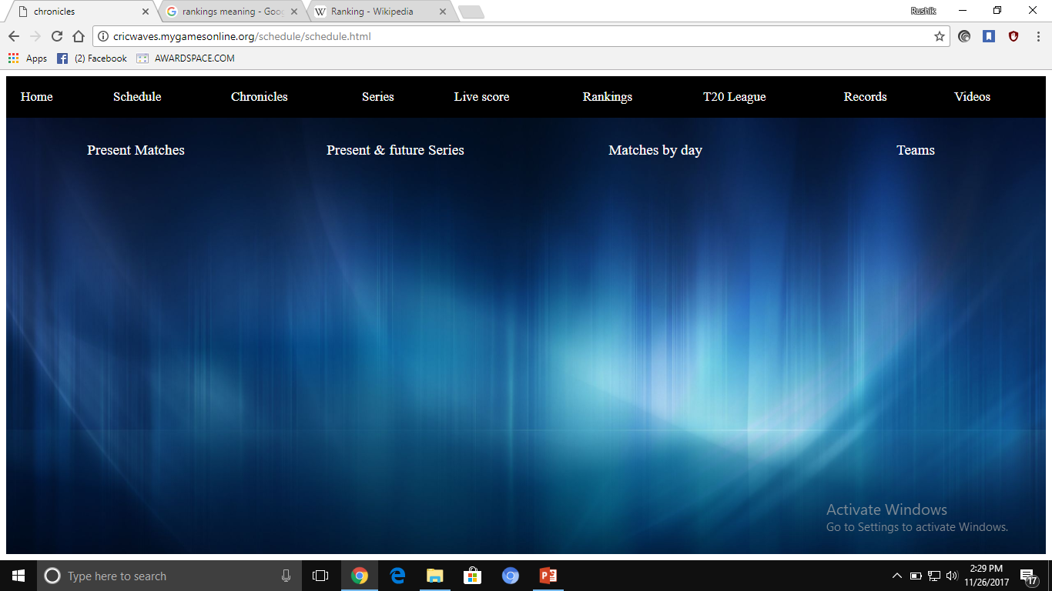

Slide 4
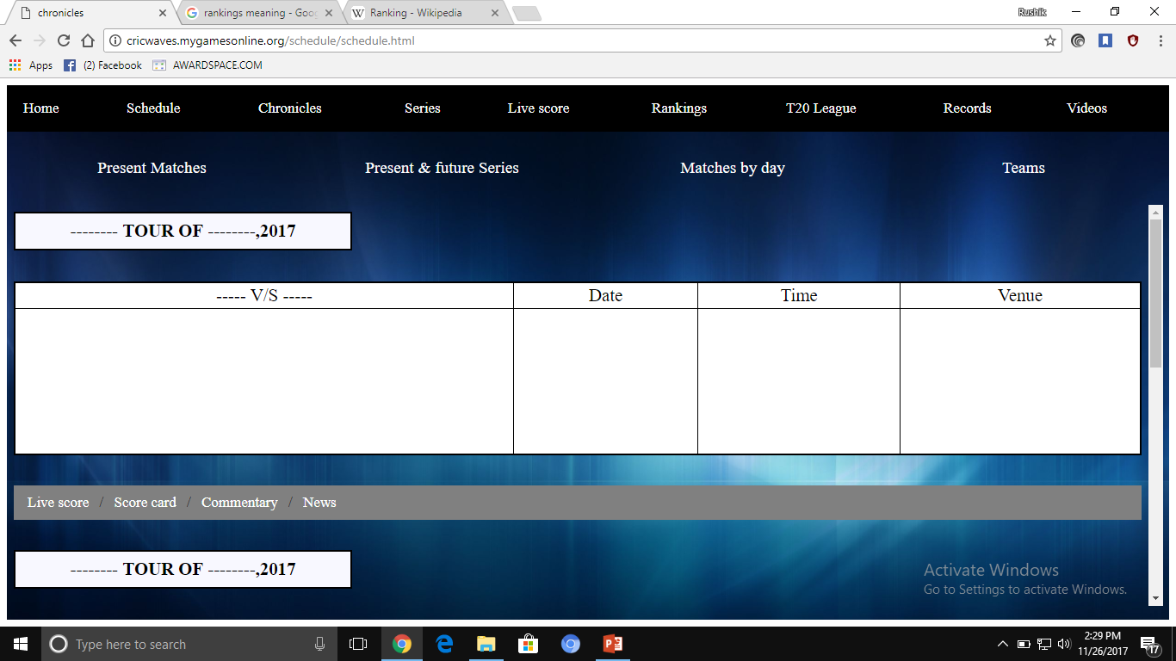
Present mAtches :

Slide 5
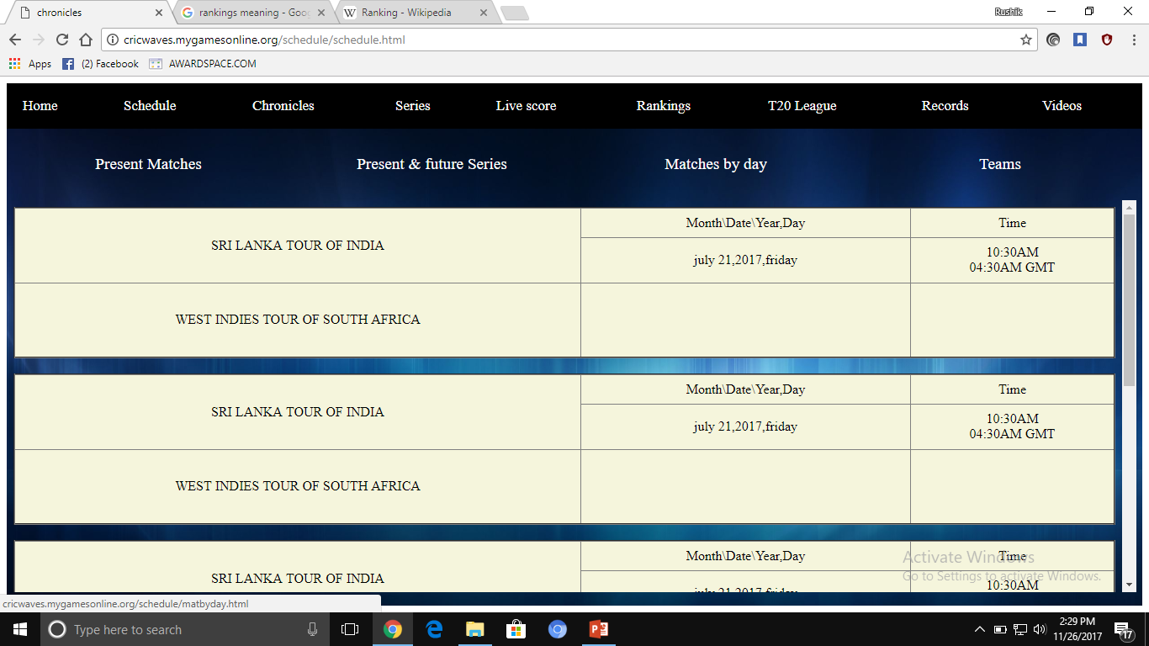
Matches by day:

Slide 6
Live score: It will also provide us with real time information about game results from various disciplines.
Rankings: It is a table where international cricket players performances are ranked using a points based system which is worked out by doing a series of calculations leading to a sophisticated moving average.

Slide 7
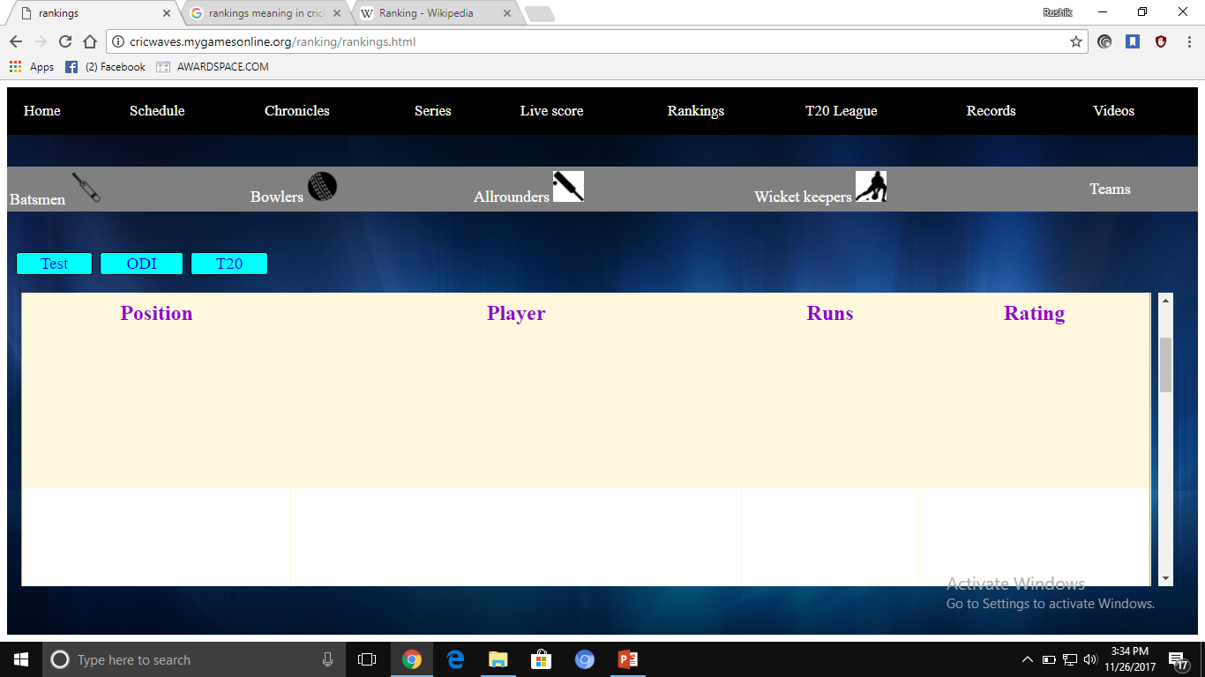

Slide 8
League:
A group of teams playing a sport who take part in competitions between each other .So, in this website we created 5 different T20 leagues i.e. t20 men’s & women’s world cup, Indian premier league, clt20 , big bash league.

Slide 9
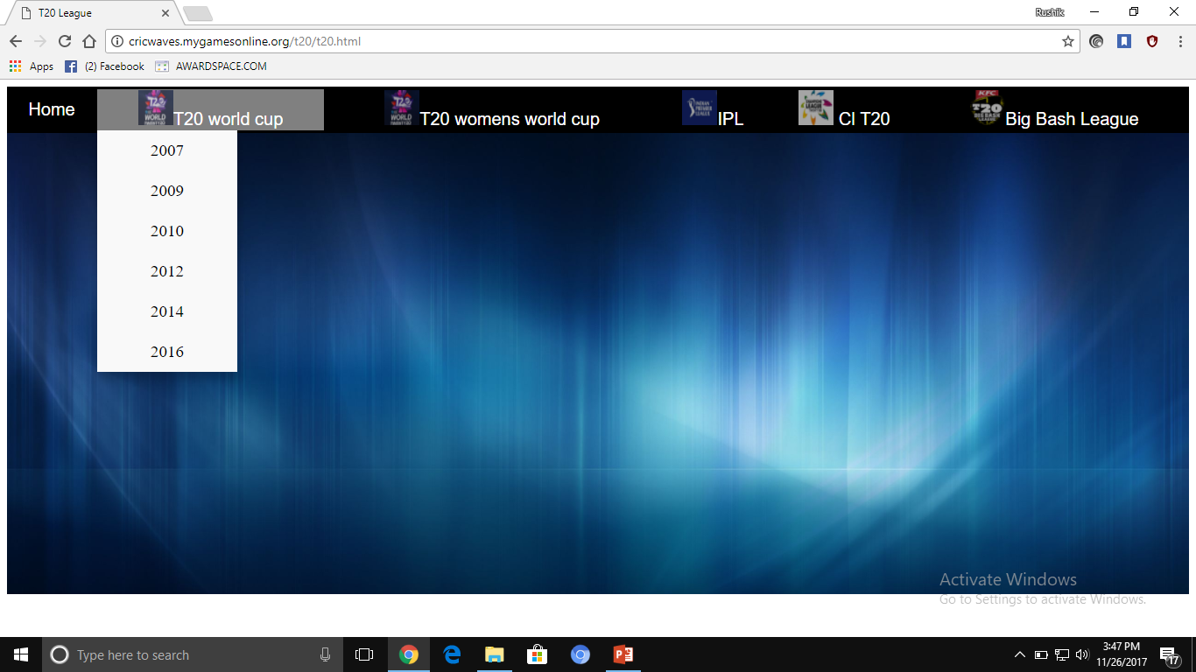

Slide 10
Records: The sum of the past achievements or performance of a person. Basically there are four records in that drop down button.
batting, bowling ,wicket keeping , all fastest records.

Slide 11
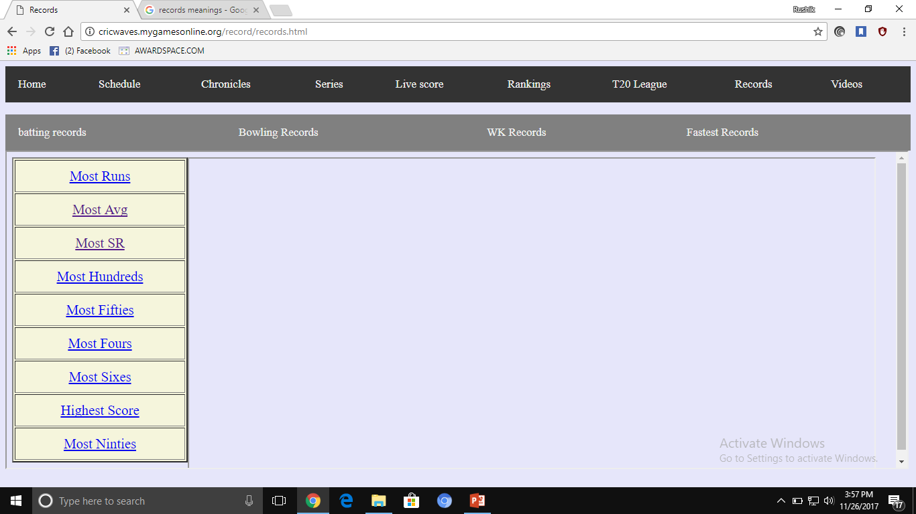

Slide 12
Squad: In this website basically we made a squad button .In that there is a search icon used for team squad by searching team name.

Slide 13
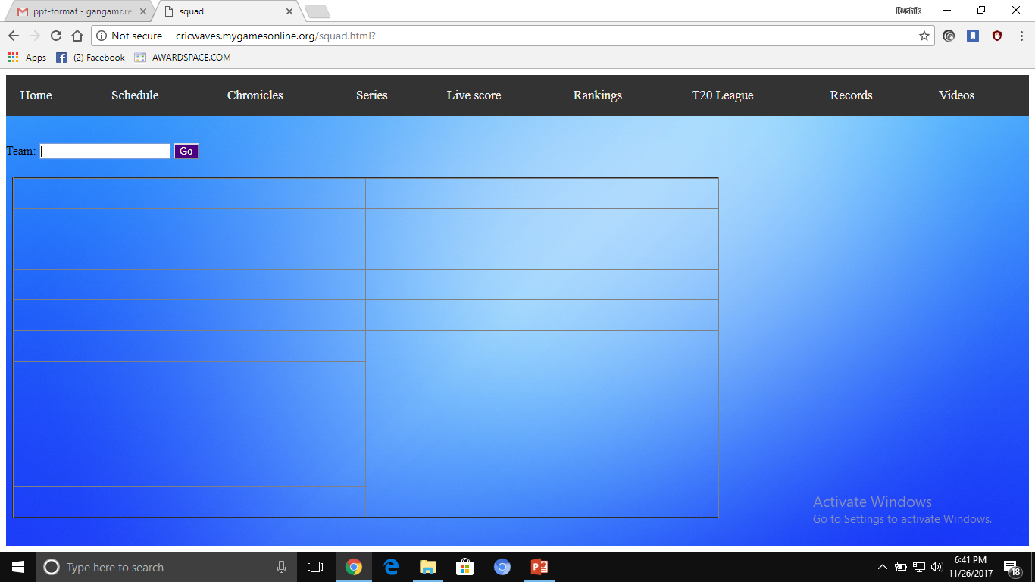

Slide 14
Technologies being used:
Program and Code:
We are used HTML & CSS to make a webpage.
Use “WINSCP” site to create a website from the webpage.
There is one more site “COFFEE CUP” to create a website.

Slide 15
Work done:
RUSHIK REDDY: Code part and created a website from webpage.
ARCHANA GUJAR: Made style sheets and colors part for website.
ADITI SINGH: Entire design of the website.

Slide 16
EXPERIMENTS & RESULTS:
Made a website and trying for live score and data entry.
Results :Website created but for live score and data entry work in progress.

Slide 17
Work left:
Making of animation video to put in commentary box, which will show about any boundaries and wickets on running commentary.
Data entry and live score work are in progress.

Slide 18
THANK YOU

