Slide 1
Modeling the geographic distribution of Trichuris trichiura (Whipworm) in Western Kenya
Sri Ramesh
UC Berkeley, SPR 2020
Notes:
For my final project, I will model the geographic distribution of the soil-transmitted helminth known as whipworm in Western Kenya

Slide 2

Preliminary analysis
Notes:
Preliminary analysis indicates that the dependent variable can follow a normal distribution when a logit transform is applied, as shown in this model. However, I want to point out that I needed to add plus 4 to the equation in order for all of the prevalence values to be above zero. This is something I have a question about and would like feedback on

Slide 3
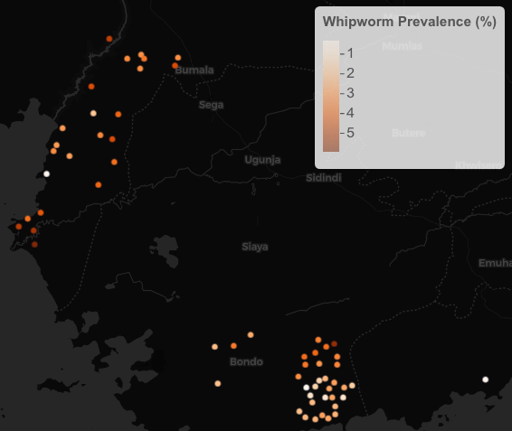
Preliminary analysis web map, shows potential clustering
Notes:
Preliminary analysis also indicates potential clusters in the Bondo and Bumala regions of Western Kenya, as shown on this leaflet map. It seems that higher prevalence points are clustered in Bumala while lower prevalence points are clustered in Bondo.

Slide 4
Analysis to do confirm existence of clusters
Will examine global clustering using Monte Carlo Simulation (nsim = 999) for Moran’s I test
Will define weights using k-nearest neighbors
Will examine local clustering using LISAs and local Moran’s I test
Notes:
I plan to examine these clusters empirically using the tests for global and local spatial autocorrelation in point prevalence data. This includes the global Moran’s I test and the local Moran’s with LISAs. For these tests, I plan to define spatial weights using a k-nearest neighbors method. I also plan to use a Monte Carlo simulation with 999 simulations to discern what the global Moran’s I statistic is.

Slide 5
External Data Short literature review
Chaiyos, J. et. al’s 2018 study in Thailand finds that mean annual precipitation most affected spatial distribution of T. trichiura
Chammartin, F. et. al’s 2013 study in Bolivia finds that altitude has a negative effect on T. trichiura
Handzel, Thomas, et al.’s 2003 study in Kenya finds proximity to Lake Victoria was associated with a variety of geohelminth infections
Notes:
A short literature review reveals that mean annual precipitation, proximity to water bodies, and altitude are potential predictors of whipworm prevalence in western Kenya.

Slide 6
External Data raster and vector types
Altitude
(NASA STRM 90)
Annual mean Temperature
(World Climate Data, Bio1)
Distance to water bodies – lakes, rivers, and canals (Digital chart of the world)
Distance to transport infrastructure – roads and railroads
(Digital chart of the world)
Notes:
Based on this literature review, I will pull altitude data from NASA’s STRM 90 mission, World Climate data, and distance to water bodies and transport infrastructure using the Digital Chart of the World.

Slide 7
Statistical tests to use Will specify GLMs and MATERN MODELS until statistically significant covariates are identified
Dependent variable to examine in each GLM (binomial family):
Prevalence of T. trichiura (Tri_Prev)
Covariates to regress in each GLM:
Annual mean temperature (Bio1)
Altitude
Distance to water bodies
Distance to nearest canal and/or river
Distance to nearest road
Distance to nearest railroad
Notes:
In my spatial and non-spatial regressions, these data will be included as 6 independent variables. The dependent variable will be whipworm prevalence in every case.

Slide 8
Statistical tests to use
Regression Analysis with Generalized Linear Model (binomial output)
Regression Analysis with Matern Model (binomial output)
Correlogram and Global Moran’s I Test before and after inclusion of spatially-correlated fixed effects
Notes:
The statistical tests I will use will be spatial and non-spatial regressions, and the global Moran’s I test. These will reveal to what extent space explains the observed prevalence pattern as opposed to the covariates.

Slide 9

Validation Methods
Will use v-fold cross validation to validate spatial models
Will determine which spatial model specification minimizes mean squared error (MSE)
This will allow me to determine covariates best explain the observed spatial pattern
Ultimately, I hope to draw conclusions about the correlates of whipworm prevalence in Western Kenya and its environmental health implications
Notes:
Finally, I will use a v-fold cross validation method to validate my spatial models. I will determine which model best minimized mean squared error. Ultimately, I hope to draw conclusions about the correlates of whipworm prevalence in Western Kenya and its environmental health implications. Thank you.

