Slide 1


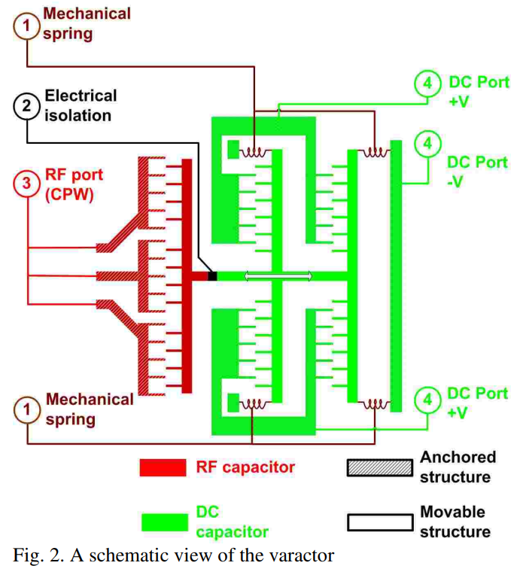


EECE-7244
Micro and Nano Fab Project
By SRIRAM G BHAGWAT
April 17, 2024
High tuning range MEMS capacitor for microwave applications
Publisher: IEEE
All Authors :E. David; T. Plotnikov; L. Gal; O. Lavie; Y. Nemirovsky

Slide 2
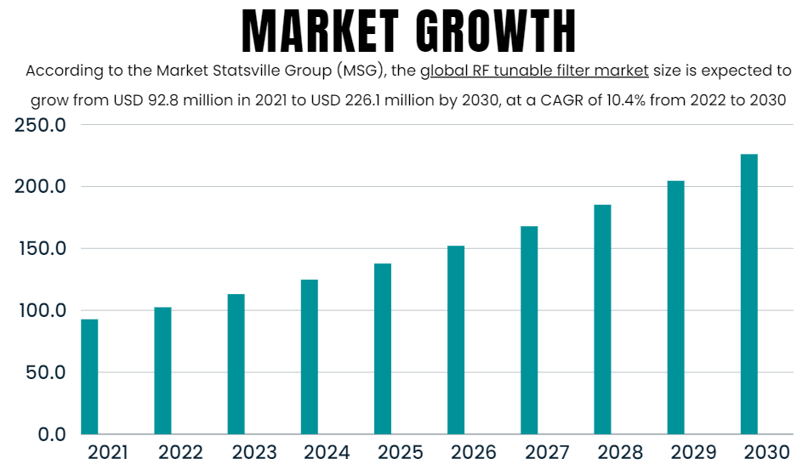
Background and Motivation
High tuning range MEMS capacitor for microwave applications
Publisher: IEEE
All Authors :E. David; T. Plotnikov; L. Gal; O. Lavie; Y. Nemirovsky
High tuning range MEMS (Micro-Electro-Mechanical Systems) capacitors play a crucial role in microwave applications due to their ability to adjust capacitance values precisely and rapidly.
High operation frequencies, low losses (high quality factor Q), high tunability and low power consumption
Adaptive Tuning and Optimization: MEMS capacitors dynamically optimize circuit performance in real-time by adjusting impedance and resonance frequency.
The market for MEMS capacitors, particularly those with high tuning ranges for microwave applications, was experiencing steady growth
Frequency Agility in Communication Systems: In modern communication systems, such as wireless networks and radar systems, there is a need for frequency agility. This involves the ability to rapidly switch frequencies or adjust operating frequencies to avoid interference, optimize performance, or adapt to changing environmental conditions.
Performance and Reliability: MEMS capacitors offer several performance advantages over traditional capacitor technologies, including low insertion loss, high linearity, fast tuning speeds, and excellent reliability.

Slide 3
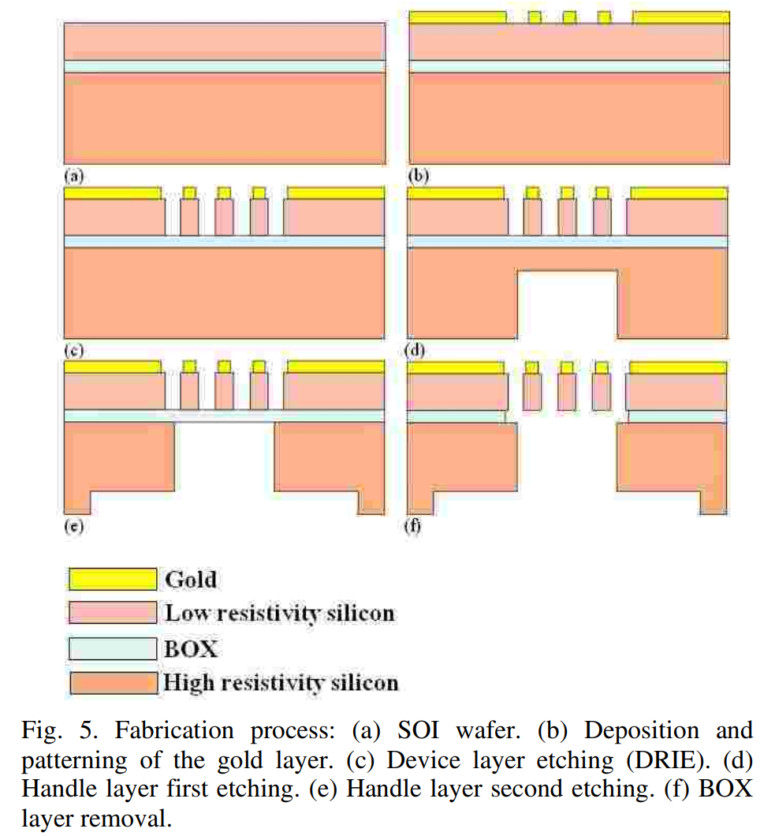
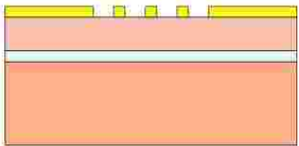
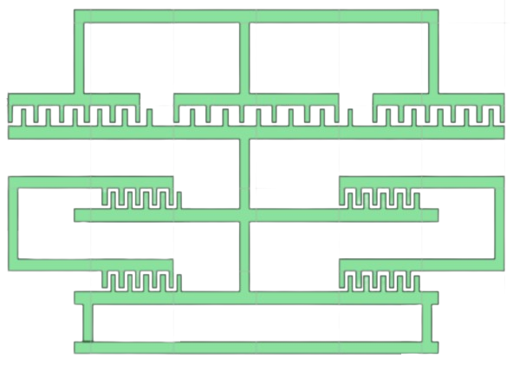
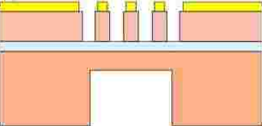
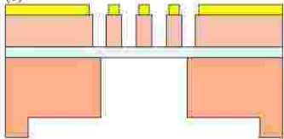
Device Overview and Fabrication Process for High tuning range MEMS capacitor
For (b) Need mask here (when using negative PR)
(b) Deposition and patterning of the gold layer.
Mask for (1)
(d) Handle layer first etching.
Mask for (2)
MEMS comb structured variable capacitor at 20GHz that features a wide capacitance tuning range of 200% yet avoids unwanted coupling through the springs. This new varactor consists of three comb structures - two of which are anchored to the substrate, while the third, which capacitively couples the two anchored ones, is movable, suspended on mechanical springs. This new design decouples the mechanical mechanism from the RF capacitor and allows an independent optimal design of the two.
(e) Handle layer second etching.
Mask for (3)

Slide 4
Fab steps in details with mask
1. Start with a Silicon wafer.
Si
2. RCA clean, LPCVD, deposit a 3 microns of oxide layer as sacrificial layer
SiO₂
Si
3. Photolithography, spin coat 4 microns of positive photoresist and expose with mask 1. (To create space to anchors)
SiO₂
Si

Slide 5
4. Photolithography, spin coat 4 microns of positive photoresist and expose with mask 1. (To create space to anchors)
Si
5. BOE etch through oxide layer.
6. Use piranha to remove photoresist and perform RCA clean.
Si
7. Deposit 2 microns of polysilicon on top of oxide layer. (Anchor thickness will be 4microns)
Si
8. Photolithography, spin coat 4 microns of positive photoresist and expose with mask 2.
Si

Slide 6
Mask 2 (UV light shines through blue area):
Note: The picture shows a general pattern of the mask(finger = 4)
09. Dry-etch polysilicon using reactive-ion etching.
10. Use piranha to remove photoresist and perform RCA clean.
Si
11. Used buffered HF to remove sacrificial layer
Si
12. RCA clean.
13. Rinse and dry to critical point.
Si

Slide 7
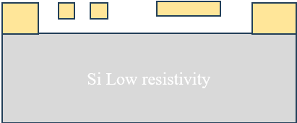
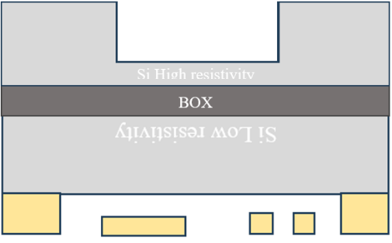
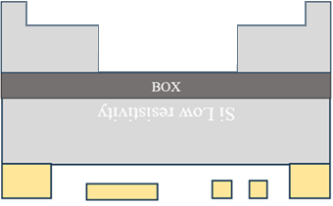
14. Now Flip the wafer and etch the below part
15. Now do Photolithography, spin coat 4 microns of negative photoresist and expose with the mask 3
16. Etch the high resistivity layer
17. Now again etch the layer using the mask below
End of fabrication process.

Slide 8
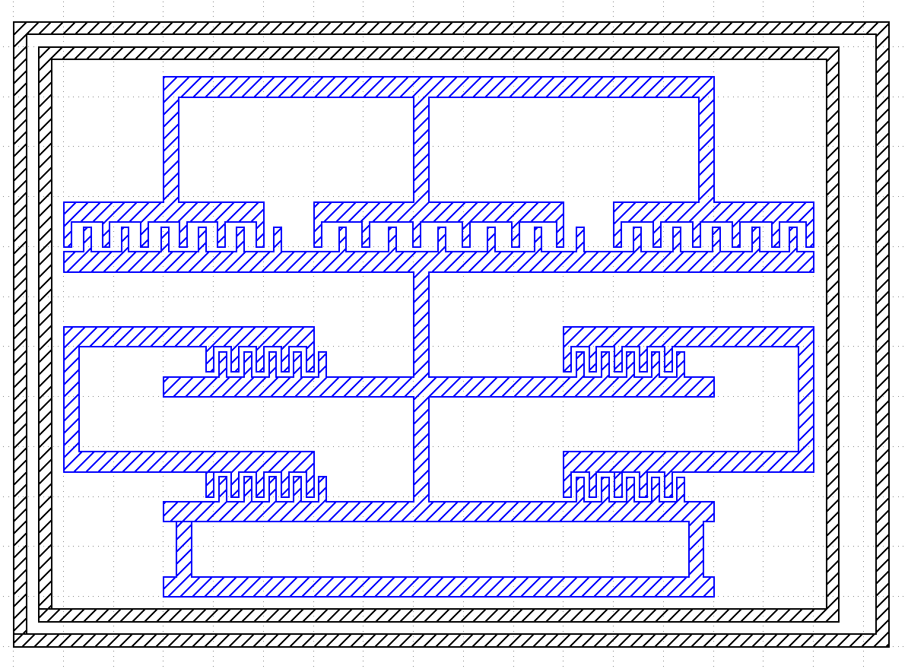
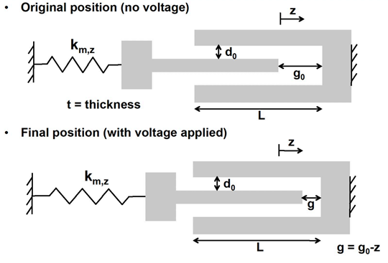
Device Variations for High tuning range MEMS capacitor
g = 0.5μm - 1.5μm
d₀= 0.1μm - 0.5μm
W= 20μm- 30μm
L=200μm - 250μm
Z = 22μm - 32μm
T = 1μm -3μm
Fs = 20GHz – 28GHz
Q=30
V= 28V in the DC port

Slide 9
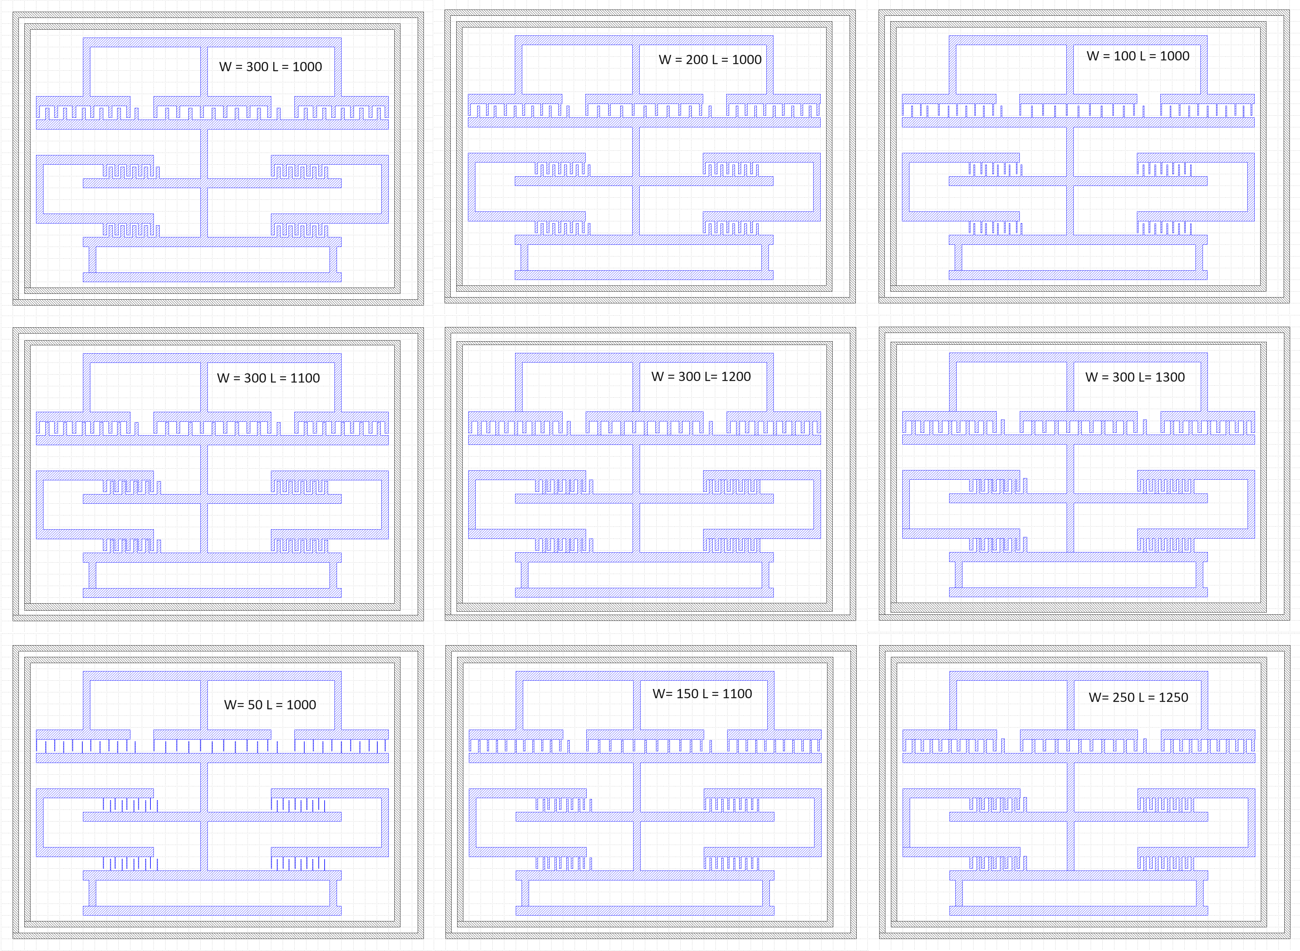
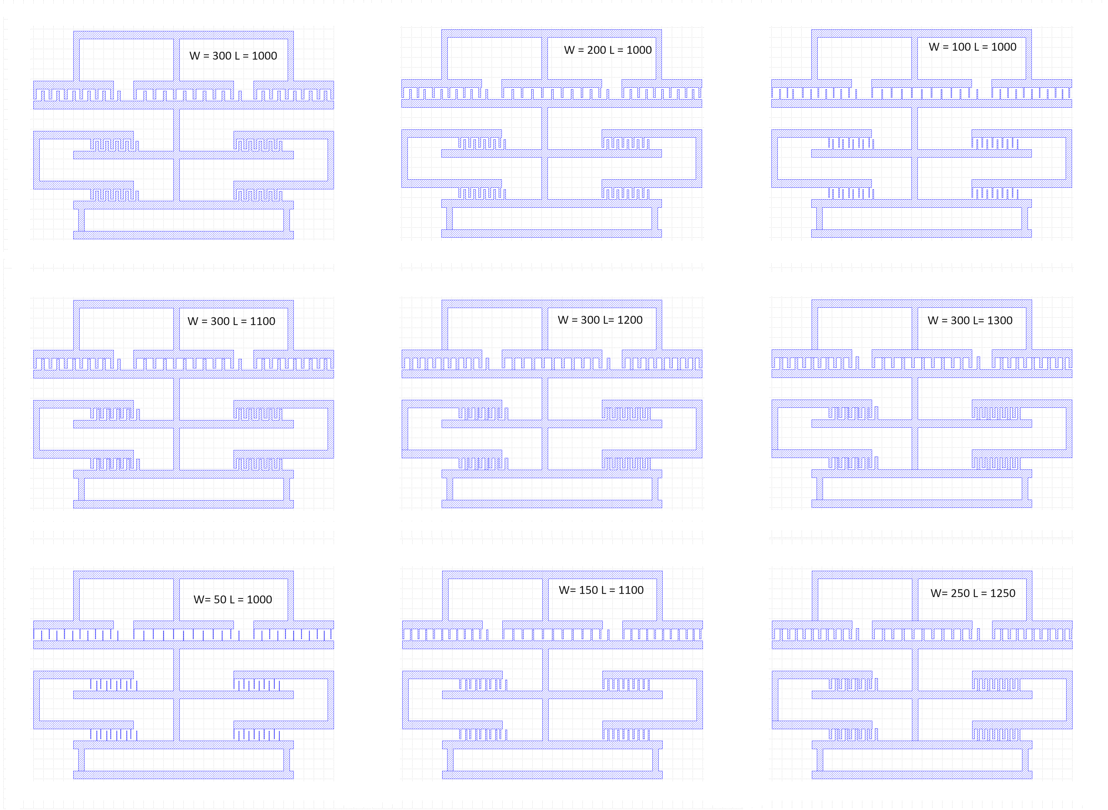
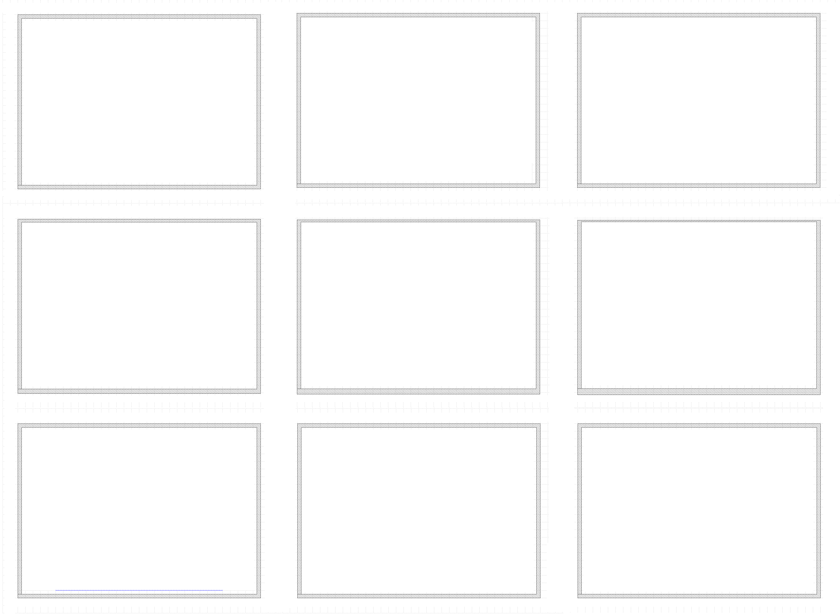

Layout Top View for High tuning range MEMS capacitor
Mask 1 : Top Comb structure
Mask 2 : Etch
Mask 3 : Etch
Note: all values in microns

Slide 10
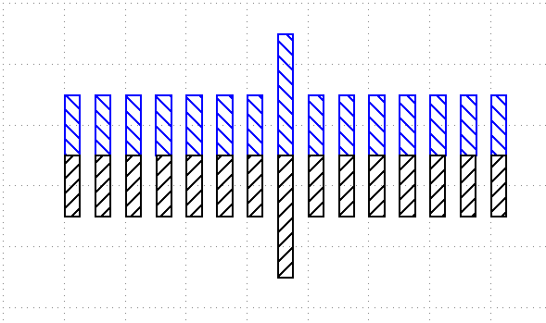
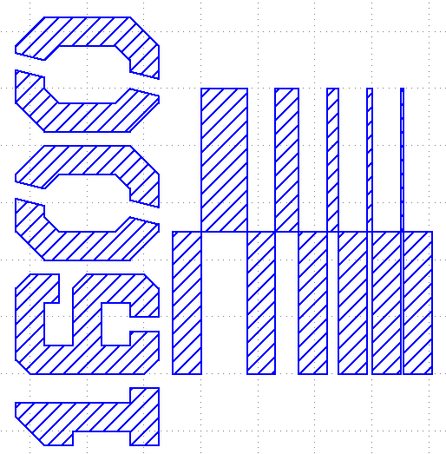
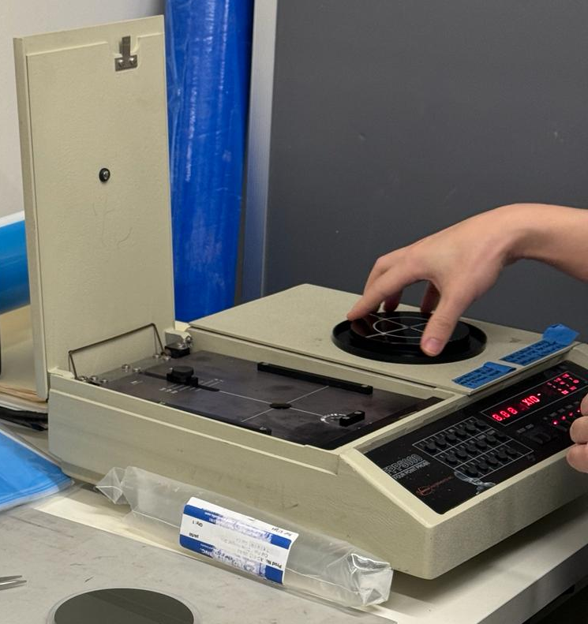
Test Structures for High tuning range MEMS capacitor
1) Step-resolution
The pg.litho_steps() function creates lithographic test structure that is useful for measuring resolution of photoresist or electron-beam resists. It provides both positive-tone and negative-tone resolution tests.
import phidl.geometry as pg
from phidl import quickplot as qp
D = pg.litho_steps(
line_widths = [1,2,4,8,16],
line_spacing = 10,
height = 100,
layer = 0
)
qp(D) # quickplot the geometry
2) Calipers (inter-layer alignment)
The pg.litho_calipers() function is used to detect offsets in multilayer fabrication. It creates a two sets of notches on different layers. When an fabrication error/offset occurs, it is easy to detect how much the offset is because both center-notches are no longer aligned.
import phidl.geometry as pg
from phidl import quickplot as qp
D = pg.litho_calipers(
notch_size = [1,5],
notch_spacing = 2,
num_notches = 7,
offset_per_notch = 0.1,
row_spacing = 0,
layer1 = 1,
layer2 = 2)
qp(D) # quickplot the geometry
Note: Here we test the Low resistivity silicon and high resistivity Silicon using the below device which we done similar in Lab 6.

Slide 11
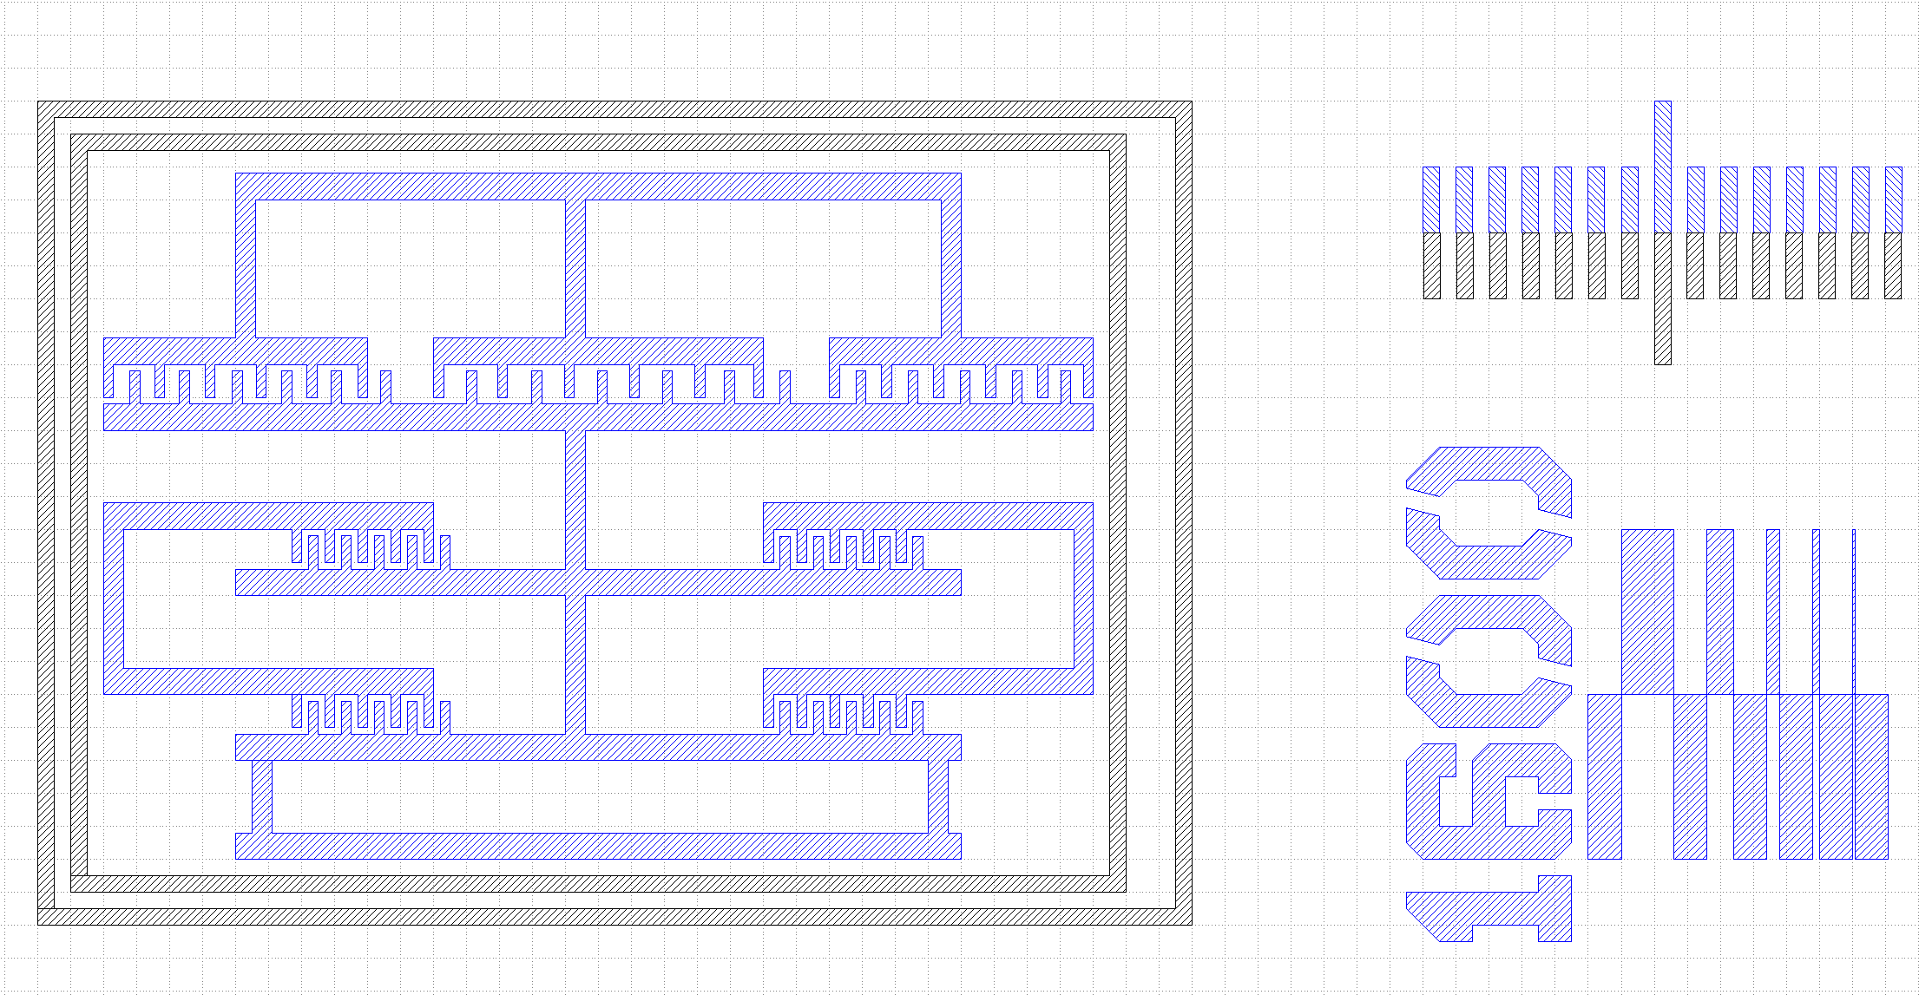

Test Structures for High tuning range MEMS capacitor

Slide 12


Thank YoU…………………………………………… ☺
Any Questions ?

