Slide 1

Enhancing Candidate Selection Efficiency through AMCAT Test Data Analysis

Slide 2
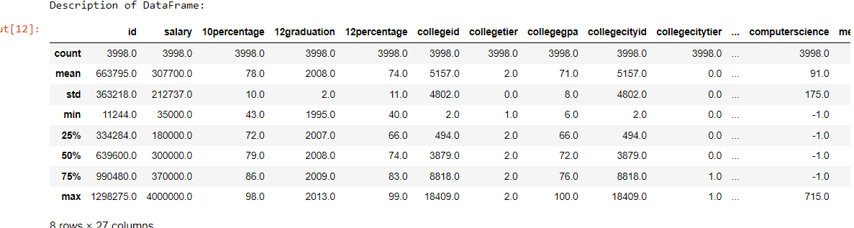
Problem Statement:
Analyse AMCAT test data to identify candidate performance trends, pinpoint strengths and weaknesses, and explore correlations with job success. Optimize the use of AMCAT scores in the hiring process for more effective candidate selection.
Objective of the Project
To Explore and mine the inference from the dataset using salary as the target variable.
Statistical Analysis(Non-Viz) :

Slide 3
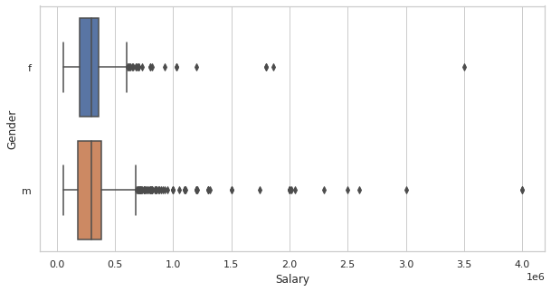
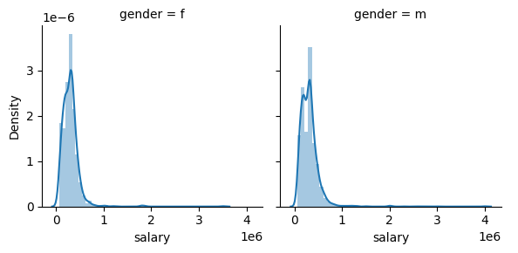
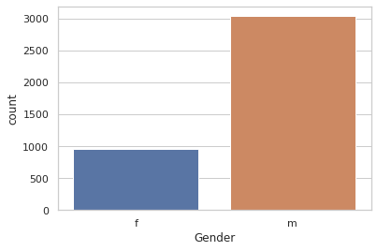
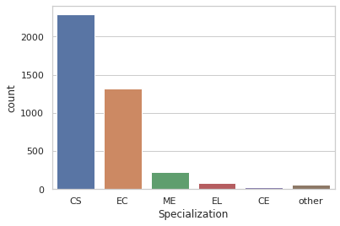
Univariate Analysis :

Slide 4
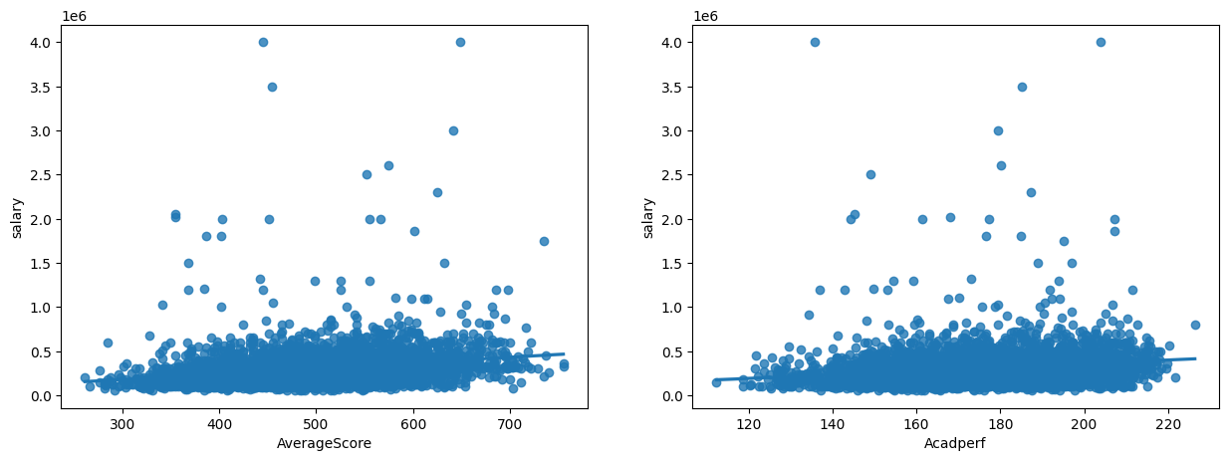
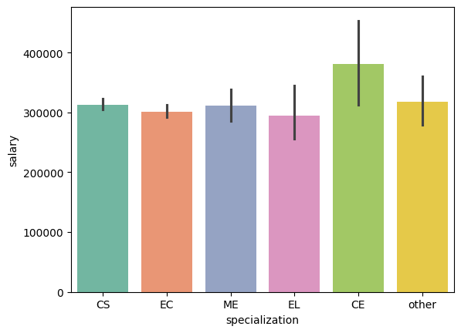
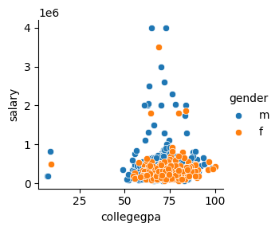
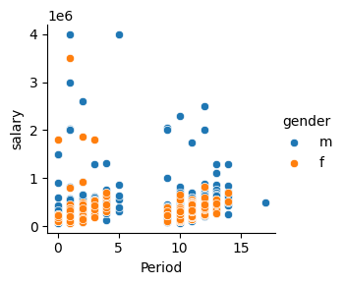
Bivariate Analysis :

Slide 5
Overall Conclusions:
Most of Amcat Aspirants are male working in IT domain with an experience of around 5years with degree in Btech and specialization in Computer Science/Information Technology from tier-2 college in Uttar Pradesh with an average salary around 300k.
High paying jobs taken up by amcat aspirants are mostly from 'IT' Domain.
Software Engineer and Software Developer are the most aimed profession for amcat aspirants.

Slide 6

THANK YOU

