Slide 1
Speech Enhancement and Noise Removal
Real-time DSP, CPU ONNX ML, hybrid processing, and virtual microphone routing
Windows desktop application for audio capture, enhancement, comparison, evaluation, and report generation.
Implemented with Python, PySide6, NumPy, SciPy, ONNX Runtime, sounddevice, and matplotlib.
Mode support: DSP, ML-enhanced, and hybrid ML-followed-by-DSP processing.
Academic fields shown as placeholders for names, roll numbers, institution, department, guide, and academic year.
Prepared for project review. Evidence is taken from the current workspace: source code, tests, evaluation results, plots, and build output.
1

Slide 2
Problem Statement, Motivation, and Objectives
Background noise reduces speech clarity in recorded and live audio.
Noise reduction must suppress noise while preserving speech; over-suppression can create distortion, pumping, ringing, or robotic artifacts.
Real-time software must avoid feedback loops, bounded-buffer overruns, and missed audio callbacks.
Objectives:
• Capture microphone audio and support configurable devices.
• Implement DSP, ML, and hybrid enhancement methods.
• Compare methods using the same input audio.
• Generate RMS, peak, SNR, RTF, plots, metrics, and PDF reports where available.
• Route enhanced speech to a virtual microphone for meeting applications without using physical speakers by default.
2

Slide 3
Proposed Solution and System Architecture
Audio Input
Preprocess
Enhancement Engine
Postprocess
Evaluation
Outputs
Virtual path: enhanced speech -> virtual audio render endpoint -> virtual capture endpoint -> meeting application microphone input.
Physical speakers/headphones are a separate optional monitoring path; they are disabled by default to reduce acoustic feedback.
Implemented in code and tested as software: capture, DSP, ML, hybrid offline, buffering, metrics, reports. Physically unverified: virtual meeting app pairing and acoustic behavior.
3

Slide 4
Technology Stack and Implementation Modules
Group | Technologies / modules verified in code
Language and GUI | Python; PySide6 (QMainWindow, tabs, sliders, status widgets)
Numerical / signal | NumPy, SciPy, STFT/ISTFT, spectral gain processing, FFT
Audio I/O | sounddevice, soundfile, PortAudio callbacks, CPU audio streaming
Machine learning | ONNX Runtime, V3 CNN ONNX model, WAV/STFT preprocessing
Visualization / reports | matplotlib, matplotlib FigureCanvas, metrics, plots, PDF report generation
Quality / packaging | pytest, psutil, PyInstaller executable build
Modules: devices.py, engine.py, recording.py, pipeline.py, v41_reducer.py, enhancer.py, workflow.py, metrics.py, main_window.py.
Core runtime flow: configuration -> GUI -> AudioEngine -> InputStream/OutputStream -> processing worker -> EnhancementPipeline / MLEnhancer.
4

Slide 5
DSP-Based Speech Enhancement
The project includes V4.1 spectral noise reduction, adapted for streaming.
Processing stages: frame/window analysis, noise estimate, speech/noise detection, Wiener gain, gain smoothing, spectral reconstruction, clipping protection.
Noise power and previous gain are maintained as reducer state.
Enhancement strength is controlled by noise reduction and voice preservation parameters.
DSP works on CPU and does not require model inference.
Offline synthetic evaluation reported DSP RTF = 0.0109 for 3.0 seconds of audio.
Limitations: V4.1 is partly utterance-oriented; live processing depends on chunk size, buffer condition, and the quality of the noise estimate.
5

Slide 6
Machine-Learning and Hybrid Enhancement
Machine learning uses a CPU ONNX V3 model discovered from the bundled models directory.
Model contract verified from checkpoint and ONNX metadata: 16 kHz, 512 FFT / 256 hop, 257 frequency bins, normalized magnitude input, normalized enhanced magnitude output.
Preprocessing: resample to 16 kHz, STFT, magnitude extraction, normalization; postprocessing: inference, inverse scaling, phase reuse, inverse STFT, output length restoration, clipping protection.
Hybrid mode performs ML enhancement first and then applies DSP enhancement to the ML result (verified in workflow.py).
All reported SNR gains come from synthetic clean-speech plus noise tests; subjective quality and clean-speech reference measurements remain necessary for stronger claims.
6

Slide 7
Application GUI and Real-Time Audio Routing
The GUI has device selection, method selection, noise-reduction and voice-preservation controls, level meters, start/stop controls, recording/analysis, plots, and status text.
Live route: physical microphone -> one capture stream -> enhancement worker -> one virtual audio destination.
Optional monitoring route: enhanced output -> headphones or speakers only when enabled. This is disabled by default to reduce acoustic feedback.
Virtual playback/render endpoint and the corresponding virtual recording/capture endpoint are not the same device; both are shown with actual device names.
Diagnostics include selected/actual device identifiers, sample rate, channels, peak, RMS, latency, queue depth, underflows, overflows, model status, and errors.
Meeting-app integration concept: enhanced speech -> virtual render endpoint -> virtual capture endpoint -> Google Meet/Teams/Zoom microphone selection.
Not physically verified in this workspace.
7

Slide 8
Experimental Setup and Evaluation Methodology
Evaluation script uses 3.0 seconds of synthetic speech at 16 kHz.
Noise cases: white (10 dB target SNR), babble (8 dB), changing (12 dB).
Each configured mode receives the same noisy input for a controlled comparison.
Offline metrics: RMS, peak amplitude, SNR, SNR improvement, processing time, and real-time factor.
Automated tests: 17 passed in the current workspace.
Missing/unverified support: clean live-speech reference, physical microphone tests, subjective listening tests, and meeting-application tests.
8

Slide 9
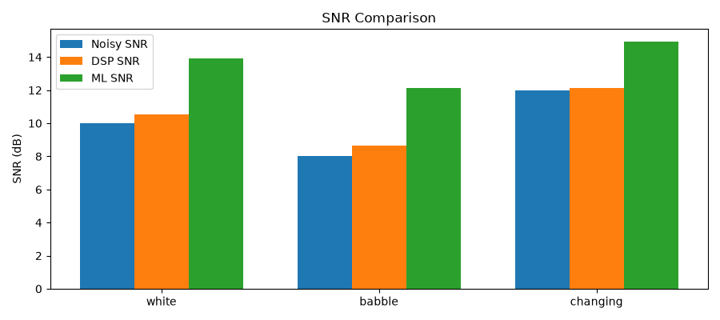
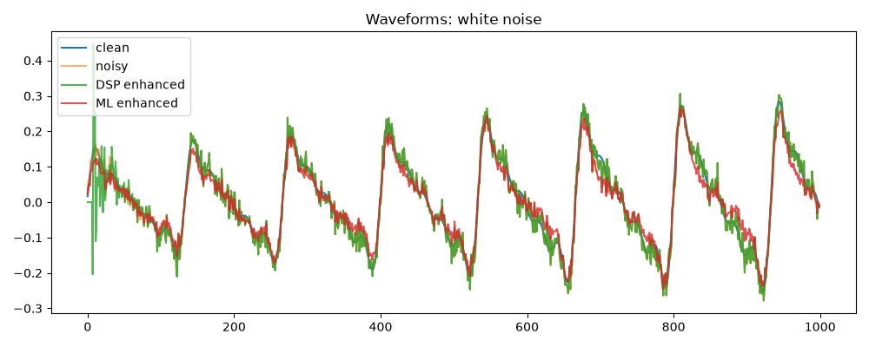
Results, Comparison Graphs, and Metrics
Noise | Noisy SNR | DSP SNR | ML SNR | DSP gain | ML gain
White | 10.000 | 10.542 | 13.920 | +0.542 | +3.920
Babble | 8.000 | 8.632 | 12.130 | +0.632 | +4.130
Changing | 12.000 | 12.116 | 14.944 | +0.116 | +2.944
DSP RTF in the synthetic evaluation: 0.0109. ML average processing time: 0.0740 s per 3.0 s block.
Lower RMS or lower SNR does not automatically prove better intelligibility; speech preservation requires listening tests.
SNR values use the synthetic clean reference generated by the evaluation script, not a live microphone recording.
9

Slide 10
Testing, Validation, and Current Status
Component | Status
Audio capture | Implemented and tested at code/interface level; physical 30-s recording reported in project status
DSP enhancement | Implemented; offline synthetic test and synthetic-data results available
ML enhancement | Implemented; offline synthetic test and synthetic-data results available
Hybrid enhancement | Implemented in offline workflow (ML then DSP)
Virtual microphone route | Implemented in software; hardware/meeting-app pairing unverified
GUI controls/status | Implemented
CSV metrics/plots/PDF | Implemented with generated plots and reports
Automated tests | 17 passed in current workspace
Physical/meeting tests | Not verified
10

Slide 11
Limitations, Challenges, and Future Scope
Physical microphone quality, room noise, acoustic feedback, and speaker use are not validated here.
No software acoustic echo cancellation is implemented; headphones are recommended for monitoring.
ML and hybrid enhancement use buffered chunks and introduce latency.
Only synthetic speech with white, babble, and changing noise was used for reported SNR comparisons.
PESQ/STOI are available only when optional dependencies are installed.
Future work: better speech preservation, reliable real-time processing, thorough ML/hybrid evaluation, virtual-microphone verification, stable packaging, and automated tests.
11

Slide 12
Conclusion and Questions
The project addresses speech enhancement in noisy environments using DSP, V3 ONNX ML, and Hybrid processing.
It includes a PySide6 GUI, offline comparison, metrics, reports, and virtual-microphone routing.
Available evidence shows synthetic-data SNR improvements and fast DSP runtime, but not full physical or meeting-app validation.
The most important remaining work is acoustic/physical testing and verification of meeting software routing.
Thank You / Questions
12

