Slide 1

Knowledge Retrieval Techniques in Robotic Cooking
Pavan Naga Sai Gullapalli(700747746)
Venkata Tarun Chowdary Garimella(700746945)
Pavankalyan Magam(700745501)
Sri Rama Krishna Komatlapalli(700745165)

Slide 2


MOTIVATION
Improve efficiency and accuracy: Robots can acquire knowledge from various sources, such as cookbooks and recipe databases, to prepare dishes with minimal human intervention.
Enhance consistency and quality: Robotic cooking eliminates human error, resulting in consistent and high-quality dishes every time, which is essential in commercial kitchens.
Expand culinary range: Access to diverse recipe sources enables robots to learn dishes from various cuisines and cultures, catering to individual preferences and broadening their appeal.
Revolutionize food preparation: Knowledge retrieval in robotic cooking aims to make robots self-sufficient in preparing a wide range of dishes, ultimately transforming the way we prepare and consume food.

Slide 3





OBJECTIVES
Robotic cooking machines utilize knowledge retrieval and machine learning to provide personalized and innovative cooking experiences for users.
Techniques such as foon, iterative deepening search, and greedy best-first search enable accurate and relevant recipe recommendations and cooking techniques.
Knowledge retrieval assists in finding suitable ingredient substitutions and adapting recipes based on user preferences, dietary restrictions, or ingredient availability.
Access to a vast amount of culinary knowledge and techniques optimizes cooking processes and improves overall performance of robotic cooking machines.

Slide 4

RELATED WORK
Robots face challenges in flexible task planning due to limited understanding of activities and environments.
Functional Object-Oriented Networks (FOONs) and graph search techniques are used to help robots decipher information and accomplish tasks.
Researchers are exploring approaches such as modular neural networks and reinforcement learning-based frameworks to improve adaptability.
These promising solutions aim to enable robots to perform complex tasks in dynamic environments by creatively adapting their task plans.

Slide 5

PROBLEM STATEMENT
Previous work has centered on creating Functional Object-Oriented Networks (FOON) graphs for task representation.
The current project advances this work by finding optimal paths from specified start to goal states.
The objective is to determine the best sequence of steps for efficient task execution.
This approach enhances robotic task planning by providing tailored solutions for complex problems.

Slide 6





ANALYSIS
Robotic systems benefit from integrating knowledge retrieval and machine learning, leading to personalized and innovative solutions in tasks like cooking.
Employing FOON graphs and graph search algorithms enables robots to find efficient sequences of steps for complex tasks, optimizing performance.
Reinforcement learning-based frameworks and modular neural networks offer adaptable solutions for robots to tackle dynamic environments and learn from experience.
The continuous development and evaluation of these approaches contributes to the advancement of robotics, allowing for increased flexibility and capability in a wide range of applications.

Slide 7
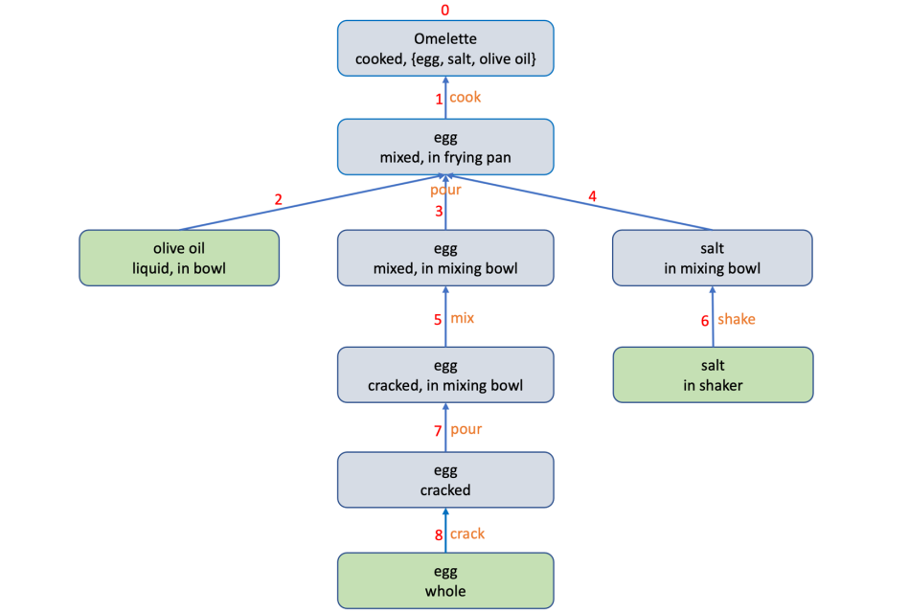
WORK FLOW

Slide 8





PROPOSED SOLUTION
The proposed framework involves collecting comprehensive cooking data, converting it to FOON, and implementing search algorithms like IDS and GBFS.
Iterative deepening search helps navigate the state space of possible actions, while greedy best-first search uses heuristics to guide the search efficiently.
Evaluation of these search algorithms is crucial for determining their effectiveness in optimizing robot cooking performance and reaching goal states with minimal cost and search time.
The dataset captures object states, motions, and attributes related to the cooking process, enabling a detailed understanding of the sequence of actions during task execution.

Slide 9
ROLES AND RESPONSIBILITIES
Responsibility | Contribution | Description
Data Collection and preprocessing | Sri Rama Krishna Komatlapalli Pavan Naga Sai Gullapalli | By watching the YouTube cooking videos FOONS are being created by using 3 states, Object, State, Motion
Implement Algorithm-1 | Pavan Naga Sai Gullapalli Venkata Tarun Chowdary Garimella | Implement the Iterative Deepening Search algorithm and extract task tree
Implement Algorithm-2 | Pavankalyan Magam Venkata Tarun Chowdary Garimella | Implementing the Greedy Best-First Search algorithm based on success rate of the motion.
Kitchen File | Pavan Naga Sai Gullapalli Venkata Tarun Chowdary Garimella | Generate a kitchen file which will search in FOON and checks the retrieved task trees.
Testing and Accuracy Checks | Pavan Kalyan Magam Sri Rama Krishna Komatlapalli | Visualize the retrieve task trees and use to debug the program.

Slide 10

RESULTS
Video annotation and FOON enable comprehensive analysis of processes and activities in videos, with task trees visually representing actions, objects, and states.
Iterative Deepening Search and Greedy Best-First Search algorithms were implemented for pouring ice into an empty glass, highlighting their unique approaches to solving the task.
Two heuristic functions were used in the Greedy Best-First Search algorithm, resulting in efficient paths based on either the success rate of motion or the number of input objects in the functional unit.
Comparisons between the algorithms' performance showcased their distinct characteristics and effectiveness in solving the task, providing valuable insights for future research and application.

Slide 11

REFERENCES
Malli, Vara Bhavya Sri. "Knowledge Retrieval using Foon." arXiv preprint arXiv:2211.03790 (2022).
Shashwat, Kumar. "A comparative study of the performance of different search algorithms on FOON graphs." arXiv preprint arXiv:2210.07428 (2022).
Lewis, Tyree. "Extracting task trees using knowledge retrieval search algorithms in functional object-oriented network." arXiv preprint arXiv:2211.08314 (2022).
Patel, Raj. "FOON Creation and Traversal for Recipe Generation." arXiv preprint arXiv:2210.07335 (2022).

