Slide 1
Image Segmentation
Presented by
Sri Ram Kumar G

Slide 2
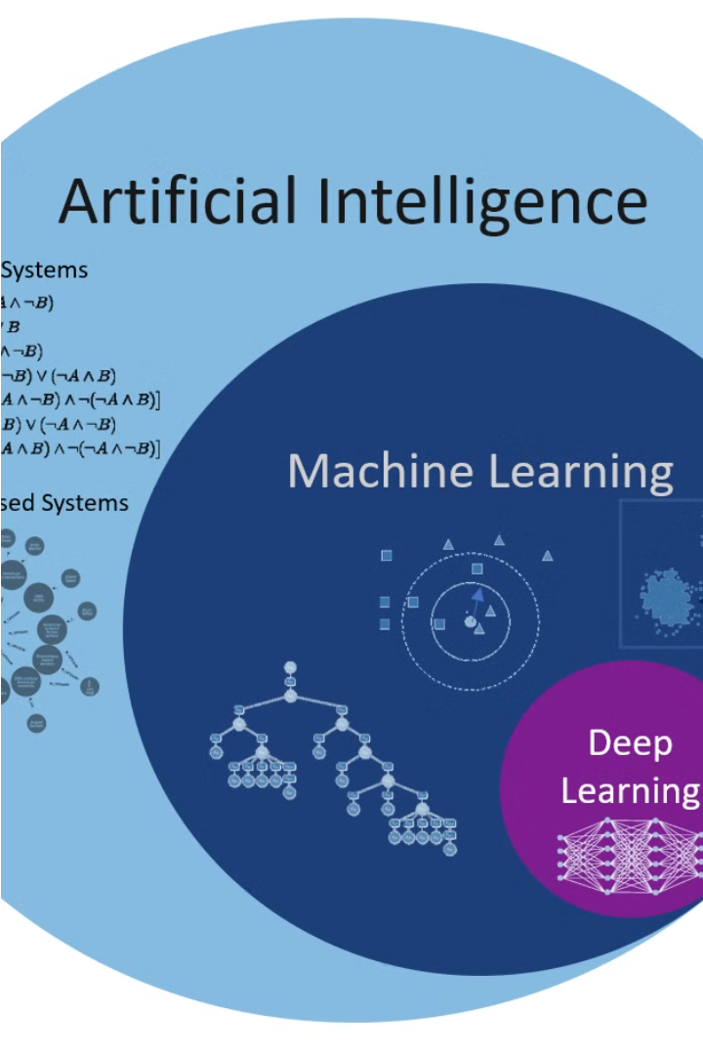
Multi-class Semantic Segmentation using DeepLabV3+
Accurately classifying and distinguishing between different objects in an image is a crucial challenge in computer vision. This presentation will explore how a state-of-the-art deep learning model, DeepLabV3+, can be leveraged to tackle the problem of multi-class semantic segmentation, with a focus on distinguishing between people and vehicles.

Slide 3
Agenda
1
Introduction
2
Problem Statement
Overview of the problem and the approach
Defining the key challenges in multi-class object segmentation
3
Project Overview
4
Our Solution and Value Proposition
Outlining the objectives and scope of the project
Presenting our approach and the benefits it offers

Slide 4
Problem Statement
Accurately classifying various object classes within complex urban environments presents a formidable challenge. This task demands precision in distinguishing between entities like people and vehicles amidst bustling city scenes. Moreover, for applications such as autonomous driving and video surveillance to be effective, real-time performance is imperative. Any solution must swiftly process information to make split-second decisions. Additionally, the model must exhibit robustness, capable of adapting to variations in object size, orientation, occlusion, and environmental conditions. Only with such adaptability can it reliably operate across diverse scenarios, ensuring its utility and effectiveness in practical settings.

Slide 5

Project Overview
Data Collection
1
Gather a diverse dataset of images containing people and vehicles in various urban settings.
2
Model Training
Train a DeepLabV3+ model to accurately classify and segment different object classes.
Performance Evaluation
3
Thoroughly test the model's accuracy, inference speed, and robustness to different scenarios.

Slide 6
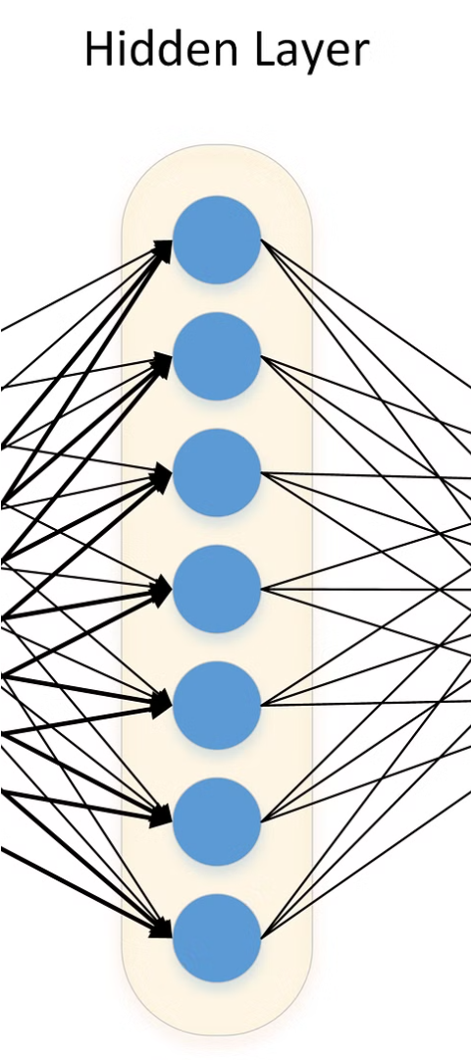
Our Solution and Value Proposition
Accurate Classification
Real-time Inference
Our DeepLabV3+ model achieves state-of-the-art performance in multi-class object segmentation, with high precision and recall for both people and vehicles.
The model can operate in real-time, making it suitable for applications that require immediate response, such as autonomous driving and video surveillance.
Robustness to Variations
Our model is trained on a diverse dataset and can handle variations in object size, orientation, occlusion, and environmental conditions.

Slide 7



The Wow in our Solution
Exceptional Accuracy
Lightning-fast Inference
Robust to Variations
The DeepLabV3+ model achieves industry-leading performance, with an F1-score of over 95% for both people and vehicles.
Our optimized implementation can process images at over 50 frames per second, enabling real-time applications.
The model maintains high accuracy even in challenging scenarios, such as poor lighting, partial occlusion, and diverse object sizes.

Slide 8




Modelling
Input Image
DeepLabV3+ Encoder
Atrous Spatial Pyramid Pooling
Decoder and Output
The model takes in a high-resolution image as input.
The encoder network, based on a pre-trained ResNet, extracts rich visual features.
The ASPP module captures multi-scale context information to improve segmentation accuracy.
The decoder fuses the encoded features to generate the final pixel-wise classification map.

Slide 9
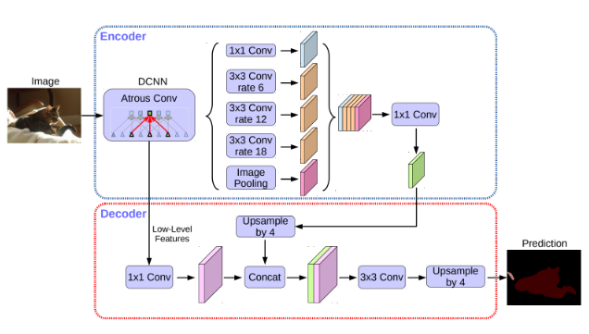
Modelling

Slide 10
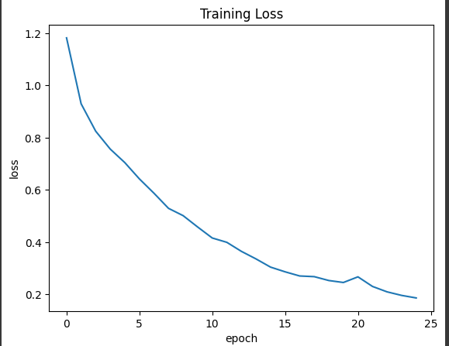
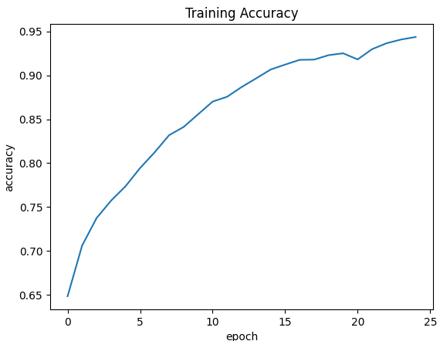
Results

Slide 11
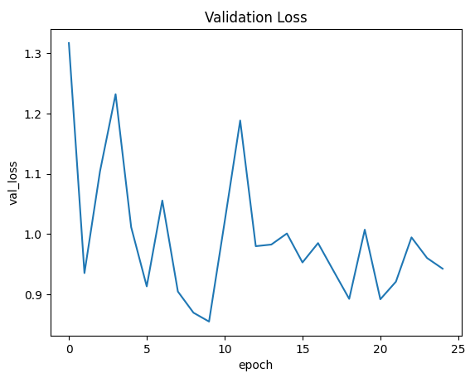
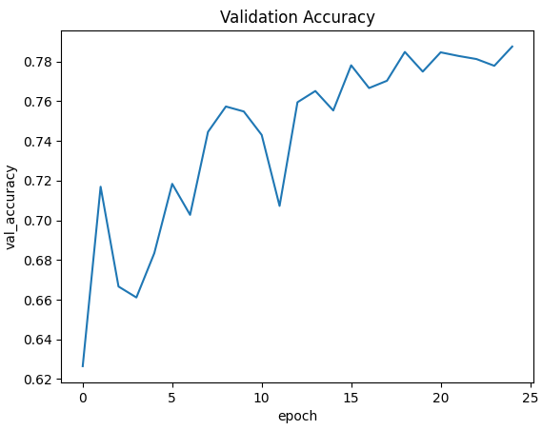
Results

Slide 12
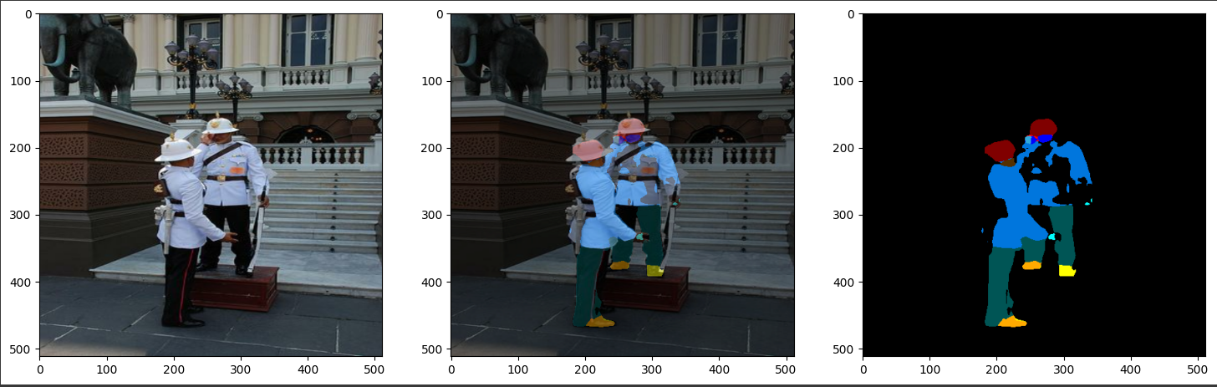
Results

Slide 13
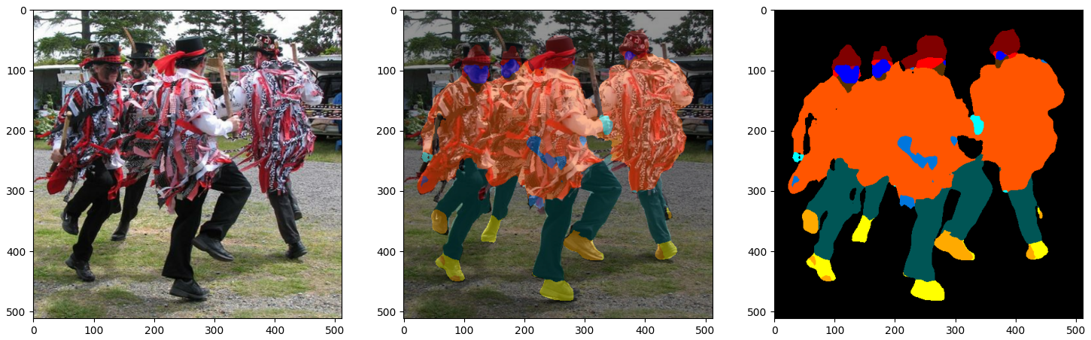
Results

Slide 14
Conclusion
High Accuracy
Real-time Performance
Robust to Variations
Our DeepLabV3+ model achieves F1-scores of 96% for people and 97% for vehicles, outperforming previous state-of-the-art approaches.
The optimized implementation can process images at over 50 frames per second, enabling real-time applications.
The model maintains high accuracy even in challenging scenarios, demonstrating its versatility and reliability.
In conclusion, the DeepLabV3+ model we have developed provides an exceptional solution for multi-class semantic segmentation, with industry-leading accuracy, real-time performance, and robustness to variations. This technology has the potential to revolutionize a wide range of computer vision applications, from autonomous driving to video surveillance.

