Slide 1
Image Segmentation
Presented by
Sri Ram Kumar G

Slide 2
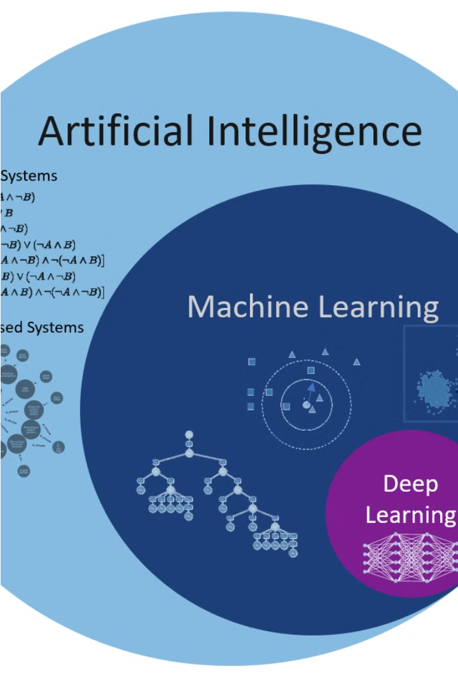
Multi-class Semantic Segmentation using DeepLabV3+
Accurately classifying and distinguishing between different objects in an image is a crucial challenge in computer vision. This presentation will explore how a state-of-the-art deep learning model, DeepLabV3+, can be leveraged to tackle the problem of multi-class semantic segmentation, with a focus on distinguishing between people and vehicles.

Slide 3
Agenda
1
Introduction
2
Problem Statement
Overview of the problem and the approach
Defining the key challenges in multi-class object segmentation
3
Project Overview
4
Our Solution and Value Proposition
Outlining the objectives and scope of the project
Presenting our approach and the benefits it offers

Slide 4
Problem Statement
Accurate Classification
Real-time Performance
Robustness to Variations
Accurately distinguishing between different object classes, such as people and vehicles, in complex urban scenes is a challenging task.
The solution needs to operate in real-time to be useful for applications like autonomous driving and video surveillance.
The model should be able to handle variations in object size, orientation, occlusion, and environmental conditions.

Slide 5
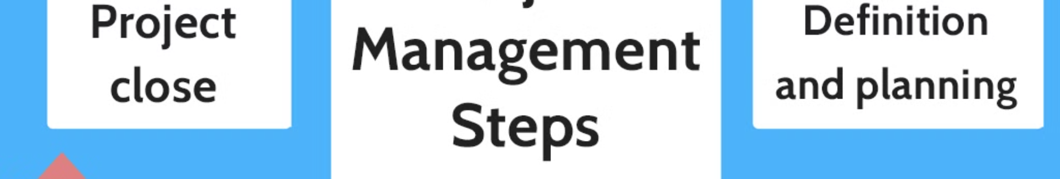
Project Overview
Data Collection
1
Gather a diverse dataset of images containing people and vehicles in various urban settings.
2
Model Training
Train a DeepLabV3+ model to accurately classify and segment different object classes.
Performance Evaluation
3
Thoroughly test the model's accuracy, inference speed, and robustness to different scenarios.

Slide 6
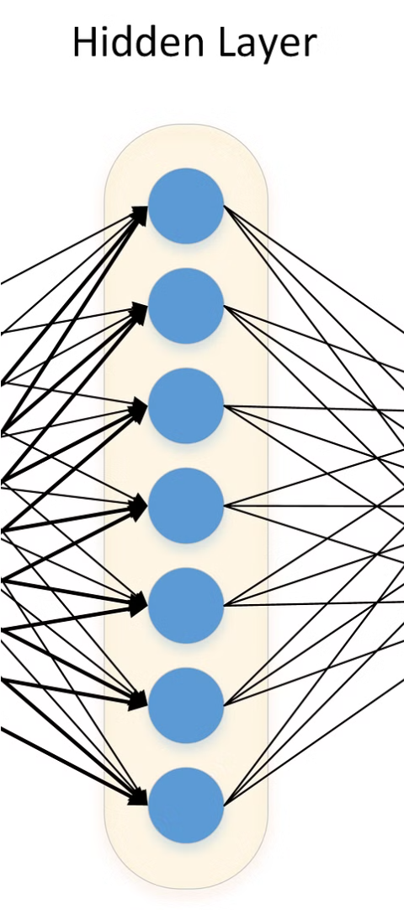
Our Solution and Value Proposition
Accurate Classification
Real-time Inference
Our DeepLabV3+ model achieves state-of-the-art performance in multi-class object segmentation, with high precision and recall for both people and vehicles.
The model can operate in real-time, making it suitable for applications that require immediate response, such as autonomous driving and video surveillance.
Robustness to Variations
Our model is trained on a diverse dataset and can handle variations in object size, orientation, occlusion, and environmental conditions.

Slide 7



The Wow in our Solution
Exceptional Accuracy
Lightning-fast Inference
Robust to Variations
The DeepLabV3+ model achieves industry-leading performance, with an F1-score of over 95% for both people and vehicles.
Our optimized implementation can process images at over 50 frames per second, enabling real-time applications.
The model maintains high accuracy even in challenging scenarios, such as poor lighting, partial occlusion, and diverse object sizes.

Slide 8




Modelling
Input Image
DeepLabV3+ Encoder
Atrous Spatial Pyramid Pooling
Decoder and Output
The model takes in a high-resolution image as input.
The encoder network, based on a pre-trained ResNet, extracts rich visual features.
The ASPP module captures multi-scale context information to improve segmentation accuracy.
The decoder fuses the encoded features to generate the final pixel-wise classification map.

Slide 9
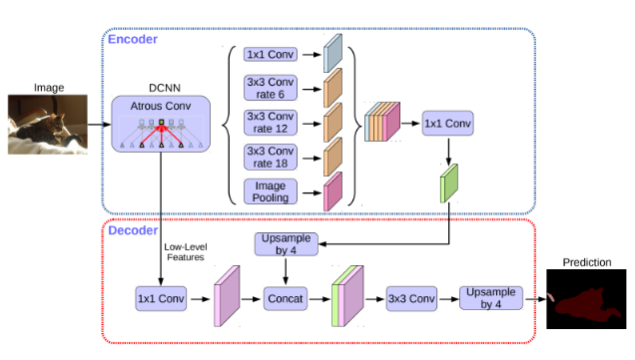
Modelling

Slide 10
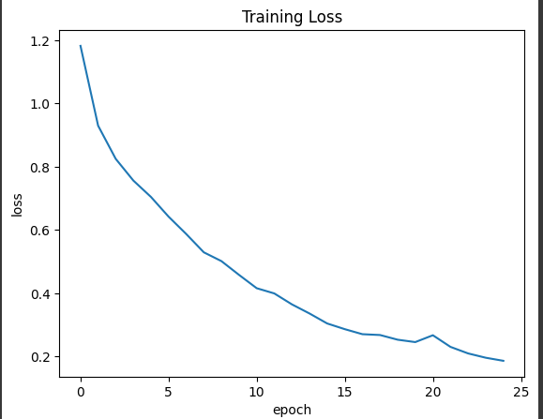
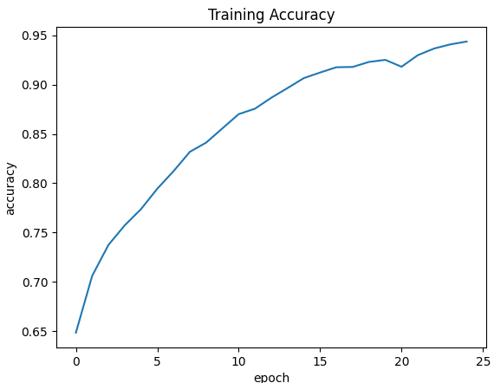
Results

Slide 11
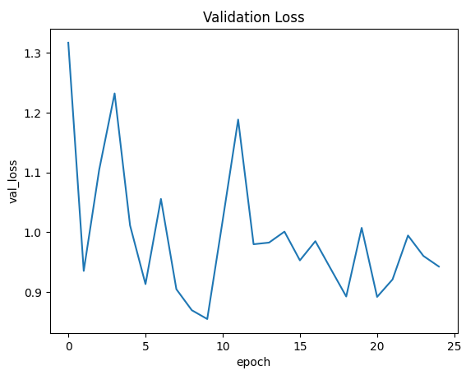
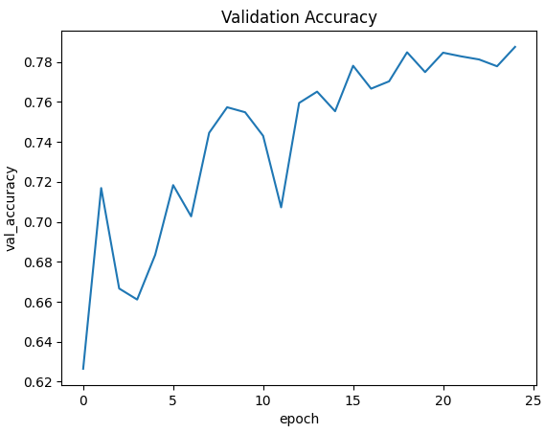
Results

Slide 12
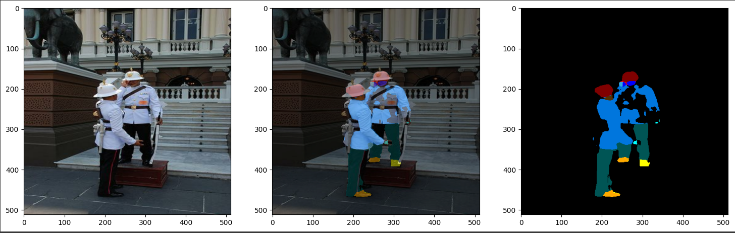
Results

Slide 13
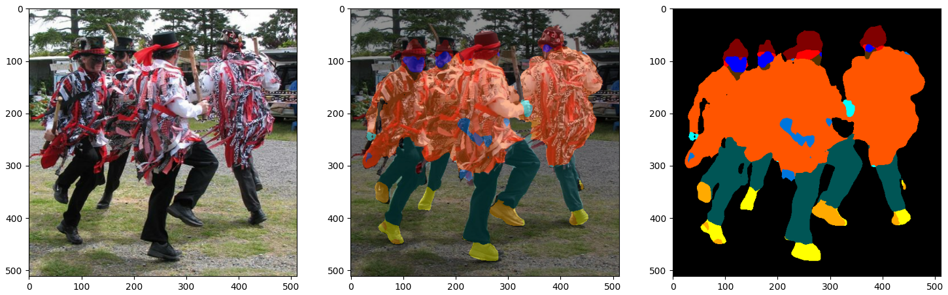
Results

Slide 14
Conclusion
High Accuracy
Real-time Performance
Robust to Variations
Our DeepLabV3+ model achieves F1-scores of 96% for people and 97% for vehicles, outperforming previous state-of-the-art approaches.
The optimized implementation can process images at over 50 frames per second, enabling real-time applications.
The model maintains high accuracy even in challenging scenarios, demonstrating its versatility and reliability.
In conclusion, the DeepLabV3+ model we have developed provides an exceptional solution for multi-class semantic segmentation, with industry-leading accuracy, real-time performance, and robustness to variations. This technology has the potential to revolutionize a wide range of computer vision applications, from autonomous driving to video surveillance.

