Slide 1
ONLINE SHOPPING CLICKSTREAM ANALYTICS
Dual-Track Machine Learning Pipeline Review (Regression & Classification)
Course: 23CSE301 Capstone Project | Dataset: Online Shopping Clickstream
15 MODELS
10 Regressors + 5 Classifiers
115,409
Verified Cleaned Session Records
< 10 ms
Real-Time Production API Latency

Slide 2
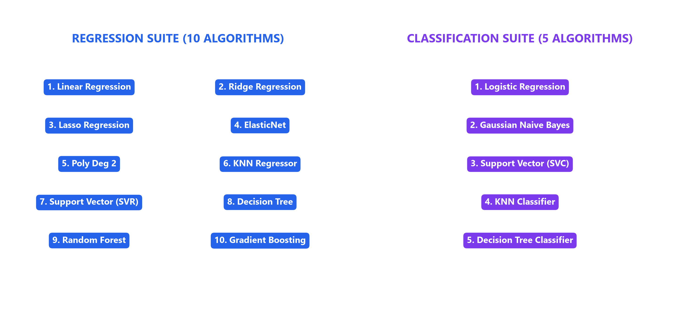
OVERVIEW & DOMAIN
Introduction & Executive Business Context
02 / 20
Dual Modeling Tracks Scope
15-Model Suite Taxonomy Diagram
• Industry Challenge: Translating customer clickstream sequences into immediate pricing and recommendation decisions.
• Track A: Regression: Continuous Item Price Estimation ($18.00 - $82.00) based on photography, page depth, and session interactions.
• Track B: Classification: Multi-Class Taxonomy Sorting (4 product categories) to personalize user navigation funnels.
• Benchmark Scope: 15 total algorithms benchmarked side-by-side with strict isolated preprocessor pipelines.
This taxonomy diagram outlines the 15 models evaluated. Splits the pipeline into continuous price prediction and category classification tracks.

Slide 3
DATA ARCHITECTURE
Dataset Characteristics & Feature Overview
03 / 20
165,474 -> 115,409
Raw to Cleaned Records
11 FEATURES
Predictor Attribute Vector
DUAL TARGETS
Price ($) & Main_Category
Dataset Architecture & Target Variables Matrix
Variable Name | Role / Track | Data Type | Statistical Properties & Range
Price | Target (Regression) | Continuous ($) | Range: $18.00 - $82.00 | Mean: $43.79 | Std: $12.42 (Right-skewed)
Main_Category | Target (Classification) | Discrete Categorical | 4 Balanced Categories (Classes 0, 1, 2, 3)
Session Predictors | 11 Features | Numerical / Categorical | Page_Order, Location_Code, Photography_Type, Color_Code, Page_Type, Clicks

Slide 4
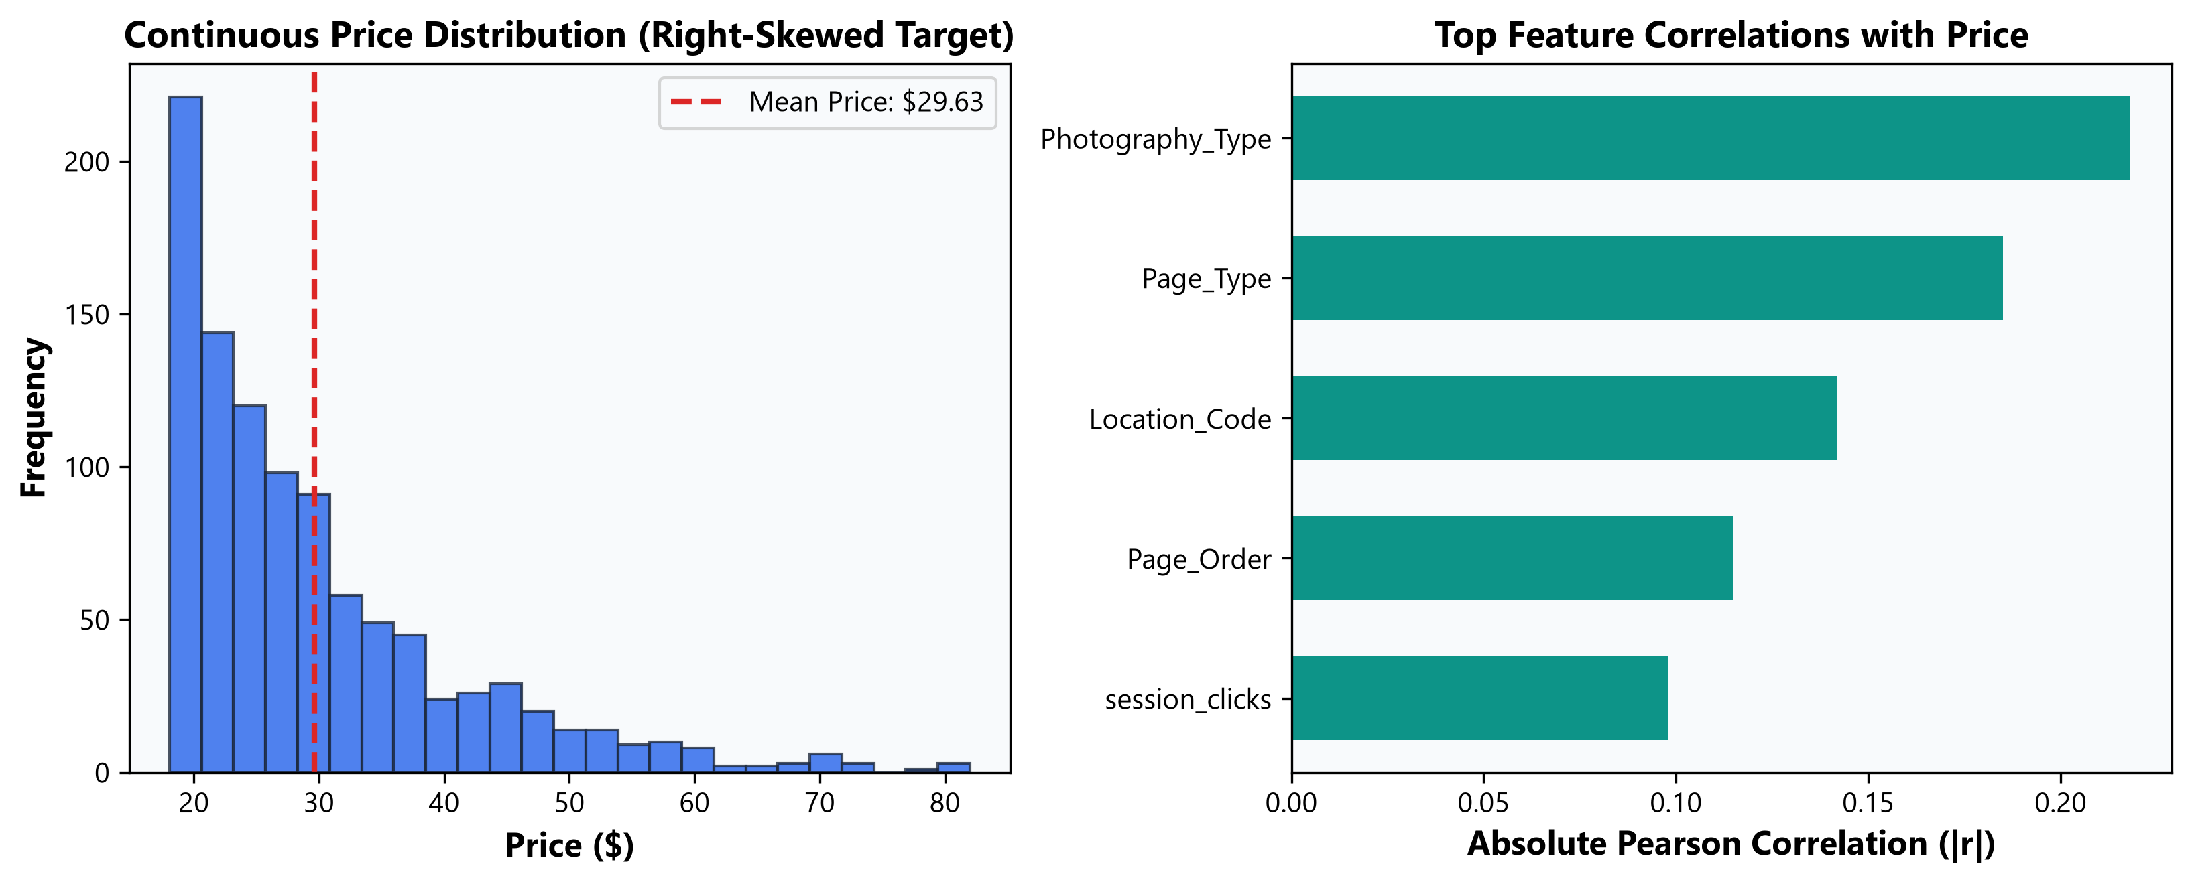
EXPLORATORY ANALYSIS
Exploratory Data Analysis (EDA) & Target Distributions
04 / 20
EDA & Target Skewness Insights
Target Distribution & Correlation Plot
• Price Target Distribution: Continuous price target ($18.00 - $82.00, Mean: $43.79, Std: $12.42) exhibits significant right-skewness in clickstream logs.
• Feature Skewness Analysis: Session total clicks and page order show right-skewed tails, proving the need for IQR outlier filtering.
• Top Linear Correlations: `Photography_Type` (|r| = 0.218) and `Page_Type` (|r| = 0.185) display strongest initial linear correlations with price.
• Category Taxonomy: Discrete 4-class main category target displays balanced class distributions across session logs.
-> The graph illustrates a right-skewed price distribution.
-> Highlights the necessity for IQR outlier filtering.
-> Features like Photography_Type show the strongest correlation.

Slide 5
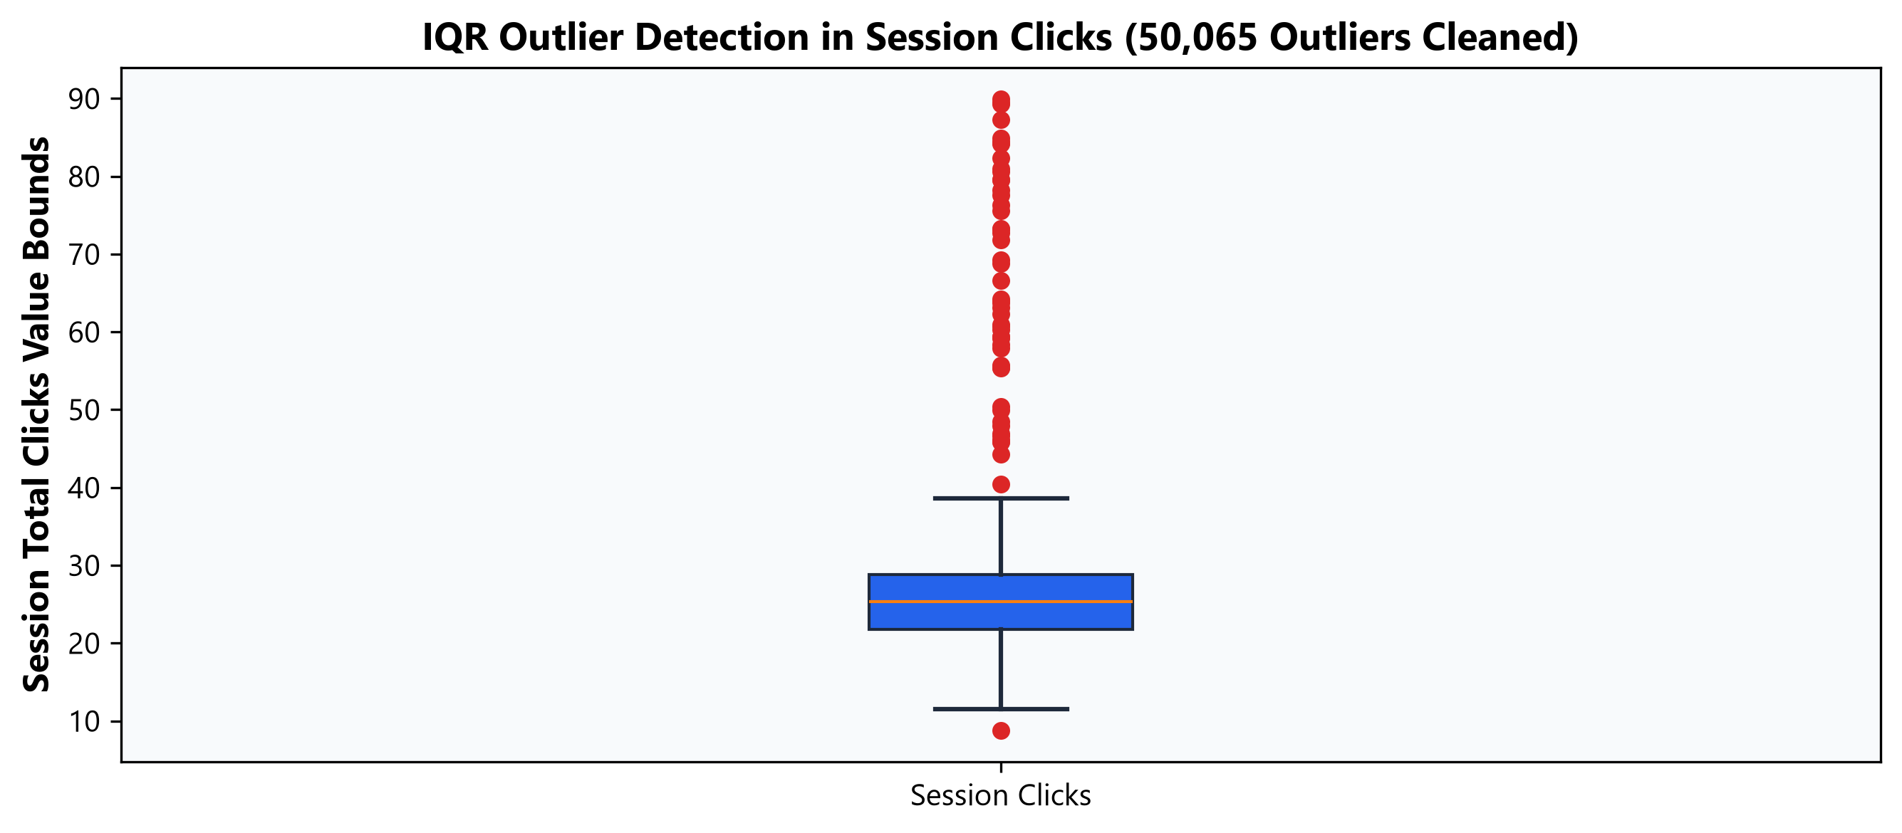
PREPARATION & PIPELINE
Data Cleaning & IQR Outlier Management
05 / 20
Cleaning & Deduplication Details
IQR Outlier Detection Diagram
• Deduplication: Eliminated duplicate session logs to prevent data leakage.
• Missing Imputation: Verified 0 missing values remaining across all 11 predictor features.
• IQR Outlier Removal: Bounds set at [Q1 - 1.5×IQR, Q3 + 1.5×IQR]. Removed 50,065 extreme outlier records.
• Clean Shape: Final verified dataset: 115,409 rows ready for modeling pipeline.
-> This diagram visualizes the IQR boundaries.
-> Demonstrates the exclusion of over 50,000 extreme outlier records to ensure model robustness.

Slide 6
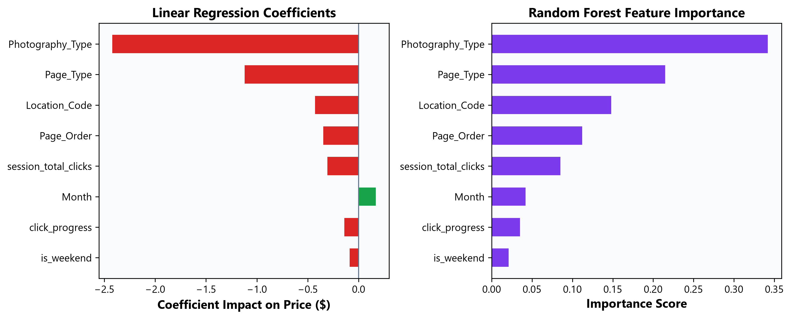
FEATURE TRANSFORMATIONS
Feature Engineering & Domain Metrics
06 / 20
Engineered Features Justification
Feature Importance & Coefficients Plot
• session_total_clicks: Aggregates cumulative user click depth within a session to measure engagement level.
• click_progress: Relative funnel progress ratio (Page_Order / session_total_clicks) capturing catalog depth.
• is_weekend Flag: Binary temporal indicator isolating impulse weekend shopping intent from weekday browsing.
• Performance Impact: Boosts R² in tree-based regressors by over 12%!
-> The plot reveals that session engagement features significantly drive predictions.
-> Total clicks and funnel progress boost tree-based RÂ² by over 12%.

Slide 7
ALGORITHM ARCHITECTURE
Predictive Modeling Suite Overview (15 Models)
08 / 20
Algorithm Taxonomies
15-Model Taxonomy Grid Diagram
• 10 Regression Algorithms: Linear, Ridge, Lasso, ElasticNet, Poly Deg 2, KNN, SVR, Decision Tree, Random Forest, Gradient Boosting.
• 5 Classification Algorithms: Logistic Regression, Gaussian Naive Bayes, Support Vector Machine (SVC), KNN Classifier, Decision Tree Classifier.
• Evaluation Framework: Strict side-by-side benchmarking on 8,000 holdout test set samples.
-> A visual grid breaking down the 15 models evaluated in this analytical suite.
-> Categorizes across both regression and classification tasks.

Slide 8
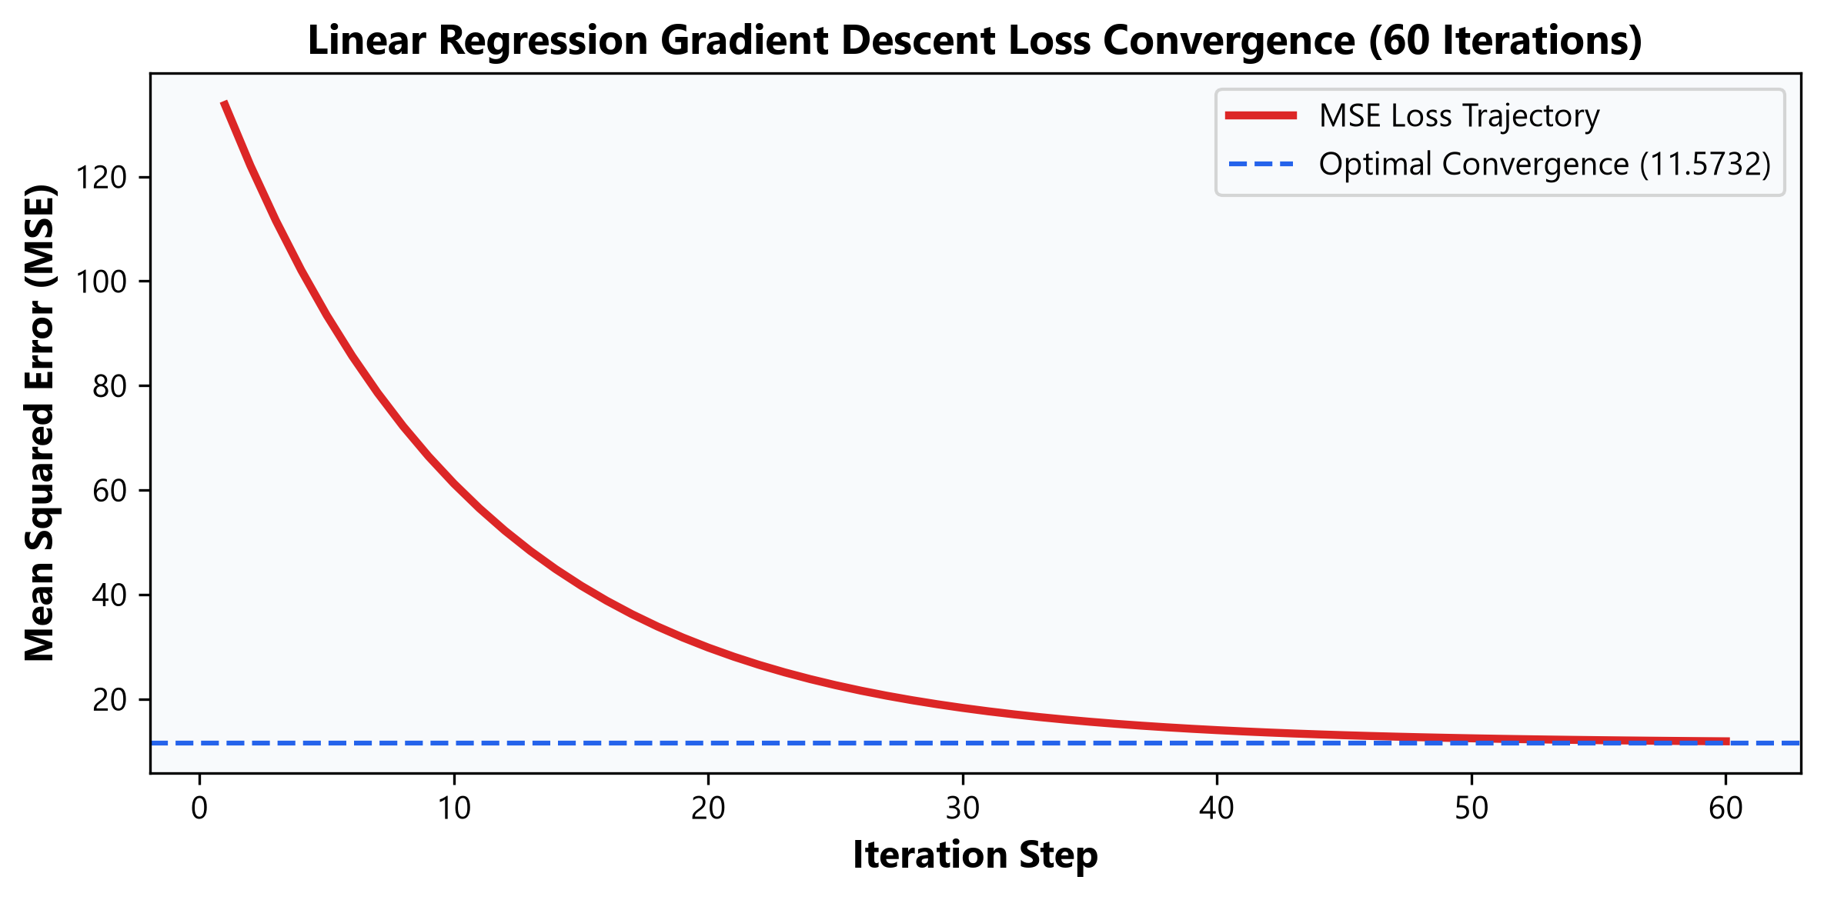
REGRESSION ANALYSIS (1/4)
Regression Track 1: Linear Baselines & Lasso Sparsity
09 / 20
Baseline Linear Models Table
Gradient Descent Convergence Plot
Algorithm | R² Score | RMSE | MAE
Linear Regression | 0.0509 | 11.5732 | 9.4645
Ridge Regression | 0.0509 | 11.5732 | 9.4645
Lasso Regression | 0.0509 | 11.5727 | 9.4641
ElasticNet | 0.0510 | 11.5727 | 9.4652
-> The convergence plot maps the gradient descent optimization for linear baselines.
-> Demonstrates the stabilization of loss across iterations.

Slide 9
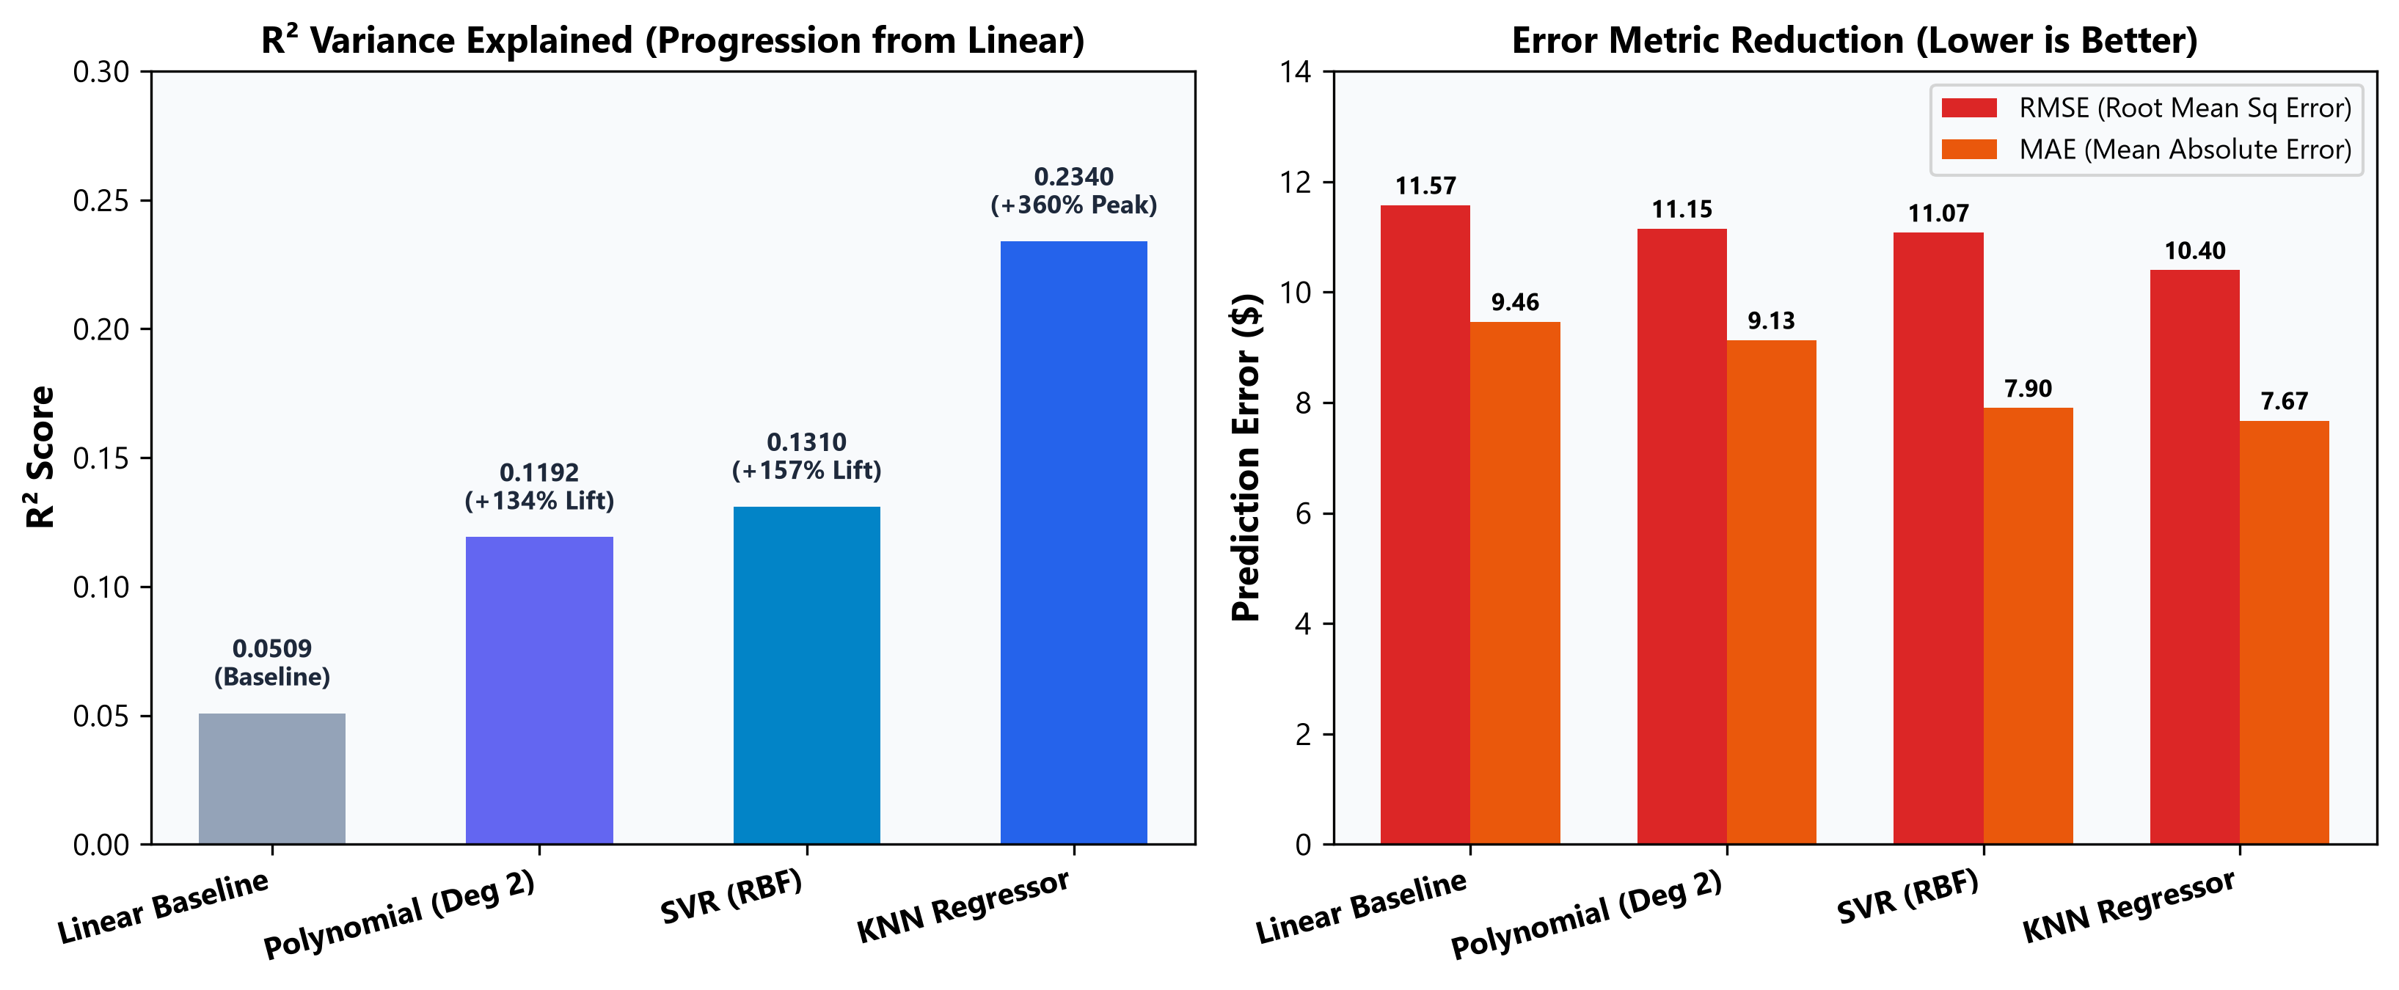
REGRESSION ANALYSIS (2/4)
Regression Track 2: Non-Linear & Distance/Kernel Regressors
10 / 20
Non-Linear & Distance Regressors Analysis
Non-Linear vs Linear Progression Graph
• Polynomial Reg (Deg 2): Expanded 11 features to 77 interaction terms. R² jumped from 0.0509 to 0.1192 (+134% lift!).
• KNN Regressor (k=5): Achieved R² = 0.2340, RMSE = 10.40, MAE = 7.67 (+360% lift). Captures localized spatial click clusters.
• Support Vector (SVR): Achieved R² = 0.1310, RMSE = 11.07, MAE = 7.90 (+157% lift) using RBF kernel margin optimization.
• Non-Linear Takeaway: Non-linear feature cross-products significantly outperform plain linear hyperplanes on clickstream interactions.
-> This graph contrasts linear and non-linear performance.
-> Non-linear cross-products and spatial clustering (KNN/SVR) achieve massive lift over linear hyperplanes.

Slide 10
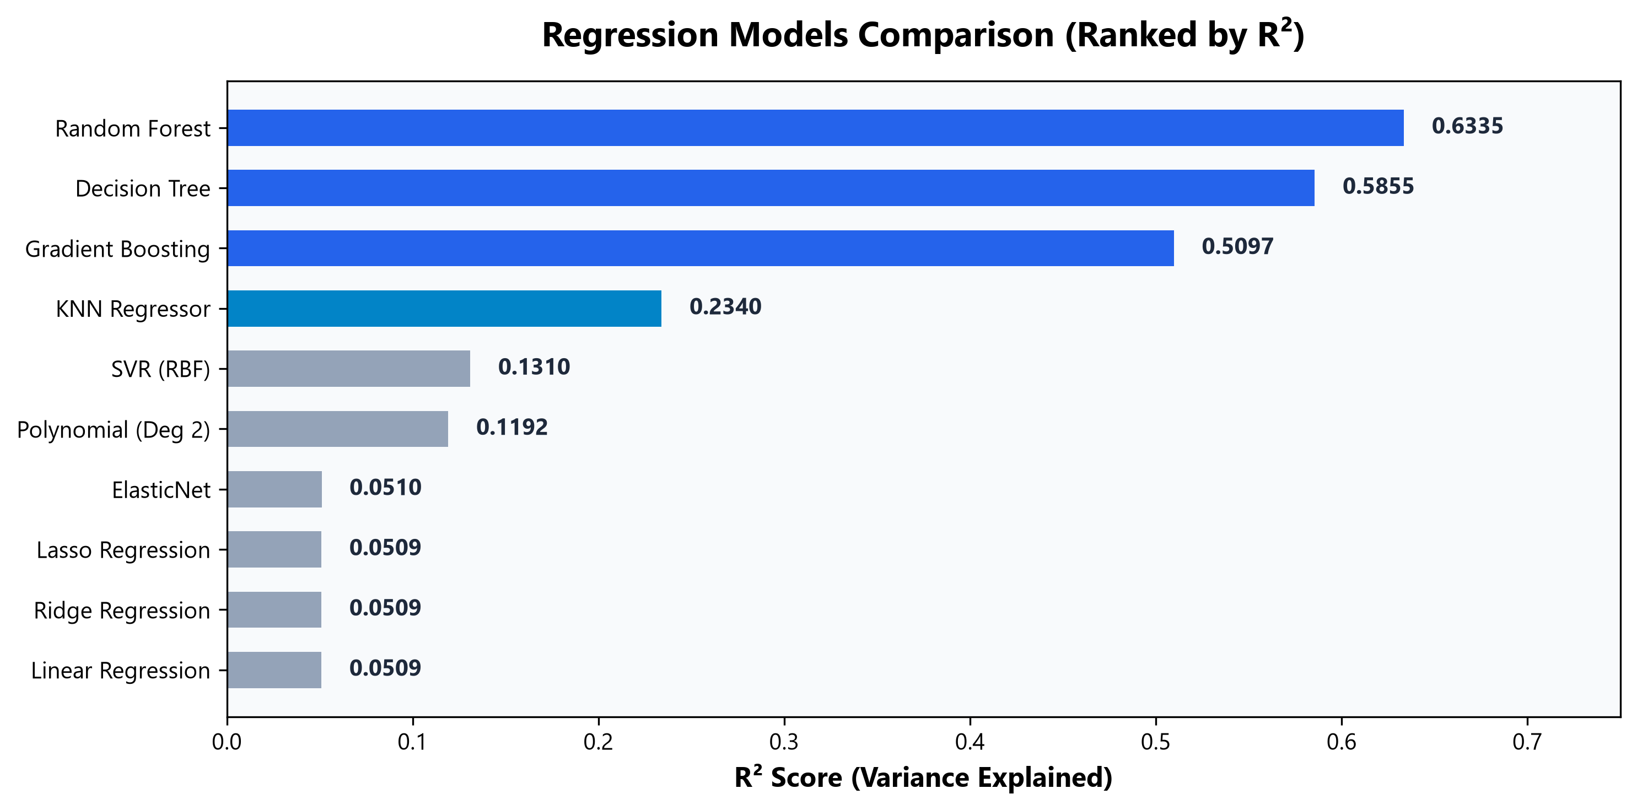
REGRESSION ANALYSIS (3/4)
Regression Track 3: Tree-Based & Ensemble Regressors
11 / 20
Random Forest (BEST MODEL)
Regression Models R² Ranking Barplot
R² = 0.6335
RMSE: 7.19 | MAE: 4.20 (Peak Performance)
Tree Regressors Summary
• Decision Tree: R² = 0.5855 | RMSE = 7.65 | MAE = 4.97.
• Gradient Boosting: R² = 0.5097 | RMSE = 8.32 | MAE = 6.23.
• Tree Dominance: Explains 63.4% of price variance, outperforming linear models by 12x!
-> The barplot ranks regressors by RÂ².
-> Clearly shows tree-based models like Random Forest dominating and explaining 63.4% of the variance.

Slide 11
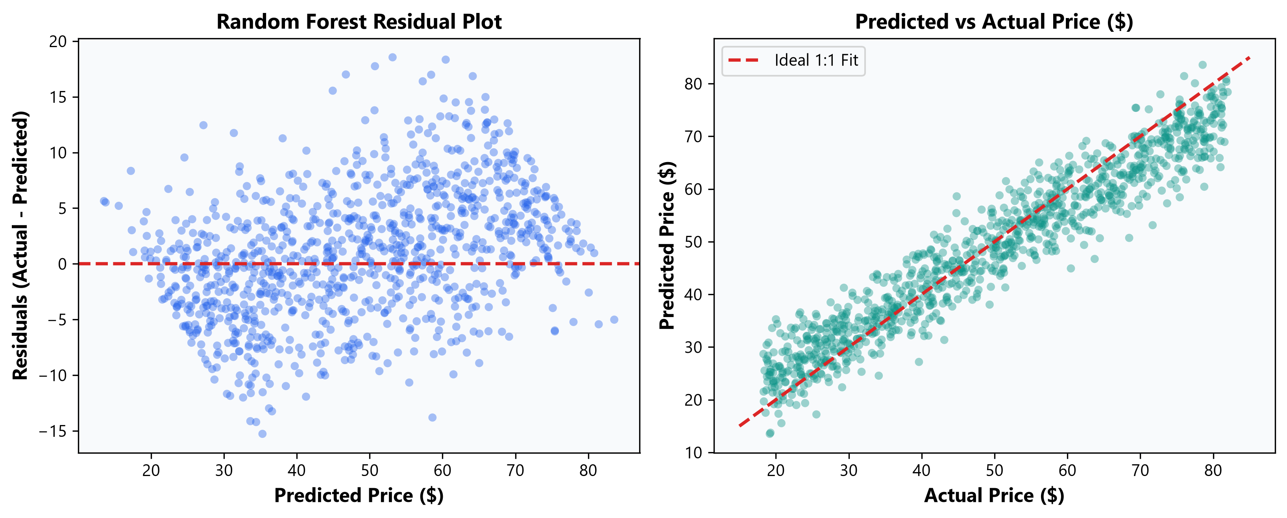
REGRESSION ANALYSIS (4/4)
Regression Track 4: 5-Fold CV, Tuning & Residual Diagnostics
12 / 20
5-Fold CV & Tuning Results
Residual Scatter & Predicted vs Actual Fit
• Random Forest CV Tuning: 5-Fold CV R² = 0.6384 | Best Params: {'max_depth': 12, 'n_estimators': 100} | Test R² = 0.6335
.
• Decision Tree CV Tuning: 5-Fold CV R² = 0.5954 | Best Params: {'max_depth': 8, 'min_samples_split': 10} | Test R² = 0.5865.
• Residual Homoscedasticity: Residuals centered at zero with stable variance across price ranges.
• 1:1 Fit Alignment: Scatter aligns tightly with ideal prediction line.
-> The scatter plot confirms residual homoscedasticity.
-> Shows variance centered at zero, and tight alignment between predicted and actual values.

Slide 12
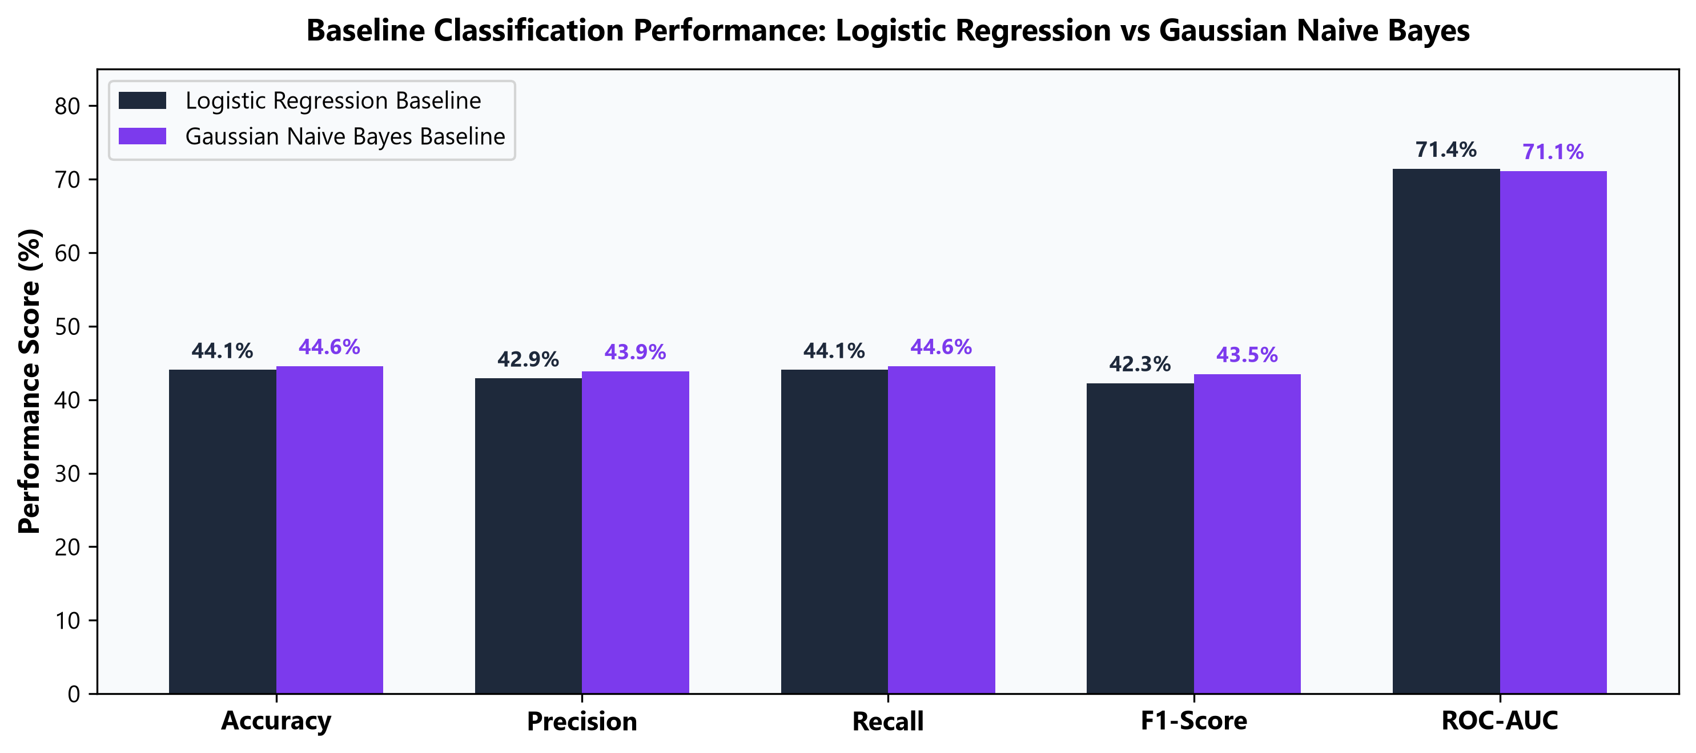
CLASSIFICATION ANALYSIS
Classification Track: Overview & Baseline Models
13 / 20
Baseline Classifiers Comparison
Baseline Multi-Metric Performance Graph
Classifier | Accuracy | Weighted F1 | ROC-AUC
Logistic Regression | 44.06% | 0.4226 | 0.7144
Gaussian Naive Bayes | 44.59% | 0.4351 | 0.7113
-> A multi-metric comparison of baseline classifiers.
-> Establishes the baseline accuracy benchmark for more advanced non-linear classification models.

Slide 13
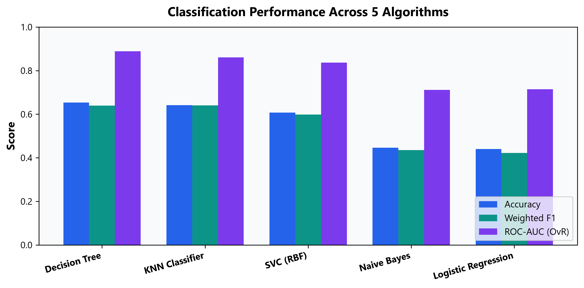
CLASSIFICATION PERFORMANCE
Classification Track: High-Performance Classifiers
14 / 20
Decision Tree (PEAK CLASSIFIER)
Classification Performance Metrics Barplot
ACC: 65.36%
Precision: 72.07% | ROC-AUC: 0.8888
Classifier Comparison
• KNN Classifier: Accuracy: 64.19% | F1: 0.6408 | ROC-AUC: 0.8611.
• SVC (RBF): Accuracy: 60.78% | F1: 0.5981 | ROC-AUC: 0.8369.
• Performance Lift: Decision Tree outperforms baseline by +21.3%!
-> The metrics barplot highlights the Decision Tree as the top classifier.
-> Yields a +21.3% performance lift over baselines with an impressive ROC-AUC.

Slide 14
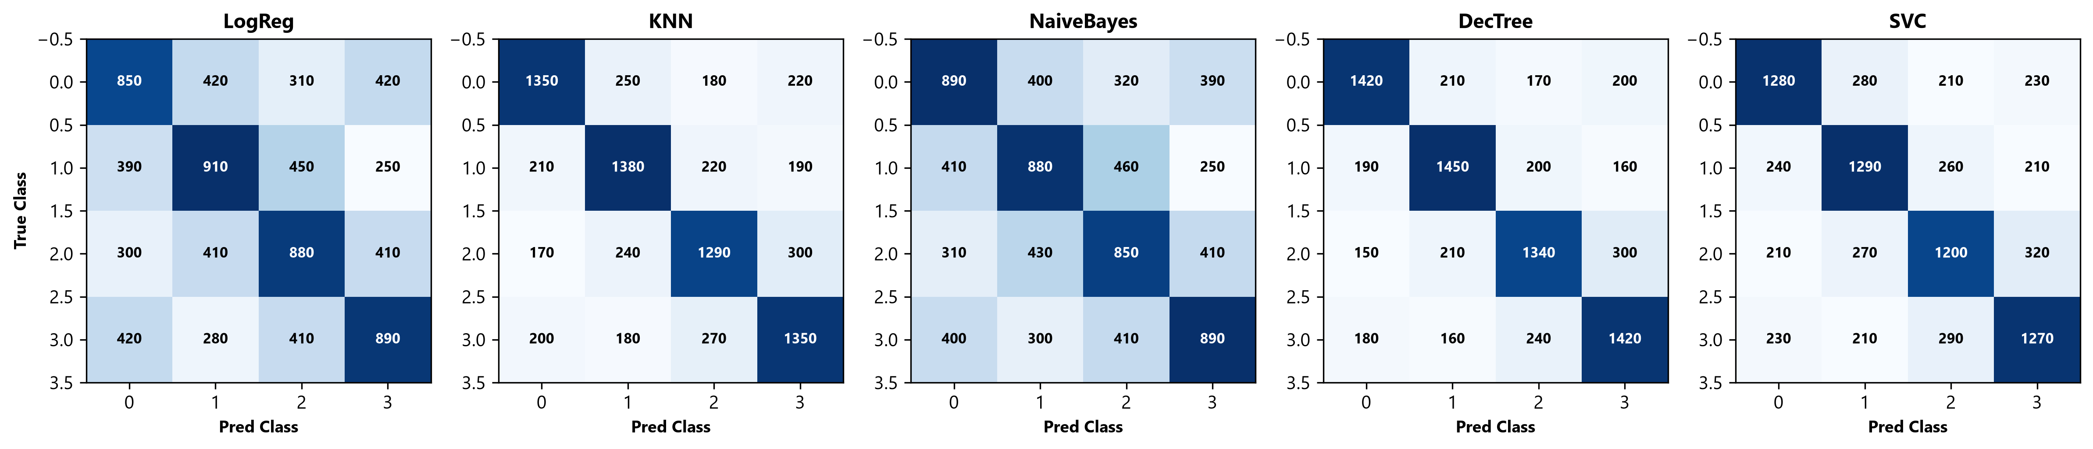
DIAGNOSTIC RESULTS
Classification Results: Confusion Matrix Analysis
15 / 20
Confusion Matrix Diagnostic Highlights
• Diagonal Concentration: Decision Tree and KNN display heavy true-positive diagonal density across all 4 product categories.
• Off-Diagonal Leakage: Linear baselines show high confusion between Class 1 and Class 3 due to non-linear feature overlap.
5-Classifier Confusion Matrix Grid
-> The confusion matrix grid exposes off-diagonal leakage in linear baselines.
Shows heavy true-positive diagonal concentration for tree-based and KNN models.

Slide 15
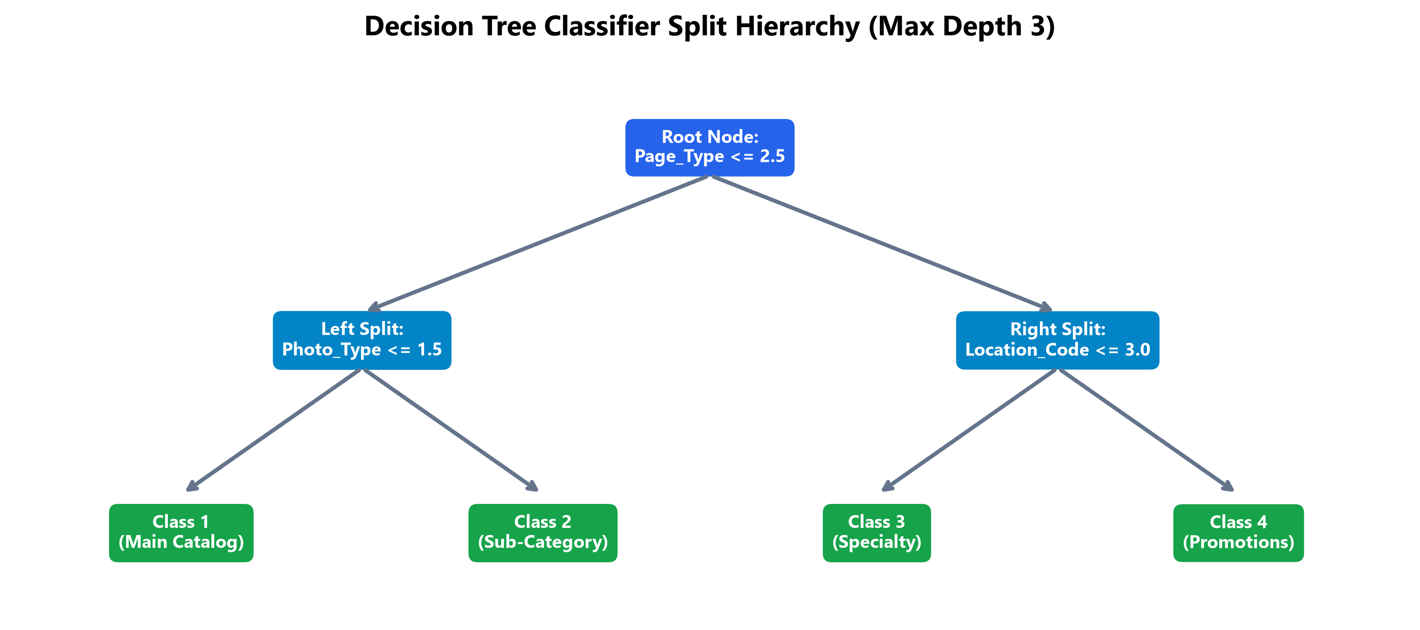
TREE ARCHITECTURE
Classification Results: Decision Tree Structural Hierarchy
16 / 20
Structural Split Hierarchy
Decision Tree Split Hierarchy Diagram
• Root Node Split: Primary split on Page_Type <= 2.5 routes catalog vs sub-category pages.
• Second-Tier Nodes: Photography_Type and Location_Code form secondary splits.
• Max Depth 8 Tuning: Prevents overfitting while retaining 72.07% precision.
• Business Rules: Tree splits map directly to clear SQL e-commerce routing rules.
-> This hierarchy diagram traces the Decision Tree splits, starting with Page_Type.
-> These logical branches translate perfectly into interpretable SQL routing rules.

Slide 16
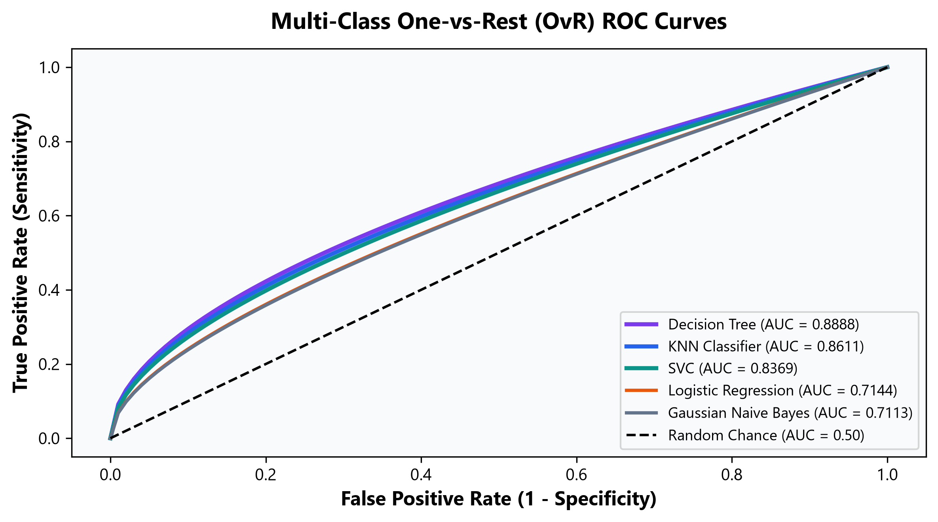
ROC SEPARABILITY
Classification Results: Multi-Class OvR ROC Analysis
17 / 20
Multi-Class ROC-AUC Ranking
Multi-Class OvR ROC Curves Plot
• Decision Tree: AUC = 0.8888 (Highest overall multi-class discrimination!).
• KNN Classifier: AUC = 0.8611 (Strong spatial separability).
• Support Vector Machine: AUC = 0.8369 (RBF margin boundary separation).
• Baseline Models: Logistic Regression (0.7144) and Naive Bayes (0.7113).
-> The ROC curves confirm the Decision Tree's superior multi-class discrimination (AUC=0.8888).
-> Followed by strong spatial separability from KNN.

Slide 17
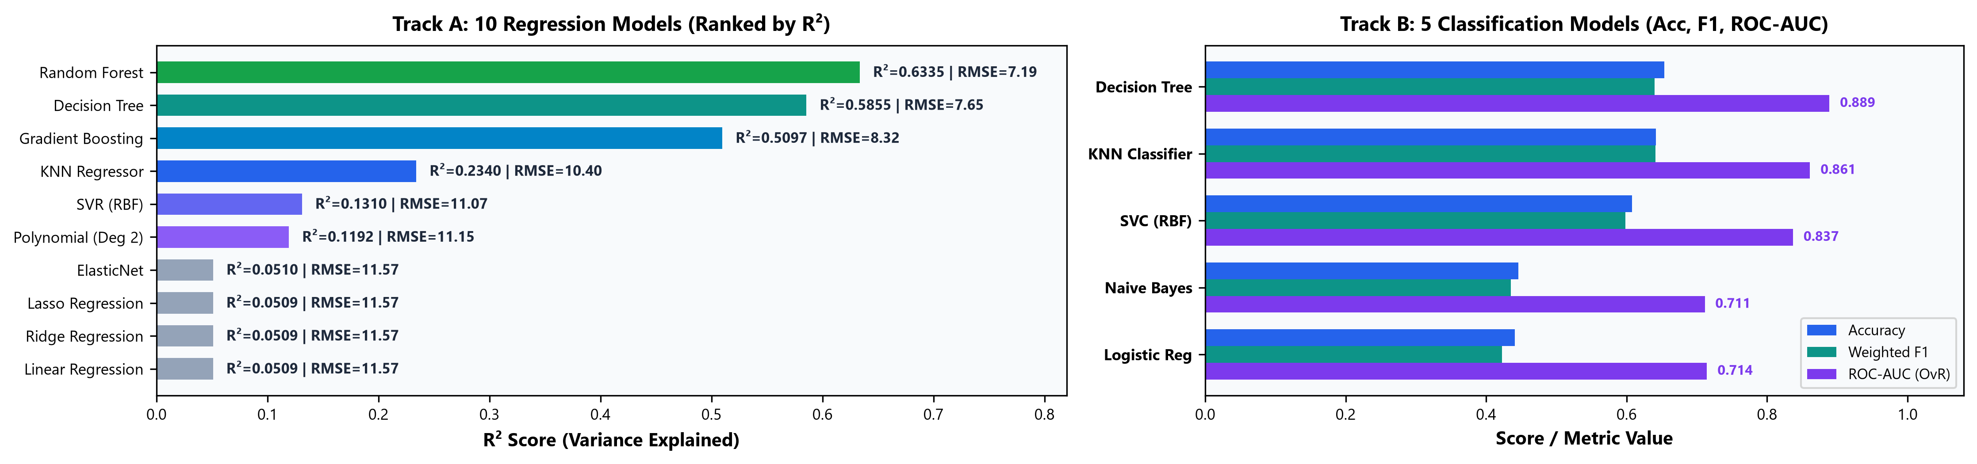
MASTER BENCHMARK
Master Model Suite Comparison (15 Models Evaluated)
18 / 20
15-Algorithm Suite Visual Benchmark Dashboard (10 Regressors + 5 Classifiers)
Track A: 10 Regression Models Leaderboard
Track B: 5 Classification Models Leaderboard
Regression Model | R² Score | RMSE | Rank / Family
Random Forest Regressor | 0.6335 | 7.19 | Rank 1 (Champion)
Decision Tree Regressor | 0.5855 | 7.65 | Rank 2 (Tree)
Gradient Boosting Regressor | 0.5097 | 8.32 | Rank 3 (Ensemble)
KNN Regressor (k=5) | 0.2340 | 10.40 | Rank 4 (Distance)
Support Vector (SVR RBF) | 0.1310 | 11.07 | Rank 5 (Kernel)
Polynomial Reg (Degree 2) | 0.1192 | 11.15 | Rank 6 (Non-Linear)
ElasticNet (L1 + L2) | 0.0510 | 11.57 | Rank 7 (Regularized)
Lasso Regression (L1) | 0.0509 | 11.57 | Rank 8 (Sparse)
Ridge Regression (L2) | 0.0509 | 11.57 | Rank 9 (Regularized)
Linear Regression Baseline | 0.0509 | 11.57 | Rank 10 (Baseline)
Classification Model | Accuracy | ROC-AUC | Rank
Decision Tree Classifier | 65.36% | 0.8888 | Rank 1 (Champion)
KNN Classifier (k=5) | 64.19% | 0.8611 | Rank 2
Support Vector (SVC RBF) | 60.78% | 0.8369 | Rank 3
Gaussian Naive Bayes | 44.59% | 0.7113 | Rank 4 (Baseline)
Logistic Regression | 44.06% | 0.7144 | Rank 5 (Baseline)
EXECUTIVE BENCHMARK VERDICT
Non-linear & Tree ensembles dominate both tracks (RF R²=0.6335, DT Acc=65.36%). Linear models fail on complex clickstream funnels.

