Slide 1
Matrix Multiplication using MapReduce
Rohith Verma Kadari (700739895)
Sriram Nalabolu (700740102)
V P S Abhay Bharath Polisetty (700740446)
Prasanth Sagar Talluru (700734537)
Venkata Ramana Cherukuri (700742704)

Slide 2
Agenda
Introduction
What is Big Data?
Why MapReduce?
How MapReduce Works?
Phases in MapReduce
Matrix Multiplication
Code for Matrix Multiplication

Slide 3
Introduction
MapReduce is a programming model for writing applications that can process Big Data in parallel on multiple nodes. MapReduce provides analytical capabilities for analyzing huge volumes of complex data.

Slide 4
What is Big Data?
Big Data is a collection of large datasets that cannot be processed using traditional computing techniques. Big data is classified in three ways Structured Data, Unstructured Data and Semi-Structured Data. Big data can be defined by using Volume, Velocity and Variety. Big data is also data but with a huge size.

Slide 5
Why MapReduce?
Traditional Enterprise Systems normally have a centralized server to store and process data. The traditional model is not suitable for processing huge volumes of scalable data and cannot be accommodated by standard database servers. Moreover, the centralized system creates too much bottleneck while simultaneously processing multiple files. The traditional model is not suitable for processing huge volumes of scalable data and cannot be accommodated by standard database servers. Google solved this bottleneck issue using an algorithm called MapReduce. MapReduce divides a task into small parts and assigns them to many computers. Later, the results are collected in one place and integrated to form the result dataset.

Slide 6
How MapReduce Works?
The MapReduce algorithm contains two important tasks, namely Map and Reduce.
The Map task takes a set of data and converts it into another set of data, where individual elements are broken down into tuples (key-value pairs).
The Reduce task takes the output from the Map as an input and combines those data tuples (key-value pairs) into a smaller set of tuples.
The reduce task is always performed after the map job.

Slide 7
Phases in MapReduce
Map − Map is a user-defined function, which takes a series of key-value pairs and processes each one of them to generate zero or more key-value pairs.
Shuffle and Sort − The Reducer task starts with the Shuffle and Sort step. The individual key-value pairs are sorted by key into a larger data list. The data list groups the equivalent keys together so that their values can be iterated easily in the Reducer task.
Reducer − The Reducer takes the grouped key-value paired data as input and runs a Reducer function on each one of them. Here, the data can be aggregated, filtered, and combined in a number of ways, and it requires a wide range of processing. Once the execution is over, it gives zero or more key-value pairs to the final step. Output formatter translates the final key-value pairs from the Reducer function and writes them onto a file using a record writer.

Slide 8
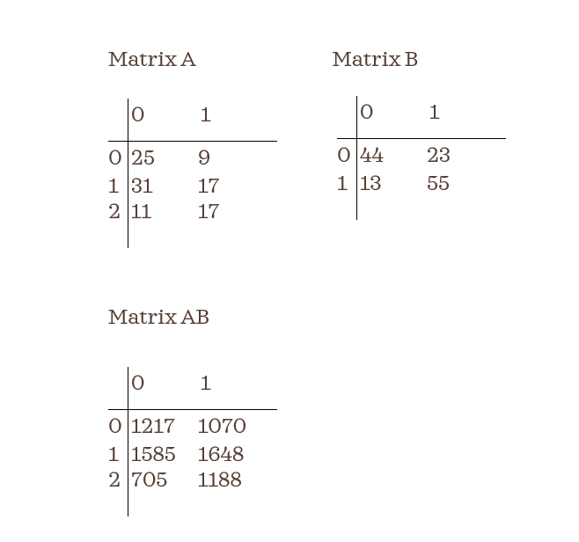
Matrix Multiplication

Slide 9
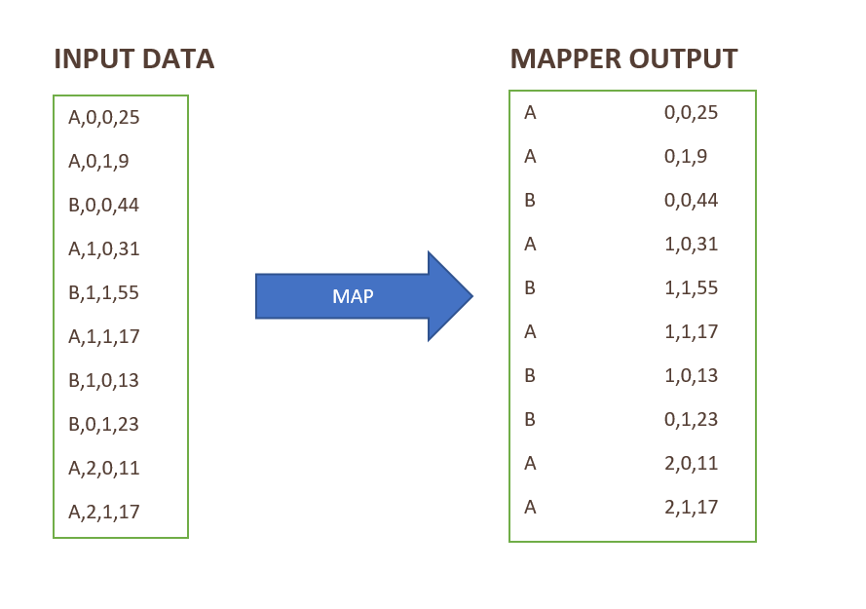
Mapper:

Slide 10
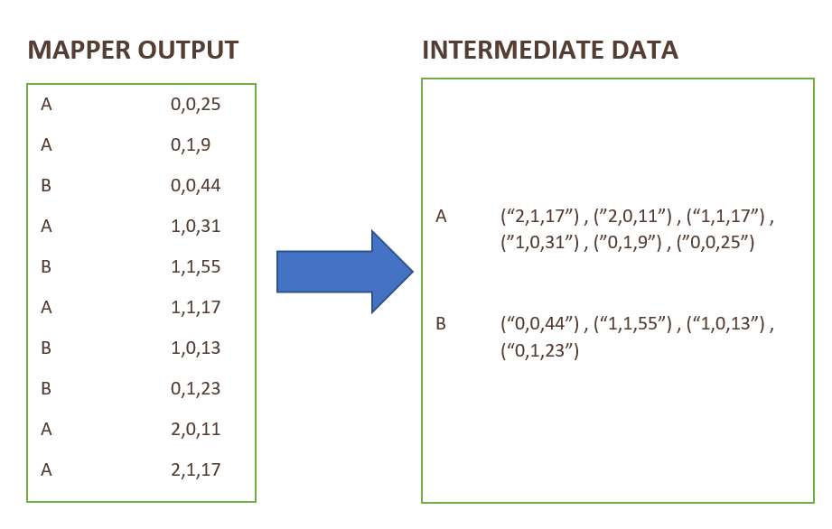
Shuffle & Sort:

Slide 11
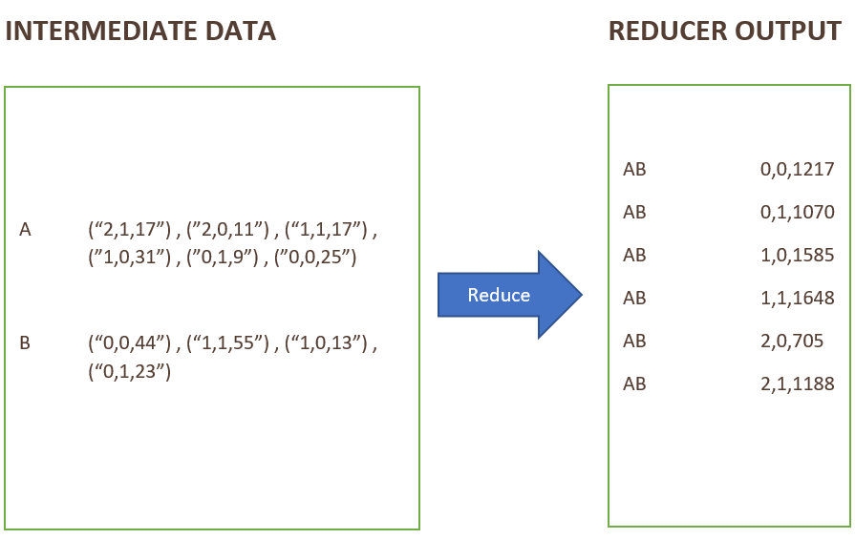
Reducer:

Slide 12
Driver Code
import java.io.IOException;
import org.apache.hadoop.mapreduce.Job;
import org.apache.hadoop.mapreduce.Mapper;
import org.apache.hadoop.mapreduce.Reducer;
import org.apache.hadoop.io.Text;
import org.apache.hadoop.io.IntWritable;
import org.apache.hadoop.io.LongWritable;
import org.apache.hadoop.mapreduce.lib.input.FileInputFormat;
import org.apache.hadoop.mapreduce.lib.output.FileOutputFormat;
import org.apache.hadoop.fs.Path;
import org.apache.hadoop.conf.Configuration;
public class MatrixMultiply
{
//Driver code
public static void main(String args[]) throws Exception
{
//Checking if 3 arguments are passed from yarn command as input
if(args.length!=3)
{
System.out.println("Usage: Matrix Multiplication <input path> <output path> <matrices size>");
System.exit(-1);
}
String[] matrices = args[2].split("");

Slide 13
//Checking if the matrices size are valid
if(Integer.parseInt(matrices[2])!=Integer.parseInt(matrices[4])) {
System.out.println("Error: Incorrect matrices, Matrices should be of size m*n,n*p");
System.exit(-1);
}
Configuration conf = new Configuration();
Job job = Job.getInstance(conf,"Matrix Multiplication");
//Setting row,column sizes of two matrices and passing to mappers and reducers
job.getConfiguration().set("firstrow",String.valueOf(matrices[0]));
job.getConfiguration().set("firstcolumn",String.valueOf(matrices[2]));
job.getConfiguration().set("secondrow",String.valueOf(matrices[4]));
job.getConfiguration().set("secondcolumn",String.valueOf(matrices[6]));
job.setJarByClass(MatrixMultiply.class);
FileInputFormat.addInputPath(job,new Path(args[0]));
FileOutputFormat.setOutputPath(job,new Path(args[1]));
job.setOutputKeyClass(Text.class);
job.setMapOutputValueClass(Text.class);
job.setMapperClass(MatrixMapper.class);
job.setReducerClass(MatrixReducer.class);
System.exit(job.waitForCompletion(true) ? 0 : 1);
}

Slide 14
Mapper
public static class MatrixMapper extends Mapper<LongWritable,Text,Text,Text>
{
/*Map method taking Byte Offset as Key,Each line from input text file as Value and processing (Text,Text) as output from mapper using Context. */
public void map(LongWritable key,Text value,Context context) throws IOException,InterruptedException
{
String line = value.toString();
//Each line from input is stored as string in an array seperated by ','.
String[] words=line.split(",");
String out1;
String out2="";
out1=words[0];
out2+=words[1]+',';
out2+=words[2]+',';
out2+=words[3];
//Processing the output by generating Matrix name as one output and Row,Column,Value as another output
context.write(new Text(out1),new Text(out2));
}
}

Slide 15
Reducer
public static class MatrixReducer extends Reducer<Text,Text,Text,Text>
{
int count=0;
String[] mat1;
String[] mat2;
String matrix="";
String firstrow;
String firstcolumn;
String secondrow;
String secondcolumn;
//Setup method to store the values in reducer from additional input
@Override
public void setup(Context context)
{
Configuration conf = context.getConfiguration();
firstrow=conf.get("firstrow");
firstcolumn=conf.get("firstcolumn");
secondrow=conf.get("secondrow");
secondcolumn=conf.get("secondcolumn");
}

Slide 16
/*Reduce method taking Matrix name as Key,array of "Row,Column,Value" Text common to the Matrix name as Value and processing (Text,Text) as Reducer output using Context. */
@Override
public void reduce(Text key,Iterable<Text> values,Context context) throws IOException,InterruptedException
{
String rowstr="";
String colstr="";
//Storing each Text from an array of input Texts into a String seperated by ";".
for(Text value:values)
{
if(count==0)
rowstr+=value+";";
if(count==1)
colstr+=value+";";
}
//Storing each String as Array of strings defining it as first matrix and adding matrix name to an empty string
if(count==0)
{
mat1=rowstr.split(";");
matrix=key.toString();
count+=1;
}

Slide 17
//Storing each String as Array of strings defining it as second matrix and concatenating matrix name to matrix string
else{
mat2=colstr.split(";");
matrix+=key.toString();
//Invoking finalStr method
String[] finalList = finalStr();
for(int i=0;i<finalList.length;i++)
{
context.write(new Text(matrix),new Text(finalList[i]));
}
}
}

Slide 18
//Method to return string of Resultant Matrix schema as "Row,Column,Value"
public String[] finalStr()
{
String[] strrows = rowMat(Integer.parseInt(firstrow),mat1,Integer.parseInt(firstcolumn));
String[] strcols = colMat(Integer.parseInt(secondrow),mat2,Integer.parseInt(secondcolumn));
String totstr="";
for(int i=0;i<strrows.length;i++)
{
for(int j=0;j<strcols.length;j++)
{
String result=matMul(strrows[i],strcols[j]);
totstr+=String.valueOf(i)+","+String.valueOf(j)+","+result+";";
}
}
String finalstr[] = totstr.split(";");
return finalstr;
}

Slide 19
//Method to return array of Row Strings from First Matrix
public static String[] rowMat(int rowIndex,String[] mat,int columnIndex)
{
String[] finalString = new String[rowIndex];
for(int i=0;i<rowIndex;i++)
{
String string1="";
for(int j=0;j<columnIndex;j++)
{
for(int k=0;k<mat.length;k++)
{
String[] list1 = mat[k].split(",");
if(Integer.parseInt(list1[0])==i && Integer.parseInt(list1[1])==j)
{
if(j==columnIndex-1)
string1+=list1[2];
else
string1+=list1[2]+",";
}
}
}
finalString[i]=string1;
}
return finalString;
}

Slide 20
//Method to return array of Column Strings from Second Matrix
public static String[] colMat(int rowIndex,String[] mat,int columnIndex)
{
String[] finalString = new String[columnIndex];
for(int i=0;i<columnIndex;i++)
{
String string1="";
for(int j=0;j<rowIndex;j++)
{
for(int k=0;k<mat.length;k++)
{
String[] list1 = mat[k].split(",");
if(Integer.parseInt(list1[1])==i && Integer.parseInt(list1[0])==j)
{
if(j==rowIndex-1)
string1+=list1[2];
else
string1+=list1[2]+",";
}
}
}
finalString[i]=string1;
}
return finalString;
}

Slide 21
//Method to multiply a Row from first matrix and a Column from second matrix and return the result as String
public static String matMul(String strrows,String strcols)
{
String[] row = strrows.split(",");
String[] col = strcols.split(",");
int sum=0;
for(int i=0;i<row.length;i++)
{
sum+=Integer.parseInt(row[i])*Integer.parseInt(col[i]);
}
return String.valueOf(sum);
}
}
}

Slide 22
Thank you

