Slide 1
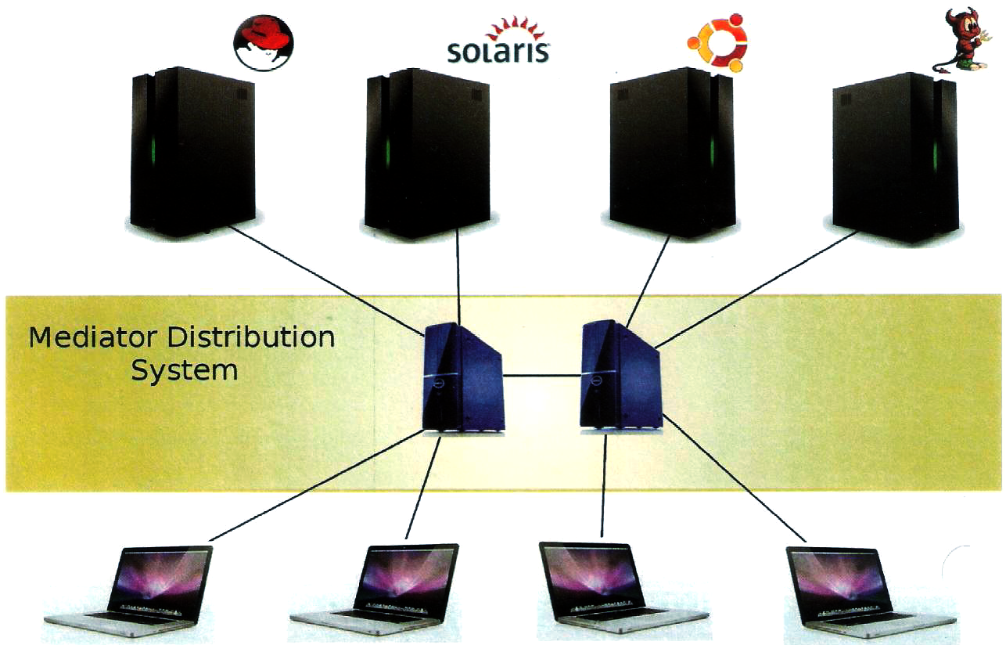
Web Based Remote Console
Saikrishnan B (21108205075)
Sriram VS (21108205092)
Vinayak R (21108205104)
Guide-Ms K.Poornimathi
Batch ID: ITB11P04

Slide 2
Abstract
Our web based remote console is tailored to manage critical and routine administration tasks on various powerful operating systems.
The goal of our project is to provide a unified remote graphical user interface to manage administrative tasks.
The main objective is to provide a system that allows the administration and configuration.

Slide 3
Need for proposed system
Too many commands to remember.
Needs complex scripts.
Malicious scripts possible.
Requires highly trained administrators.
High platform dependency.

Slide 4
Application of proposed system
Intuitive HTML5 and CSS3 GUI.
Power of classified tasks.
Controlled and secured access.
Platform diversity.

Slide 5
Literature Survey
Paper 1: Michael Hasenstein, “SuSE LVM Management Paper”,SuSE Inc, 2001.
Advantages:
-Power of commandline.
-Attach/detach disks without server downtime.
Limitations:
-Malicious scripting possible.
-Overwhelming switches.

Slide 6
Paper 2: Daniel Price, “Solaris Zones”, Sun Microsystems Inc, 2004.
Advantages:
-Consolidate Servers.
-Multiple OS' on same hardware.
Limitations:
-Purely command oriented.
-Cannot administer zones over network.

Slide 7
Paper 3: Brian Down, “Management of Systems and Services Made Simple with the Oracle Solaris Service Management Facility”, Oracle Inc, 2010.
Advantages:
Simple management of Services.
XML based storage- open.
Limitations:
Lacks service classification.
Dependency clash.

Slide 8
Main objective
To provide a system that allows to administer, configure and execute tasks in remote systems in a unified manner.
Allows Remote host to directly administer the system tasks, so that he does not have to remember too many commands

Slide 9
System requirements
Hardware platform specification
  Processor-Pentium IV
  RAM -512 MB RAM
  Secondary Storage -20 GB HDD
Software platform specification
  Operating System -Ubuntu 11.10 32 Bit with GNOME Desktop
  Programming Language-Python 2.7
  Front end -Python server pages

Slide 10
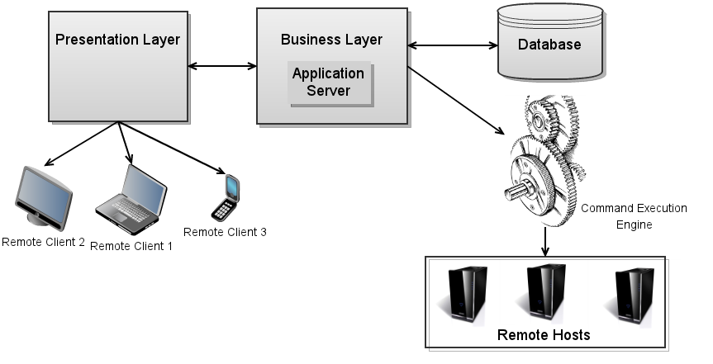
System Architecture
Notes:
Doubty stuff

Slide 11
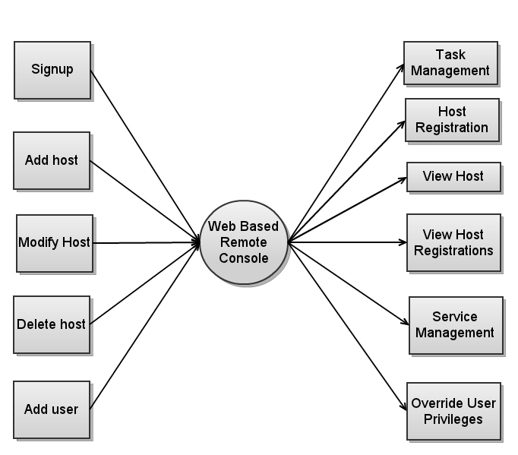
Data Flow Diagram
Zeroth level DFD

Slide 12
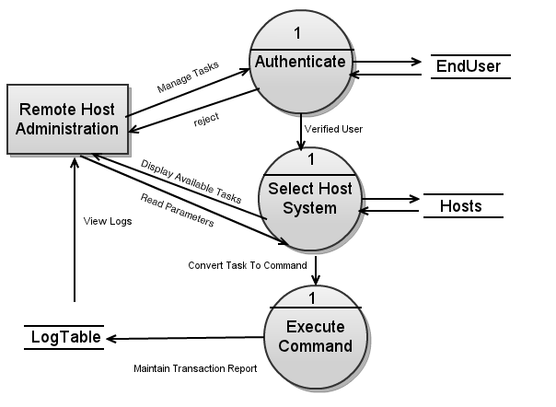
Task Management DFD
Level 1 DFD

Slide 13
Functional Description
Sign up module.
Host registration module:
  - Attach/detach hosts to system.
- Based on OS, IP Address.
Task management module:
  - Disk management.
  - Package management.
  - Automated task management.

Slide 14
Database design- EndUser Table
Column name | Datatype | Description
Regno | Integer | Registration number
UserId | Varchar | User identifier
Pwd | Varchar | Password

Slide 15
Database design-SeniorUser Table
Column name | Datatype | Description
Regno | Integer | Registration number
UserId | Varchar | User identifier
Pwd | Varchar | Password

Slide 16
Database design-Hosts Table
Column name | Datatype | Description
HostId | Integer | Host identifier
Regno | Integer | Registration number
IPAddr | Varchar | Internet protocol address
Hostname | Varchar | Host identifier string
Platform | Varchar | Operating system of remote host

Slide 17
Database design-Log Table
Column name | Datatype | Description
TxnId | Integer | Transaction Identifier
HostId | Integer | Host identifier
Regno | Integer | Registration number
Timestamp | Date | Time of execution
Task | String | String depicting the task
Outcome | Varchar | Outputs and error

Slide 18
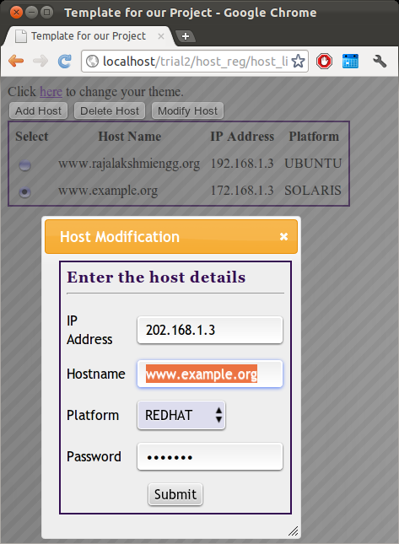
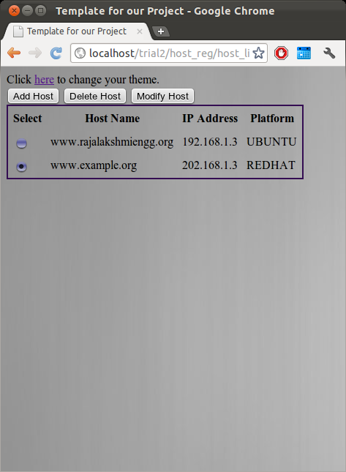
Host Modification
Remote Host Administrator manages hosts.
Enter requisite fields and submit to register

Slide 19
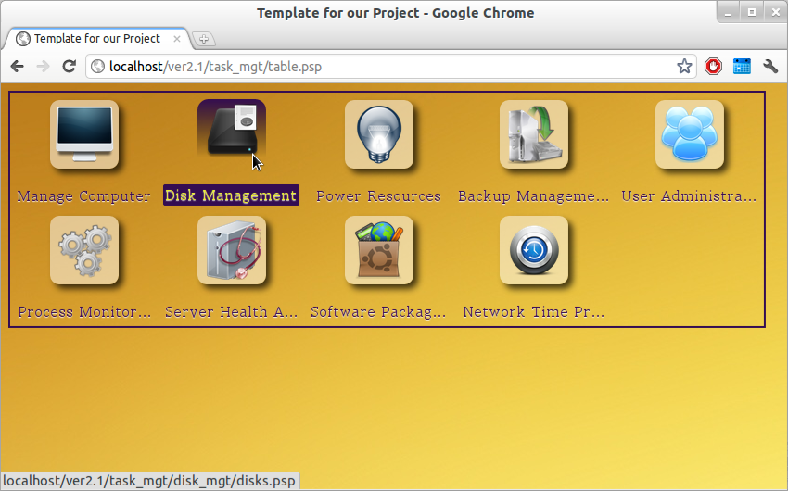
Task grid that are available on the remote host.
Translate to commands and execute remotely.
Task Execution

Slide 20
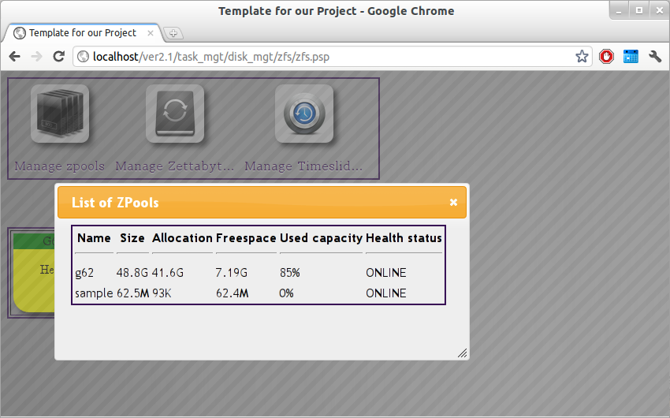
ZFS Management
Used to manage ZFS and Zpools.
FUSE based (FileSystem in User SpacE).

Slide 21
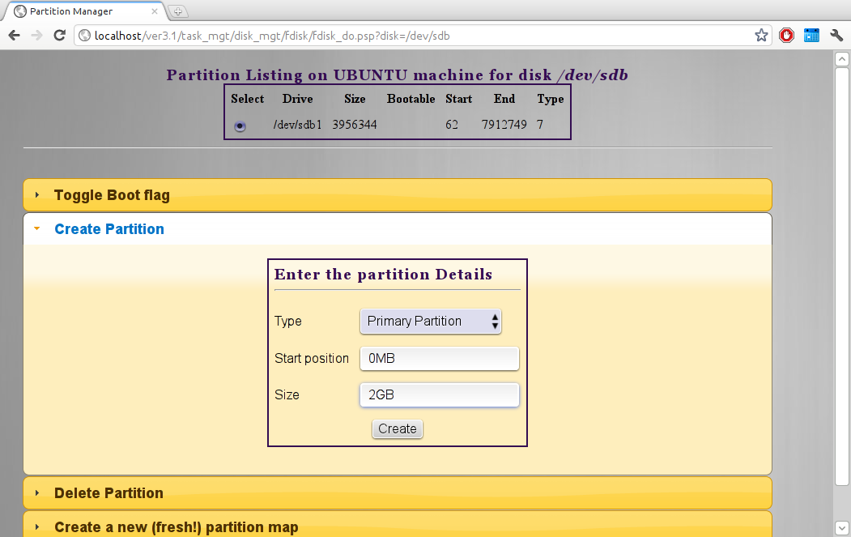
Disk Management
Web GUI to fdisk disk management.

Slide 22
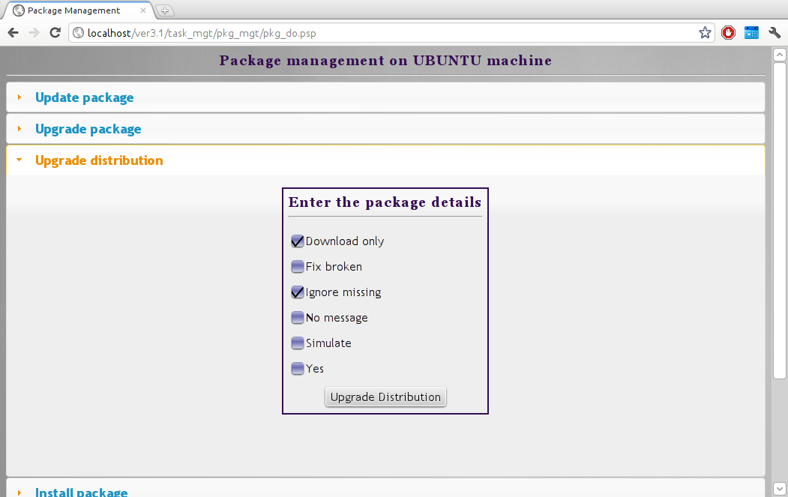
Package Management
Allows user to manage packages.
Variety of options to configure.

Slide 23
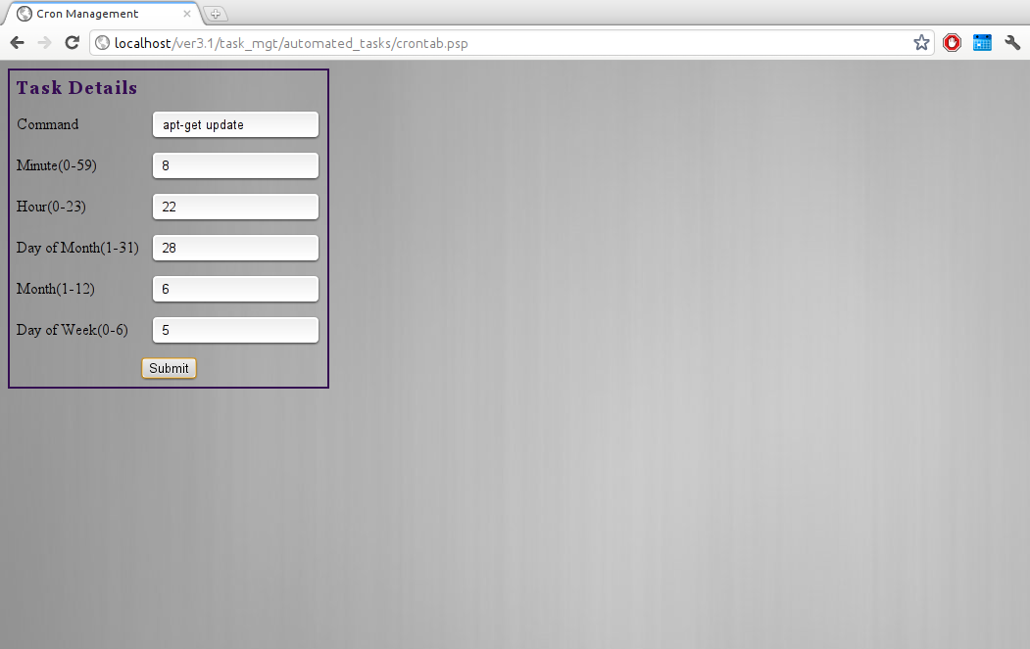
Cron Management
Allows scheduling of tasks.
Run automatically at scheduled intervals.

Slide 24
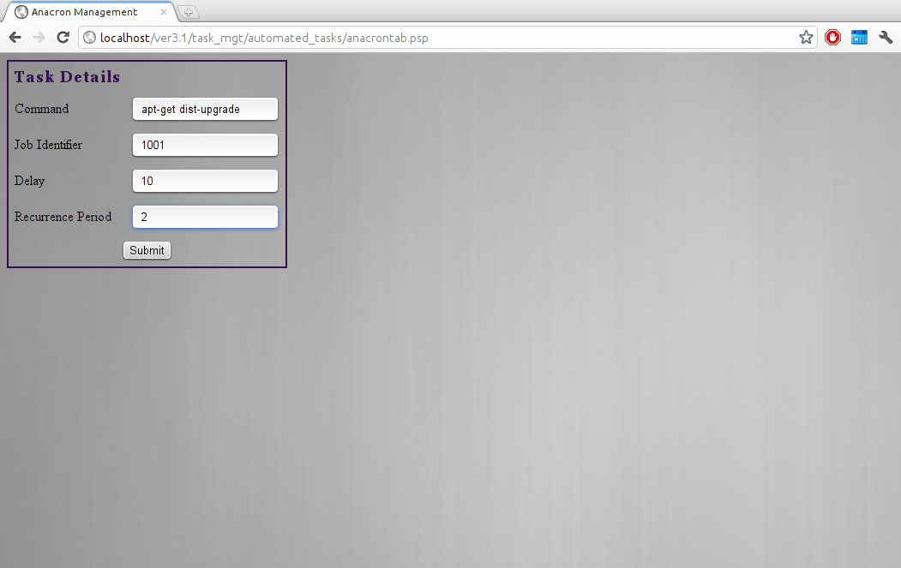
Anacron Management
The cron for laptops and desktops.
System need not run 24x7.

Slide 25
Unit Testing
Smallest testable parts of the application, called units, are individually and independently scrutinized for proper operation.
The modules are individually built and compiled for errors
  Host Listing
  Package Installation

Slide 26
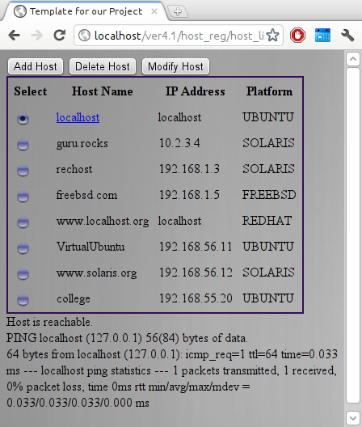
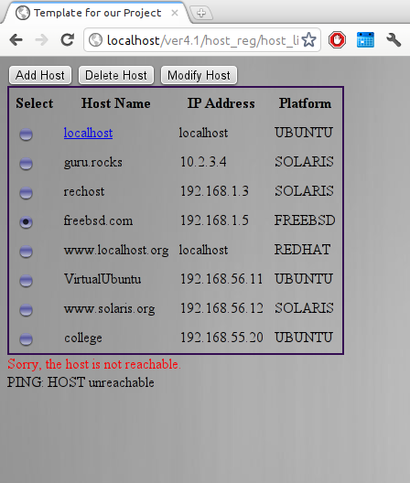
Test Case- Host Listing

Slide 27
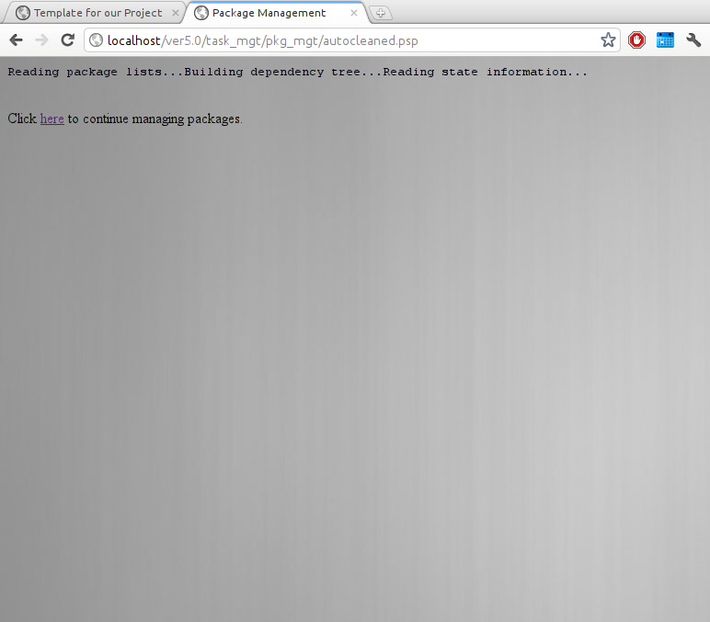
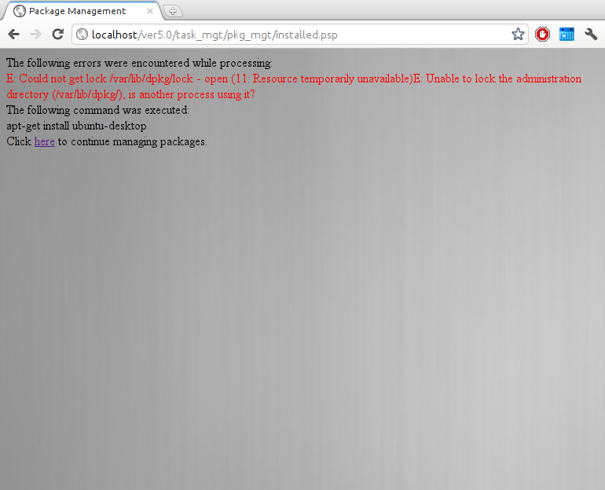
Test case-Package Installation

Slide 28
Setup
mod_python from Ubuntu Software Package Manager.
MySQLdb module for database connectivity.
Configure /etc/apache2/apache2.conf .
Add PSP handler.
Set PythonPath variable.
Installation Procedure:

Slide 29
References
[1] Michael Hasenstein, SuSE LVM
Management Paper,SuSE Inc, 2001
http://www.hasenstein.com/lvm_whitepaper.pdf
[2] Daniel Price, Solaris Zones, Sun
Microsystems Inc, 2004
http://blogs.oracle.com/dp/resource/lisa.pdf
[3] Brian Down, Management of Systems and
Services Made Simple with the Oracle Solaris
Service Management Facility, Oracle Inc, 2010
http://developers.sun.com/solaris/docs/smf-bp-0610.pdf

Slide 30
References
Websites
[1] The Linux Project
http://www.tldp.org/
[2] Distrowatch
http://www.distrowatch.com/sites/opensuse.html
[3] FreeBSD Project
http://www.freebsd.org/docs/

Slide 31
Thank you.

