Slide 1
ADVANCED PATTERN MATCHING
pandiyan,sriram

Slide 2
GAME DESCRIPTION:
This game will be played by one person at a time.
The user has to login using his userid and password.
After authentication, player selects the difficulty level like easy, medium & hard.
Depending on the level selected, a random display of horizontal & vertical bars are displayed on the seven-segment displays for the player to memorise.
Now, player enters the pattern displayed above using toggle switches.
If the pattern matches then the score increases depending on the level selected.
The timer module starts from ‘99’ and comes down to ‘00’ and later on inputs are not taken.

Slide 3
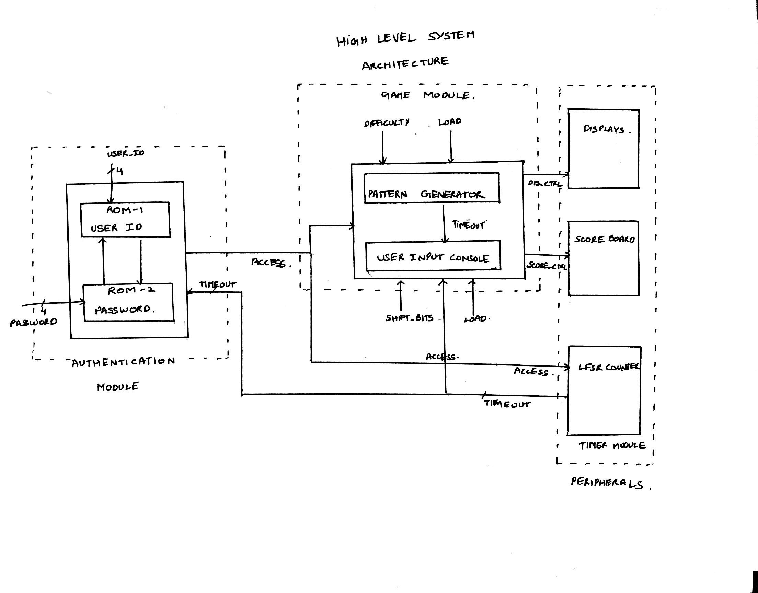
SYSTEM ARCHITECTURE DESIGN:

Slide 4
MODULES DESCRIPTION:
1) AUTHENTICATION MODULE
We have used sixteen 4 digit userid & password combinations for our system.
These are stored in their specific ROMs.
Userid is entered using the toggle switches.
If the userid is valid then user can enter the password.
Now, this combination is authenticated and an access signal for the game module is generated.

Slide 5
Video Demo for authentication:
https://drive.google.com/open?id=16QeK4-S42eMEi16LpPcqFjPqRRJSxDoH

Slide 6
2) PATTERN GENERATOR:
After the player is authenticated, this module receives an authorise signal from the
authentication module.
Player chooses the level of play from easy, medium and hard using toggle switches.
→ Easy --- 00
→ Medium --- 01
→ Hard --- 10
Depending on the level, a random sequence of horizontal & vertical bars is displayed on the
3 seven-segment displays dedicated for this.

Slide 7
3) USER INPUT CONSOLE:
In this module, the player has to depict the randomly generated sequence using the
toggle bars and push button.
The timer starts from ‘99’ and ends at ‘00’.
Toggle bars are used to switch from one segment to other on the display.
Push button is used to load the pattern.
Now the entered pattern is compared and win signal is sent to the score module.

Slide 8
Video Demo for playing the game:
https://drive.google.com/open?id=1ZlGwpjT1An8JrGC6yfmzKGObznzaV5mU

Slide 9
4) SCORE MODULE:
This module counts the score of each player and stores them in RAM using their userid addresses.
When player wins, depending on the level selected the score increases.
→ Easy --- 1 point
→ Medium --- 2 points
→ Hard --- 3 points
If player looses, the score will not be updated.
When the timeout is reached, no more inputs are taken.
The maximum score can be taken from the RAM by enabling the read option.

Slide 10
THANK YOU

