Slide 1
PROJECT Local Area Unemployment Statistics (LAUS)
Sriram Pulipaka

Slide 2
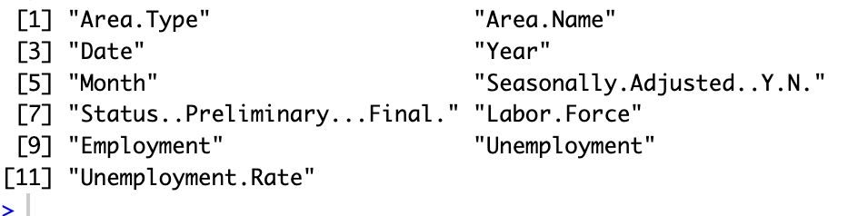
Introduction
The Local Area Unemployment Statistics (LAUS) program is a collaboration between the federal government and states. Its goal is to provide monthly estimates of employment and unemployment for around 7,300 areas in california, such as counties, cities, and metropolitan statistical areas. These estimates help us understand the local economic conditions.
Dataset Columns:

Slide 3
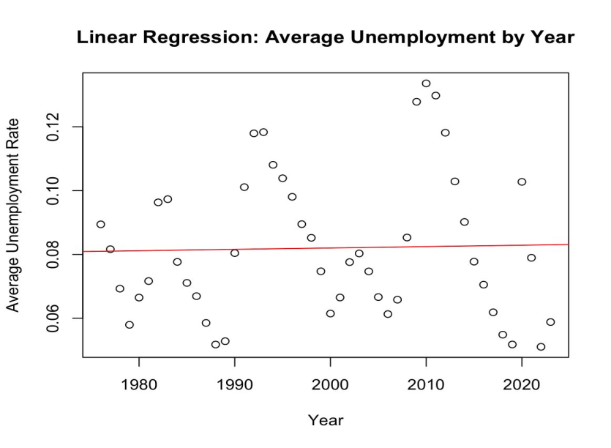
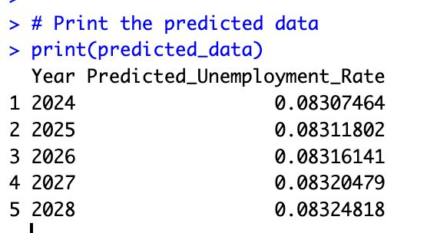
Data Analysis - Linear Regression
" Average Unemployment by Year“
Plot:
Predicted data:

Slide 4
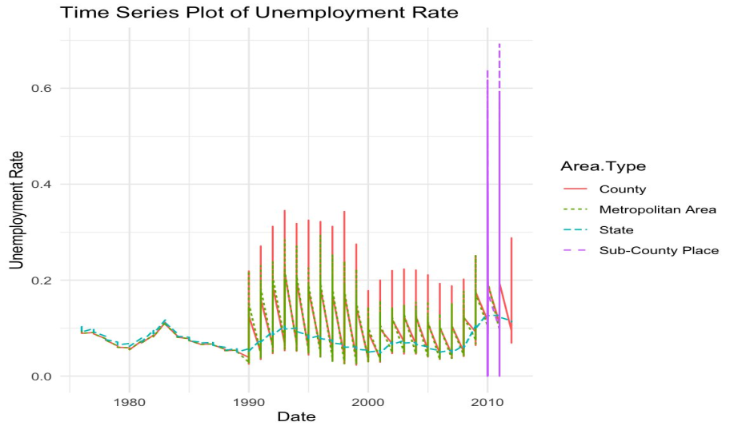
Time Series Analysis
Unemployment Rate Over Time
Plot:
Interpretation : Time series plot with different area types distinguished. For example in 2010 , The unemployment rate is highest in sub county place.

Slide 5
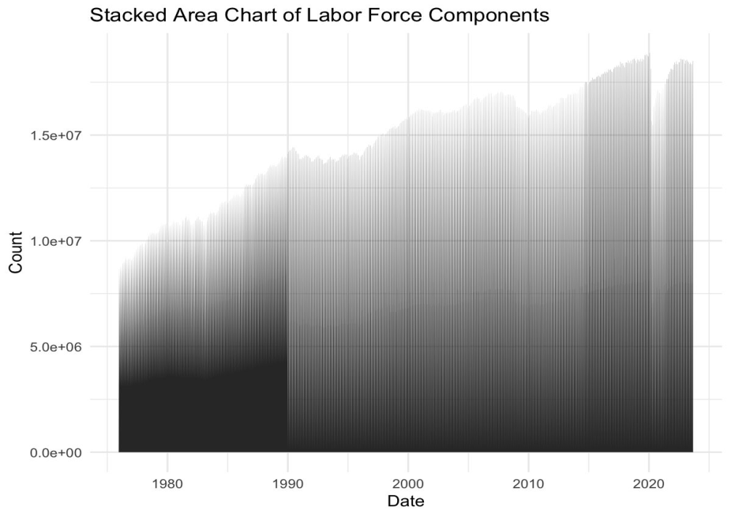
Stacked Area Charts
Components of Labor Force Over Time
Stacked area chart for employment:
Plot:
Interpretation: Over Time, Employment rate is increasing.

Slide 6
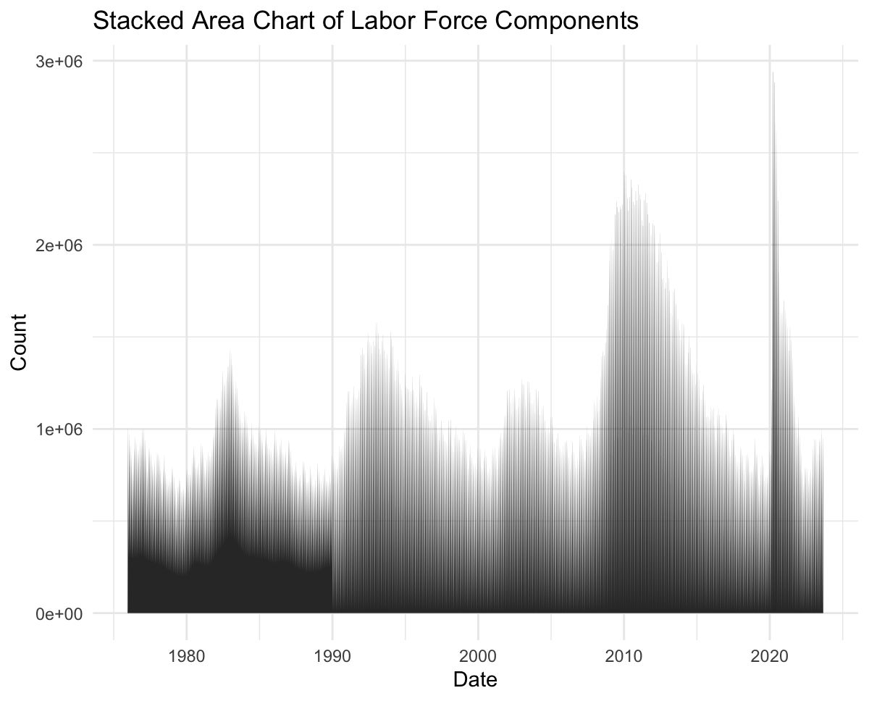
Stacked area chart for unemployment:
Plot:
Interpretation: Over Time, Unemployment rate is showing different fluctuations.

Slide 7
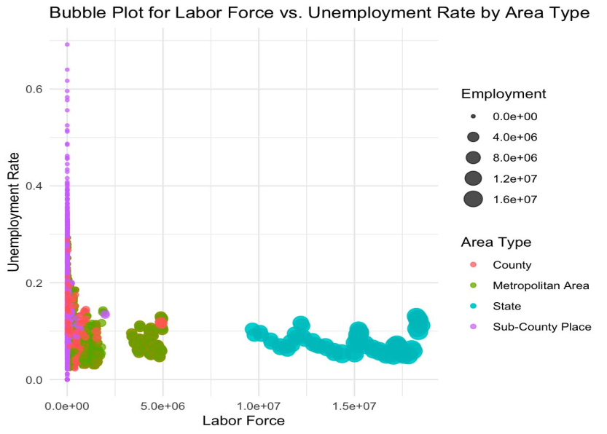
Bubble Plot
Labor Force vs. Unemployment Rate
Plot:
Interpretation: State Area type has less unemployment rate and subcounty has more.

Slide 8
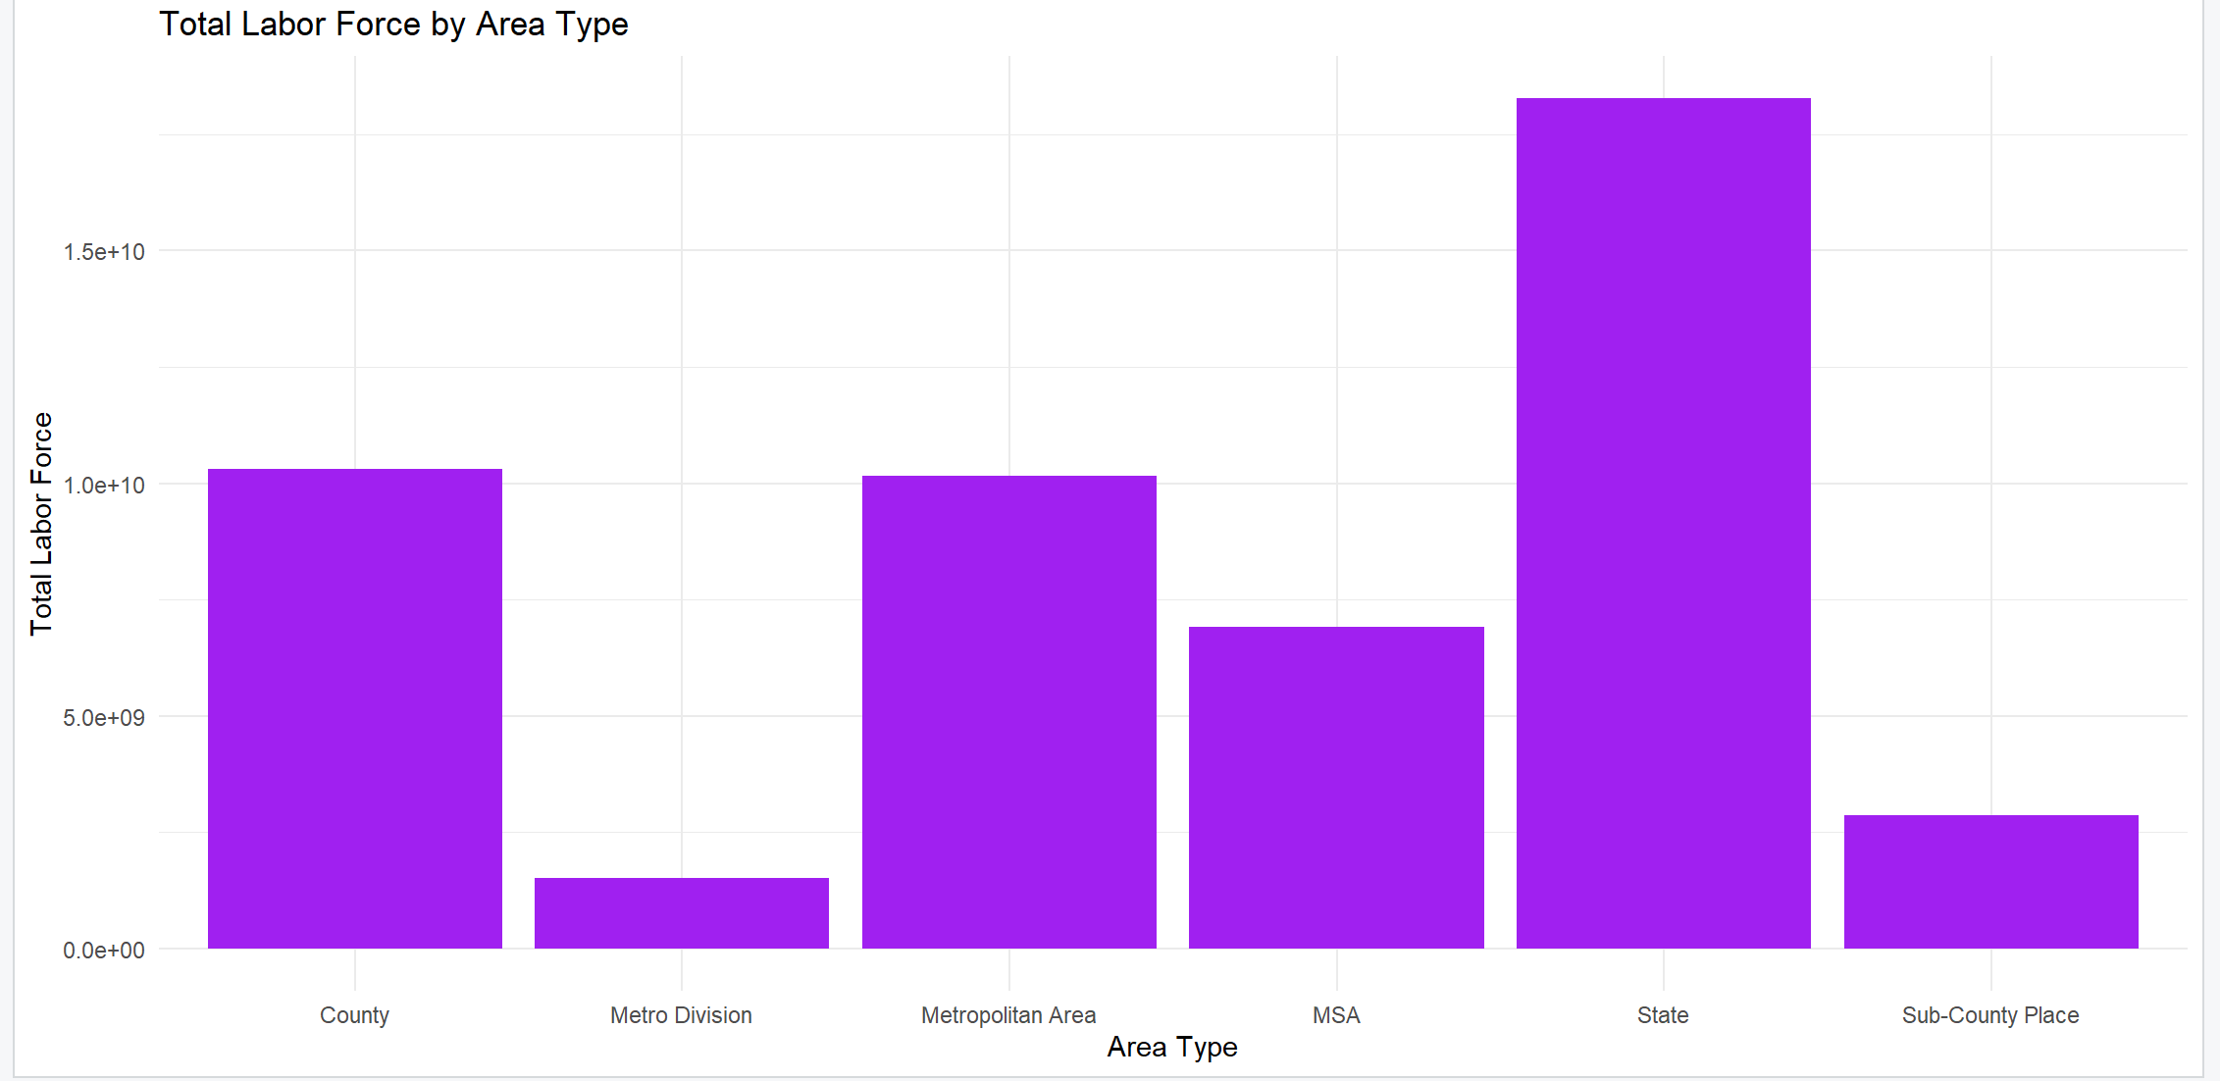
Bar Chart
Total Labor Force by Area Type
Plot:
Interpretation: State area type has more Labor force and Metro Division has the lowest

Slide 9
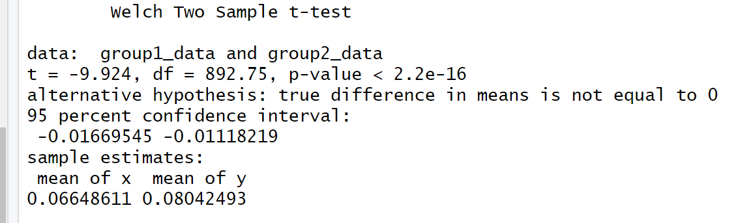
Statistical Tests - t-test
Comparison of Unemployment Rates (t-test)
Result:

Slide 10
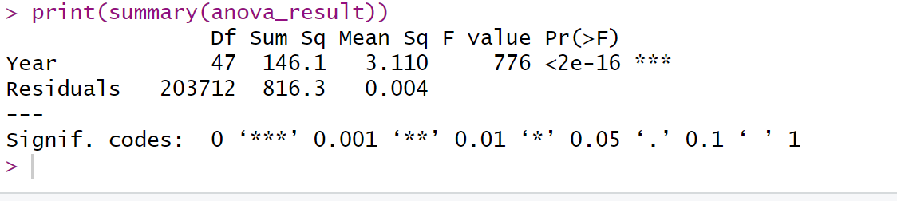
ANOVA
Yearly Variation in Unemployment Rates (ANOVA)
Result:

Slide 11
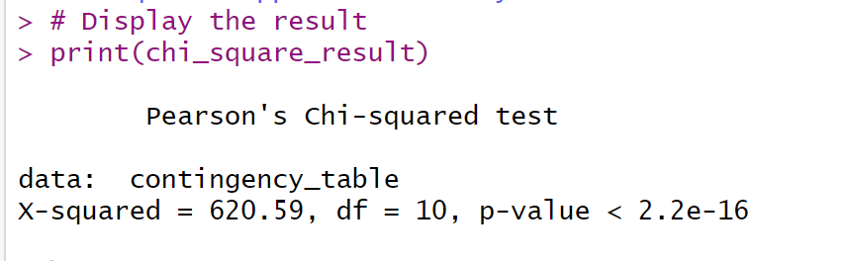
Chi-square Tests
Association Between Categorical Variables
Example 1: Test b/w Area and Status
Result:

Slide 12
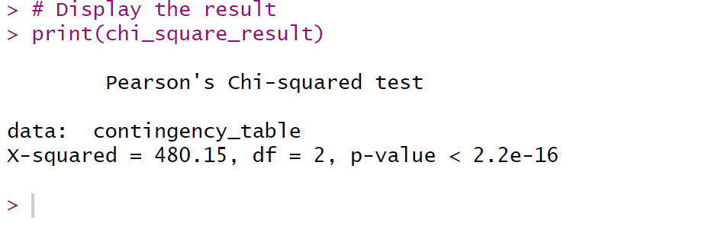
Example 2: Test b/w Seasonally and Status
Result:

Slide 13
Conclusion
Analysis of California's labor market unveils diverse trends. Varied regional fluctuations and nuanced relationships between labor force and unemployment rates highlight the state's economic complexity.
LAUS program is a way for the government to figure out how many people are working and unemployed in different areas, helping us understand the economic health of those places.

