Slide 1


26
ANNUAL CONFERENCE 2026
STATIM
Transforming Insurance Through AI and Composable Solutions
INTELLIGENT
CONNECTED
COMPOSABLE
GLOBAL
Senthil Viswanathan

Slide 2










MARKET CONTEXT
The Insurance Industry Is Transforming
01
02
03
04
05
Digital Customers
AI Goes Mainstream
Embedded & Parametric Insurance
Regulatory Evolution
Competition
Fully digital journeys are the baseline
AI decisions across the value chain
Cover sold inside everyday journeys
Continuous compliance, by design
InsurTechs reset expectations
06
07
08
09
10
Connected Ecosystems
Hyper-personalization
Open APIs
Cloud Adoption
Faster Launches
Partner-driven distribution
Tailored products and pricing
Seamless partner integration
Elastic scale, lower run cost
Speed to market wins
Ten forces, one implication: the platform underneath must change.

Slide 3





DESIGN PRINCIPLES
The Next-Generation Insurance Platform
Customer Centric
AI Native
API First
Designed around policyholder journeys
Intelligence embedded, not bolted on
Every capability exposed as a service
Next-Gen
Platform
Composable
Cloud Ready
Capabilities assembled like blocks
Any cloud, any scale
EIGHT TRAITS
Configuration First
Data Driven
Connected Ecosystem
Change products without code
Decisions grounded in platform data
Built to plug into partners

Slide 4






AI OPPORTUNITY
AI Across the Insurance Value Chain
01
Customer Acquisition
Personalized recommendations
AI-powered segmentation
Lead scoring & next-best-offer
03
Policy Administration
Proposal validation & extraction
AI-assisted issuance
Automated document generation
05
Customer Service
AI chat & voice assistants
Intelligent knowledge search
Automated response generation
02
Underwriting
Document intelligence (OCR/NLP)
ML risk scoring & pricing
Telematics & IoT-based risk
04
Claims Management
24×7 FNOL chatbots
Computer-vision damage estimates
Fraud detection & STP settlement
06
Renewals & Retention
Renewal propensity models
Churn prediction
Cross-sell & upsell targeting

Slide 5


ARCHITECTURE
Why Composable Architecture?
Traditional Platform
Composable Platform
One monolithic application
Independent business capabilities
Tight coupling between modules
API-first architecture
Long release cycles
Microservices deployment
Heavy customization
Configuration over customization
Expensive, disruptive upgrades
Continuous upgrades
Complex integrations
Plug-and-play integrations
Months
Weeks
Time to introduce new capabilities — deploy independently, upgrade continuously.
Business Impact: Faster product launches, lower change costs, independent scaling, and continuous innovation.

Slide 6

OUR ANSWER · STATIM VISION
An AI‑powered, composable, cloud‑native platform that helps insurers launch faster, operate leaner and compete in the global digital insurance ecosystem.
AI Powered decision support across the lifecycle
Composable modular business capabilities
Digital Ecosystem partners & marketplaces
Configuration First agility without code
Global Ready multi-country · currency · language
Cloud Ready scalable, resilient, always on

Slide 7
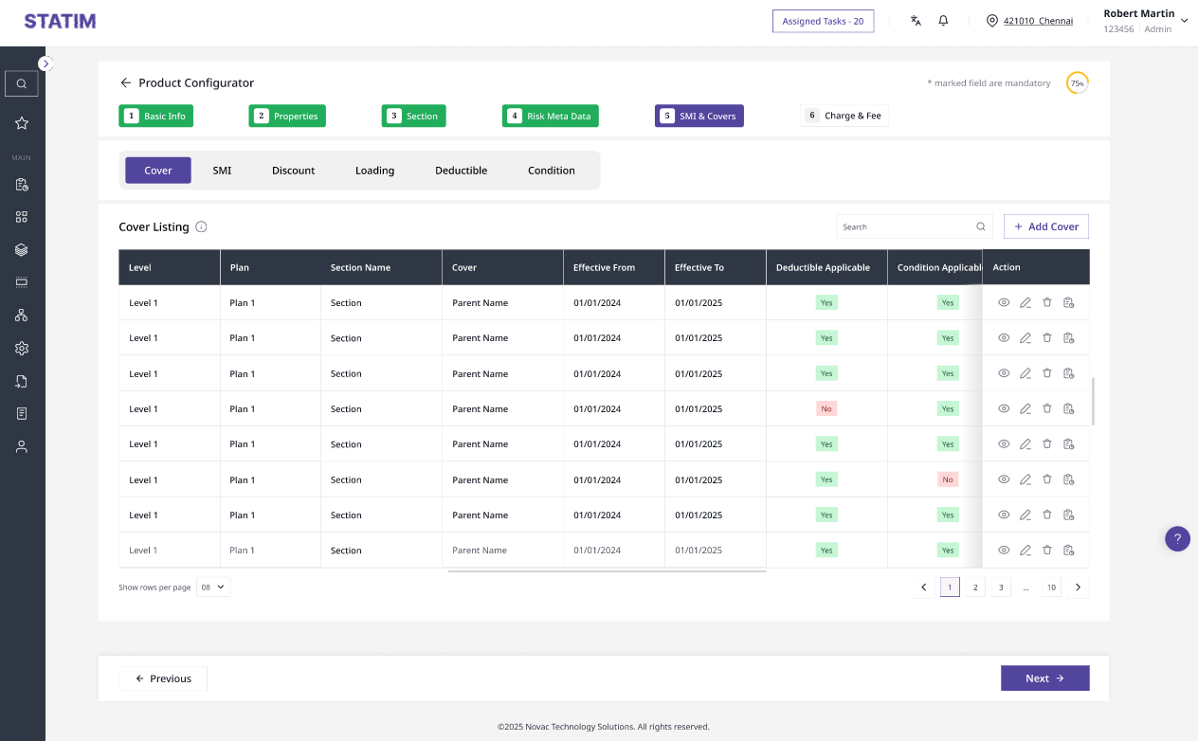
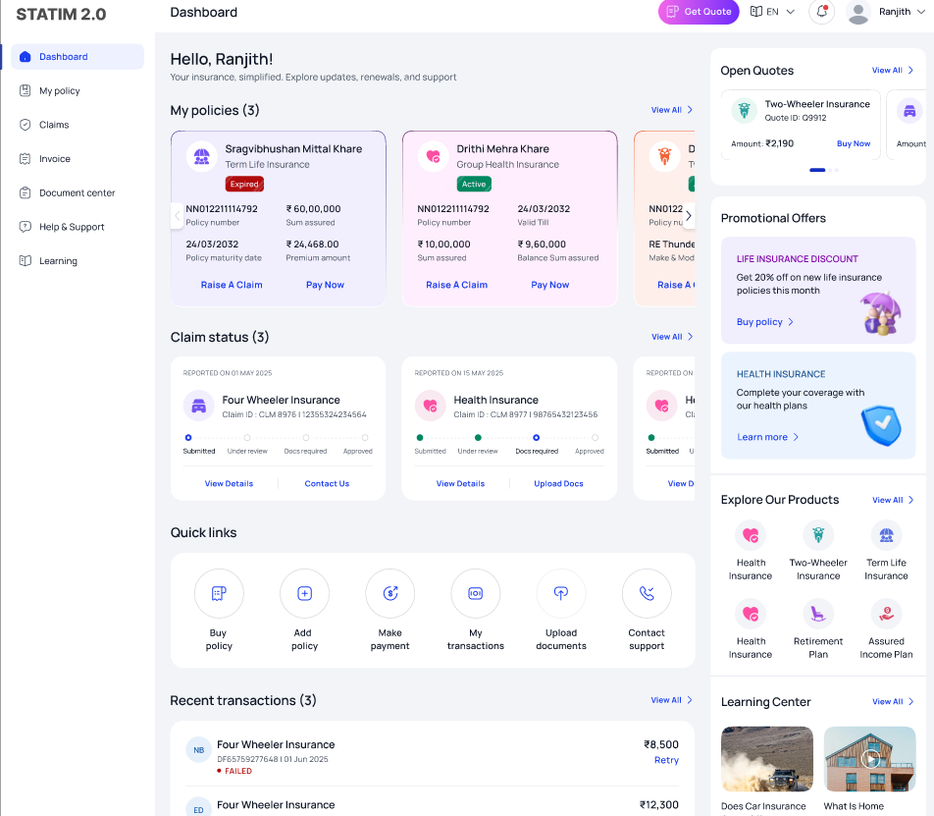
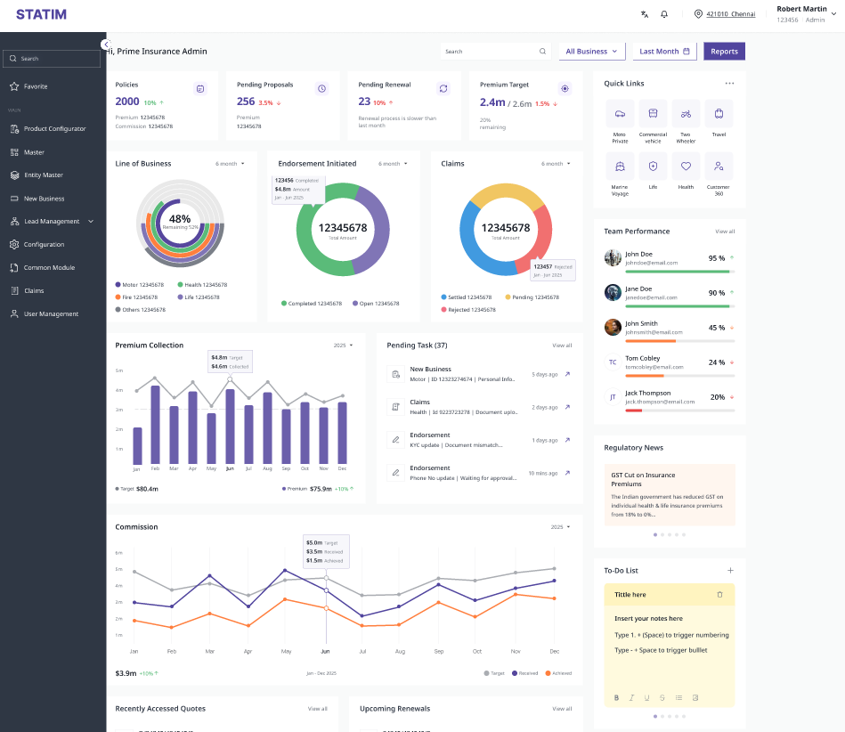
WHERE WE STAND
STATIM Platform Today
CORE
Policy
Claims
Billing
Commission
Reinsurance
POLICY LIFECYCLE
16
DIGITAL
Partner Portal
Customer Portal
Mobile
EXPERIENCE
INTELLIGENCE
Rules
Rating
Workflow
Dunning
Capabilities IN PRODUCTION
DECISIONING
across four platform layers
TECHNOLOGY
API
Microservices
Integration
Security
FOUNDATION
PRODUCT CONFIGURATOR
CUSTOMER PORTAL
AGENT DASHBOARD
16 modules in production across core, digital, intelligence, and technology layers.

Slide 8


WHERE WE ARE GOING
STATIM Innovation Roadmap
03
FUTURE
HORIZON
02
NEXT
● Embedded Insurance
● Open Insurance APIs
● Partner Marketplace
● Autonomous Decision Support
● Global Insurance Ecosystem
● SaaS Platform
IN DEVELOPMENT
01
● AI Underwriting
● Document Intelligence
● ML Models
● Damage Assessment Via computer Vision
● Fraud Detection
● Chatbots
● Customer 360 Intelligence
● Intelligent Search
TODAY
LIVE
● Core Insurance Platform
● Digital Portals
● Product Configuration
● Workflow Automation
● API-first Architecture
● Microservices

Slide 9



PROOF
STATIM in Action
YAS Takaful
UAE
Motor
Non-Motor
Health
● First international implementation
● Phased rollout across three lines of business
● Built for UAE market requirements
Sep 2026
Oct 2026
Dec 2026
Shriram General Insurance
INDIA
Health
Motor
Non-Motor
● Enterprise-wide modernization
● Migration from NOVA platform to STATIM
● Phased across all major lines of business
Oct 2026
Mar 2027
Sep 2027
Shriram Life Insurance
INDIA
POS
PMS
Claims
● Enterprise-wide modernization
● LI Capabilities modernized on the STATIM
● Phased across all Modules
Sep 2025
Dec 2026
Mar 2027
STATIM is active across three strategic customer programs in India and UAE

Slide 10


HOW WE WIN
Scaling STATIM — Building Capability for Global Growth
Product Capability
Technology Capability
Delivery Capability
Product Capability Roadmap · Domain Expertise · Product Governance
AI · Cloud · Microservices · DevSecOps
Standardized Implementation · Accelerators · Automation
Support Capability
People Capability
Innovation Capability
24×7 Support · Monitoring · Continuous Releases
Upskilling · Domain Knowledge · Leadership Development
AI Lab · Customer Feedback · Product Innovation
Our success will not be measured by the number of implementations we complete, but by the capability we build to continuously innovate, deliver, and support a world-class insurance platform.

Slide 11
HOW WE WIN
Our Strategy to Build a Global Insurance Platform
Product Excellence
Innovation & Ecosystem
02
Build a configurable, scalable, future-ready platform
Leverage modern technologies to stay ahead
Continuous innovation · Configuration-first · Reusable capabilities · Industry best practices
Artificial intelligence · Composable architecture · Cloud-native · Open API ecosystem
01
Global
Platform
ONE OBJECTIVE
04
Customer Success
Global Expansion
Every implementation strengthens the product
Design once, deploy anywhere
Customer-driven enhancements · Standardization · Faster implementation · Real-world maturity
Multi-country · Multi-language · Multi-currency · Regulatory adaptability
03

Slide 12
CLOSING
The Future We Are Building
“Transforming Insurance Through AI and Composable Solutions.”
The platform is live, and the pipeline is real: three enterprise implementations underway across the UAE and India, with go-lives from September 2026 through 2027.
The next phase adds AI across underwriting, claims, and product configuration.
The objective is clear: make STATIM the platform of choice for insurers building for the next decade.
INTELLIGENT
CONNECTED
COMPOSABLE
GLOBAL

Slide 13
Thank You
STATIM · Transforming Insurance Through AI and Composable Solutions

