Slide 1
Feature Selection Using Genetic Algorithm
Record Slide Show
ECE750 - Project Presentation
Sriram Ranganathan (20986334)

Slide 2
Introduction
Every biological evolution is based on Survival of the fittest
In nature evolution may result in generations that are better than the previous generations.
What if we extend the same to finding the optimal solution?
Feature selection is the process of reducing the size of the feature vector (removing redundant features)

Slide 3
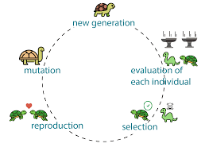
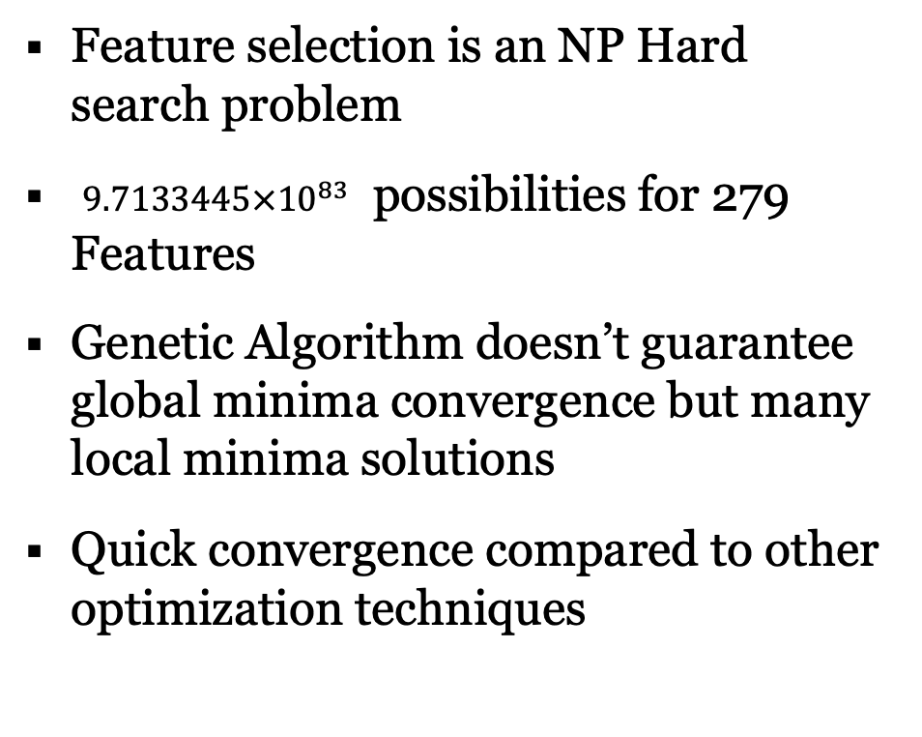
Why Genetic Algorithm?
Feature selection is an NP Hard search problem
$9.7133445×{10}^{83}$ possibilities for 279 Features
Genetic Algorithm doesn’t guarantee global minima convergence but many local minima solutions
Quick convergence compared to other optimization techniques

Slide 4
Dataset and Initial training
Dataset | No. of instances | No. of attributes | ML task type | No. of Output classes | Type of Classifier
Arrythmia [17] | 452 | 279 | Classification | 13 | SVM
Breast Cancer Wisconsin (Diagnostic) [18] | 569 | 30 | Classification | 2 | Random Forest Classifier
White Wine quality [19] | 4898 | 11 | Classification | 7 | Random Forest Classifier
Dataset | Validation Accuracy | Hyperparameters | Type of Classifier
Arrythmia [17] | 72.52% | Kernel: Polynomial Regularization: 1 | SVM
Breast Cancer Wisconsin [18] | 93.8% | Maximum depth: 50 Estimators: 200 | Random Forest Classifier
White Wine quality [19] | 68.57% | Maximum depth: 50 Estimators: 200 | Random Forest Classifier

Slide 5
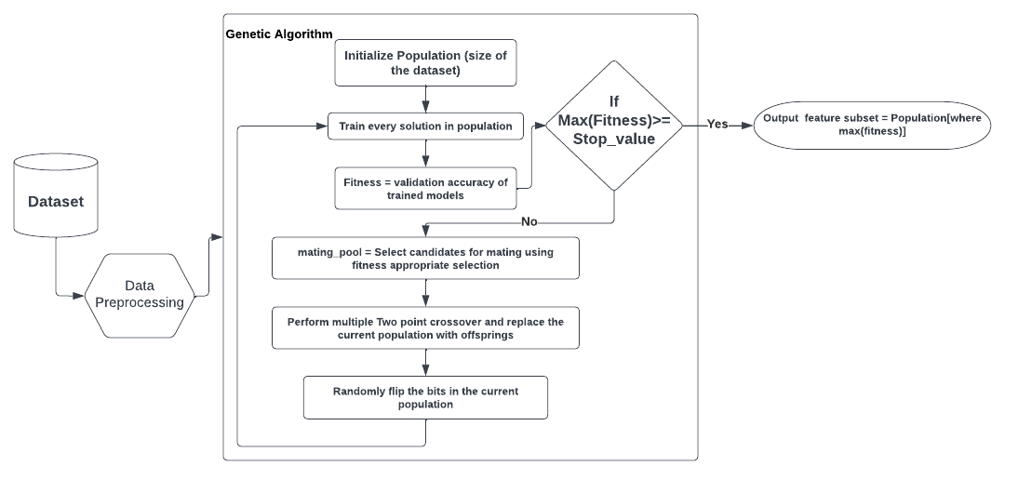
Methodolgy

Slide 6
Hyper Parameter setting
Hyper-parameter | Arrythmia | Breast Cancer | White Wine quality
Crossover Probability | 0.9 | 0.9 | 0.9
Mutation rate | 0.01 | 0.01 | 0.01
Population size | 50 | 20 | 10
Mating pool | 25 | 10 | 5
Type of fitness evaluator | SVM | Random forest | Random forest
Total generation | 100 | 100 | 20
Feature Selection Using Genetic Algorithm

Slide 7
Accuracy Improvements
Dataset | Random Selection of parents |  | Fitness proportionate selection of parents
 | Top Validation accuracy | Best solution generation | Top Validation accuracy | Best solution generation
Arrythmia | 80.21% | 18 | 83.51% | 7
Breast Cancer | 99.9% | 8 | 99.9% | 24
White Wine quality | 71.6% | 6 | 72.04% | 12
Feature Selection Using Genetic Algorithm

Slide 8
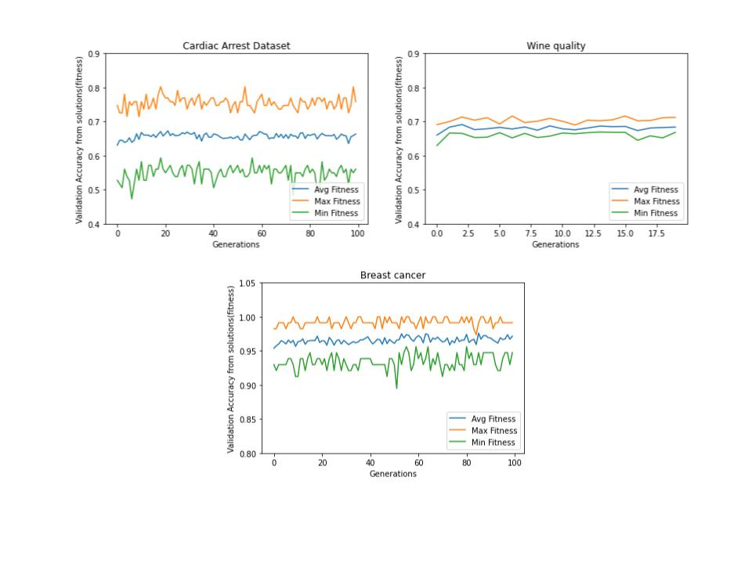
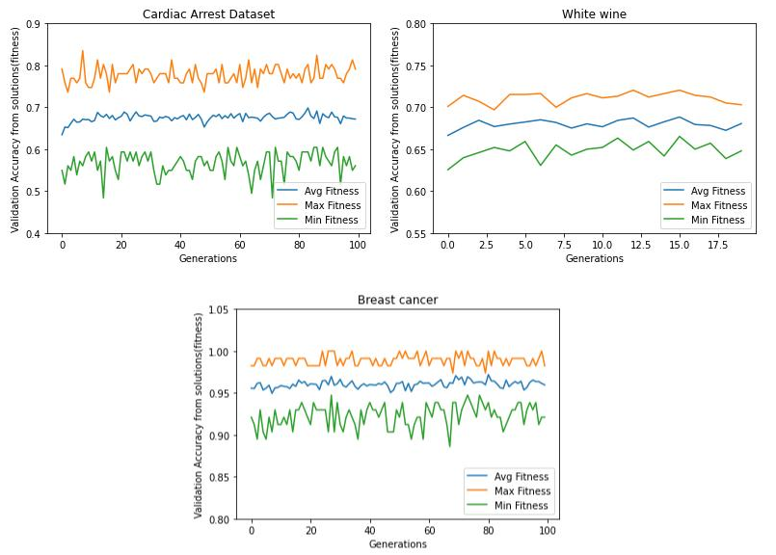
Random Selection Vs Fitness Proportionate Selection
Feature Selection Using Genetic Algorithm

Slide 9
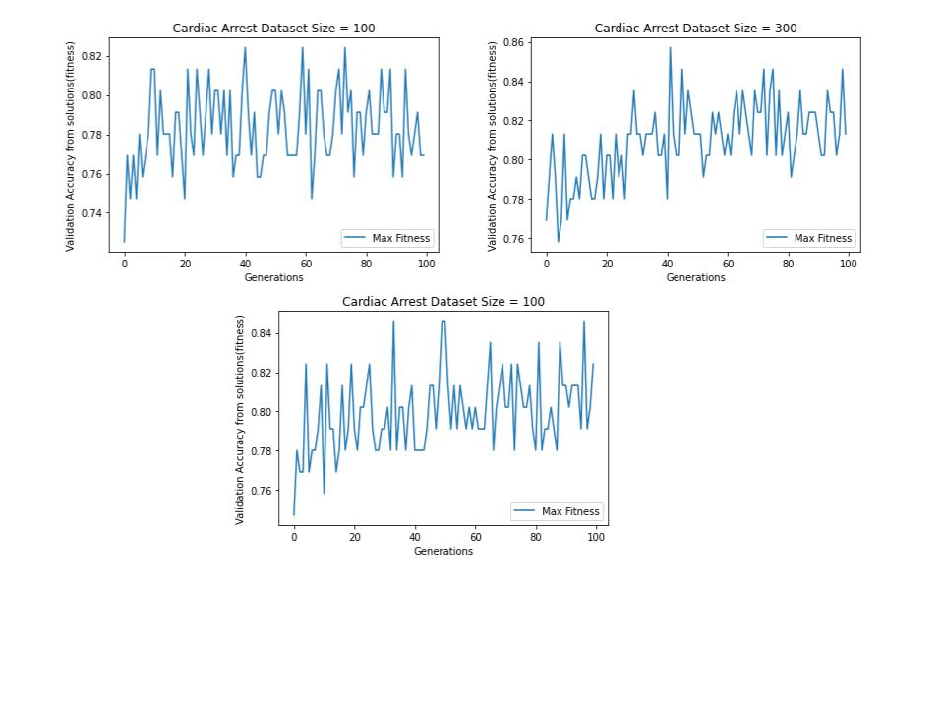
Varying Size of Population
Population size is 100
Population size is 200
Population size is 300
Feature Selection Using Genetic Algorithm

Slide 10
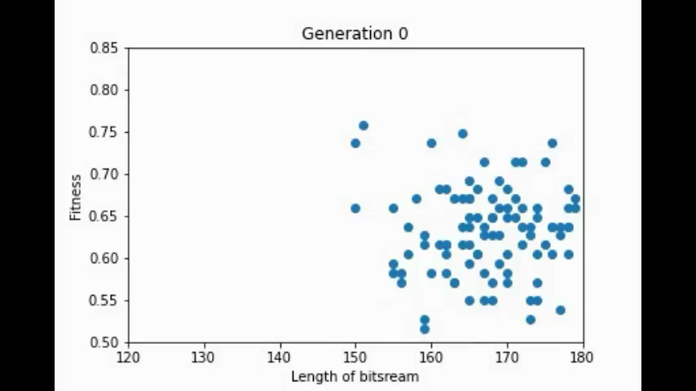
Generational Movement of Solutions
Feature Selection Using Genetic Algorithm

Slide 11
Conclusion
Variation in population size corresponds to how wide wide the search space is.
Higher the number of generations higher the possibility attaining the global minima
Better performance for problem with large solution space
Quicker convergence
Feature Selection Using Genetic Algorithm

Slide 12
Thank you

