Slide 1
Tech Guidance Project With Django

Slide 2



SRIRAM REDDY KOONADI
https://www.linkedin.com/in/sriram-reddy-koonadi/
https://github.com/sriramreddy-7
https://sriramreddy-7.github.io/My-Portfolio/

Slide 3
Agenda
01
02
03
04
05
06
What is a Web Framework
Python Django
Companies Using Django
Installation
Getting Started with Django
Project – A Web Application

Slide 4
What is a Web Framework?
A web framework is a server-side application framework that is designed to support the development of dynamic websites, web applications, web services and resources.
A Python web framework is a code library that makes the life of a web application developer much easier for building flexible, scalable and maintainable web applications.

Slide 5
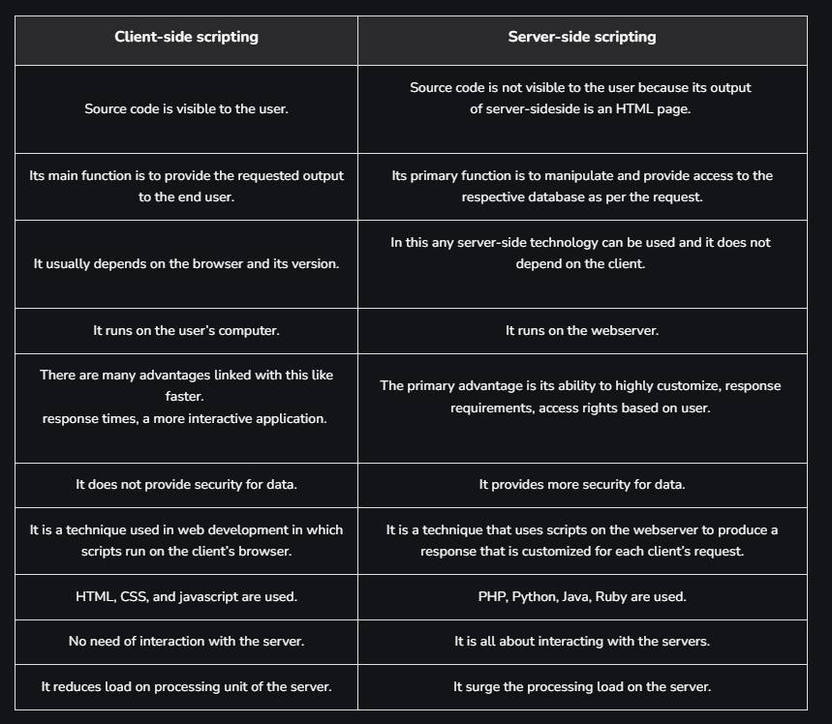

Slide 6
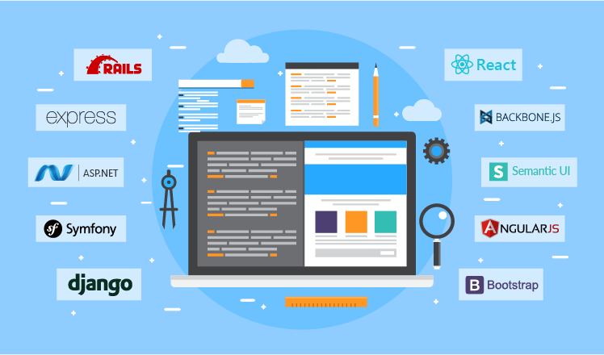
Different Web Frameworks

Slide 7
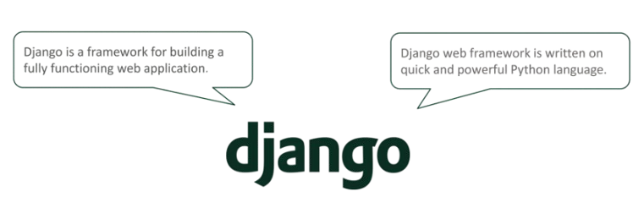
Django Framework

Slide 8
Features of Django
🌟 Rapid Development
🔒 Built-in Authentication 🔧 Robust Admin Interface
🌍 URL Routing
🗃️ ORM (Object-Relational Mapping)
📝 Extensive Documentation

Slide 9
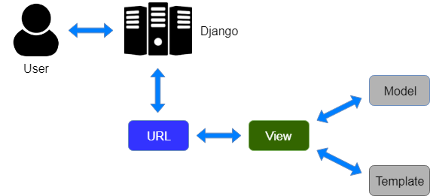
Model View Template

Slide 10
Model View Template
Model (M)🗃️ Data Handling Layer
The Model is responsible for defining the structure of the database.
Each model class corresponds to a database table, and each class attribute represents a database field.
Django’s ORM (Object-Relational Mapping) allows you to interact with the database using Python code, without needing to write SQL queries.

Slide 11
Model View Template
View (V) Business Logic Layer
The View is responsible for processing user requests, interacting with the model, and returning the appropriate response.
Views contain the logic that determines which data to present to the user.
A view typically returns an HTML response, but it can also return JSON, XML, or other formats.

Slide 12
Model View Template
Template (T) Presentation Layer:
The Template is responsible for defining the user interface.
Templates are HTML files that can include dynamic content using Django’s templating language.
They allow the separation of presentation logic from business logic, making the code more modular and easier to maintain.

Slide 13
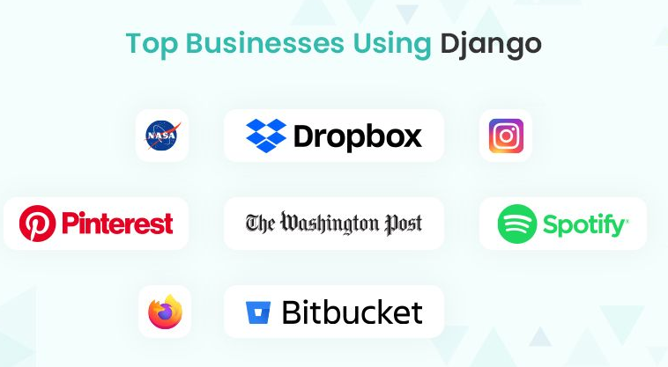
Companies Using Django

Slide 14
Installation

Slide 15
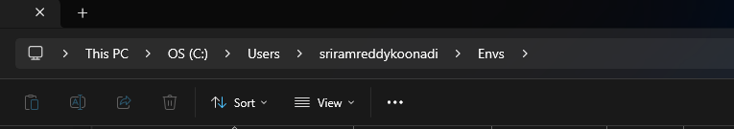
Choose a (empty folder or create a new folder) in PC
Click here and type cmd

Slide 16
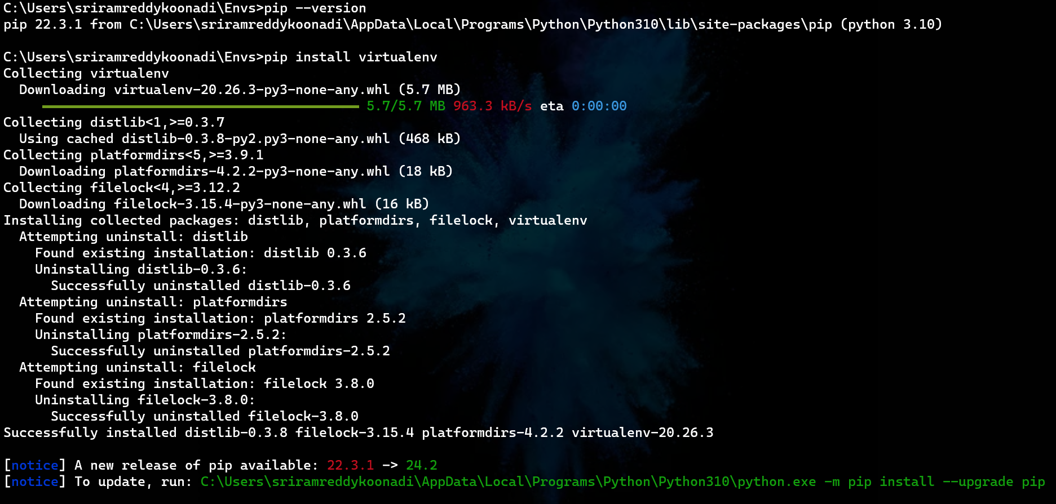

Slide 17
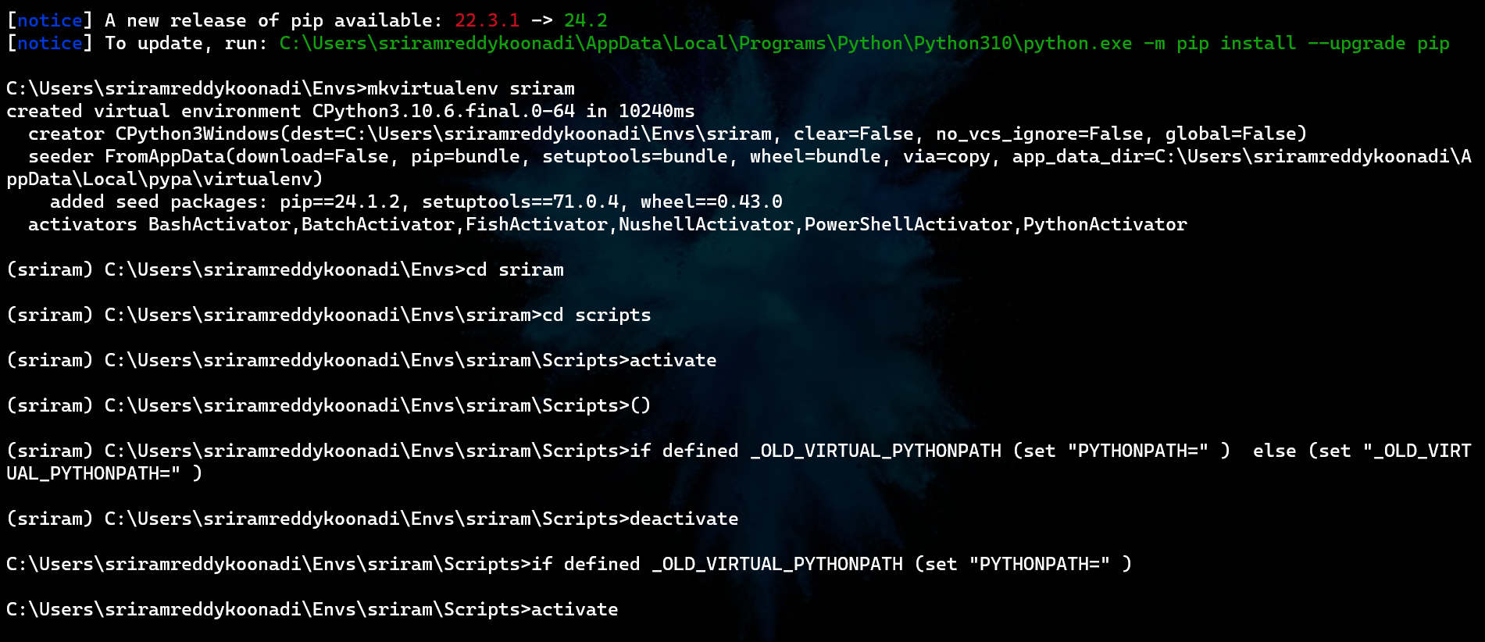

Slide 18

Django Documentation
https://docs.djangoproject.com/en/5.1/

Slide 19
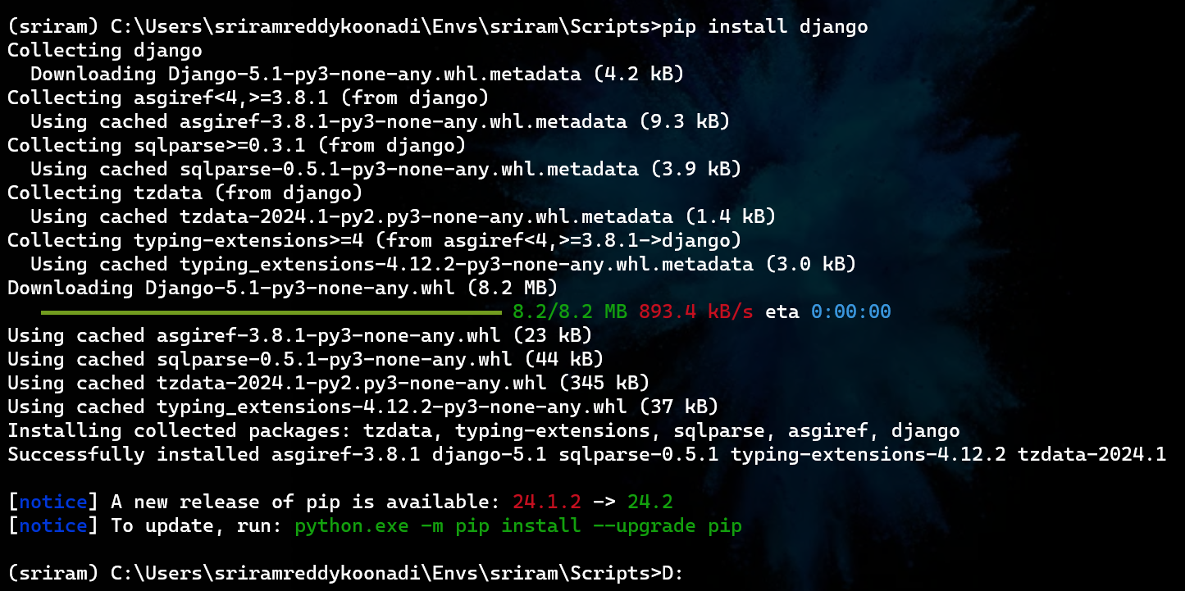

Slide 21
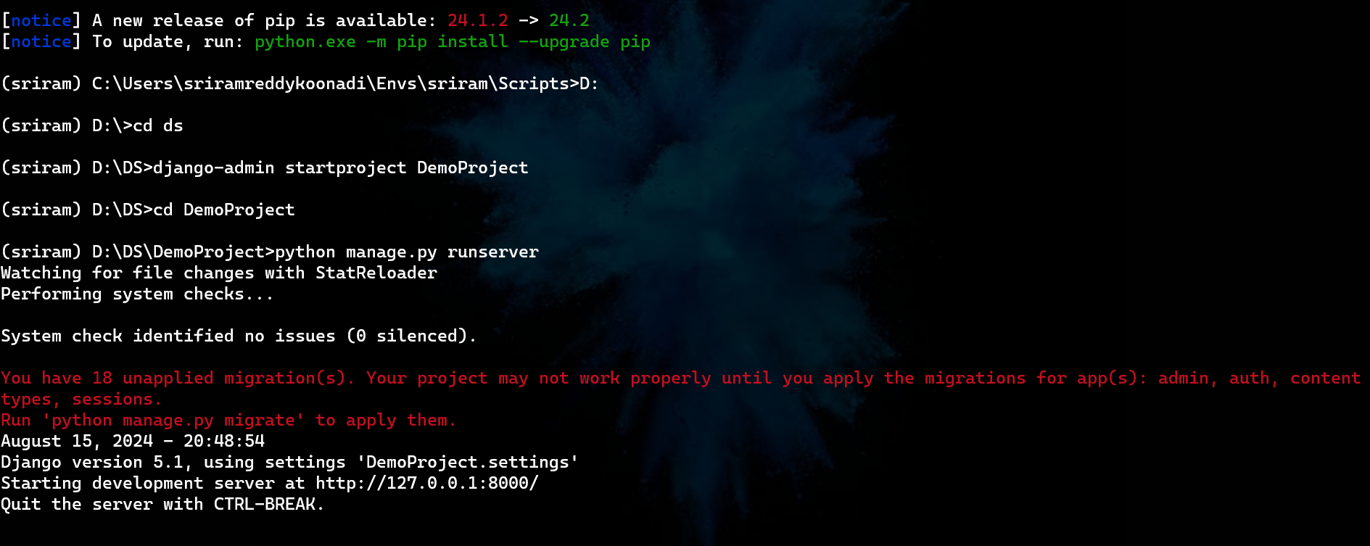

Slide 22
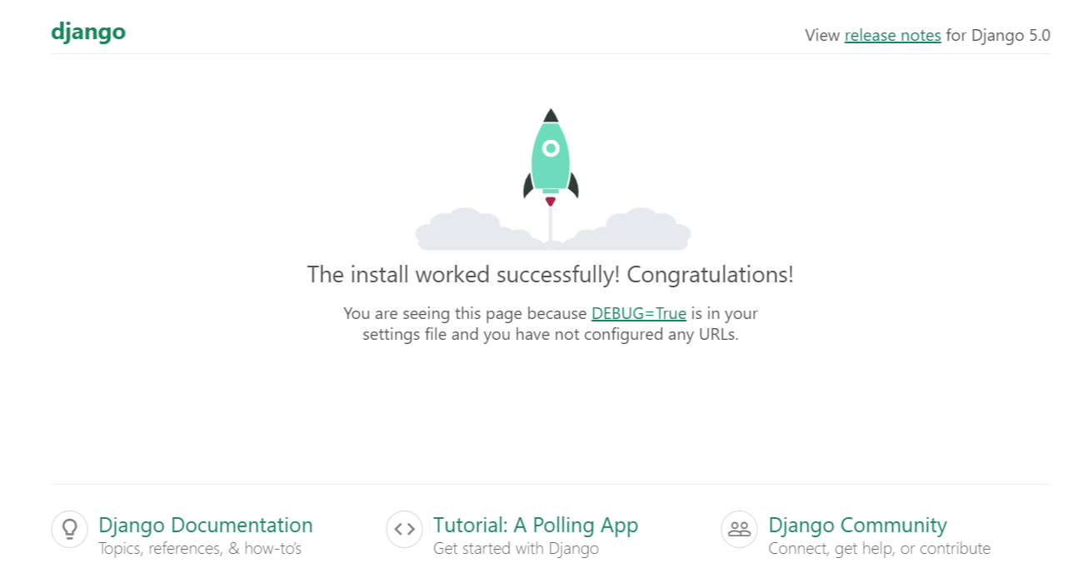
Installation

Slide 23
Installation

Slide 24
Django Project Structure :
myproject/
├── manage.py
├── sqlite3.db
├── myproject/
│ ├── __init__.py
│ ├── settings.py
│ ├── urls.py
│ ├── asgi.py
│ └── wsgi.py
└── myapp/
├── migrations/
├── __init__.py
├── admin.py
├── apps.py
├── models.py
├── tests.py
└── views.py

Slide 25
Django Project Structure :
myproject/
├── manage.py
├── sqlite3.db
├── myproject/
│ ├── __init__.py
│ ├── settings.py
│ ├── urls.py
│ ├── asgi.py
│ └── wsgi.py
└── myapp/
├── migrations/
├── __init__.py
├── admin.py
├── apps.py
├── models.py
├── tests.py
└── views.py
"myproject" folder is just your project container or
directory. You can rename it to anything you like.

Slide 26
Django Project Structure :
myproject/
├── manage.py
├── sqlite3.db
├── myproject/
│ ├── __init__.py
│ ├── settings.py
│ ├── urls.py
│ ├── asgi.py
│ └── wsgi.py
└── myapp/
├── migrations/
├── __init__.py
├── admin.py
├── apps.py
├── models.py
├── tests.py
└── views.py
It is a command line utility that lets you interact with the
django project.

Slide 27
Django Project Structure :
myproject/
├── manage.py
├── sqlite3.db
├── myproject/
│ ├── __init__.py
│ ├── settings.py
│ ├── urls.py
│ ├── asgi.py
│ └── wsgi.py
└── myapp/
├── migrations/
├── __init__.py
├── admin.py
├── apps.py
├── models.py
├── tests.py
└── views.py
This stores the database file in the project directory.

Slide 28
Django Project Structure :
myproject/
├── manage.py
├── myproject/
│ ├── __init__.py
│ ├── settings.py
│ ├── urls.py
│ ├── asgi.py
│ └── wsgi.py
└── myapp/
├── migrations/
├── __init__.py
├── admin.py
├── apps.py
├── models.py
├── tests.py
└── views.py
This folder is the actual python package of your project
which contains some default files.

Slide 29
Django Project Structure :
myproject/
├── manage.py
├── sqlite3.db
├── myproject/
│ ├── __init__.py
│ ├── settings.py
│ ├── urls.py
│ ├── asgi.py
│ └── wsgi.py
└── myapp/
├── migrations/
├── __init__.py
├── admin.py
├── apps.py
├── models.py
├── tests.py
└── views.py
It is an empty file that tells python that this folder
should be treated as package.

Slide 30
Django Project Structure :
myproject/
├── manage.py
├── sqlite3.db
├── myproject/
│ ├── __init__.py
│ ├── settings.py
│ ├── urls.py
│ ├── asgi.py
│ └── wsgi.py
└── myapp/
├── migrations/
├── __init__.py
├── admin.py
├── apps.py
├── models.py
├── tests.py
└── views.py
This contains the settings or the configurations of the
project.

Slide 31
Django Project Structure :
myproject/
├── manage.py
├── sqlite3.db
├── myproject/
│ ├── __init__.py
│ ├── settings.py
│ ├── urls.py
│ ├── asgi.py
│ └── wsgi.py
└── myapp/
├── migrations/
├── __init__.py
├── admin.py
├── apps.py
├── models.py
├── tests.py
└── views.py
This file contains all the links of your project and the
function to call.

Slide 32
Django Project Structure :
myproject/
├── manage.py
├── sqlite3.db
├── myproject/
│ ├── __init__.py
│ ├── settings.py
│ ├── urls.py
│ ├── asgi.py
│ └── wsgi.py
└── myapp/
├── migrations/
├── __init__.py
├── admin.py
├── apps.py
├── models.py
├── tests.py
└── views.py
It is an entry point for WSGl-compatible web services to
serve your project.

Slide 33
Django Project Structure :
myproject/
├── manage.py
├── sqlite3.db
├── myproject/
│ ├── __init__.py
│ ├── settings.py
│ ├── urls.py
│ ├── asgi.py
│ └── wsgi.py
└── myapp/
├── migrations/
├── __init__.py
├── admin.py
├── apps.py
├── models.py
├── tests.py
└── views.py
This folder is the actual python package of your app, inside the project which contains some default files.

Slide 34
Django Project Structure :
myproject/
├── manage.py
├── sqlite3.db
├── myproject/
│ ├── __init__.py
│ ├── settings.py
│ ├── urls.py
│ ├── asgi.py
│ └── wsgi.py
└── myapp/
├── migrations/
├── __init__.py
├── admin.py
├── apps.py
├── models.py
├── tests.py
└── views.py
Migrations are Django’s way of propagating changes you make to your models (like adding a field or deleting a model) into your database schema

Slide 35
Django Project Structure :
myproject/
├── manage.py
├── sqlite3.db
├── myproject/
│ ├── __init__.py
│ ├── settings.py
│ ├── urls.py
│ ├── asgi.py
│ └── wsgi.py
└── myapp/
├── migrations/
├── __init__.py
├── admin.py
├── apps.py
├── models.py
├── tests.py
└── views.py
An empty file that indicates this directory is a Python package.

Slide 36
Django Project Structure :
myproject/
├── manage.py
├── sqlite3.db
├── myproject/
│ ├── __init__.py
│ ├── settings.py
│ ├── urls.py
│ ├── asgi.py
│ └── wsgi.py
└── myapp/
├── migrations/
├── __init__.py
├── admin.py
├── apps.py
├── models.py
├── tests.py
└── views.py
Used to define how your models are displayed and managed in the Django admin interface.
You can register models with the admin site using admin.site.register().

Slide 37
Django Project Structure :
myproject/
├── manage.py
├── sqlite3.db
├── myproject/
│ ├── __init__.py
│ ├── settings.py
│ ├── urls.py
│ ├── asgi.py
│ └── wsgi.py
└── myapp/
├── migrations/
├── __init__.py
├── admin.py
├── apps.py
├── models.py
├── tests.py
└── views.py
Configures the app and its settings.

Slide 38
Django Project Structure :
myproject/
├── manage.py
├── sqlite3.db
├── myproject/
│ ├── __init__.py
│ ├── settings.py
│ ├── urls.py
│ ├── asgi.py
│ └── wsgi.py
└── myapp/
├── migrations/
├── __init__.py
├── admin.py
├── apps.py
├── models.py
├── tests.py
└── views.py
Contains the data models for your app.
Each model corresponds to a database table.
Models are defined as Python classes, and each class attribute represents a database field.

Slide 39
Django Project Structure :
myproject/
├── manage.py
├── sqlite3.db
├── myproject/
│ ├── __init__.py
│ ├── settings.py
│ ├── urls.py
│ ├── asgi.py
│ └── wsgi.py
└── myapp/
├── migrations/
├── __init__.py
├── admin.py
├── apps.py
├── models.py
├── tests.py
└── views.py
Contains test cases for your app.
You can write unit tests, integration tests, and other automated tests here.

Slide 40
Django Project Structure :
myproject/
├── manage.py
├── sqlite3.db
├── myproject/
│ ├── __init__.py
│ ├── settings.py
│ ├── urls.py
│ ├── asgi.py
│ └── wsgi.py
└── myapp/
├── migrations/
├── __init__.py
├── admin.py
├── apps.py
├── models.py
├── tests.py
└── views.py
Contains view functions or classes that handle requests and return responses.
Views are where you define the logic of your web application.
Each view function typically takes an HTTP request as input and returns an HTTP response, which could be HTML, JSON, or other content types.
Views can render templates, return JSON data, or redirect to another URL.

Slide 41
Important Commands of Django:
django-admin --version
displays the installed Django version
django-admin startproject project_name
creates a new Django project directory structure with the specified project name.
cd project_name # change directory (not a django command )
changes the current directory to the newly created project directory.
django-admin startapp app_name
creates a new Django application with the specified app name within the project.
python manage.py runserver
starts the django development server, allowing you to view your project in a web browser.
python manage.py makemigrations
creates new migrations based on the changes detected in your models (database schema).

Slide 42
Important Commands of Django:
python manage.py migrate
Applies the migrations to the database, updating the schema to match your models.
python manage.py collectstatic
collects all static files (CSS, JavaScript, images) from your apps and places them in the directory specified by STATIC_ROOT, typically for production use.

Slide 43
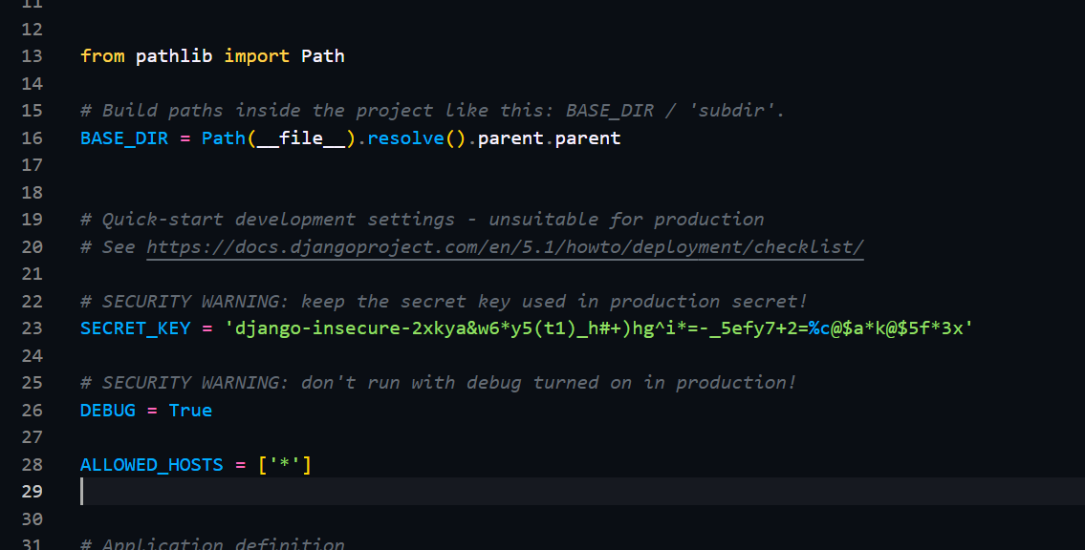
Things you need to before starting the project:
settings.py

Slide 44
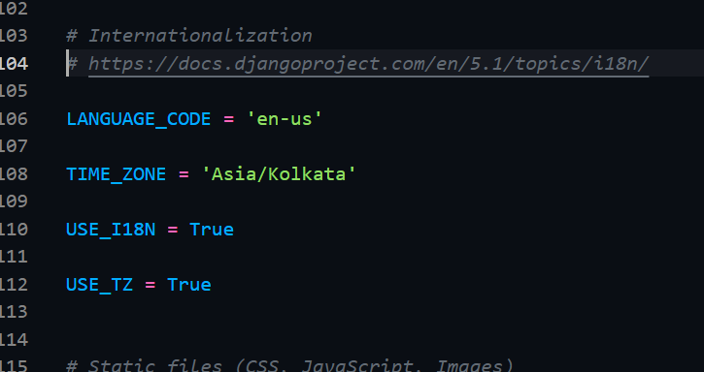
Things you need to before starting the project:
settings.py

Slide 45
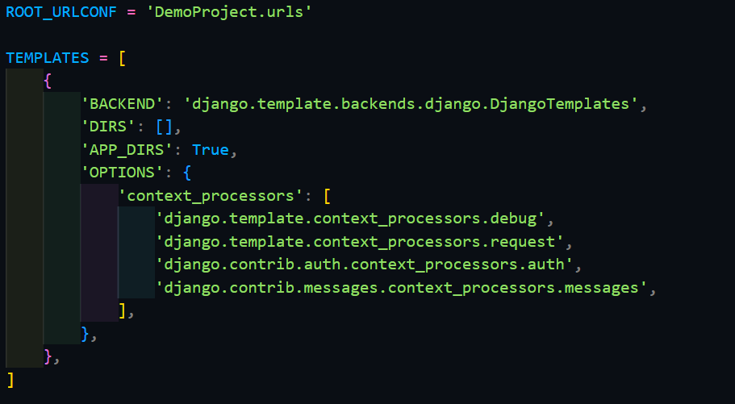
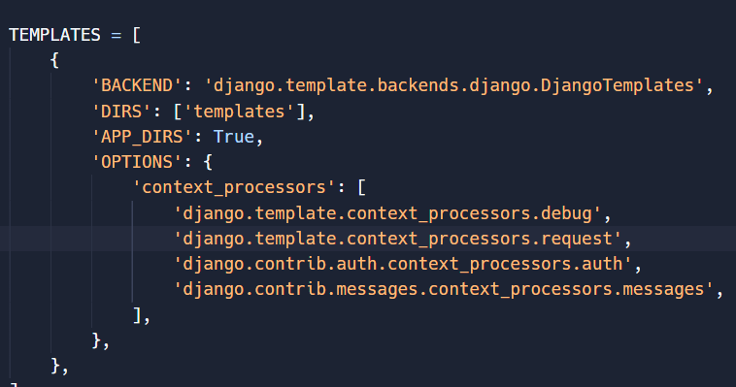
Things you need to before starting the project:
settings.py

Slide 46
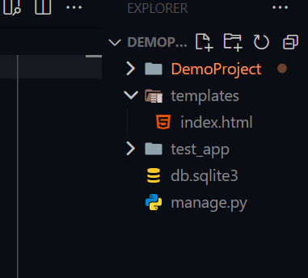
Things you need to before starting the project:

Slide 47
Project Building

Slide 48
Project Building
https://pms-sriramreddy.onrender.com/
https://sriramreddy-7.github.io/My-Portfolio/

Slide 49

Special Thanks to

Slide 50
Thank You

