Slide 1


NEXT GEN EMPLOYABILITY PROGRAM
CREATING A FUTURE-READY WORKFORCE
Student Name :
Koonadi Sriram Reddy
Student ID :
College Name :
STU626a97c8e12ef1651152840
SR University ,Hanamkonda

Slide 2
CAPSTONE PROJECT SHOWCASE
Project Title :Vote Tech
Abstract | Problem Statement | Project Overview | Proposed Solution | Technology Used | Modelling & Results | Conclusion | Q&A

Slide 3
Abstract
1
This project aims to develop a web-based voting application using Django framework.
2
Key functionalities include user authentication, poll creation, and real-time results data visualization experience.
3
Citizens can register to access their personalized dashboard and vote on active polls.
4
Administrators will manage polls, edit content, and oversee voter registration, ensuring a secure and efficient voting process.

Slide 4


Problem Statement
Conducting polls is currently a hassle, which makes it hard for everyone to participate. We need an easy-to-use website where people can vote securely and conveniently, so everyone's voice can be heard.

Slide 5

Project Overview
Develop a web-based voting application.
Implement distinct roles for administrators and citizens/voters.
Enable citizens to register on the website.
Provide citizens with a dashboard to view active polls.
Grant administrators the authority to create and manage polls.
Allow citizens to vote in real-time on active polls.
Display real-time poll results to citizens.
Included graphical representations of poll results for easier interpretation.
Enable administrators to edit polls.
Facilitate administrators in managing the list of registered voters.
Aim for a seamless and transparent voting experience for citizens.
Provide administrators with tools to effectively manage the polling process.

Slide 6
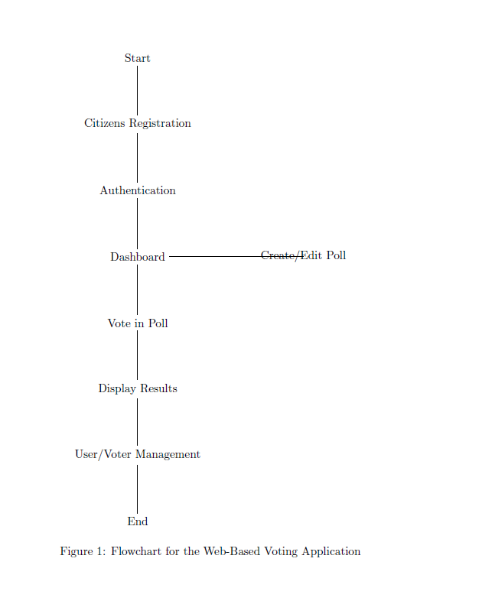
Proposed Solution
Develop a web-based voting app using Django for backend and HTML/CSS/JavaScript for frontend.
Implement separate modules for administrators and citizens, enabling efficient poll management and user interaction.
Admin module allows easy creation, editing, and management of polls, while citizens can securely register and vote in real-time.
Prioritize user experience with intuitive interfaces, visually appealing displays, and options for filtering and searching polls.
Ensure data integrity and security through robust authentication, encryption, and access controls, enhancing trust in the democratic process.

Slide 7








Technology used
 | In HTML, I structured the skeleton of the website to establish its foundational layout. |  | CSS, I crafted the look and feel, ensuring a visually appealing design and user experience.
 | Using JavaScript, I implemented form validation to enhance data integrity and user input accuracy. |  | Leveraging Bootstrap, I optimized the user interface for a seamless and responsive experience across devices.
 | In Python, I utilized its robust features and libraries to build the backend functionality of the voting web application. |  | With the Django framework, I streamlined development, enabling rapid prototyping, and implemented user authentication and authorization, ensuring secure and scalable code architecture.
 | Utilizing SQLite3, I stored poll details and organization information, ensuring efficient data management. |  | With Render Cloud hosting service, I deployed the Django-based voting web application, "Vote Tech," ensuring scalability and reliability.

Slide 8
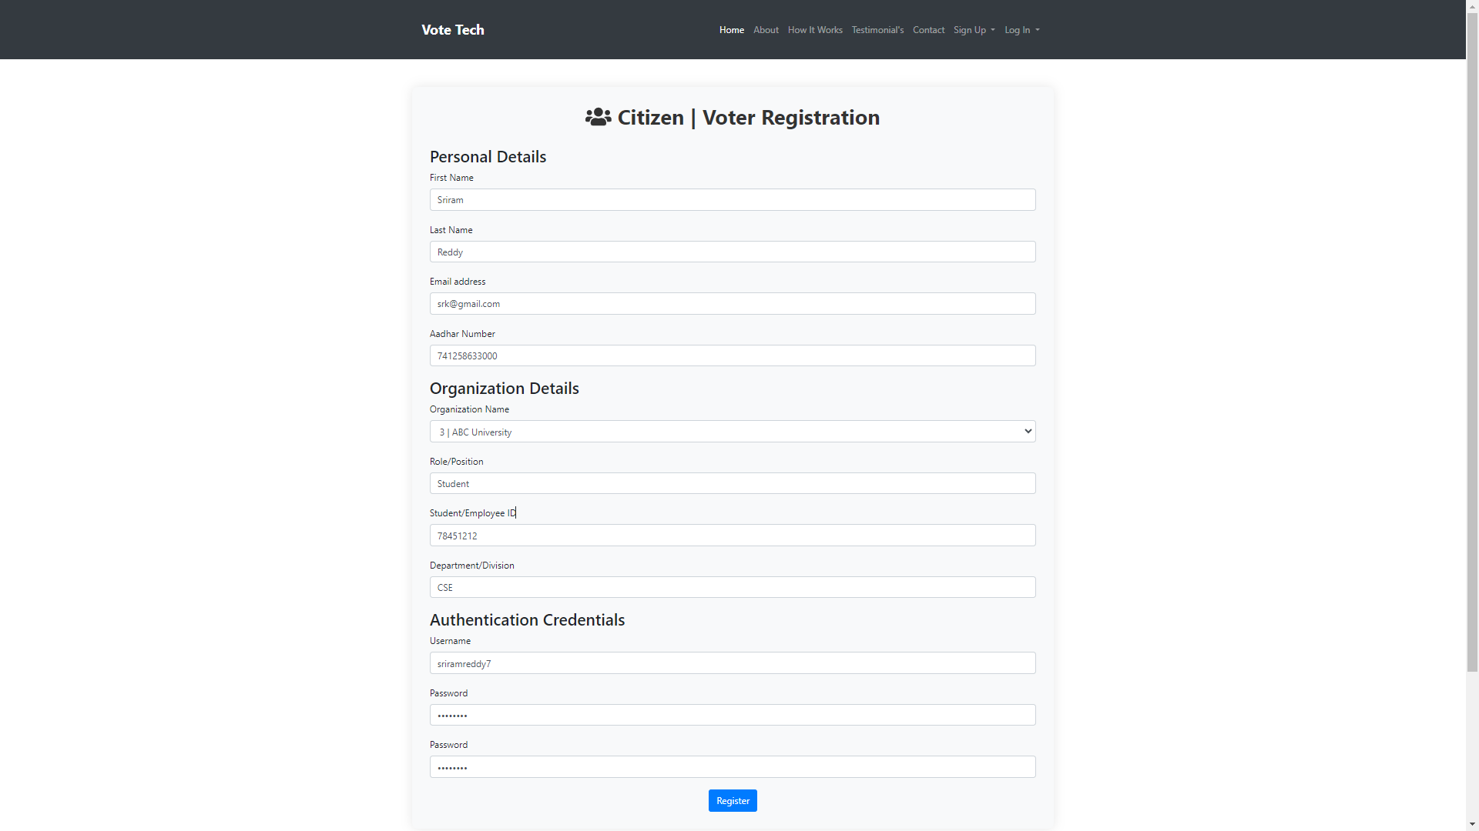
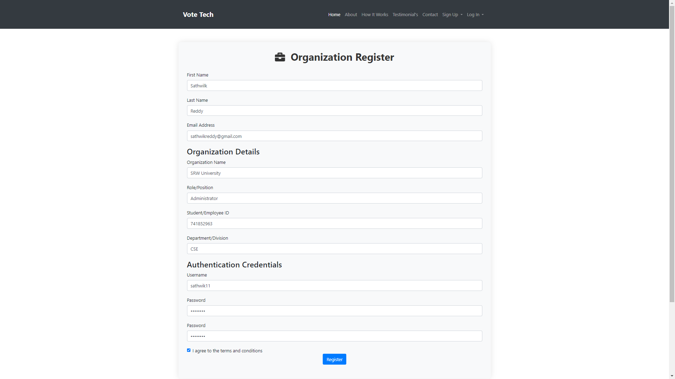
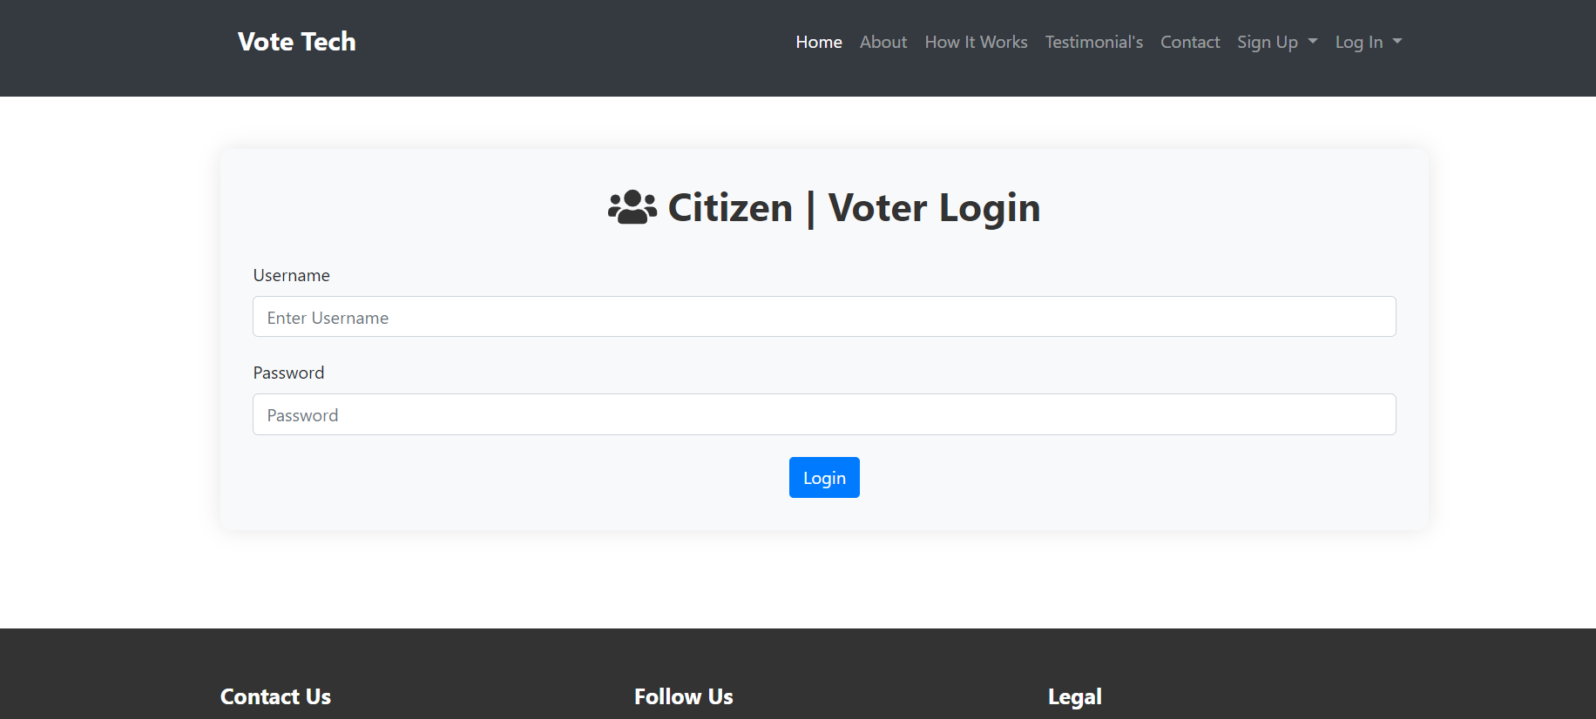
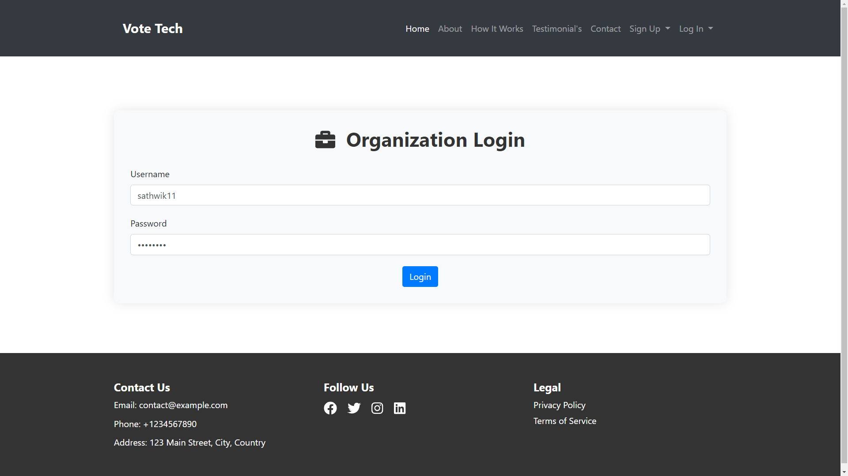
Modelling & Result

Slide 9
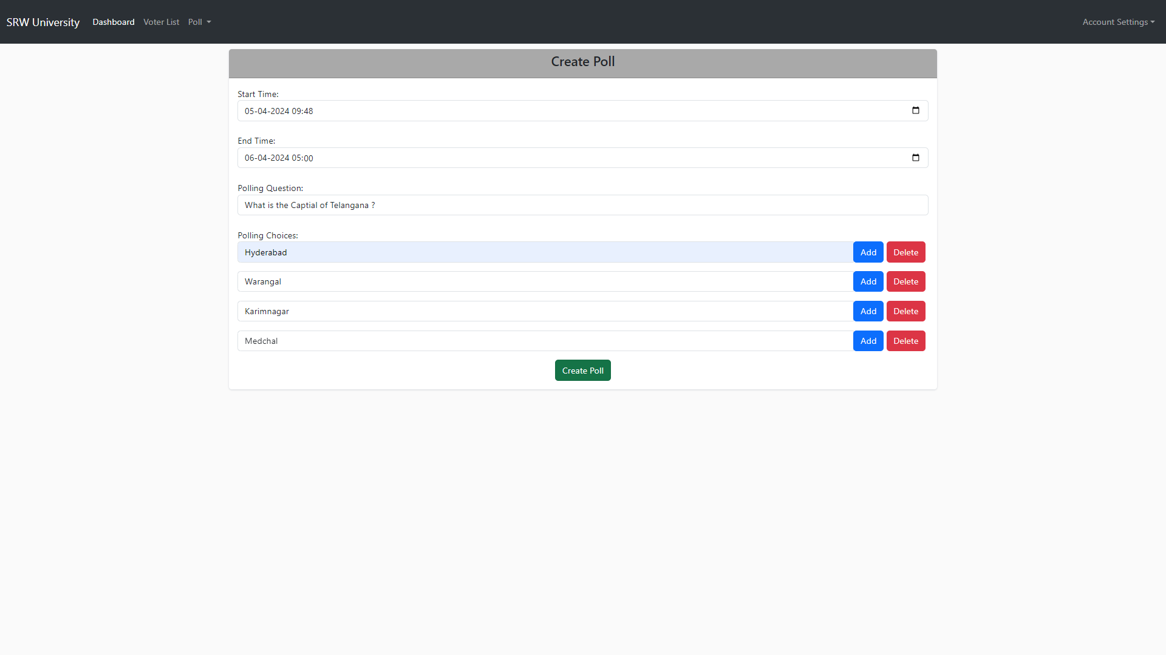
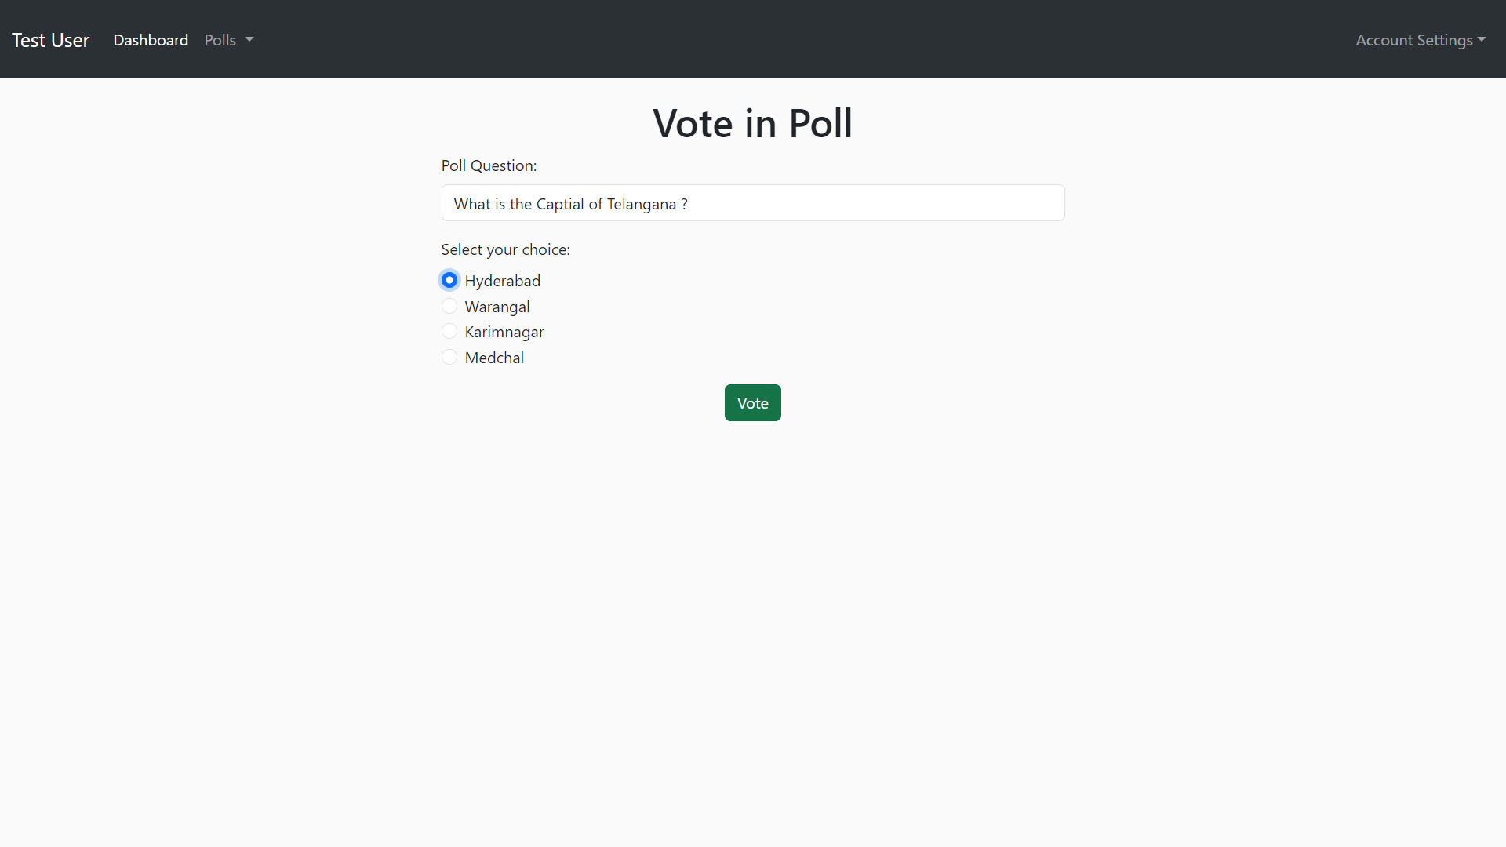
Modelling & Result

Slide 10
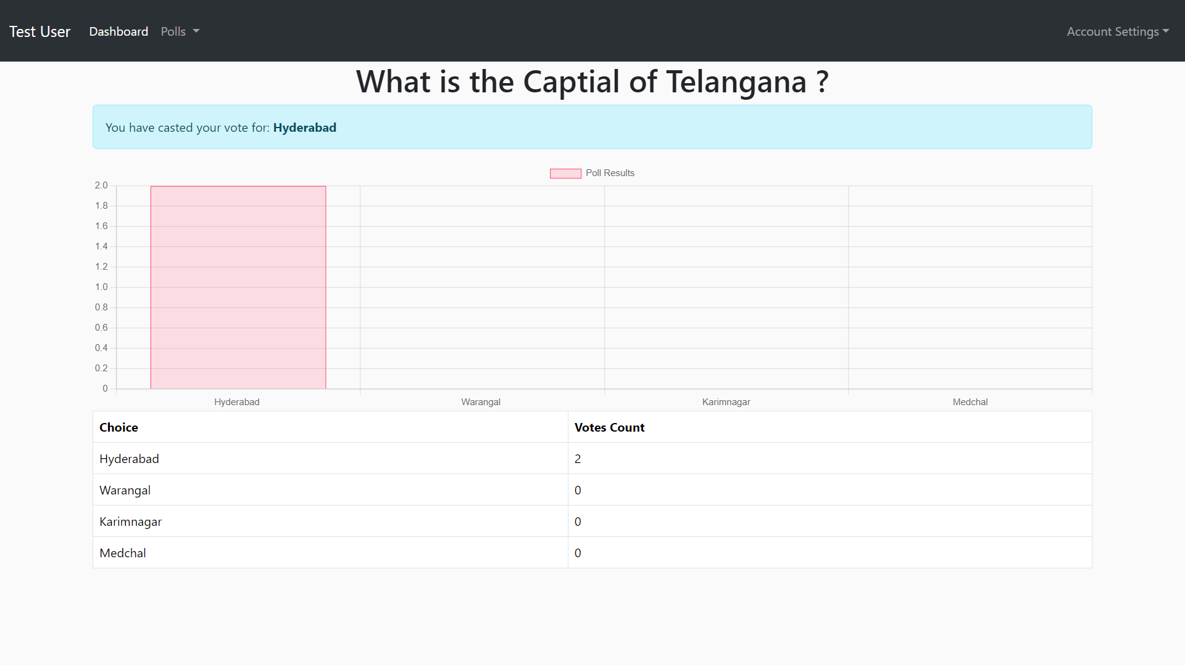
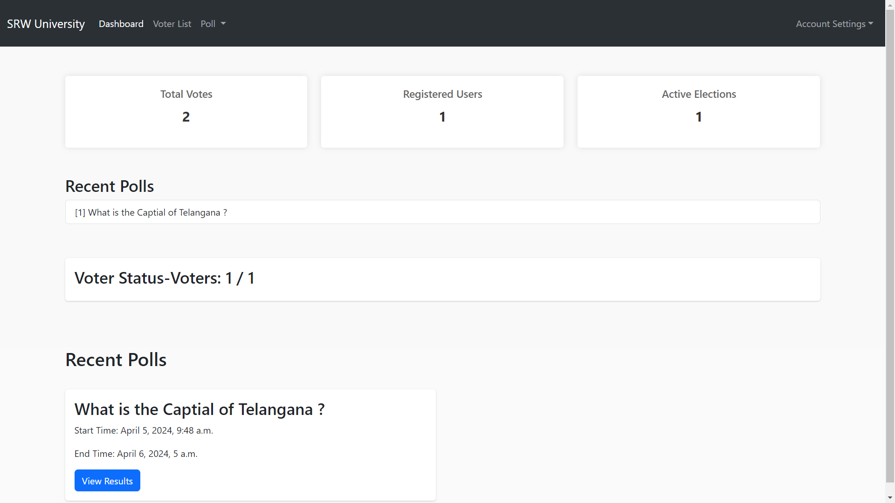
Modelling & Result
Webapp:
https://voting-web-application-9gl4.onrender.com

Slide 11

Conclusion
Implementation of enhanced security measures such as two-factor authentication and blockchain technology for tamper-proof voting records.
Integration with government systems to streamline voter registration processes and facilitate real-time verification of voter eligibility.
Expansion of voting options to include methods like absentee voting and ranked-choice voting to cater to diverse voting preferences.
Development of a mobile application version to enhance accessibility and convenience for users who prefer to vote using their smartphones or tablets.
Integration of face recognition technology for authentication during the voting process, enhancing security and preventing unauthorized access to voting privileges.

Slide 12


Notes:
Thank You !!

