Slide 1
Meeting -05
Magician Project Update

Slide 2



Project: Magician
Status Update
Meeting -05

Slide 3
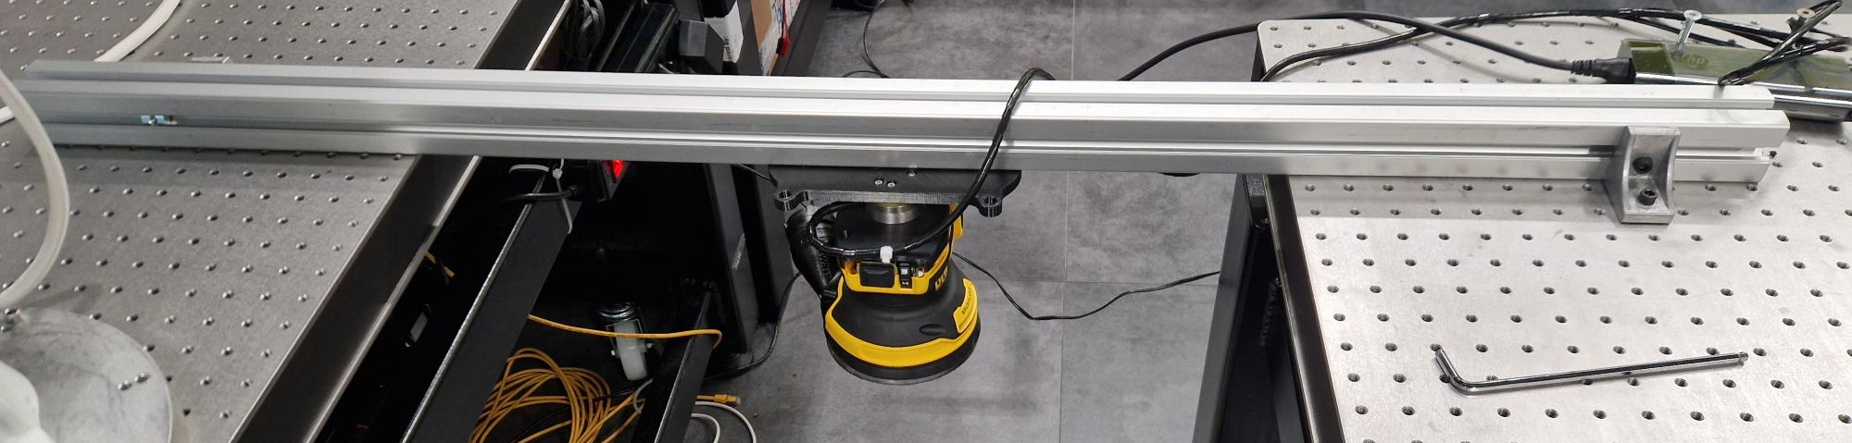
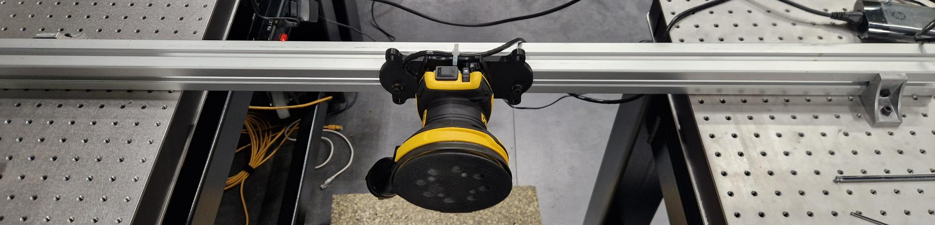
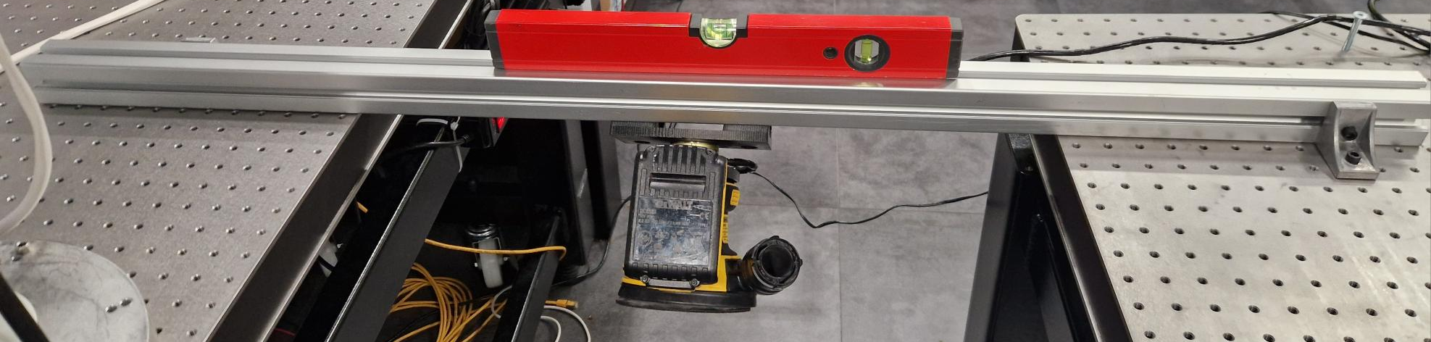
Work Status Update for the Project Magician
Work Status Update for the Project Magician
Doing the Ideal Tool Experiment in 3 orientations
Experimental Setup:
In 0-degree orientation
In 90-degree orientation
In 45-degree orientation
Duration of each experiment : 20 seconds ( 20000 sample points)
Static test without any external forces

Slide 4
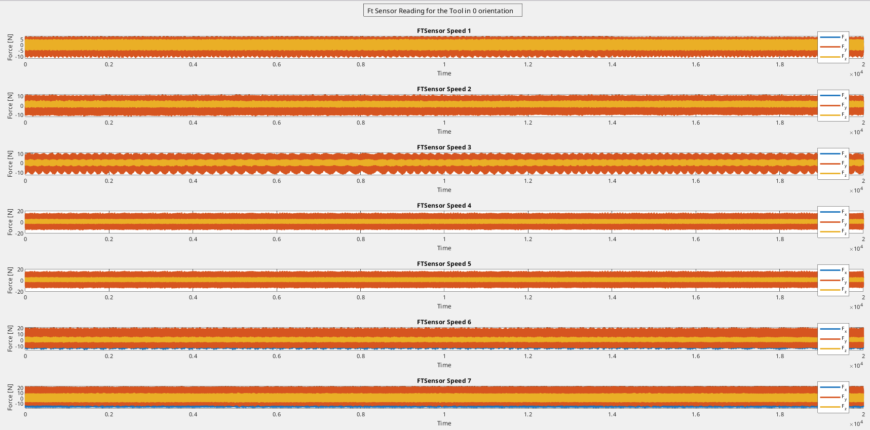
Work Status Update for the Project Magician
Force Plots in all the 3 axes in 0 Orientation

Slide 5
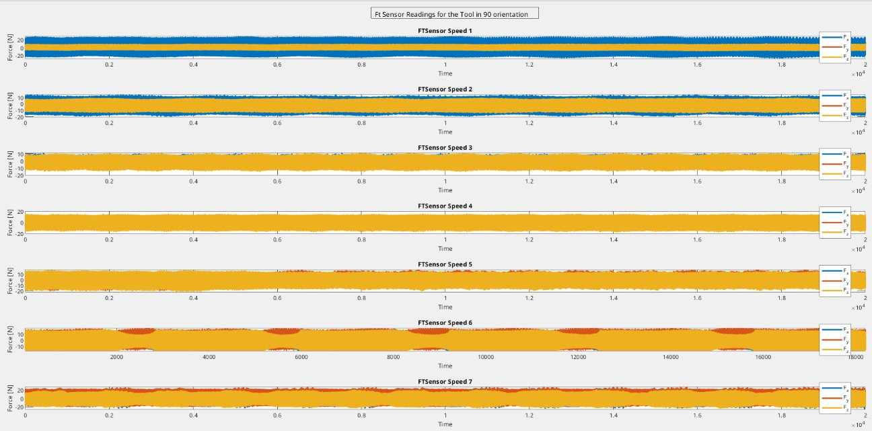
Work Status Update for the Project Magician
Force Plots in all the 3 axes in 90 Orientation

Slide 6
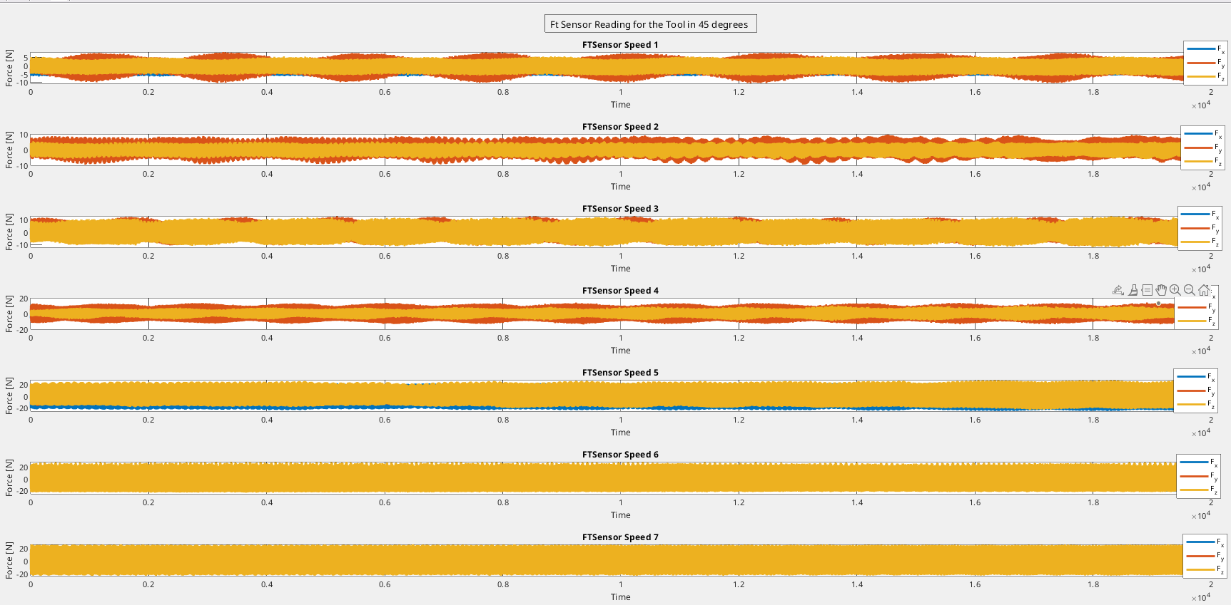
Work Status Update for the Project Magician
Force Plots in all the 3 axes in 45 Orientation

Slide 7
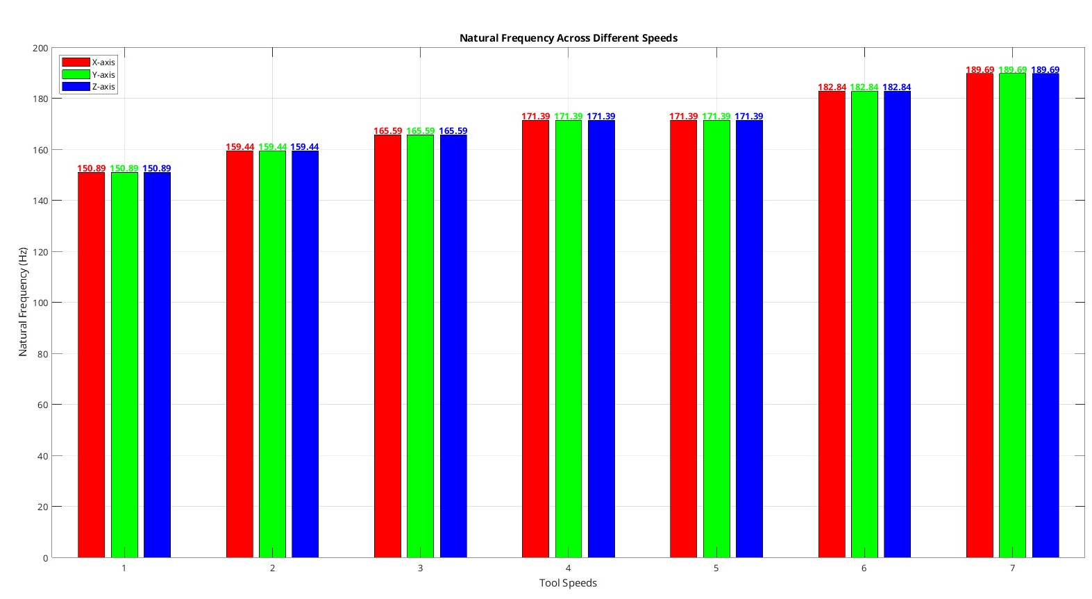
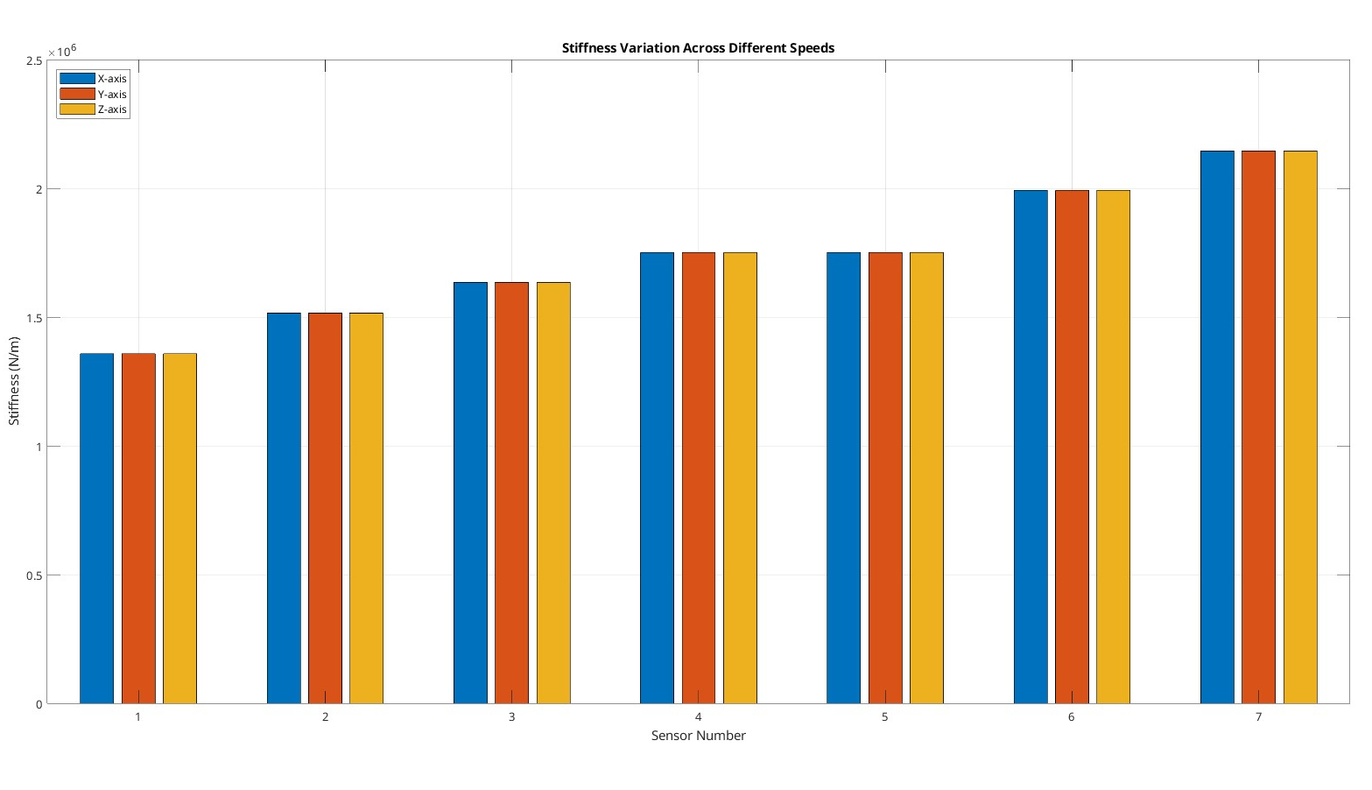
Work Status Update for the Project Magician
Frequency and Stiffness Plots at 0 Orientation
Frequency Range: 150 to approx. 190 Hz
Stiffness Range: 1.4 e6 to approx. 2.2 e6 N/m

Slide 8
Work Status Update for the Project Magician
Force Plots in all the 3 axes in 45 Orientation

Slide 9
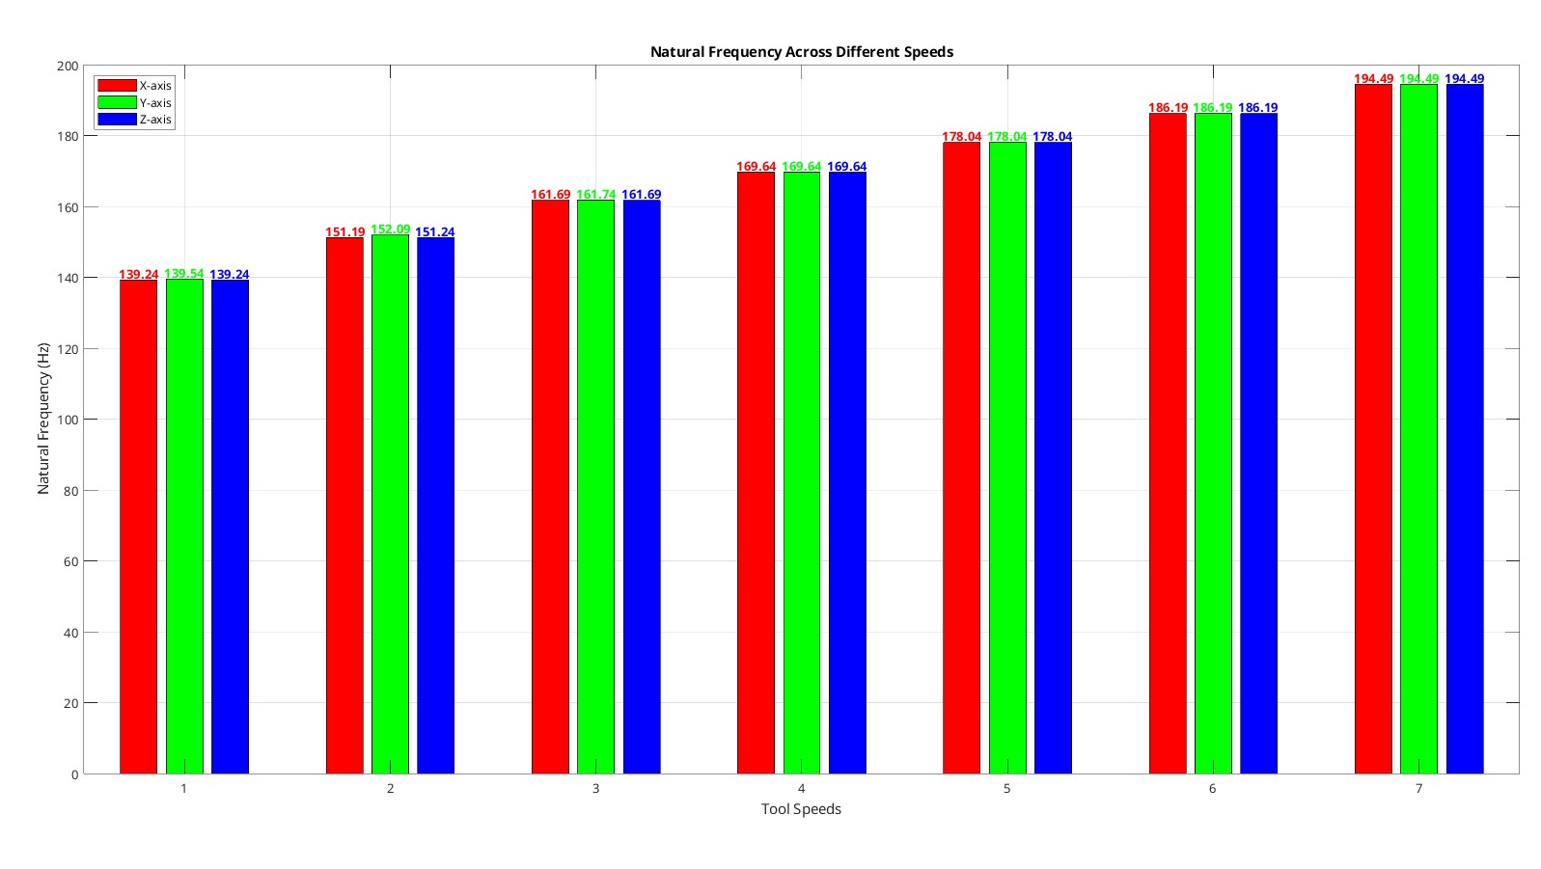
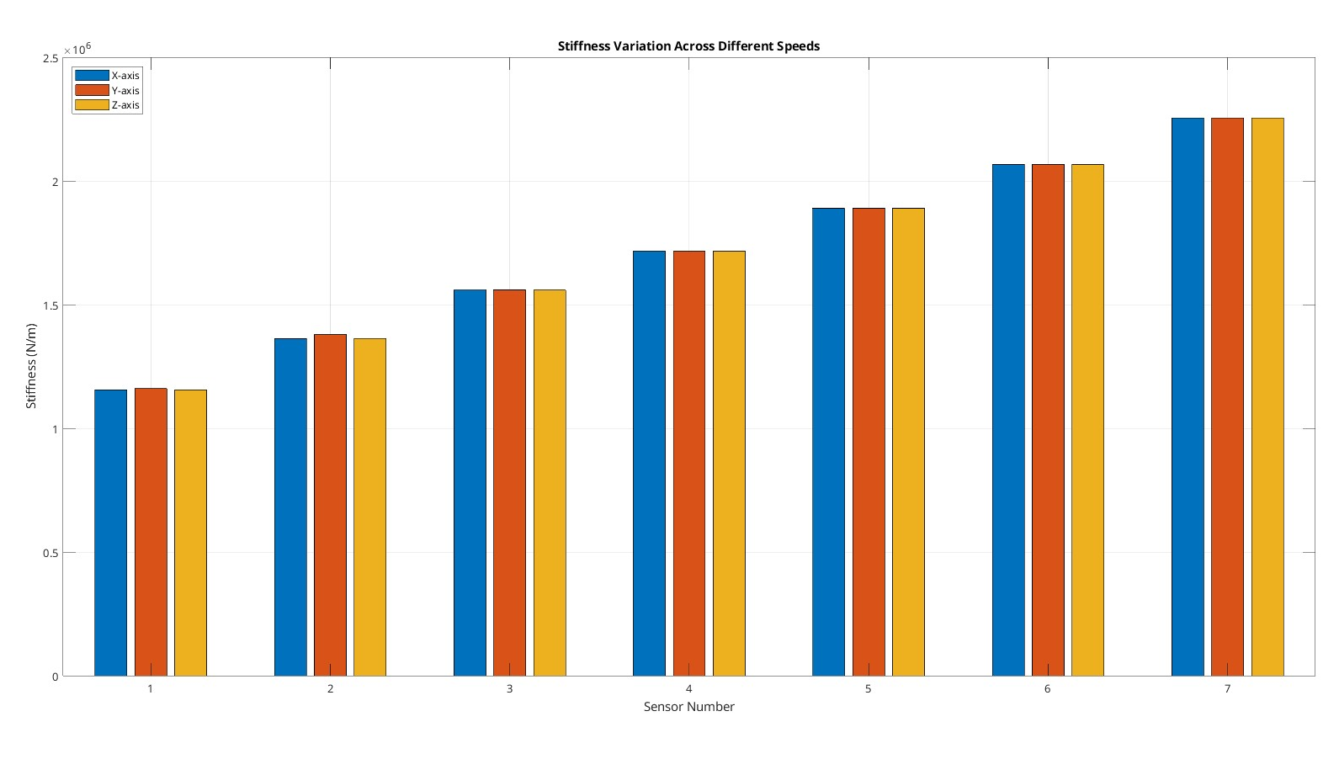
Work Status Update for the Project Magician
Frequency and Stiffness Plots at 90 Orientation
Frequency Range: 139 to approx. 195 Hz
Stiffness Range: 1.25 e6 to approx. 2.25 e6 N/m

Slide 10
Work Status Update for the Project Magician
Force Plots in all the 3 axes in 45 Orientation

Slide 11
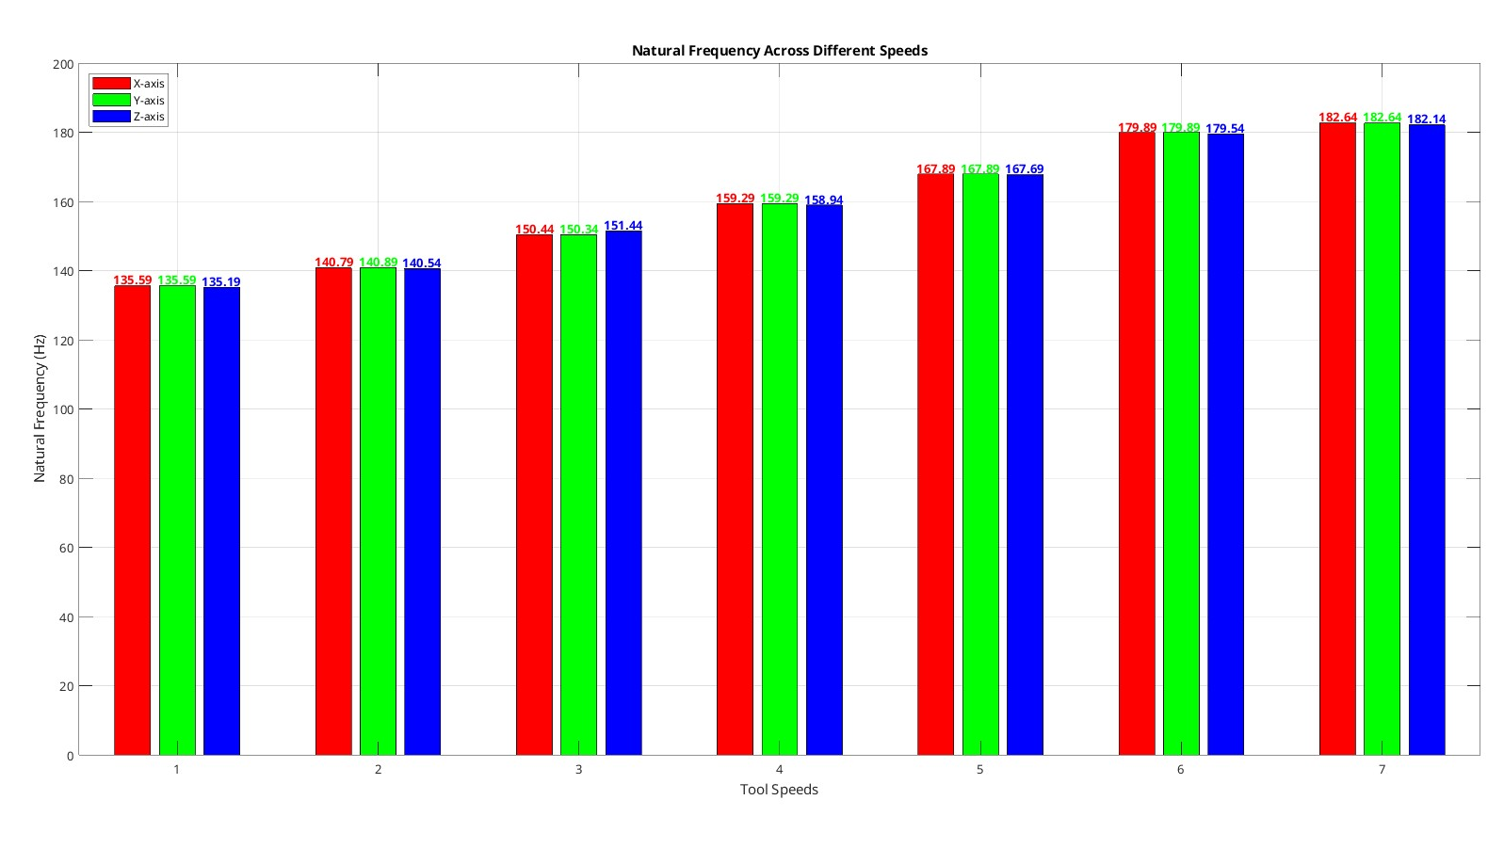
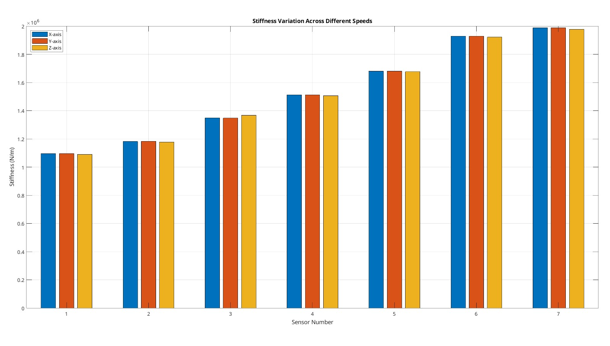
Work Status Update for the Project Magician
Frequency and Stiffness Plots at 45 Orientation
Frequency Range: 135 to approx. 183 Hz
Stiffness Range: 1.1 e6 to approx. 2 e6 N/m

Slide 12
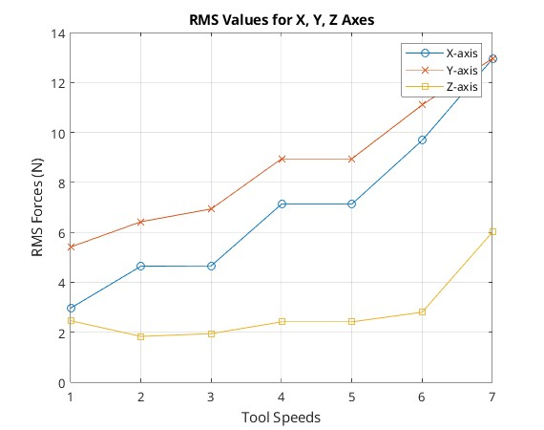
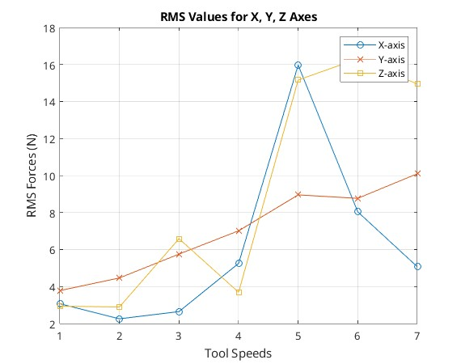
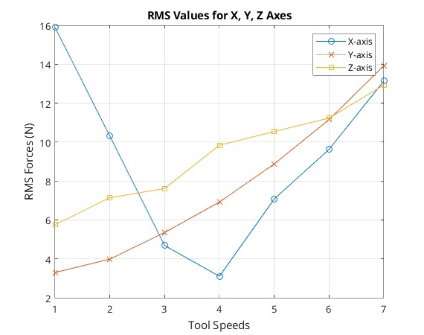
Force variation Trends that was observed during the Experiment
0 Orientation
45 Orientation
90 Orientation

Slide 13
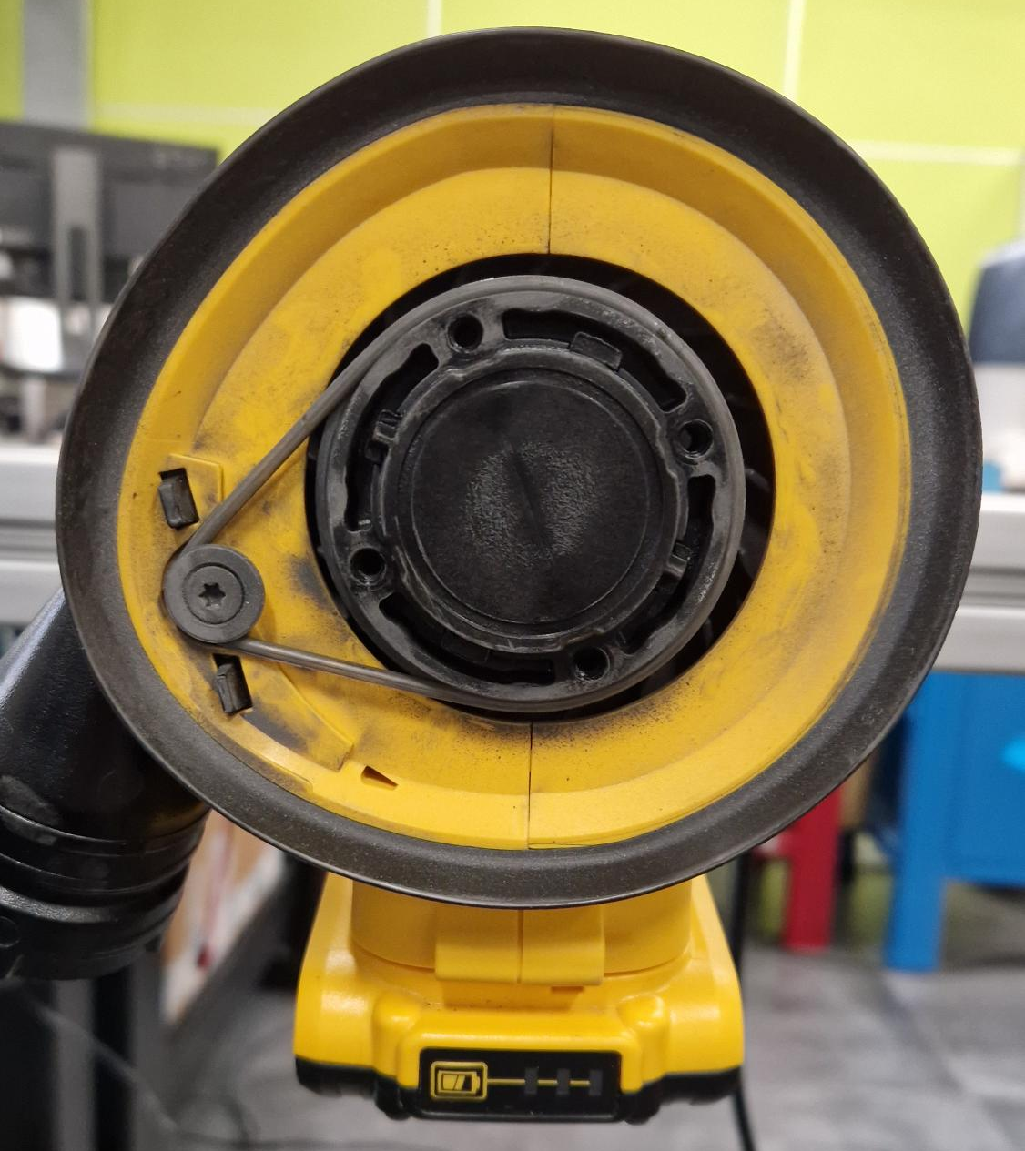
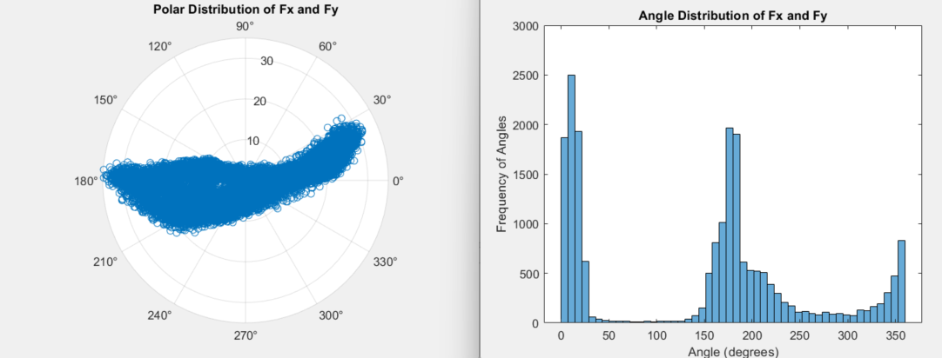
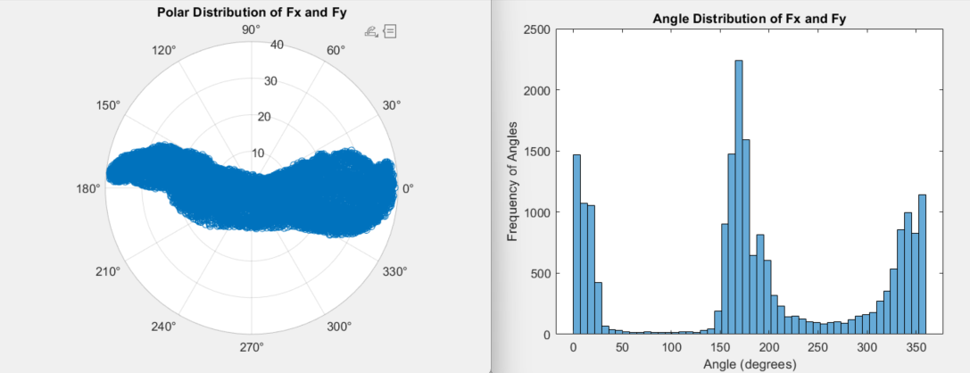
Work Status Update for the Project Magician
Polar Plot
With the rubber belt in vertical position
Without the rubber belt in vertical position

Slide 14
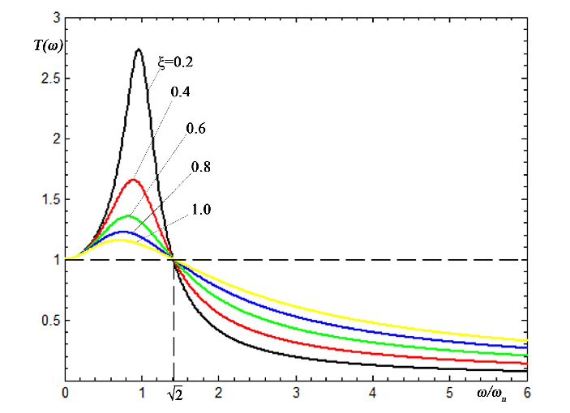
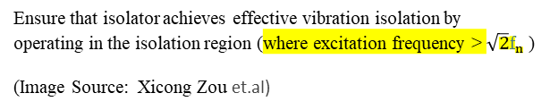
Work Status Update for the Project Magician
Some Key Design Considerations for Vibration Isolator
Use isolators with low stiffness to lower natural frequency.
Ensure isolator frequency is below the source operating frequency.
Balance stiffness to prevent excessive deflection.
Test isolators to confirm proper vibration isolation.
Avoid overlap with source and receiver frequencies.
Isolator Region
Ensure that isolator achieves effective vibration isolation by operating in the isolation region (where excitation frequency > $\sqrt{2}f_{n}$ ​)
(Image Source: Xicong Zou et.al)
Zou, X., Li, Z., Zhao, X., Sun, T., & Zhang, K. (2014, August). Study on the auto-leveling adjustment vibration isolation system for the ultra-precision machine tool. In 7th International Symposium on Advanced Optical Manufacturing and Testing Technologies: Advanced Optical Manufacturing Technologies (Vol. 9281, pp. 606-612). SPIE.

Slide 15
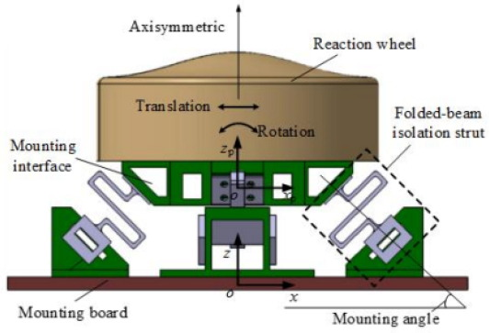
Work Status Update for the Project Magician
Further Ideas for the Vibration Isolator:
Since the Tool is vibrating in Higher frequency domain and most of the isolation systems where designed for low vibration system from the past literature data.
(Image Source: Shi, H. T., et al)
One suitable Idea is to design a Complaint Flexures.
Shi, H. T., et al. "Vibration isolation methods in spacecraft: A review of current techniques." Advances in Space Research (2024).

Slide 16

Work Status Update for the Project Magician
Thank you very much for your Attention

