Slide 1

Image Lifecycle

Slide 2
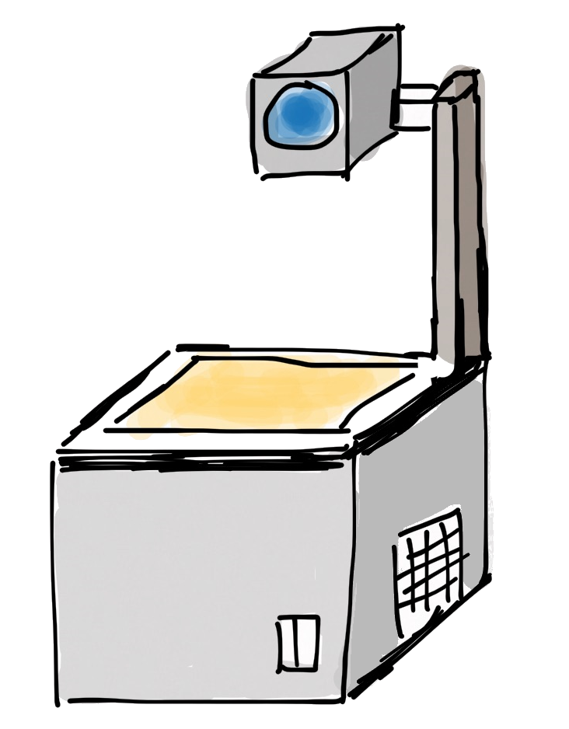
Layers of images and containers
Container
writable layer
Image
Custom content
NGINX
Base Image (e.g. Debian)

Slide 3


Advantages of layers
tomcat:7.0-jre7
openjdk:7-jre
nginx:1.23
buildpack-deps:bullseye
debian:bullseye
debian:bullseye
debian:bullseye
Layers get shared between images - downloaded and persistent only once

Slide 4
Please type along
$: docker images
($: docker pull nginx:latest)
$: docker image inspect nginx:latest
$: docker image history nginx:latest
$: docker image list --digest
Notes:
By now, there should be images available locally. If not, please download them.

Slide 5

Creating images with Dockerfiles

Slide 6


Building Container images
docker build <path to build context>
nginx
dockerd
buildkit
Kaniko
debian:bullseye-slim
Build Context
scratch
Container Image
Dockerfile
Notes:
Creating a Docker image involves two things
A Dockerfile containing directives on how the image is meant to be built
A build-context (or PATH) which is a directory on your hard disk
every file to be added to the image must be inside the build-context
Best to use an empty directory as everything in build context will be transferred to build-tool (i.e. dockerd)
Image is built by the Docker daemon
the whole build-context is sent to the daemon
Dockerfile is processed
Image stored in the local image store, can then be tagged and uploaded to a registry
Images can be built by tools other than Dockerd:
Buildkit (spin-off from Docker)
Kaniko (https://github.com/GoogleContainerTools/kaniko)

Slide 7
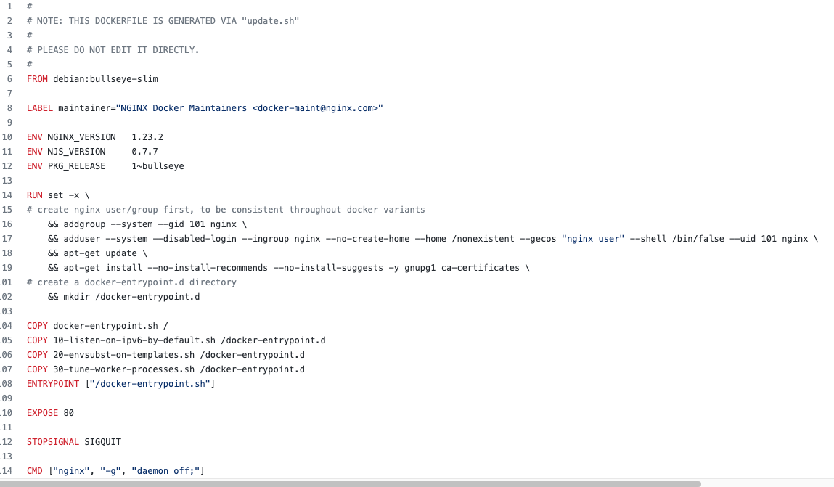
Dockerfile
https://github.com/nginxinc/docker-nginx/blob/fef51235521d1cdf8b05d8cb1378a526d2abf421/mainline/debian/Dockerfile

Slide 8
Ingredients of a Dockerfile
First line: FROM
Meta-data can be added as LABEL
Environment variables can come in handy with ENV
You can ADD or COPY files to the image
It is possible to RUN commands in the image
Do not forget to EXPOSE network ports
Containers start their life with a CMD or an ENTRYPOINT
Each line is executed in a temporary container which gets persisted as a new layer on top of the existing layers.
Remember the layer limit – keep it short and simple.

Slide 9
Dockerfile directives (1)
FROM
first line in a Dockerfile
specifies which image to build upon / to extend
special case: FROM scratch starts from scratch without any previous image
ENV
Sets an environment variable
Will be present during the build process and in the final image
Examples:
FROM debian:jessie
will pull the a Debian image from Docker Hub and use it as base image
FROM scratch
will start with an empty image
Examples:
ENV http_proxy http://proxy:8080
ANTI-PATTERN: will set the http_proxy environment while building the image and in the finished image and thus hard-code infrastructure specifics into the image

Slide 10
Dockerfile directives (2)
LABEL
sets meta-data of an image
labels are key-value pairs
Examples:
LABEL maintainer="Homer Simpson"
adds a piece of meta-data to the image specifying the maintainer

Slide 11
Dockerfile directives (3)
COPY
copies a file from the build-context to the image
no additional magic like the ADD command
does not copy files inside the image
ADD
adds a file from the build-context to the image
can download files from a URL
will automatically extract archives
Examples:
COPY default.conf /etc/nginx/conf.d/
will copy the file default.conf into the image at /etc/nginx/conf.d/default.conf
Examples:
ADD rootfs.tar.bz2 /
will extract the contents of rootfs.tar.bz2 to the root directory / of the image
ADD http://plx172:1080/pic.jpg /usr/share/pics
will download a picture from plx172 and place it into the image at /usr/share/pics

Slide 12
Dockerfile directives (4)
RUN
runs the specified command in the image
command binary and shell must be present in the image
EXPOSE
exposes a port
exposed ports can be automatically mapped by Docker
Examples:
RUN apt-get update
will run the Debian package manager and build its package cache inside the image
RUN cp /etc/nginx/nginx.conf /root
will copy the file /etc/nginx/nginx.conf within the image to the directory /root within the image
Examples:
EXPOSE 80
will expose port 80 so that “docker run -P” can automatically map it to a port on the host

Slide 13
Dockerfile directives (5)
CMD
specifies the command to run when a container is created from the image
all but the last CMD directive are ignored
can be overridden upon container instantiation
ENTRYPOINT
sets the program to be directly run when a container is created
can be overridden with the option “--entrypoint”.
Examples:
CMD /bin/helloworld
will run a hello-world program when the container is started. This form is executed in a shell
CMD ["nginx", "-c", "daemon off;"]
will run the nginx binary with the arguments “-c” and “daemon off;” This form is directly executed via a system call (without shell)
Examples:
ENTRYPOINT [ "/usr/bin/nginx" ]
starts nginx directly without using a shell to start it. (Note the brackets)

Slide 14
Dockerfile directives (6)
USER
Set the active user & group for following commands
Specified user is valid for RUN as well as CMD & Entrypoint
Prerequisite: the target user / group has to exist
Examples:
RUN adduser -D -s /sbin/nologin nginx
will create a new user with name “nginx”
USER nginx
will switch from current user to “nginx”. Valid for all following commands such as RUN but also when starting a new container later

Slide 15
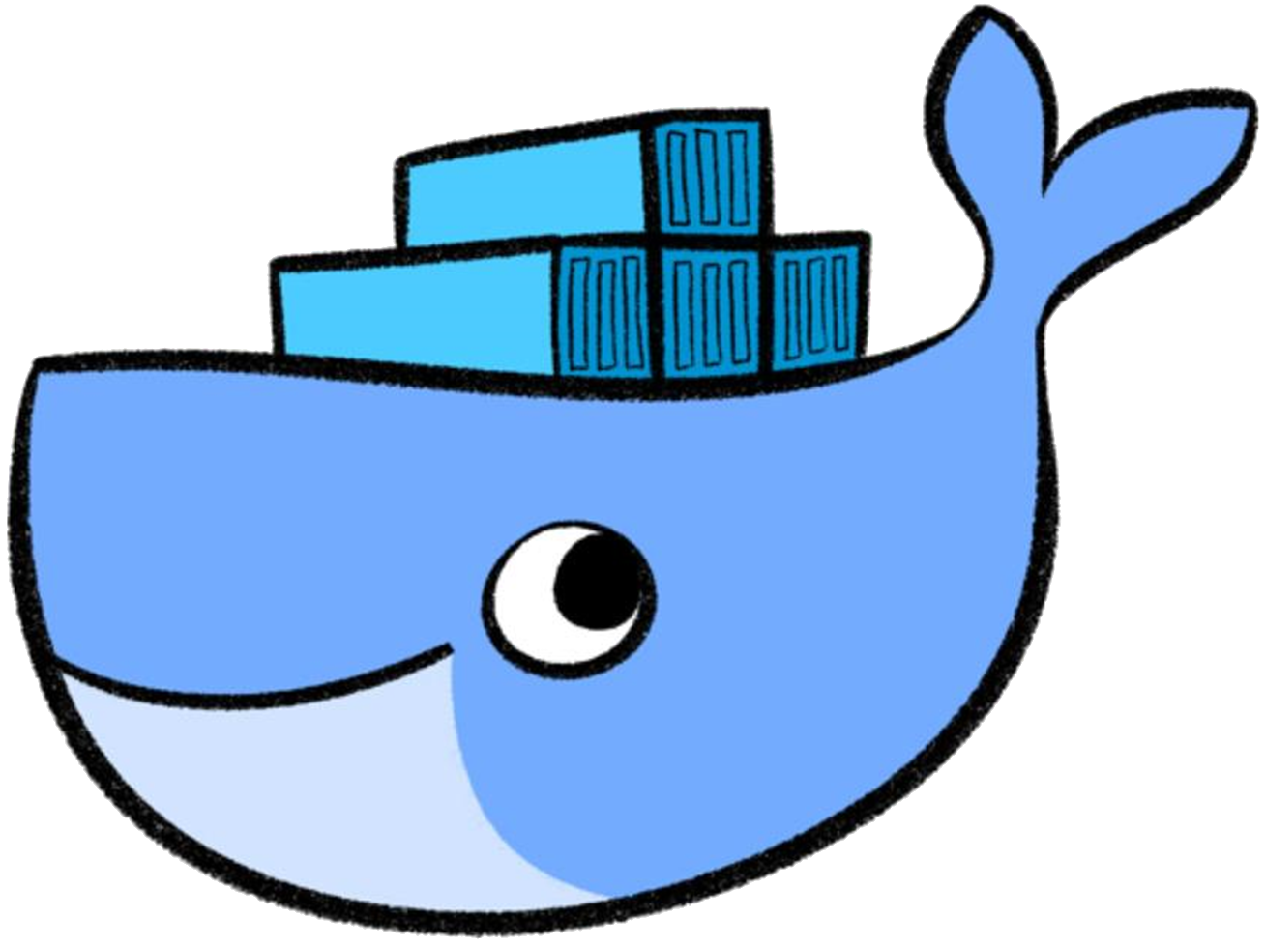

Running a container as root
user “root” within the container is the same as outside
Via volumes files owned by “root” can be created or modified on the host
# whoami
>> root
# id root
>> uid=0(root) gid=0(root)
# touch /hostfs/test
$: ps aufx
…
root /usr/bin/containerd
root \_ containerd-shim -namespace moby
root \_ /bin/sh
root \_ whoami
Notes:
Let’s have a look at the implications of the USER directive.
When a process within a container is running as user root, the process will be also run as user root on the host. This can open doors for some severe (security) issues as an attacker might try to break free from the container.
What could happen? For example if the host’s file system is mounted into the container, touching or modifying files happens in the name of user root. Even if the user you used to start the container (docker run) is not root, you can now act as root user (privilege escalation) .

Slide 16
USER – non-root is best practice!
Use a different user within the container to limit access to the host
Regular permission checks apply
# whoami
>> app-user
# id app-user
>> uid=1001(app-user) gid=10001(app)
# touch /hostfs/test
Permission denied.
$: ps aufx
…
root /usr/bin/containerd
root \_ containerd-shim -namespace moby
1001 \_ /bin/sh
1001 \_ whoami
Notes:
When building images, it is recommended to create a separate user and let the CMD/ENTRYPOINT command run with this specific user.

Slide 17
User Namespace: remap
user “root” within the container is mapped to a different UID
Docker can be configured to automatically remap user & groups
# whoami
>> root
# id root
>> uid=0(root) gid=0(root)
# touch /hostfs/test
$: ps aufx
…
root /usr/bin/containerd
root \_ containerd-shim -namespace moby
231072 \_ /bin/sh
231072 \_ whoami
Notes:
Another way to deal with this topic is the usage of the user namespace. It allows to define mappings (check /etc/subuid file) so that your user appears to be root from within the container but not from the outside.
Right now the docker daemon supports the usage of the user namespace but it is not switched on by default.
To enable this feature:
Add "userns-remap": "default“ to /etc/docker/daemon.json (fit it into the existing json structure).
Reload the config & restart docker:
systemctl daemon-reload
systemctl restart docker
Check /etc/subuid -> it should have a docker remap user entry now.
Important: this feature is currently not compatible with Kubernetes!
Details can be found in these discussions:
https://github.com/scality/metalk8s/issues/484
https://github.com/kubernetes-sigs/kubespray/issues/962
https://github.com/kubernetes/kubernetes/issues/59152

Slide 18

Exercise #1– Dockerfile

Slide 19
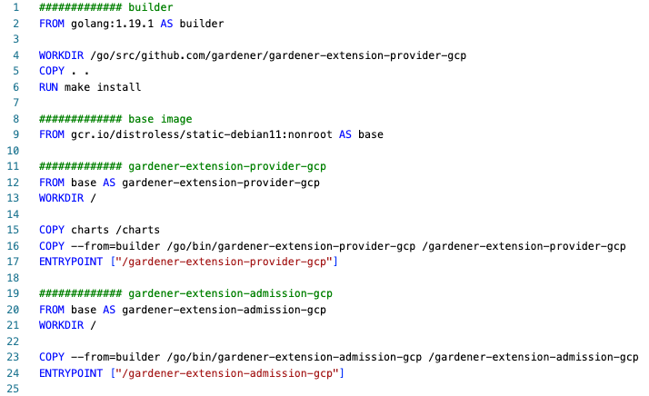
Multistage Dockerfile
A Dockerfile may have multiple FROM lines – each is a called a „stage“
Stages are build separately
Stages can be named and referred to by this name in the same file or during build with --target
Files from previous stages can be copied

Slide 20
Exercise #2– Multistage Dockerfile

Slide 21
Publishing Images to a Registry

Slide 22
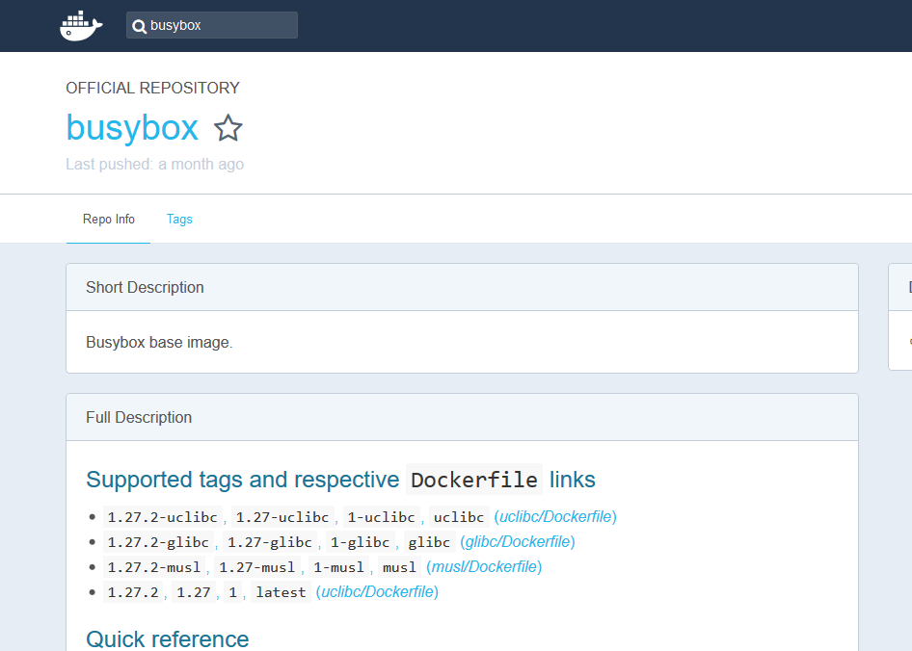
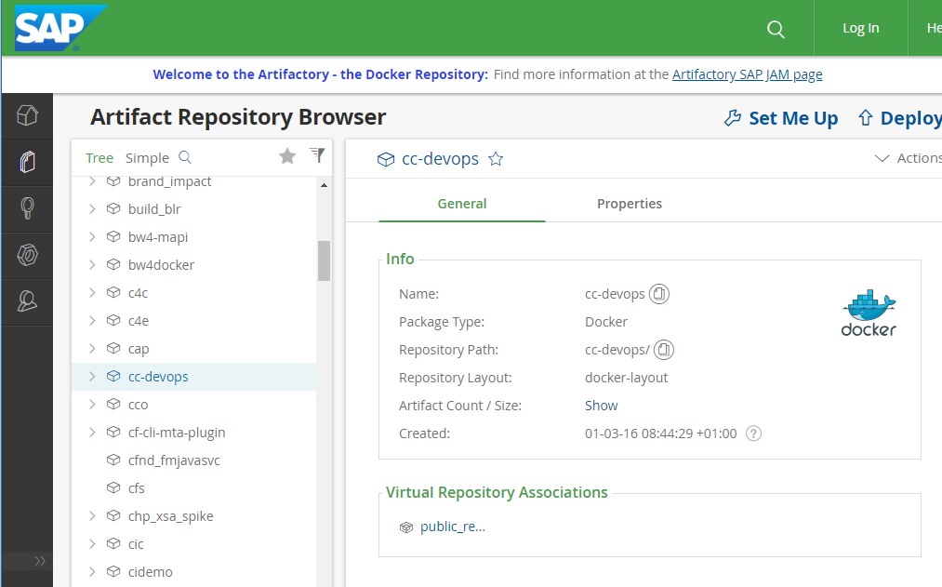
Registries for images
Docker Hub
JFrog Artifactory
Notes:
The docker hub offers (provides storage and the push/pull protocol for) docker images.
Each docker image has a clearly specified version. There can be multiple version tags.
The 'Dockerfile' defines the automated build instructions and show what is in the image. (see Dockerfile chapter). Dockerfiles are also included in images and document the contents.
At SAP, Artifactory is the preferred solution to host and distribute your Docker images.

Slide 23



Publishing images
Components of an image reference:
- registry host
- repository path/name
- tag or @sha256:<digest>
hub.docker.com
v1
v2
latest
$: docker tag <image> <target registry/repo>:<tag>
$: docker push <target registry/repo>:<tag>

Slide 24
Please type along
#use the nginx image build during the previous exercise here
$: docker images
$: docker tag <image id> nginx:awesome-<some random characters>
$: docker push nginx:awesome-<some random characters>
# “lengthy URL“ will be something like: h.ingress.xyz58.k8s-train.shoot.canary.k8s-hana.ondemand.com
$: docker tag <image id> <lengthy URL>/training/<your-repo>:<tag>
$: docker push <lengthy URL>/training/<your-repo>:<tag>
$: docker login <lengthy URL>
$: docker push <lengthy URL>/training/<your-repo>:<tag>
Notes:
Some commands will throw an error. This is supposed to happen and meant to help learn.
Username: participant
Password: 2r4!rX6u5-qH
Following commands are expected to throw an error:
Docker push nginx:awesome (it is targeting the official nginx repo on docker hub. This is supposed to be denied)
Docker push to the harbor registry without logging in before

Slide 25



Docker login credentials
Private Registry
dockerd
docker login <registry url>
-u <username>
-p <password>
User Management
config.json
Notes:
Some, if not most registries require to log in to push or even to pull images.
With 'docker login', one can submit the username and password for a given registry (specified by its URL). Docker will persist these login credentials in a config.json (usually found in ~/docker/config.json) and use them every time a registry is accessed.

Slide 26
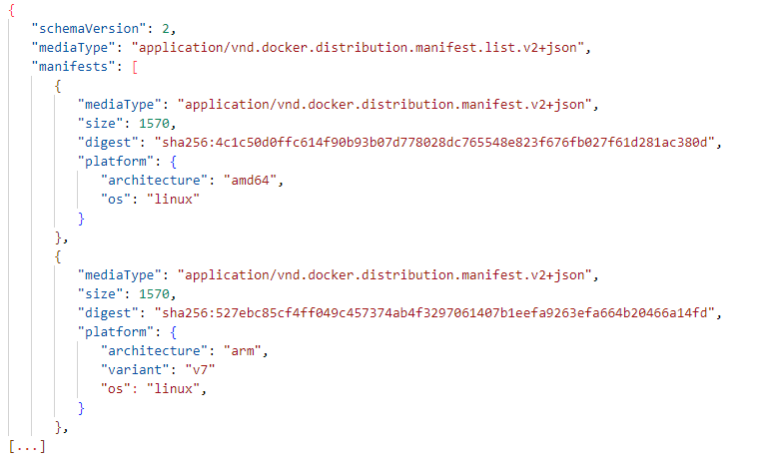
Support for multiple architectures
https://docs.docker.com/engine/reference/commandline/manifest/
Notes:
Images contain platform-specific binaries. You can bundle multiple images in a manifest which can be published as well. With a manifest users can resolve to the platform specific digests (images) they need.

