Slide 1
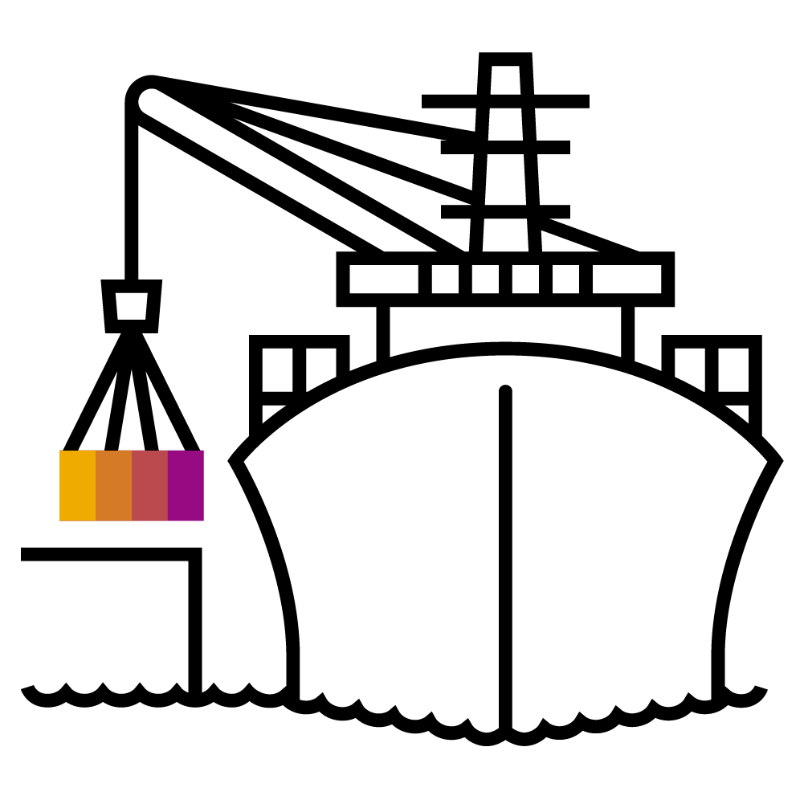
Ports and Volumes

Slide 2
Docker networking
HOST
DOCKER_HOST
nginx
Containers in isolated network
private network 172.17.0.0/16
Containers can see each other
Not reachable from outside
NAT to connect to the outside world
nginx
nginx
:80
:80
172.17.0.2
172.17.0.3
172.17.0.0/16
172.17.0.1
:80
:81
:80
192.168.2.42

Slide 3
Port forwarding
Port forwarding
Port forwarding to host
docker run -p <host port>:<container port> …
Containers expose ports, can be mapped automatically
docker run -P …
Exposed ports can be inspected
nginx
:80
NAT
:81
Notes:
Every docker host spins up a local private network. A container will get an IP address form this network to be reachable locally. So as long as all container are on the same host, they can communicate via this network.
However, this is a very unlikely scenario. Probably there are more hosts involved or you want to expose your application to the outside. Docker supports network address translation (NAT) to map a <container_ip>:<port> to a port on the external network interface of the docker host. If you have a container with 172.16.0.2:80 locally it could be exposed to the outside on 192.168.52.1:32710 (ip address of the docker host + unused port).
This feature is called port forwarding and docker knows two flavors of it.
Map a dedicated host port to a container port – this has to be specified manually. So you have to keep track of all your used ports in order to avoid conflicts. Use the “-p” (lower case) switch and specify host port & container port.
Map a random port to a container port. Use the “-P” (upper case) switch. Docker detects the ports a container exposes and automatically assigns an unused port. Check with “docker ps” or “docker container list”, which port was assigned.

Slide 4

Demo
Notes:
Let’s get back to our nginx examples.
Docker run -d -p 8081:80 nginx:mainline
Access the nginx on port localhost:8081
Run the same with -P and get the port via docker container list
Access the nginx via the random port
It’s important to remember – the first port is referencing the port that is opened on the docker host, the 2nd port is referencing the container port.
Talking about networking:
Docker network list
Show the different docker networks and create a new bridge network (docker network create test)
If you want to wire 2 containers, you have to put them into the same docker network. But be careful, DNS resolution doesn’t work in the default network!
Spin up a nginx: docker run -d --name nginx --network test nginx:mainline
Spin up a helper: docker run -it --name helper --network test alpine:3.8
From within the helper container, show the dns resolution : nslookup nginx
And connect to the webserver: wget nginx
Show the downloaded index.html page: cat index.html
So actually it is possible to wire container with docker directly, but kubernetes will make things easier ☺

Slide 5

Volumes
Container
Local Filesystem
Bind mounts
Hides everything in destination directory
Named volumes
Contents in container are merged with volume
No straightforward access from host
writable layer
Image
PHP
nginx
Debian
Volume mount
Notes:
Since it is not recommendable to store data in a docker container, adding a persistence is quite important. With the volumes API it is possible to assign persistent storage to a container.
Docker supports 2 ways of doing so:
Bind mounts: mount a local host directory onto a certain path in the container. Everything that was present before in the target directory is hidden (nature of the bind mount). For example, if you have some configuration you want to inject, write your config file, store it on your docker host at /home/container/config and mount the content of this directory to /usr/application/config (assuming the application reads config from there).
Command: docker run --mount type=bind,source=<source path>,target=<container path> …
Named volumes: docker can create a separated storage volume. Its lifecycle is independent from the container but still managed by docker. Upon creation, the content of the mount target is merged into the volume.
Command: docker run --mount source=<vol name>,target=<container path> …
How to differentiate between bind mounts and named volumes?
When specifying an absolute path, docker assumes a bind mount.
When you just give a name (like in a relative path “config”), it will assume a named volume and create a volume “config”.
Note: Persistent storage is 'provided' by the host. It can be a part of the file system on the host directly but also an NFS mount.

Slide 6
Demo
Notes:
Volumes are the docker way to work with any kind of persistent data.
Let’s start simple and (bind) mount a directory into a container. Therefore assume you have a toolbox container and you need some environment in there (like a config file or ssh keys).
docker run -it –mount type=bind,source=/home/vagrant,target=/mnt/home alpine:3.8
Show the content of /mnt/home, which would be you’re home directory
Let’s see what else you could do with a bind mount:
Docker run -it --mount type=bind,source=/home/vagrant,target=/etc alpine:3.8
What happens? Well, our home directory is mounted to /etc. The original content of /etc is still there but hidden.
Of course you can also inject a nginx index page or any configuration this way, but that’s part of the exercise ;)
Let’s move on to docker volumes. When working with a container, you might want to persist some data during runtime. For this example you will use a Jenkins and make it’s home a volume.
docker run -d -P --mount source=jenkins_home,target=/var/jenkins_home jenkins/jenkins:lts
Next, get the ports and connect the port that forwards to container port 8080
On the jenkins logon page, you’re asked for a password, run “docker logs <container name>” and obtain the logon token
Logon to the jenkins and choose “select plugins to install”, select “none” (upper left corner) and continue.
Create a user e.g ‘root’ with a simple password and finish the setup.
Now stop the container and restart it – obviously you’re still able to logon with the credentials created before.
Finally, delete the container and with that also the RW layer and re-execute the docker run jenkins command.
Connect to your new jenkins (get the ports before) and logon with the same credentials as you’re still referring to the same jenkins home.
Inspect the jenkins_home volume (docker volume inspect jenkins_home) and go to it’s path (probably you need to be root for that) and show the content.
Highlight, that the volume upon creation was empty. With the first start of jenkins, content was written to it. However when launching the 2nd jenkins container the content was not overwritten / re-initialized. So if you need to persist some initial data, a named volume might be useful.
Downsides: it’s hard to move a volume to another host, but the k8s storage api will provide better ways of adding persistence.

Slide 7

Exercise #3 – Ports and Volumes

