Slide 1
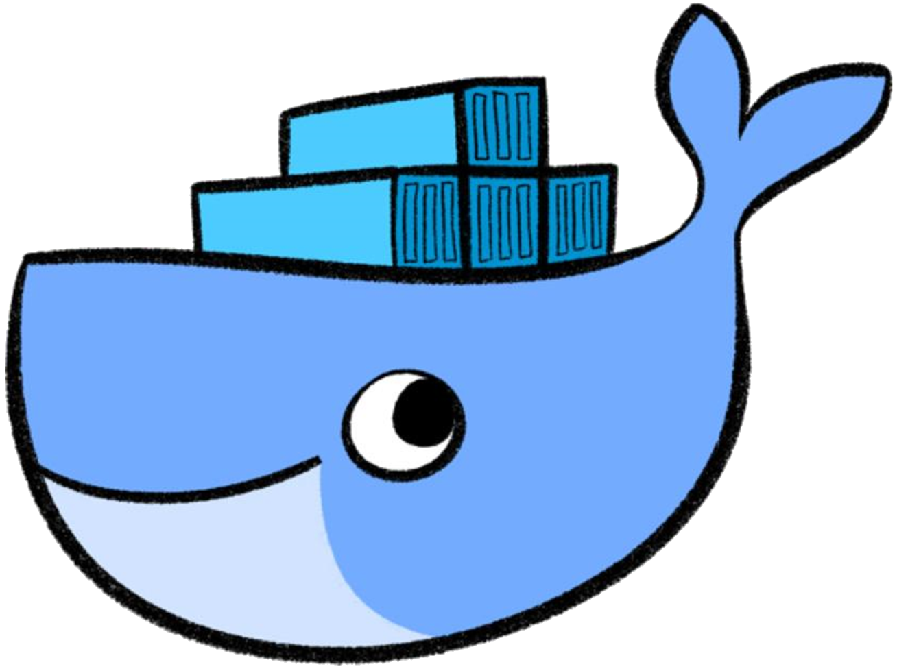
Container Lifecycle

Slide 2



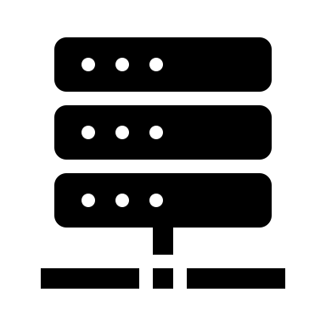
Images
Images:
read-only templates
Stored centrally in a so-called registry
Addressable via a „tag“ or sha256 digest
hub.docker.com
v1
v2
latest
Notes:
Images are read-only templates. They are stored centrally and can be downloaded from a so-called registry

Slide 3
Please type along
$: docker info
$: docker pull ubuntu:latest

Slide 4
Container lifecycle
docker/ubuntu
docker create
docker start
Container exists
$: echo hello world
docker start
docker stop
docker rm
Everything is gone
Container still exists
Notes:
When talking about a “container”, we are referring to the combination of read-only layers from the image and one read-write layer on top of it. You can derive / instantiate an indefinite number of containers from the same image. They only vary by the read-write layer on top. Or stated another way: A container consists of just the read-write layer, some meta data (settings, flags pass on start) and a reference to the image. All containers share only one common image.
The container lifecycle illustrates, what happens to this read-write layer. With “docker create” you tell docker to create such a read-write layer. With “docker start” you bring it to life, meaning a process with ID 1 is started. The “run” command combines “create” & “start”.
Once you have the read-write layer everything that happens inside the container is stored there. You can “stop” the container (killing PID 1) and re-start it. Since all these operations happen on the same read-write layer, everything you did when the container ran, is still present.
But if you “rm” the read-write layer everything is irretrievably gone.

Slide 5
Please type along (1)
$: docker container create –it ubuntu:latest
$: docker container list –a
$: docker container start –i <name/ID of your container>
$: apt-get update
$: apt-get install cowsay
$: cd /usr/games
$: cowsay hello world
$: exit
Notes:
Let‘s create a container and start it. For us to be able to work with it, we need it to be interactive and attached to our terminal – hence the ‘-it’ parameter

Slide 6
Please type along (2)
$: docker container list –a
$: docker container start <ID/name of your container>
$: docker logs <ID/name of your container>
$: docker stop <ID/name of your container>
$: docker container list –a

Slide 7
Please type along (3)
$: docker start <ID/name of your container>
$: docker exec –it <ID/name of your container> bash
$: docker stop <ID/name of your container>
$: docker rm <ID/name of your container>

Slide 8
Details of the container lifecycle
docker run
docker create
docker start
writable layer a320d5f4bd36
writable layer a320d5f4bd36
docker start
docker stop
docker rm
writable layer a320d5f4bd36
writable layer a320d5f4bd36
Notes:
When talking about a “container”, we are referring to the combination of read-only layers from the image and one read-write layer on top of it. You can derive / instantiate an indefinite number of containers from the same image. They only vary by the read-write layer on top. Or stated another way: A container consists of just the read-write layer, some meta data (settings, flags pass on start) and a reference to the image. All containers share only one common image.
The container lifecycle illustrates, what happens to this read-write layer. With “docker create” you tell docker to create such a read-write layer. With “docker start” you bring it to life, meaning a process with ID 1 is started. The “run” command combines “create” & “start”.
Once you have the read-write layer everything that happens inside the container is stored there. You can “stop” the container (killing PID 1) and re-start it. Since all these operations happen on the same read-write layer, everything you did when the container ran, is still present.
But if you “rm” the read-write layer everything is irretrievably gone.

Slide 9
Please type along (4)
$: docker run -d nginx:mainline
$: docker container list –a
$: docker inspect <ID/name of your container>
$: docker container stop <ID/name of your container>
$: docker container prune
Notes:
The “run” command makes our live a bit easier as it bundles “create” and “start” into a single command. Please note, we want our nginx webserver to be running in the background (“detached”), hence “-d”.

Slide 10
What’s happening in the background?
$ docker run container
cgroups resource limitation
chroot filesystem isolation
namespaces process isolation
seccomp & capabilities additional security
iptables network routing
and more…
Notes:
You actually specify an image name as argument of the docker run but that will be explained in the next few slides.

Slide 11
Container Engine

Slide 12
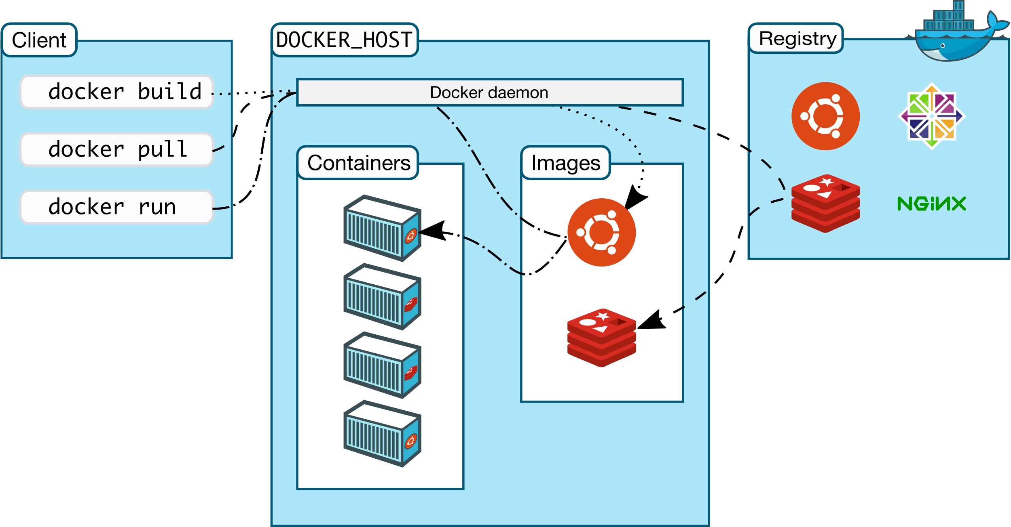
Docker eco-system
https://docs.docker.com/engine/docker-overview/
Notes:
Docker offers more than “just” running containers. It brings a complete eco-system of building, persisting and sharing containers.
The client triggers the docker host to execute actions related to container lifecycle, but also building, downloading & sharing images. The Docker Registry concepts allows to store images permanently. The most famous registry is the docker hub.

Slide 13

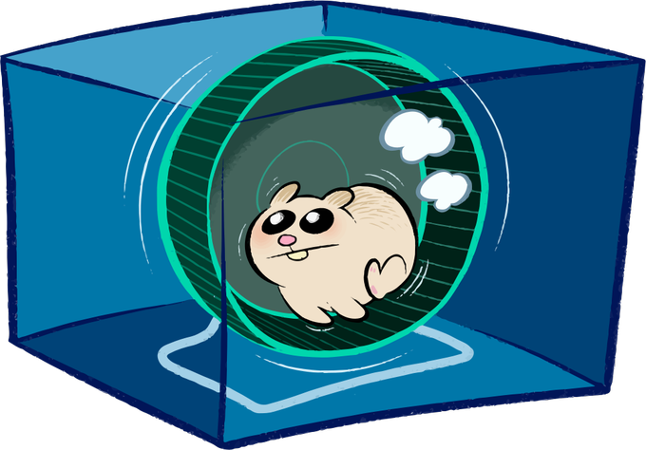
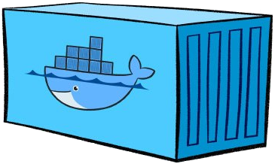
A look into the docker engine
Docker daemon is the central entry point for all API requests
dockerd
Container runtime to handle container lifecycle based on OCI specs
containerd
shim process which takes over parent ownership of a running container
containerd-shim
containerd-shim
containerd-shim
runc
runsc
runc
runc actually starts the container
Notes:
The docker daemon works as central entry point. It receives API requests and is home of docker specific features.
Containerd actually is the container runtime. It is a refactored part of the former docker engine and handles the complete lifecycle of a container. It works on the basis of the open container initiative (OCI) specifications for container runtimes. Containerd also depends on OCI compatible images (root file system + container.json)
Containerd instructs runc to start a container. Runc sets up all the linux magic with cgroups etc and forks the container’s PID #1. Afterwards it will exit(0) and handover parent ownership of the container to containerd-shim. The shim module is there to decouple the daemon and container processes.
Details can be found here:
https://containerd.io/
https://www.slideshare.net/PhilEstes/diving-through-the-layers-investigating-runc-containerd-and-the-docker-engine-architecture
https://hackernoon.com/docker-containerd-standalone-runtimes-heres-what-you-should-know-b834ef155426?gi=c8140ae48de2

