Slide 1
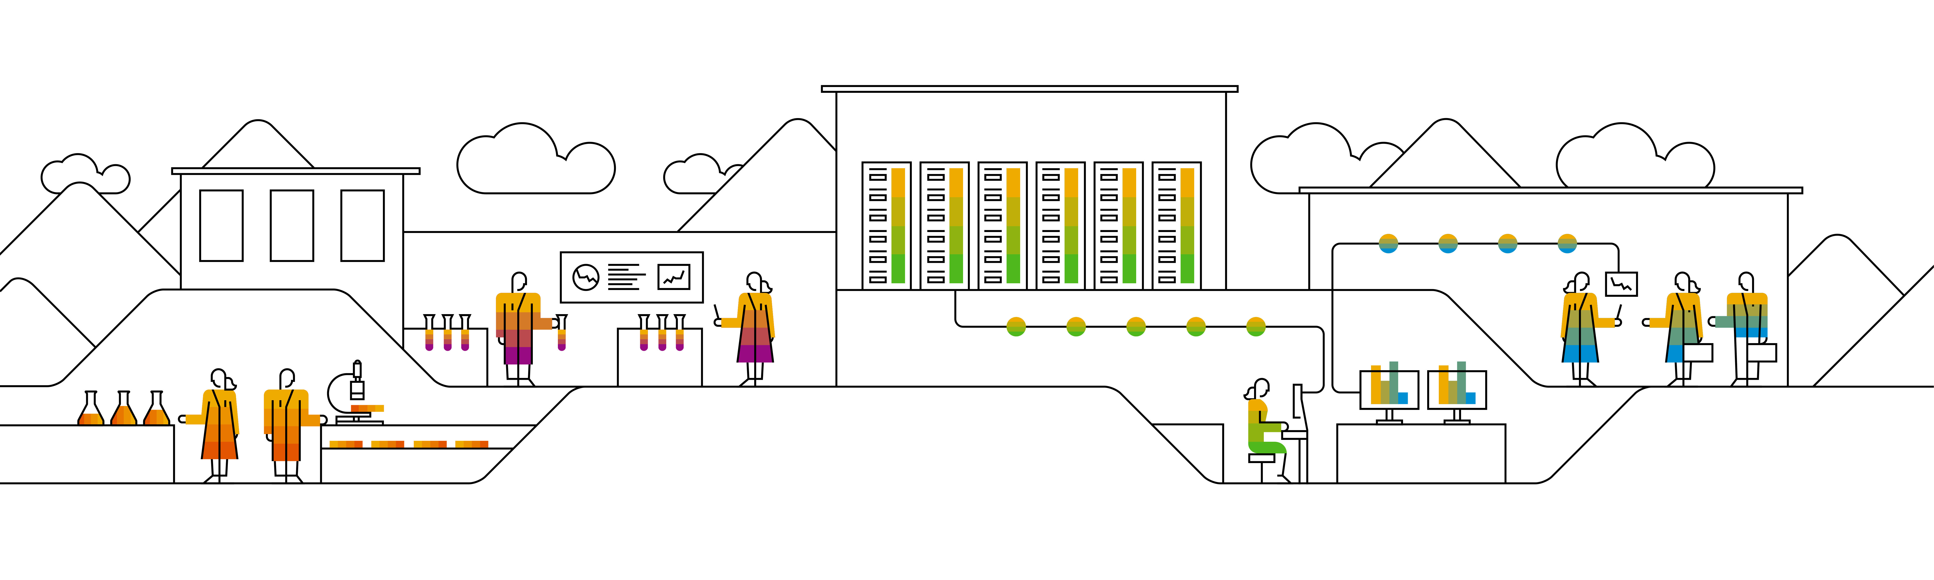
Kubernetes Persistence

Slide 2

What‘s the issue?
Pods have no strong runtime guarantees. They can easily be evicted.
Data residing in a Pod will vanish with the Pod
Containers in a Pod are not restarted upon errors but re-created
IP: 10.10.10.1
Pod-A
container:
nginx
Container FS
Notes:
Pods provide only ephemeral storage. When a pod is killed, all data is gone. This section is all about the creation & usage of storage in the context of Kubernetes.

Slide 3


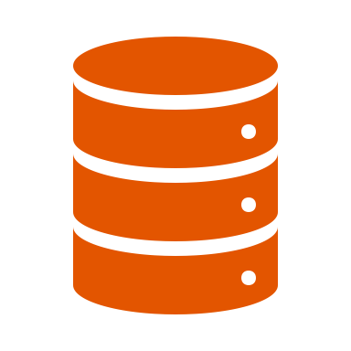


Technically, it’s still about containers …
Container
azureDisk
gcePD
NFS
Node
Notes:
In order to solve the problem of ephemeral container storage, a file system of the underlying host can be bind-mounted into a container.
Whether this is a local or remote file system, does not matter to the container.
Ideally, we can set this up for our Pods without leaving the K8s space.

Slide 4
How to solve it on K8s level?
Pods may declare & request the usage of storage
Kubernetes makes the file system available to the container
Kubernetes offers different types of storage integration:
https://kubernetes.io/docs/concepts/storage/volumes/
IP: 10.10.10.1
Pod-A
Storage backend
Container:
mount to /mnt/app
reference
Notes:
Add the reference to the storage to the pod definition in spec.volumes
Refer to the spec.volumes entries in the container spec and define to which location the bind-mount should point. If the container places data at /mnt/, it will be persisted on the actual storage

Slide 5


What happens in the background …
Node
bind mounts /mnt/gce-pd-volume into container file system
kubelet
Pod
Container
/usr/share/nginx/html
10 GB Persistent Disk
/dev/sdb
Mount disk to node
/mnt/gce-pd-volume/
Notes:
While abstraction is easy to work with, it is also quite helpful to know, what is happening in the background.
When declaring the pod spec with it’s volume mount section, in the end it refers to some physical storage. To get actual access to it, the disk needs to be mounted to the node first. Only then the docker daemon can use a bind mount to make the disk available to the container.

Slide 6
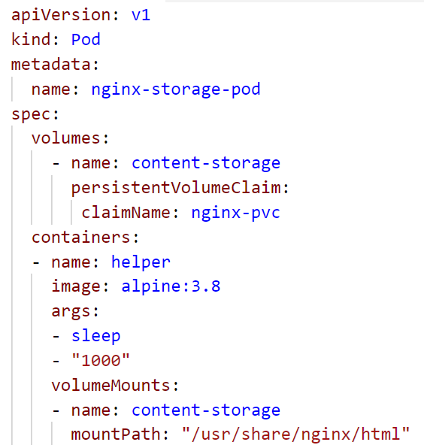
Volumes & VolumeMounts
Volumes are part of the PodSpec object
Available for a lot of backends
local storage (nfs, hostPath, ceph)
cloud storage (Azure, GCP, AWS,…)
Make storage available in a container via VolumeMounts as part of the container specification
Special volumes:
emptyDir
secret
configMap
persistentVolumeClaim
Notes:
To use persistent storage within a container, firstly you need to make it available to the pod.
This is done by specifying a volume object on PodSpec level.
A volume could link to a NFS share, some local storage cluster like ceph or glusterfs or even access the storage provided by cloud platforms like GCP, AWS or Azure.
It is also possible to share storage that is part of a cluster node itself (hostPath). However this is quite dangerous as you need to ensure this storage is available (incl. content) on every single cluster node.
In addition there are other special volume types:
emptyDir: temporary storage, usually to cache or test something. Its lifecycle is bound to the pod and therefore data is ephemeral as well
Secret & configMaps: hold confidential or configuration data and are accessed also via the volumes interface.

Slide 7
What features should the storage interface have?
Notes:
Automation is key (in every aspect of the lifecycle)
Hide implementation details behind a common / standardized API
Resources should be appliable to different clusters without chaning

Slide 8
Storage with PersistentVolumes & PersistentVolumeClaims
User space
Administrator space
Pod-A
Persistent Volume Claim
Persistent Volume
Physical storage
container
nginx
Use the claim as a volume in a pod.
Note: the claim has a separate lifecycle.
Create a Persistent Volume Claim to bind the Persistent Volume
Persistent Volumes objects represent physical storage
Notes:
Managing storage is a distinct problem from managing compute. The PersistentVolume subsystem provides an API for users and administrators that abstracts details of how storage is provided from how it is consumed. To do this we introduce two new API resources: PersistentVolume and PersistentVolumeClaim.
A PersistentVolume (PV) is a piece of storage in the cluster that has been provisioned by an administrator. It is a resource in the cluster just like a node is a cluster resource. PVs are volume plugins like Volumes, but have a lifecycle independent of any individual pod that uses the PV. This API object captures the details of the implementation of the storage, be that NFS, iSCSI, or a cloud-provider-specific storage system.
A PersistentVolumeClaim (PVC) is a request for storage by a user. It is similar to a pod. Pods consume node resources and PVCs consume PV resources. Pods can request specific levels of resources (CPU and Memory). Claims can request specific size and access modes (e.g., can be mounted once read/write or many times read-only).

Slide 9
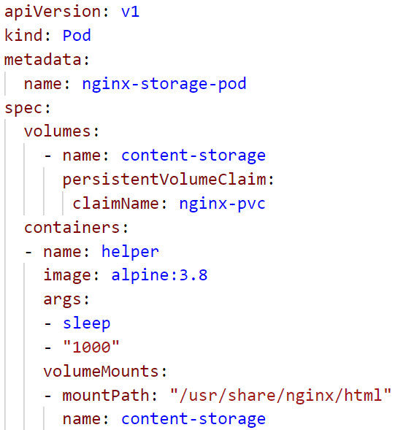
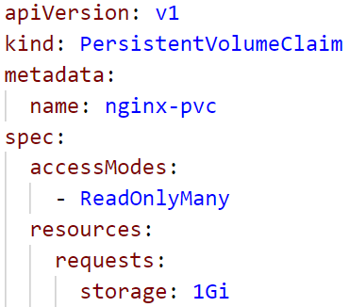
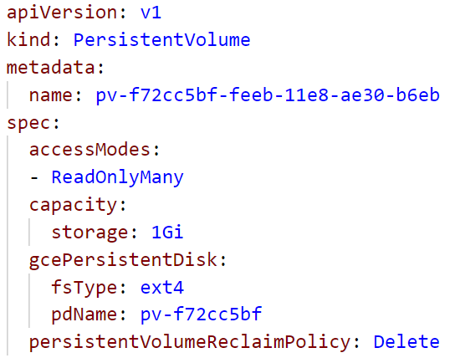
Storage with PersistentVolumes & PersistentVolumeClaims
PV:PVC is always 1:1
PV size must match or exceed PVC requested size
PVC is used as volume within the pod
PVC referenced by Pod
PV is bound to PVC
Notes:
1 PV is always bound by exactly 1 PVC. There is no real order but Kubernetes tries to create matches between requested and provisioned size.
Problem: the match making is based on “equals or greater”. So if the PVC requests 1GB but there is only one PVC with 50GB available, it will be bound nevertheless (and “waste” 49GB)

Slide 10
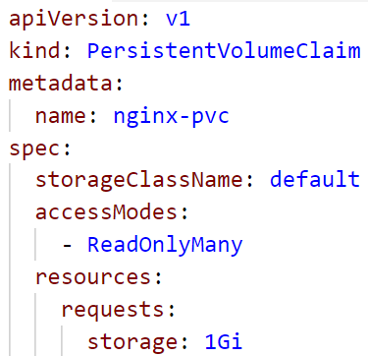
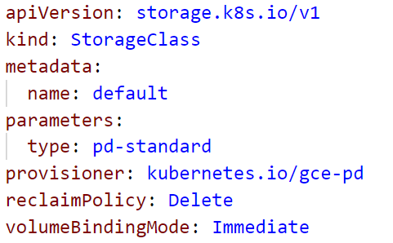
Storage Classes
Provisions a PV for based on PVC request
Overcomes need to manually provision PV
Uses standardized “Container Storage Interface”
PVC references storage class as part of its spec
Storage class provisions a PV matching the request
Notes:
Due to the PV-PVC bind mechanism, it might happen that storage is claimed by the “wrong” requests. Storage classes overcome this issue by reversing the order. Firstly create a PVC and the storage class provides a fitting PV.
On Kubernetes level a storage class is a piece of software running inside the cluster that also is able to administer the storage backend.

Slide 11


CSI
Storage Class
PVC
PV
CSI
AWS EBS
GCP PD
Ceph
…
Notes:
CSI – Container Storage Interface
User requests a PVC
StorageClass is triggered to provision a PV
PV is backed by a physical volume, which is made available via the container storage interface
Depending on the CSI driver used, all kinds of storage backends can be exposed.

Slide 12
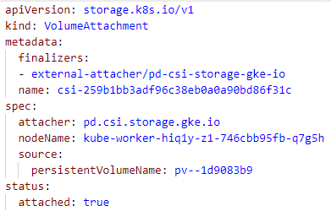
CSI
PVC
Pod
PV
Node
CSI
AWS EBS
GCP PD
Ceph
…
Notes:
To make use of a CSI provisioned volume:
User requests to schedule a pod
The pod used a PVC
To get the volume mounted to the respective node, a VolumeAttachment gets issued
The CSI driver that also provisioned the volume reacts and ensures the volume gets mounted to the node.

Slide 13

PV/PVC lifecycle
User creates a PVC to request storage
PVC will be bound to PV
Storage Class
Persistent Volume
Persistent Volume Claim
Persistent Volume Claim
Physical storage
Storage Class is triggered to fulfill request
Upon PVC deletion reclaim policy is executed
Notes:
Upon deletion of the claim object the persistent volume becomes “unbound”.
There are 3 scenarios:
Retain: nothing happens, the PV will remain until an administrator deals with it. The data is not (yet) deleted.
Delete: together with the PVC also the PV will be deleted. All data is gone.
Recycle (deprecated): remove all data and make PV available to be bound again by a different PVC

Slide 14
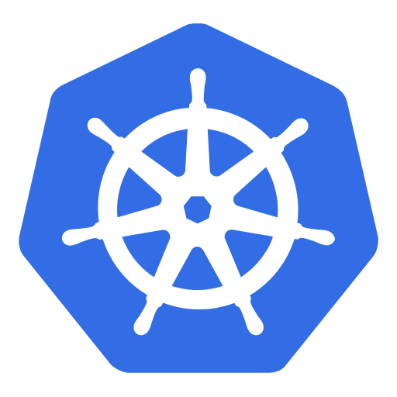
Access Modes
RWOP = ReadWriteOncePod
Only 1 pod can mount the PVC
Feature state
beta: v1.27
Pod A1
IP: 10.10.10.1
Pod A2
Persistent Volume Claim
Persistent Volume
Physical storage
IP: 10.10.10.2
Pod A3
IP: 10.10.10.3
Notes:
https://kubernetes.io/docs/concepts/storage/persistent-volumes/#access-modes
Access modes are tricky. In essence, it describes how PVC may be consumed.
There is a (beta) feature, that allows to apply these conditions on the level of a pod. With RWOP, only a single pod at one point in time can use the PVC (reading & writing data).

Slide 15
Access Modes
RWO = ReadWriteOnce
Only 1 node can mount the PVC
Node A1
IP: 10.64.10.1
Node A2
Persistent Volume Claim
Persistent Volume
Physical storage
IP: 10.64.10.2
Node A3
IP: 10.64.10.3
Storage backend has to support access modes
Notes:
https://kubernetes.io/docs/concepts/storage/persistent-volumes/#access-modes
RWO applies to the node level. Only a single node can mount a volume at a point in time. However, if multiple pods run on the same node, they all can use the volume!

Slide 16
What could possibly go wrong …
Node
bind mounts /mnt/gce-pd-volume into container file system
kubelet
Pod
Container
/usr/share/nginx/html
Pod
Container
/usr/share/nginx/html
10 GB Persistent Disk
/dev/sdb
Mount disk to node
/mnt/gce-pd-volume/
Notes:
Technically, it is still a bind-mount, once the disk is attached to a node. Therefore, it is very well possible (even though not necessarily desired) to use the same volume within multiple pods, provided they run on the same node.

Slide 17
Access Modes
RWO = read-write once
Only 1 pod can mount the PVC
ROX = ReadOnlyMany
Multiple Nodes can mount read-only or 1 node read-write
Node A1
IP: 10.64.10.1
Node A2
Persistent Volume Claim
Persistent Volume
Physical storage
IP: 10.64.10.2
Node A3
IP: 10.64.10.3
Storage backend has to support access modes
Notes:
Modes depend on the storage backend (physical storage). Example for RWX is NFS
https://kubernetes.io/docs/concepts/storage/persistent-volumes/#access-modes

Slide 18
Access Modes
RWO = read-write once
Only 1 pod can mount the PVC
ROX = read-only many
Multiple pods can mount read-only or 1 pod read-write
RWX = ReadWriteMany
Multiple nodes can mount read-write
Node A1
IP: 10.64.10.1
Node A2
Persistent Volume Claim
Persistent Volume
Physical storage
IP: 10.64.10.2
Node A3
IP: 10.64.10.3
Storage backend has to support access modes
Notes:
Modes depend on the storage backend (physical storage). Example for RWX is NFS
https://kubernetes.io/docs/concepts/storage/persistent-volumes/#access-modes

Slide 19

Demo
Notes:
Create a PVC from yaml
Explain the waitForFirstConsumer Policy (storage class will provision the PV only when a pod actually requests to mount the pvc)
Create a deployment which mounts the PVC. Discuss the volume & volumeMount section and highlight the matching names for the volume within the pod spec to make it referenceable.
Show the storage class reference in the PVC yaml and the corresponding storage class within the cluster (kubectl get storageclass). These have to match!
Query the PV’s and outline the connection between the PVC in the namespace and the PV. Print out the PV yaml and highlight that there is no namespace as PV resources are not namespaced.
Once the pod is created, logon to it and create some content.
Next, scale the deployment that attempts to mount the same PVC.
Discuss the error message (kubectl describe pod <pod of a deployment>)
Outline the implication of the access-mode. If the PVC is already bound once in RWO mode, it cannot be bound in any other mode.
Highlight, that if a pod already runs on a node and mounts a volume a 2nd pod can start on the same node and also use this volume (which of course is dangerous)

Slide 20
What YOU will do in exercise #05
nginx
nginx
nginx
Add persistent storage to your pods
content
config
tls certs

