Slide 1
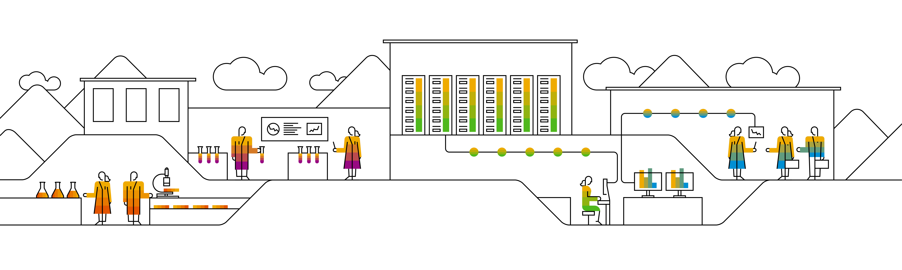
Cloud Native Developer Journey Fortune Cookies

Slide 2
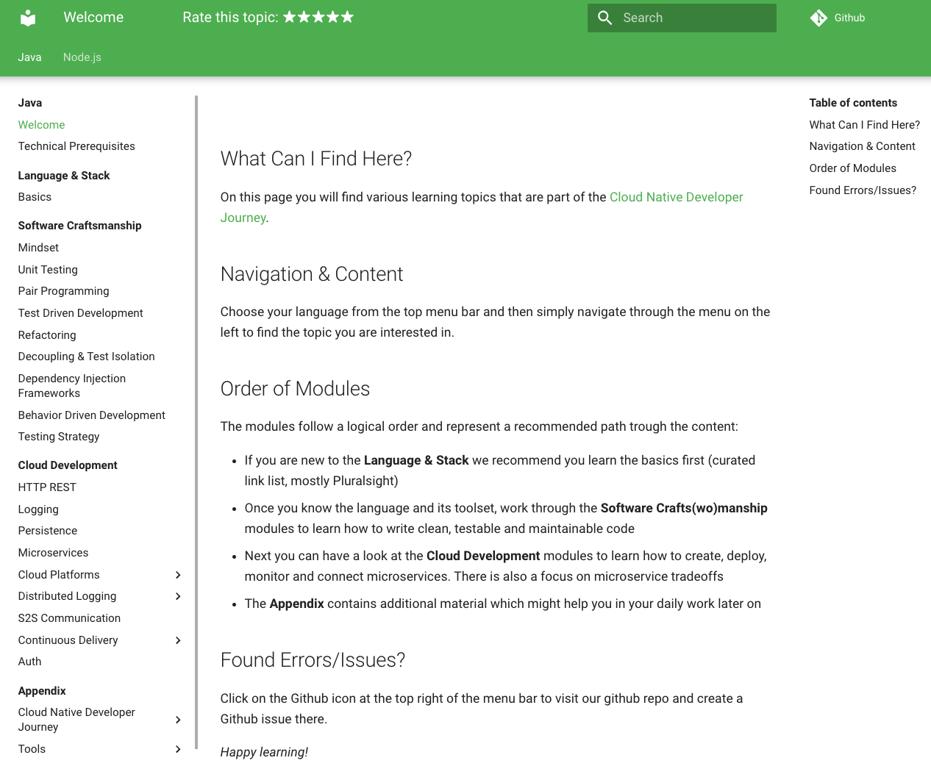
Goal of this exercise
Apply what you have learned in this training:
Building container images
Deploy applications
Apply configuration
Use K8s networking stack
…
Use something different than “nginx”:
Cloud Curriculum Fortune Cookies
https://pages.github.tools.sap/cloud-curriculum/materials/
Notes:
Cloud Curriculum materials cover a broad learning journey ranging from application development basics to cloud native technology.
Fortune Cookies is a sample application used to showcase some of the cloud native traits. We will use it for this final exercise to reiterate learned content.

Slide 3
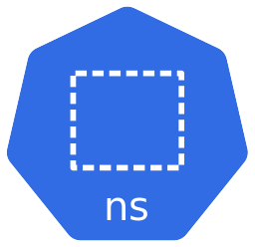



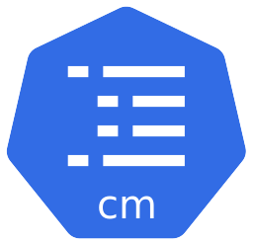
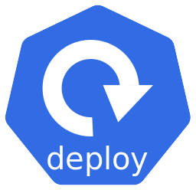
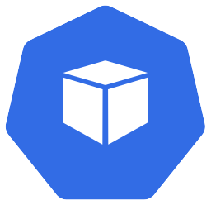
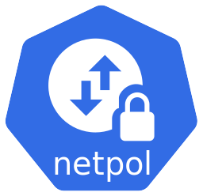

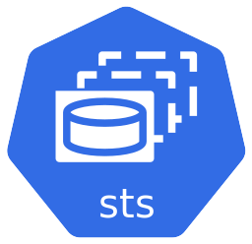
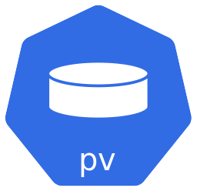
Fortune Cookies in K8s: Target picture overall
Fortune Cookies
$>: curl fortune-cookies.ingress.mycluster…
UNIX was half a billion (500000000) seconds old on Tue Nov 5 00:53:20 1985 GMT (measuring since the time(2) epoch).
-- Andy Tannenbaum
PostgreSQL
Notes:
- Discuss statefulset vs deployment
- Discuss headless service vs ???
- Discuss service vs ingress

Slide 4
Labeling of resources
Labeling everything makes our life easier. It helps to identify resources reliably.
Horizontally we distinguish between the app part and the DB part and call these distinction module.
Additionally, we group everything with a common label component: fortune-cookies.
module: app
Component: fortune-cookies
Fortune Cookies
module: db
Postgres

