Slide 1
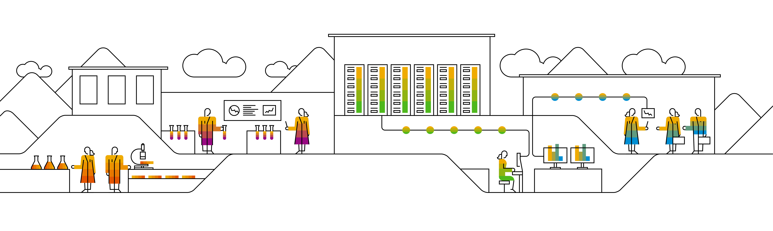

Kubernetes Gardener

Slide 2




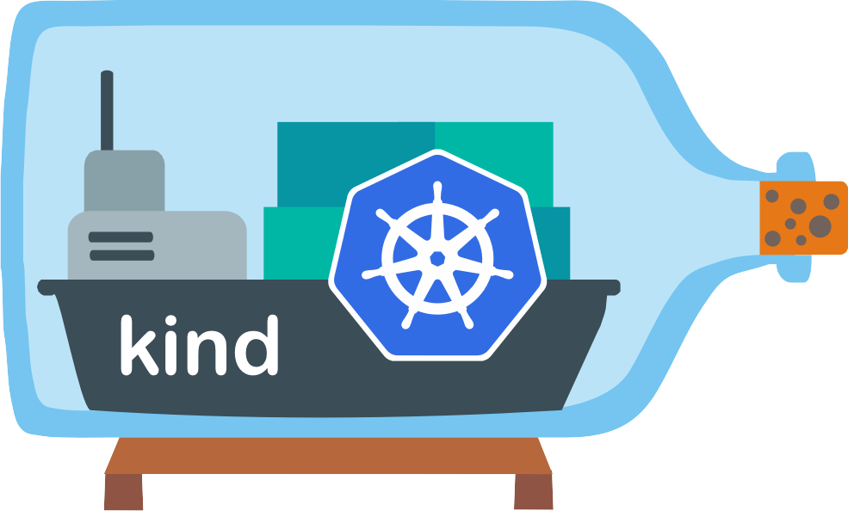
Wherefrom can I get a cluster?
Notes:
You can use Minikube for a local Kubernetes installation on your Laptop. Great for testing and development, but of course, unsuitable for productive usage.
K3S is similar to Minikube and offers a very lightweight, one-node Kubernetes Cluster on your laptop.
Kind is Kubernetes in Docker. It spins up a small Kubernetes Cluster in Docker containers on a local machine and is ideal for development purposes. In fact, Kind is used by companies like linkerd to do their integration tests. https://kind.sigs.k8s.io/
The Cloud Providers/Hyperscalers offer managed, large-scale Kubernetes clusters for a fee. AWS calls its managed K8S offering EKS, Google calls it GKE and Microsoft's Azure calls it AKS. They all have their own custom adaptations and modifications to Kubernetes which offer additional functionality but can make portability across the different offerings a bit harder.

Slide 3
Isn't there something by SAP?
https://gardener.cloud/
Notes:
Gardener is SAP’s solution for managed kubernetes cluster. It is open source & completely available on github: https://github.com/gardener/gardener/
Show internal landing page: https://github.wdf.sap.corp/pages/kubernetes/gardener/ including blog & help section & the numbers
Gardener Adoption overview: https://gadopt.ingress.cicdes.core.shoot.live.k8s-hana.ondemand.com/d/RMWfoOVAn/gardener-adoption-overview?orgId=1

Slide 4
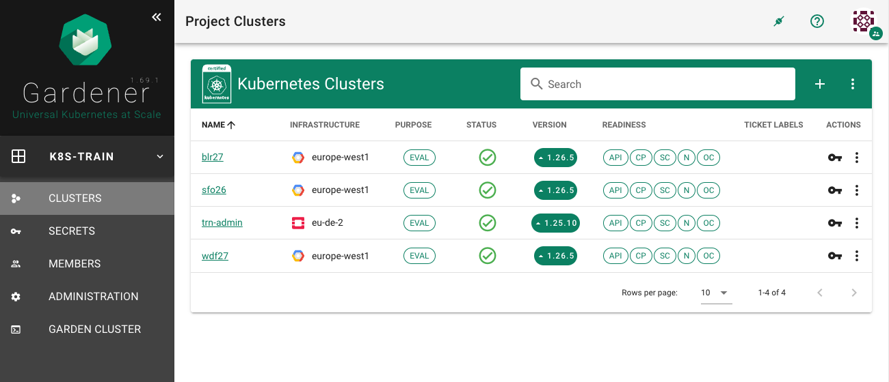
Gardener Dashboard
https://dashboard.garden.canary.k8s.ondemand.com/

Slide 5
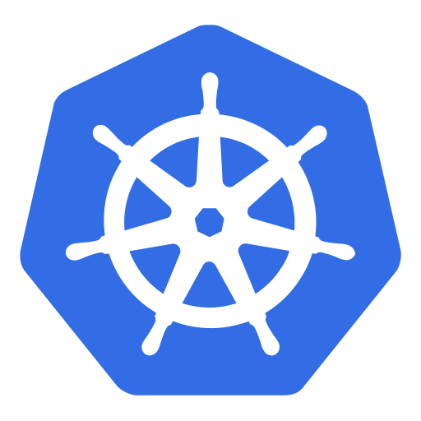
Kubeception
Seed Cluster
Shoot Cluster
35.65.257.1
443
LoadBalancer
Control Plane
Nodes
D
API Server
kubelet
proxy
etcd
(distributed) key-value store
STS
Pod
Pod
D
Scheduler
Container
Container
D
Controller Manager
Notes:
Kubeception – Kubernetes in Kubernetes in Kubernetes
In the classic setup, there is a dedicated host/VM to host the master components/control plane of a Kubernetes Cluster. However, these are just normal programs that can easily be put into containers. Once in containers, we can make Kubernetes Deployments and Statefulsets (for the etcd) watch over them. And now we put all that into a separate, dedicated Kubernetes cluster – et voilà, we have Kubernetes in Kubernetes, aka Kubeception (named after the famous movie Inception with Leonardo DiCaprio).
In Gardener’s terminology, the cluster hosting the control plane components is called a Seed cluster. The cluster that end-users actually use (and whose control plane is hosted in the Seed) is called a Shoot-cluster.

Slide 6
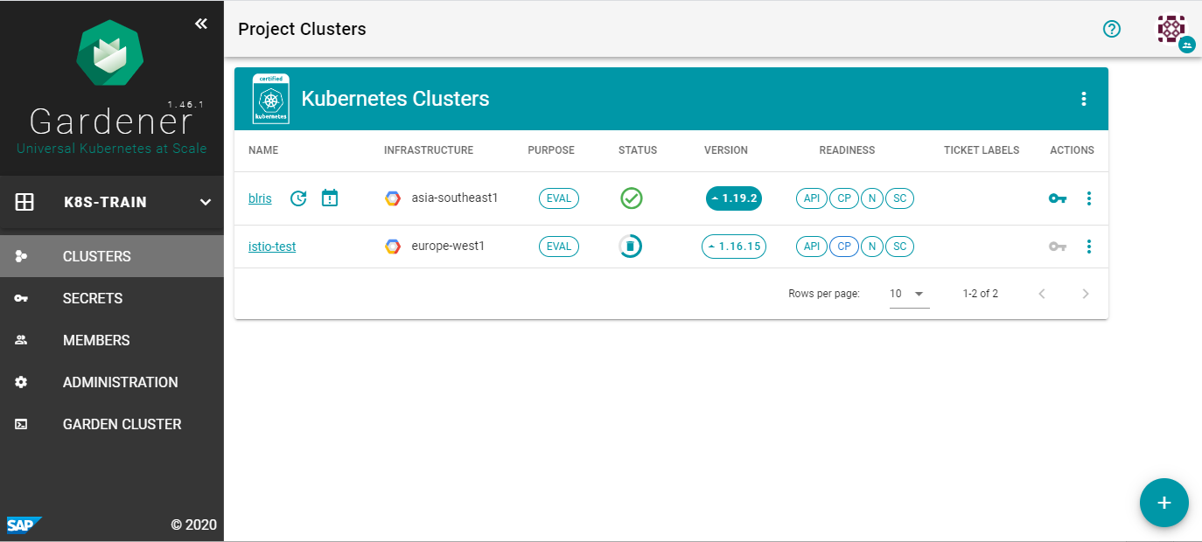
Let’s create a cluster in GCP
Seed Cluster
shoot
ns: shoot--my-cluster
Control Plane
Scheduler
Scheduler
Garden Cluster
GCP Extension
Nodes
Gardener API Server
MCM
controller-manager
ns: shoot--his-cluster
scheduler
ns: shoot--her-cluster
gardenlet
Shoot Cluster
Notes:
Enter the next Kubeception level – which is the Garden cluster. The Garden cluster is what you talk to when using the dashboard and has a number of seeds in different locations and cloud providers registered.
Once you create a new (shoot) cluster through the dashboard, a shoot resource will be posted to the Gardener API server running in the Garden cluster. The scheduler will pick a seed that is best suited to host the control plane of your shoot-cluster.
The seed-clusters run a component called the gardenlet, which is – in terms of what it should do – comparable to the kubelet (hence the name). The gardenlet monitors the Gardener API server if there are any new shoots, that its seed should take care of. If so, the gardenlet will create a new namespace in the seed and deploy the shoots control-plane into it. Also, it will deploy two very important components: the cloud-provider-extension and the machine-controller-manager (MCM).
The cloud-provider extension will talk to AWS/Azure/GCP/… to create the environment of the shoot cluster, i.e. networks, firewall rules, permissions, etc.
The machine-controller-manager is responsible for all lifecycle operations of the VMs that become the worker nodes of the shoot cluster. It constantly monitors their state and makes sure that the desired amount and configuration of worker nodes is always present.

Slide 7




Lifecycle Operations
K8S Patch Management
Worker v1.26
Worker v1.27
Auto-Scaling
Worker
v1.27
Worker
v1.26
Worker v1.26
Worker
v1.27
Worker
v1.26
Hibernation
Notes:
Gardeners lifecycle operations
If a worker node fails or becomes unhealthy, Gardener will realize about it and will create a new worker node to join the cluster. The number of worker nodes does not change, i.e. the misbehaving node will be removed.
If the cluster gets under heavy load, the Cluster auto-scaler will kick in and provide additional nodes (if configured) until the pressure is relieved.
Likewise, if the load on the cluster gets very low, Gardener will scale the cluster down by removing worker nodes to save on costs.
New Kubernetes version? Gardener can automatically upgrade the cluster nodes by removing worker nodes with an outdated Kubernetes version and replacing them with worker nodes running the latest release – one by one.
Gardener supports hibernation: all worker nodes of a cluster will be removed to save costs. The control plane of the cluster will stay alive in the seed cluster. The cluster’s state will not get lost and will get restored once it wakes up and deploys a new set of worker nodes. This whole process can even be scheduled.

Slide 8
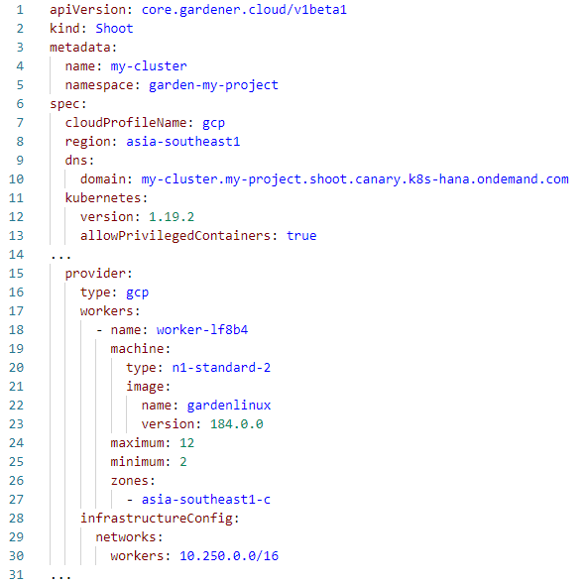
Gardener Shoot Resource
native Kubernetes resource
specify Cloud provider
manage my DNS
set K8S version &
tweak K8S control plane
define pools of worker nodes
network configuration
Notes:
… and many many more.
The shoot resource is described in Gardeners API documentation at https://gardener.cloud/documentation/references/core/#core.gardener.cloud/v1beta1.Shoot

Slide 9
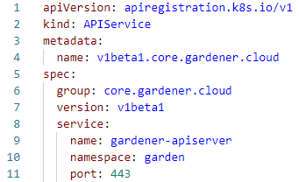
API Extensibility
Pod
Deployment
Service
PersistentVolume
Node
…
Shoot
Seed
CloudProfile
SecretBinding
…
kubectl
Ctrl Plane
Extension
API Server
API Server
etcd
dedicated
etcd
Notes:
Kubernetes’ API can be extended – either by CRDs or by an extension-API server.
An extension API server serves certain resources and API groups on its own. It even persists their state in its own etcd and does not use the etcd of the main K8S API server.
Extension API servers are registered with the K8S resource APIservice to the master API server and points to the URL of the extension API server.
Gardener uses its very own extension API server for its resources Shoot, Seed, CloudProfile, SecretBinding, etc…
More on API extension at https://kubernetes.io/docs/tasks/extend-kubernetes/setup-extension-api-server/

Slide 10

Demo
Notes:
Create a trial cluster with Gardener!

Slide 11




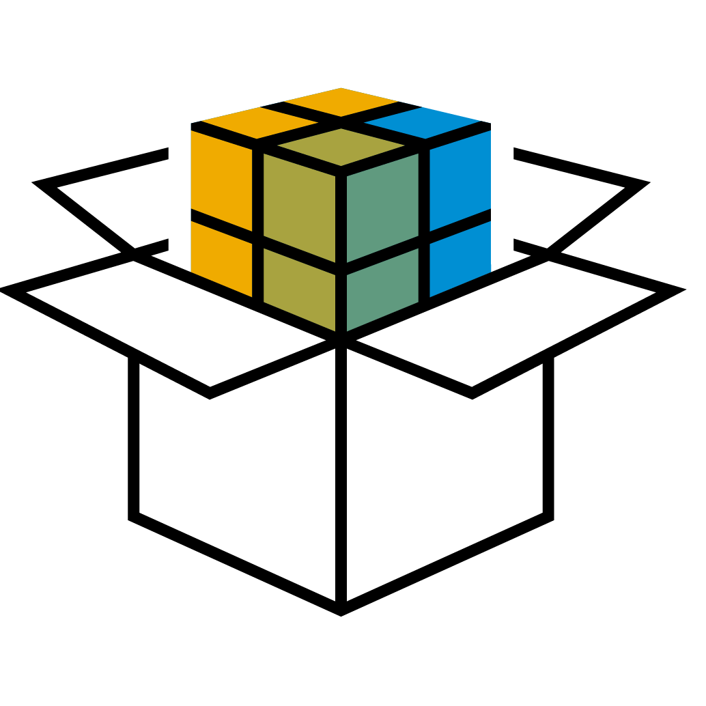

On all major IaaS providers
7500 + Production clusters 60 + Regions worldwide
Running SAP Services for The Intelligent Enterprise
Using a solution 100% open source
Operated efficiently by: A team of 5
Kubernetes
is actively used
by SAP SE

Slide 12
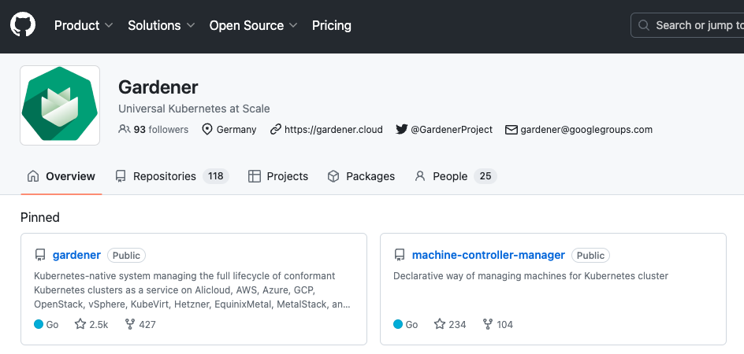
Gardener on GitHub
Gardener has grown into a community project with contributors from many other organizations
Notes:
Gardener in the open source
More than 2.500 Stars on github
Gardener is completely developed in the open source. No internal SAP development on the core gardener product.
Multiple independent contribution by companies like StackIT, CodeSphere, Mercedes-Benz, FinTS, Xcellent
https://github.com/gardener

Slide 13











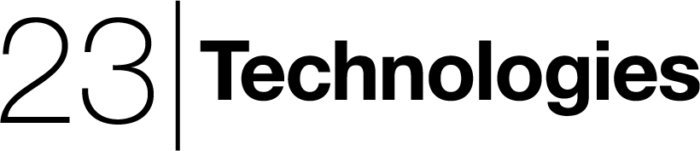






Gardener Adopters
https://gardener.cloud/adopter/

Slide 14




Garden Linux
Hardened minimal operating system serving as foundation for Gardener and Metal Stack:
Designed to run container workloads only
Immutable
Very small footprint
Minimal attack vector
gardenlinux.io

Slide 15


Garden Cluster
Seed Cluster
Shoot Cluster A
Central Management
Admins/Users/Customers
...
...
Kubernetes Cluster
Kubernetes Cluster
Kubernetes Cluster A
Leader
Leader
Control Plane
Control Plane A
Worker
Worker
Kubelet + Container Runtime
Kubelet + Container Runtime
Cloud Native App
Data Intelligence
Control Plane B
HANA Cloud
Business Workloads
Control Plane C
Machine/ClusterAS
HVPA
Custom Services
CRD for IaaS
...
IaaS
Target IaaS
Target IaaS/Account
Notes:
To visualize that, let‘s go back to the architecture diagram.
We now will use a separate Kubernetes cluster, the so called Seed Cluster, to host the control plane of this cluster A.
This way we can minimize the TCO as we do not need the multiple dedicated master nodes per end-user cluster anymore!
Another interesting outcome is that we can host multiple control planes in the same cluster! “Control-Plane as a Service” if you will.
To complete the picture, our Gardener is running in another „central management“ cluster and operates on all of these seeds and shoots from a single place.
Why do we it that way? Well, because Kubernetes is the new virtualization layer – it was made to reliably run software in the cloud with built in cloud native principles and qualities.
For example, we use autoscaling on every component. We rollout life cycle operations centrally onto thousands of clusters. We leverage Kubernetes primitives wherever possible.
And we only need to learn one paradigm. If you understand cloud native, you understand Gardener.
This was btw. a feedback we have got from our critical open source community!
We are providing clusters in SAP data centers this way.
For all other cloud providers, we just need a seed and our beautiful landscapes can blossom.

