Slide 1
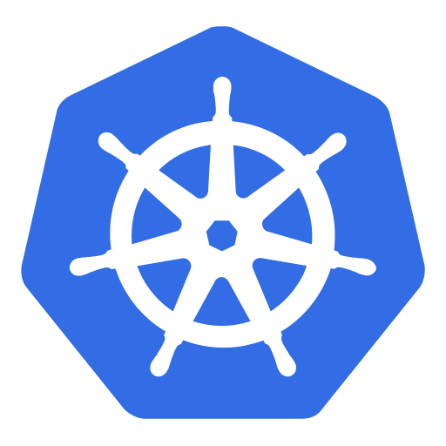
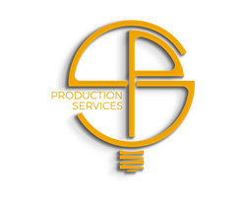
An (non-technical) introduction to
Kubernetes

Slide 2
We have isolated containers!
https://i.kym-cdn.com/photos/images/original/001/142/233/897.gif
Notes:
Though isolation of individual apps is one of many goals achieved with container technology, it introduces new issues.
How should these container work together?
How can the communicate?
Kubernetes helps with an advanced network concepts as well as service discovery features.

Slide 3

So, what is this Kubernetes all about then?
Do you remember, how fun it was to …
start and stop every container?
map ports and don’t get confused?
check the health of a container?
miss a volume on a different host?
…

Slide 4
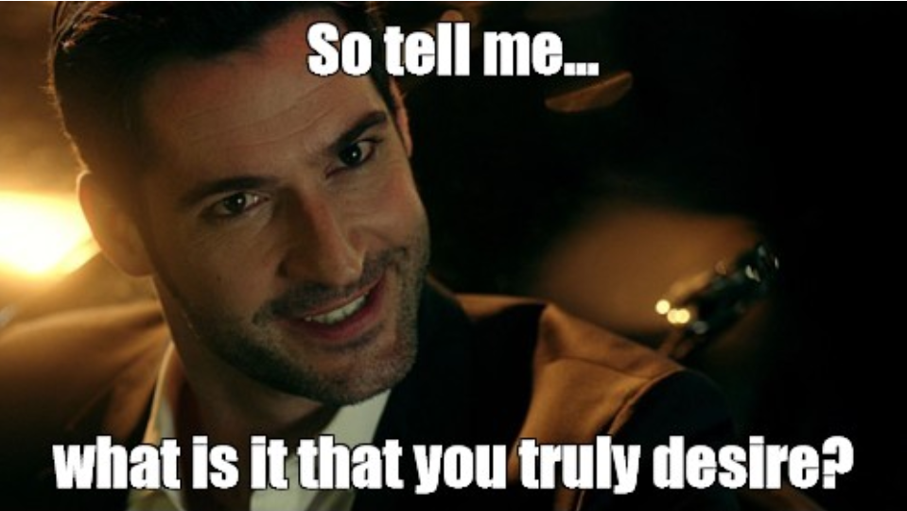
So tell me…
I’ve always dreamt of having four instances of my awesome software that would restart automatically, have reliable load balancing and persistent disks without me having to overlook the whole thing all the time…
Notes:
Kubernetes takes a “construction plan” and instantiates it as often as you want – as long as you have enough resources
What you describe, is what you get.

Slide 5

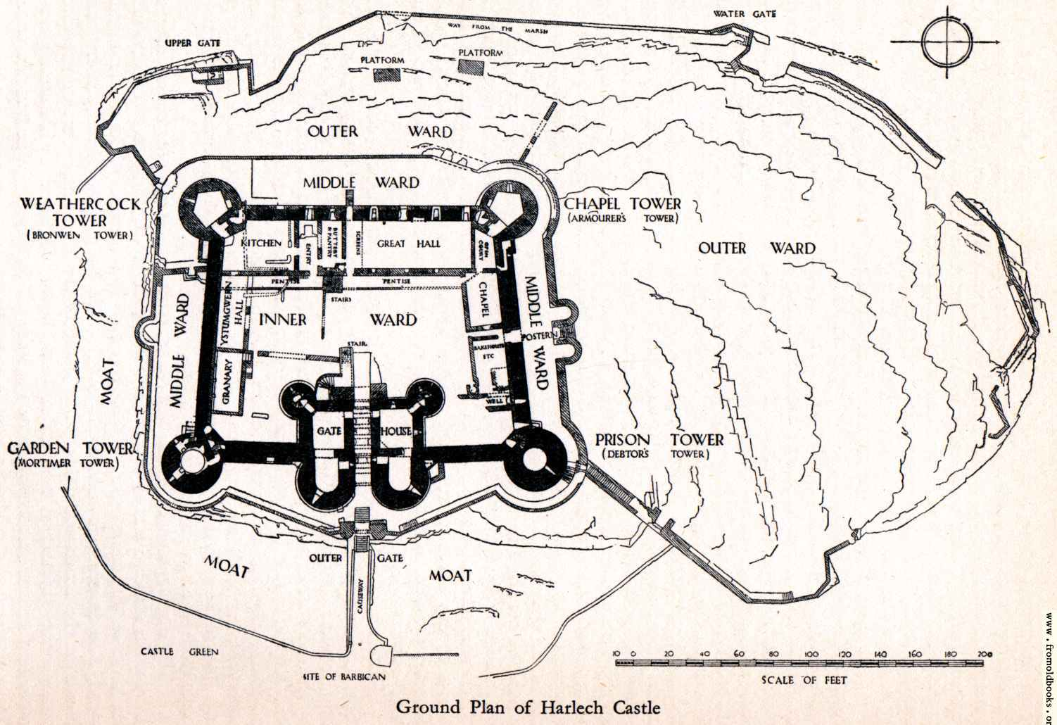
Tell me, what is it you truly desire…
All it takes, is a description and some bricks…
Notes:
Kubernetes takes a “construction plan” and instantiates it as often as you want – as long as you have enough resources
What you describe, is what you get.

Slide 6
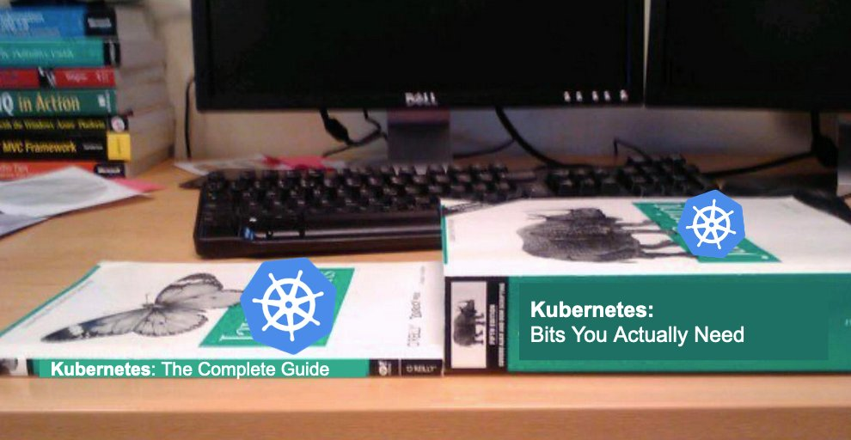
How it works
https://twitter.com/IanColdwater/status/1315850704016285702?s=20

Slide 7

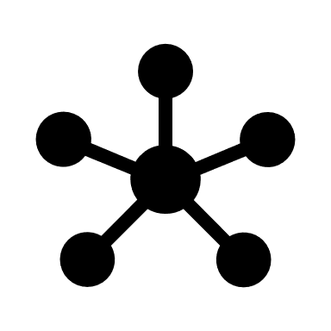

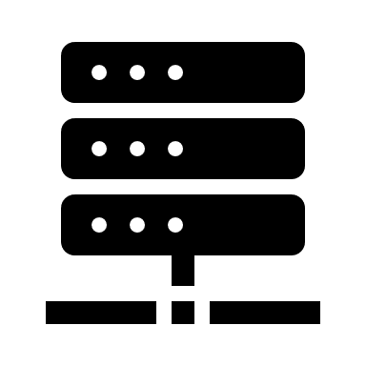
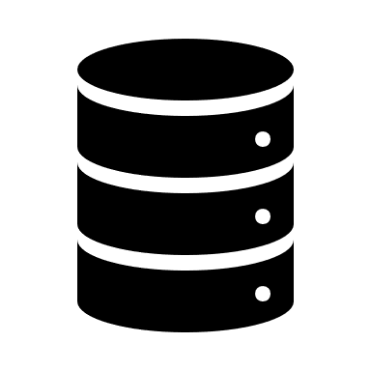
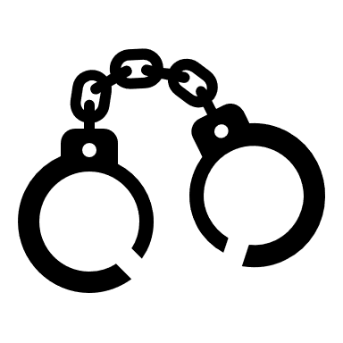

Orchestration
Service Discovery
Network
Scheduling
Scaling
Storage
Security
Observability
Notes:
Kubernetes orchestrates your workloads & applications – also several of them in parallel.
In order to put this picture together, we will look at different dimensions during the training.

Slide 8
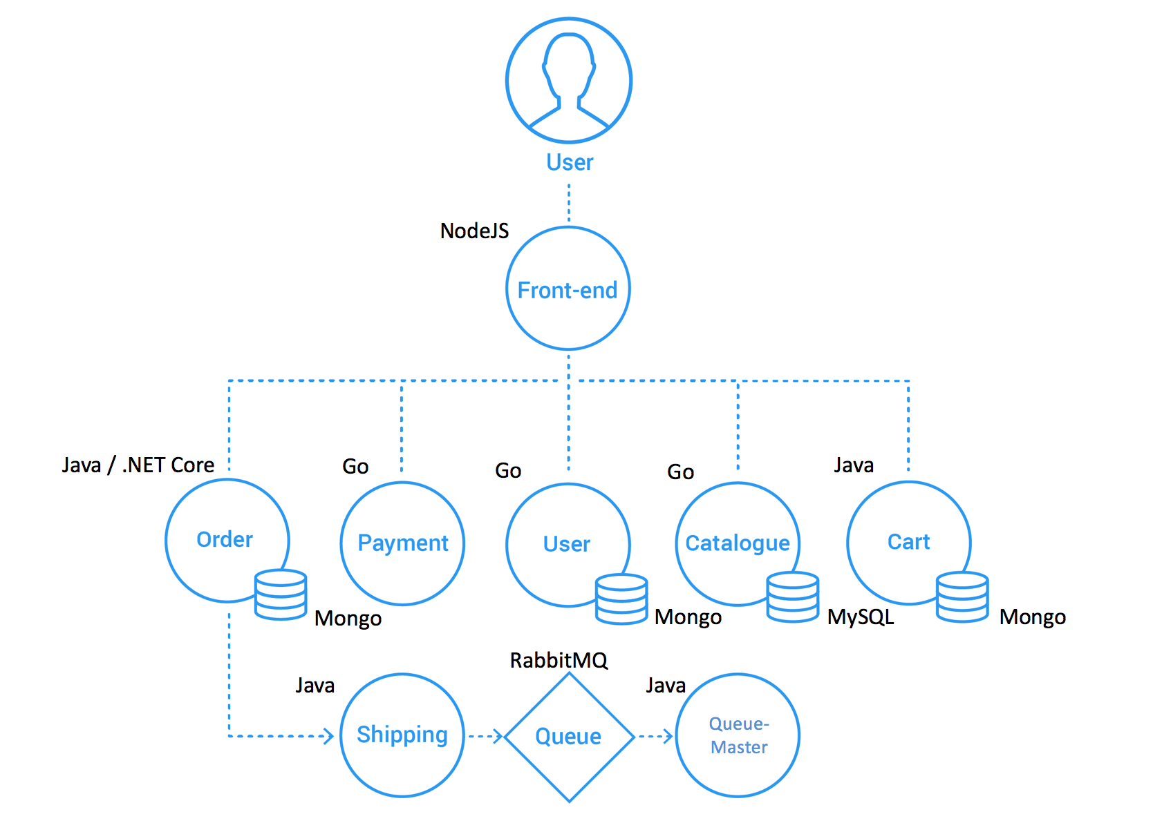
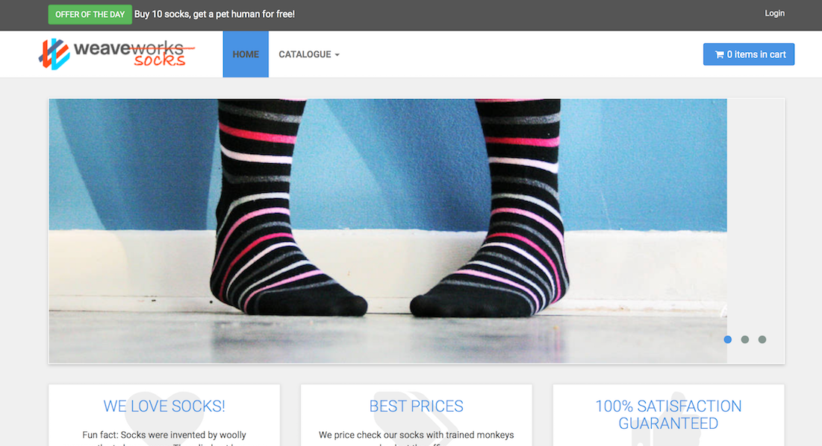
Getting started: let‘s buy some socks
Notes:
The demo is based on the “sock shop” e-commerce platform developed by weaveworks. This is a full-blown demo application, including content – however you have to wait ~2min until the content is fully loaded.
To demo use the sock-shop.yaml from the kubernetes/demo folder to deploy all components. Adapt the host on the Ingress according to the cluster-name and project-name, used within your training (line with ‘host: sock-shop.ingress.<cluster-name>.<project-name>.shoot.canary.k8s-hana.ondemand.com’) before you call ‘kubectl apply –f sock-shop.yaml’.
To show how K8s works, just delete a pod and see how the sock-shop still works properly.
You can find all needed K8s entities in the namespace ‘sock-shop’, which gets automatically created.
The URL to call the sock-shop in the browser is: sock-shop.ingress.<cluster-name>.<project-name>.shoot.canary.k8s-hana.ondemand.com (e.g. http://sock-shop.ingress.wdfcw43a.k8s-train.shoot.canary.k8s-hana.ondemand.com/)
The design of the sock-shop is based a micro-services architecture and was containerized appropriately. See https://github.com/microservices-demo/microservices-demo/blob/master/internal-docs/design.md for further details

Slide 9
Some facts about K8s, kubernetes, …
Kubernetes = Greek for “helmsman” or “pilot”
Based on Google’s Borg – a cluster manager for container orchestration
Open sourced by Google and firstly announced in 2014
v1.0 was released in July 2015
By now K8s is governed by the Cloud Native Computing Foundation (CNCF)
Vanilla Kubernetes is the basis for commercial products like RedHat’s Openshift or CoreOS’ tectonic
New minor releases roughly every 3 month
Extensive list of beta features
Documentation: https://kubernetes.io/docs/home/ - concepts, tasks, API reference

Slide 10
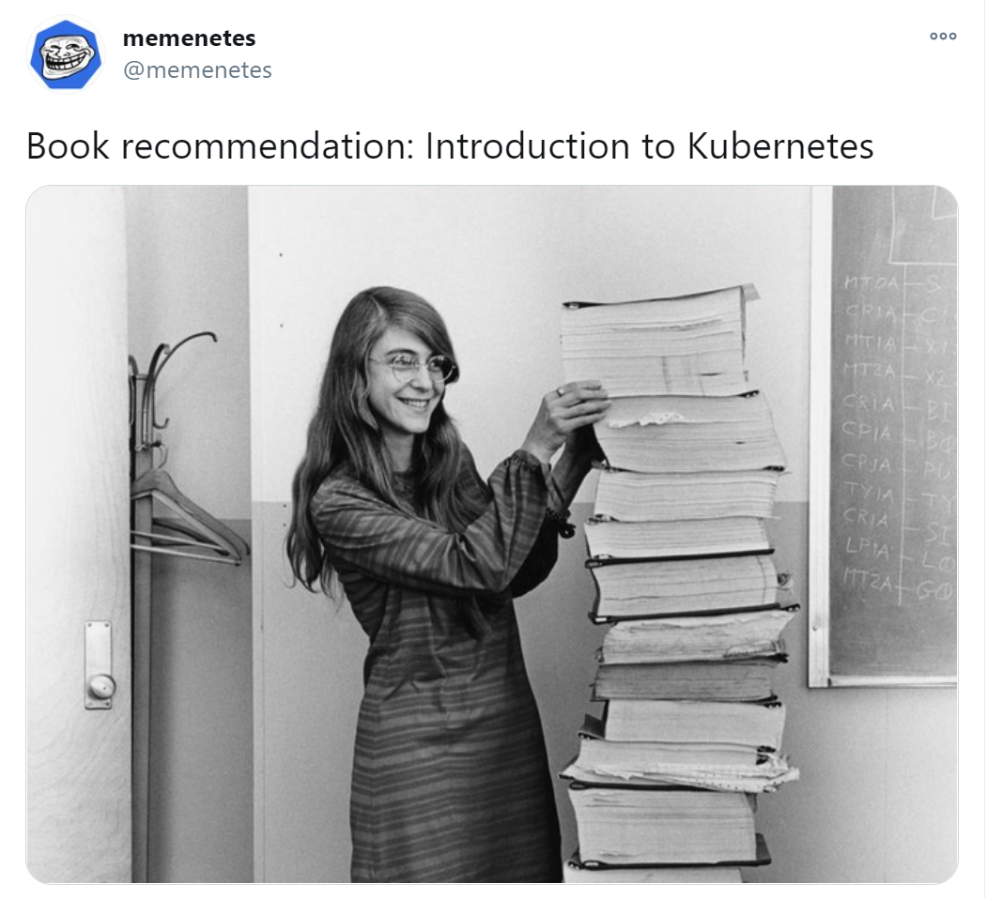
Documentation
https://twitter.com/memenetes/status/1305612451443023876?s=20

Slide 11
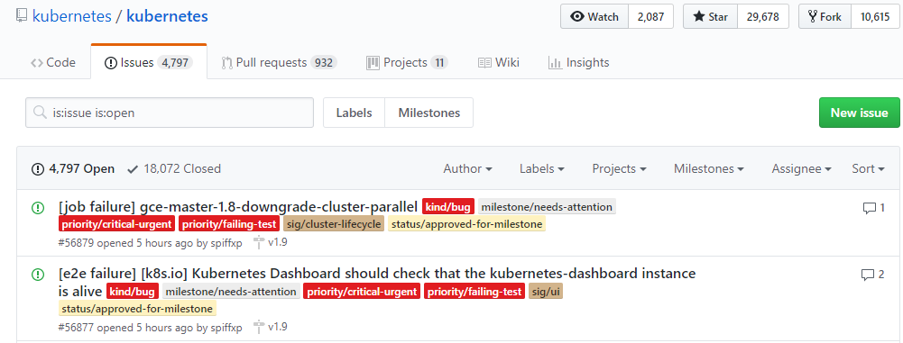
If it doesn’t always work as expected …
https://groups.google.com/forum/#!forum/kubernetes-users
https://github.com/kubernetes
https://github.com/kubernetes/community/blob/master/communication.md

Slide 12
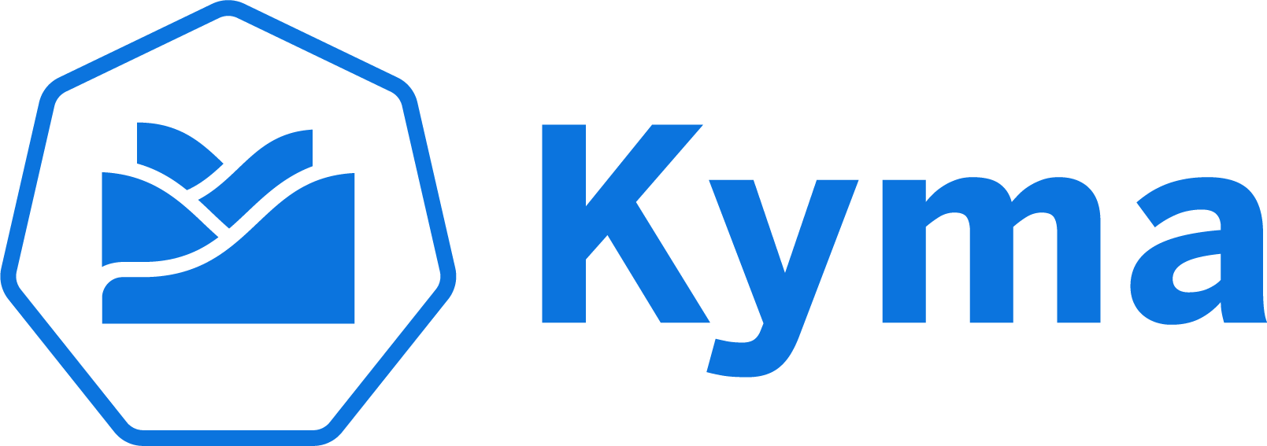
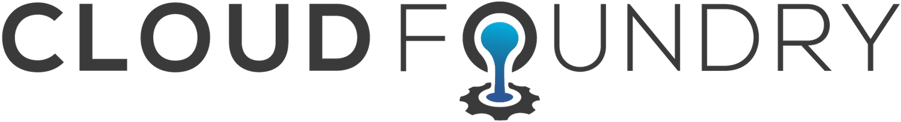
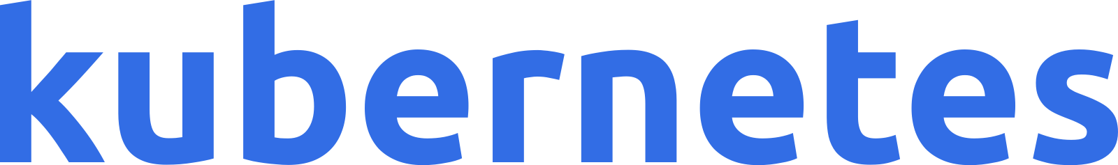
[A-Z]* as a Service
Software
Serverless
Functions
Platform
(Application) Runtime
Infrastructure
Notes:
Kubernetes itself is something between infrastructure and platform. It is not as opinionated as cloud foundry but provides more than pure IaaS provider.
When combining K8s with addons such as Kyma or Knative, it is possible to move up the stack and provider higher level services.
If there has to be a classification, it’s probably fair to say that K8s provides a runtime environment for applications of all kind.

