Slide 1

Linux Kernel Hot-Patcher for i386
Sriram S
(1998HZ70968)

Slide 2
Hot-Patching Overview
Conventional Kernel Patching.
  Make Changes, Build, Halt & Reboot.
  Time Consuming.
Patch live kernel symbols.(Hot-Patch)
  No Interruption.
  Less turnaround time.
Audience
  Kernel Developers, Sustenance Engineers.

Slide 3
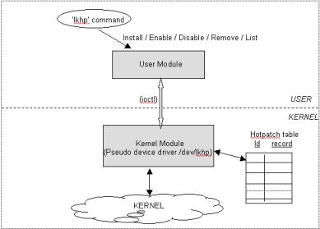
Design of LKHP

Slide 4
User Module
Exists in User space.
Provides ‘lkhp’
Process object file, load.
Query Kernel Symbol Table.
‘strap’ Utility

Slide 5
Kernel Module
Core Part.
Loadable Module.
Why not Sysctl?.
  Not Flexible.
  No Patches please.
HotPatch table.

Slide 6
Heart of LKHP
Change Kernel CS.
Symbols already relocated.
Replace whole function code?.
Ans: Redirection of execution flow.
Solution: long jump new symbol.
Write ljmp kernel_CS, <offset>.

Slide 7
Rabbit hole is always deeper
Kernel pages swappable.
Kernel CS page protected.
Reset PTE, Flush TLB.
Kernel Processes Preemptive?.
What about Interrupts?. NMIs?
Flushing icache is needed?.

Slide 8
Alternative: Why not Interrupts?
Interrupt handler for LKHP.
INT xx, Call hot-patch function.
Fine, then how do I
  know the prototype of fn?.
  Pass arguements?.
  Return value?.
Conclusion: Too complex.

Slide 9
Limitations
No SMP compliant.
Kernel cannot be pre-emptive(MontaVista).
Real Mode Addressing in i386.
Patches only exported symbols.
Only one patch can be applied at a time.
Not possible to patch loadable modules.
Couldn't find if it is already being used.
No safeguard against NMIs.
Tested only on RedHat 7.1 with Kernel 2.4.2.

Slide 10
Issues faced
Endianness of Intel.
Unresolved symbols in object file.
release_module() vanishes.
Obtaining module pointers.
Exporting symbols in hotpatch module
libelf library couldn't obtain symbols.

Slide 11
How to Use LKHP
Redhat binary RPM
Only Superuser can use this.
Setup the system(lkhp_setup).
lkhp command line utility.
  lkhp install/remove/disable/enable/list
Pass the object file, symbol name.

Slide 12
Word of Caution
Never compile with -O option.
Patch will be locally relocated.
Static calls within file.
Dont modify kernel data structures.
No use in declaring global variables.

Slide 13
Next Step
Patch even unexported symbols.
Why not SPARC/MIPS?.
Do away with 'strap'
Patch more than one symbol.
Man page to lkhp.
Contact Open Source community.

Slide 14
Linux Kernel Hot-Patcher for i386
Thanks for your Valuable time

