Slide 1
DISASTER TWEETS ANALYSIS USING NLP IN AWS ENVIRONMENT
Group 5
Sriram sathwik Tippavaram
Sai Srinivas Lakkoju

Slide 2
SCOPE
The scope of this project is to develop and implement a scalable, end-to-end Natural Language Processing (NLP) pipeline using AWS cloud services. The project will involve the ingestion of csv containting tweets into Amazon S3 for centralized storage, followed by data cleaning and preprocessing using AWS Glue for automated ETL workflows. Advanced NLP techniques, such as sentiment analysis will be executed using AWS to build and train machine learning models. The processed data and insights will be visualized using Amazon QuickSight.

Slide 3
DATASET OVERVIEW
The dataset consists of tweets used for predicting whether they are related to real disasters or not.
It is taken from Kaggle competition: https://www.kaggle.com/competitions/nlp-getting-started
Train and Test Sets
train.csv: Contains the training data, including the target variable indicating disaster-related tweets.
test.csv: Contains the test data for model evaluation.
Columns
id: Unique identifier for each tweet.
text: The actual text content of the tweet.
location: The location from which the tweet was sent (can be blank).
keyword: A specific keyword from the tweet (can be blank).
target: Present only in train.csv, indicating whether a tweet is about a real disaster (1) or not (0).

Slide 4
Features
For this project, we will leverage a combination of AWS services to analyze customer behavior, optimize marketing strategies, and store and visualize the results
Amazon IAM :
Amazon IAM (Identity and Access Management) is a service that helps us to securely control access to AWS resources by managing users, groups, roles, and permissions.
Amazon S3 (Simple Storage Service):
we will store the dataset in the S3 bucket, sot that it can be easily accessible for data analysis in quick sight and model training in sage maker.
Amazon Glue:
Amazon Glue is used to preprocess the data which extracts,load and transform the data.
Amazon Quick Sight:
QuickSight will be used for visual analysis and reporting on the dataset. We will create interactive dashboards and visualizations to gain insights into customer demographics, campaign outcomes, and other relevant metrics

Slide 5







Loads data from S3 into Quick sight
AWS Glue For ETL
Aws QuickSight
Stores output in s3
Stores output in s3
ARCHITECTURE
Store Dataset
Loads data from S3
Store Results
Launching
Notebook Instance
Evaluate
Train
Notebook

Slide 6
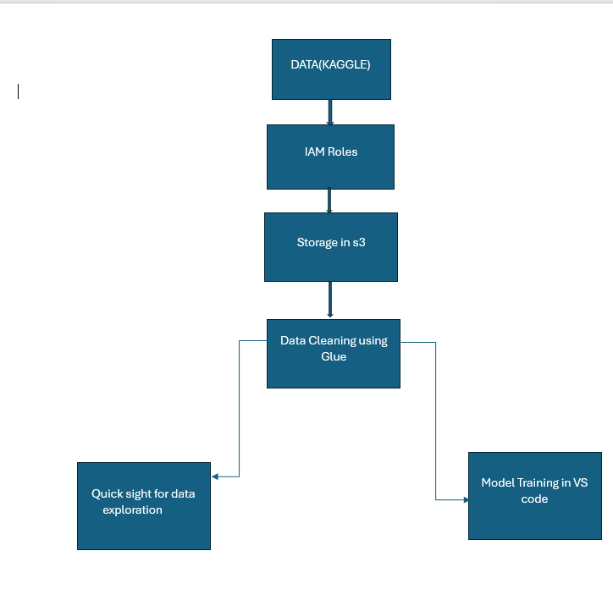
Data flow
Notebook

Slide 7
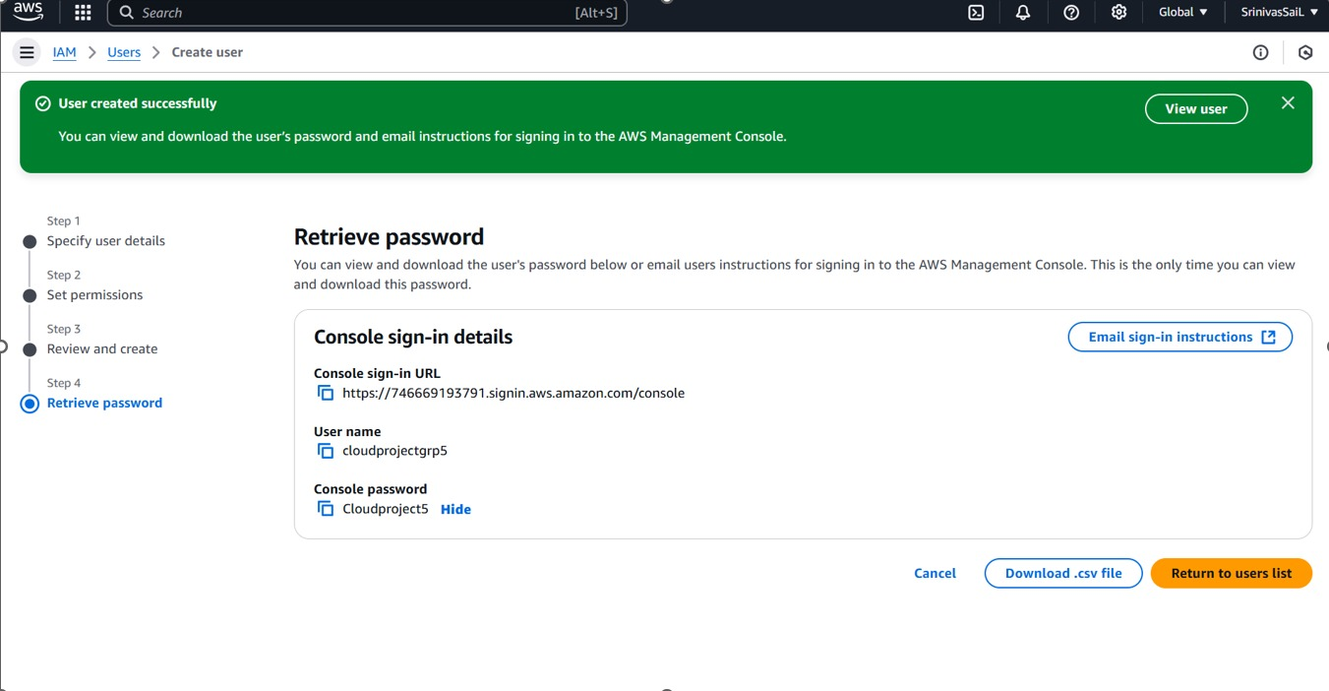
Cloud services in action
IAM

Slide 8
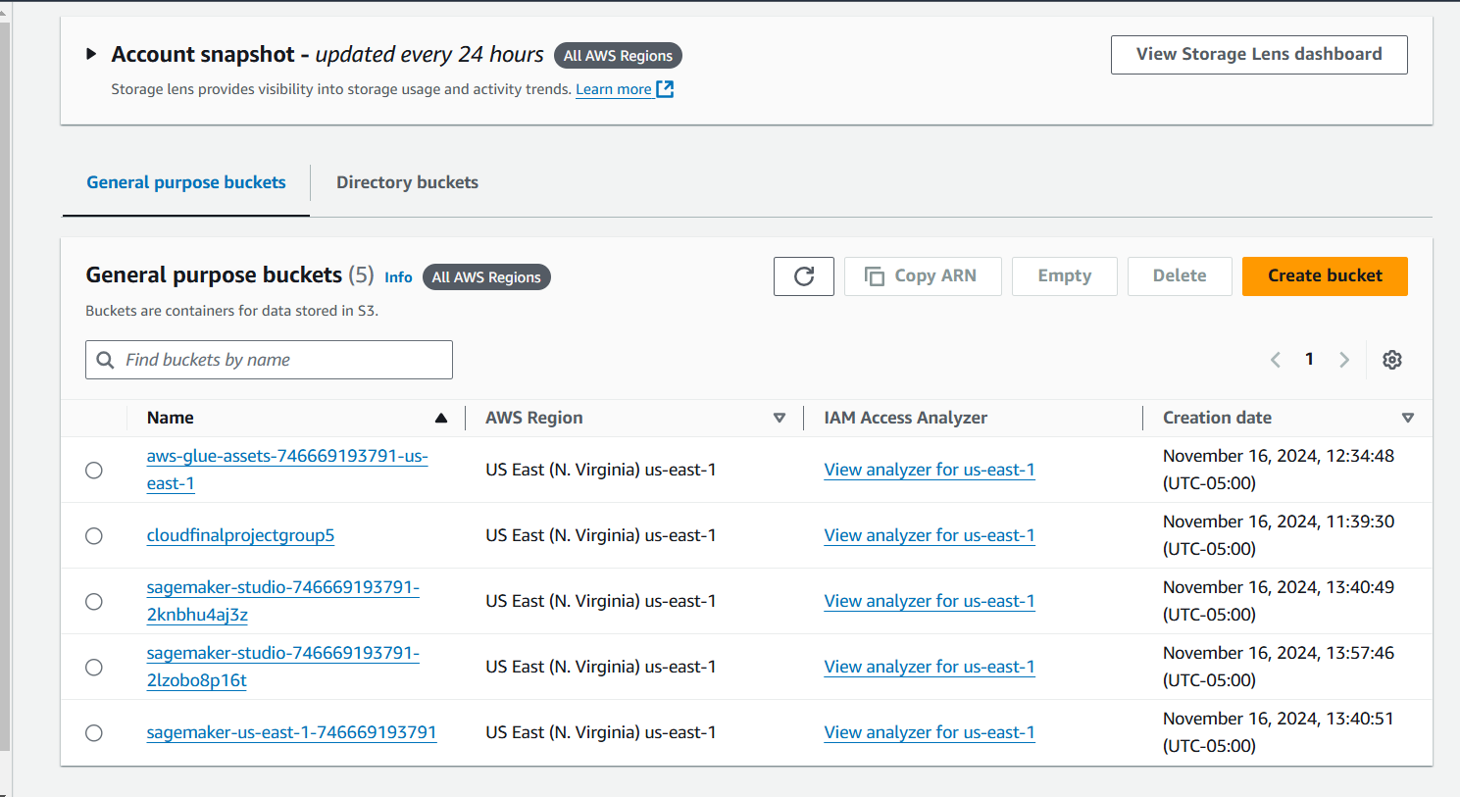
Cloud services in action
S3 BUCKET

Slide 9
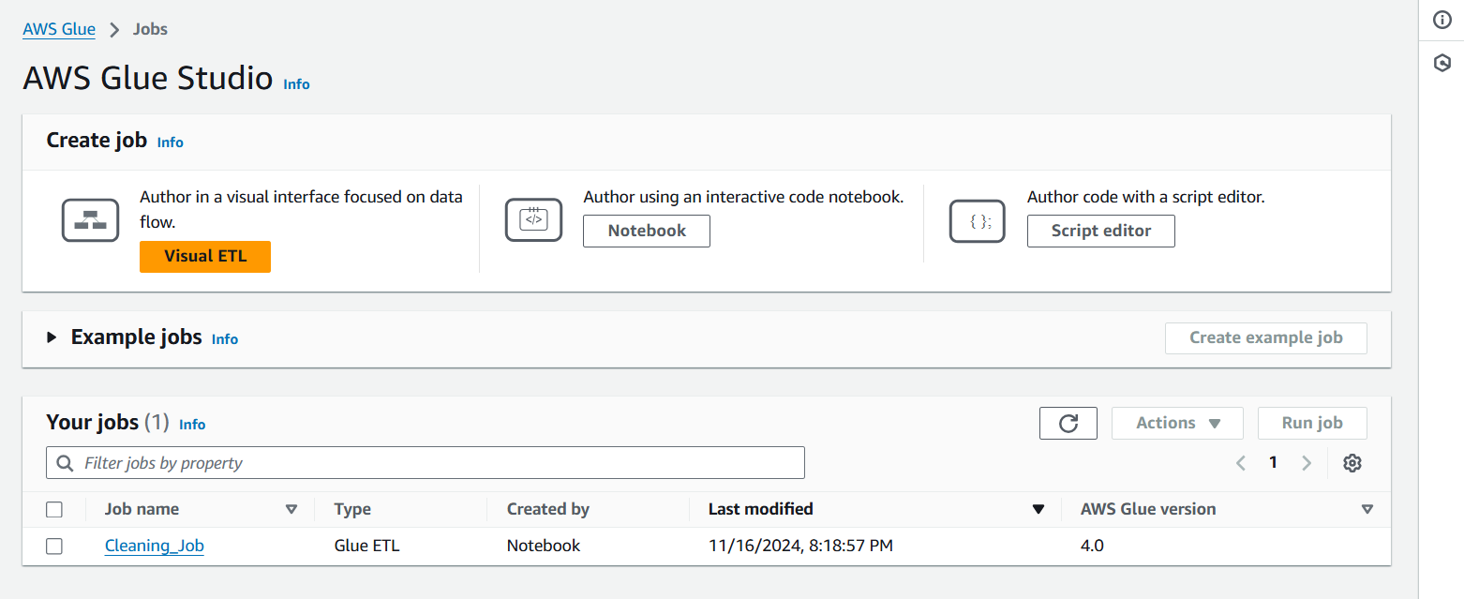
Cloud services in action
DATA CLEANING WITH GLUE

Slide 10
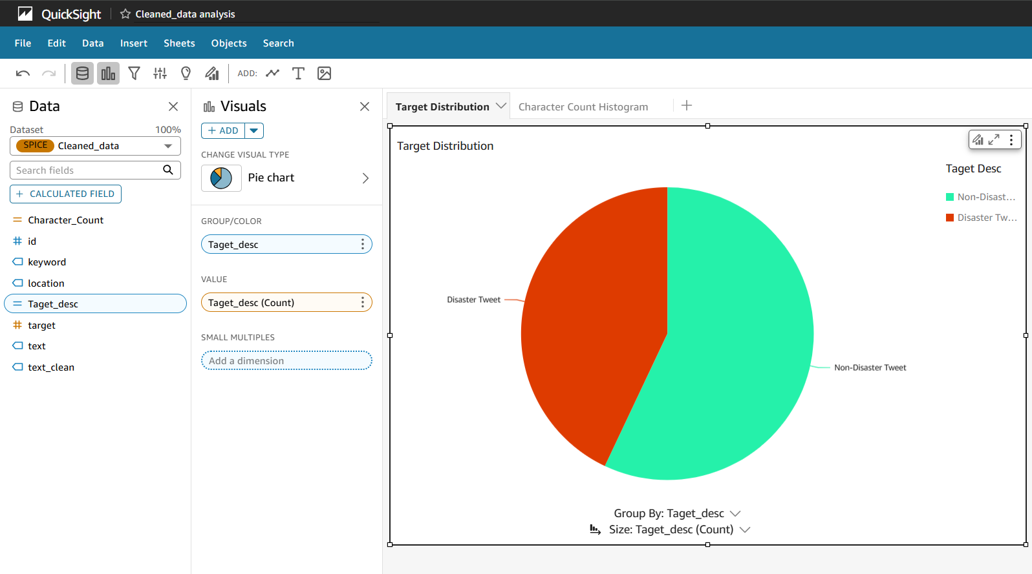
Cloud services in action
QUICK SIGHT

Slide 11
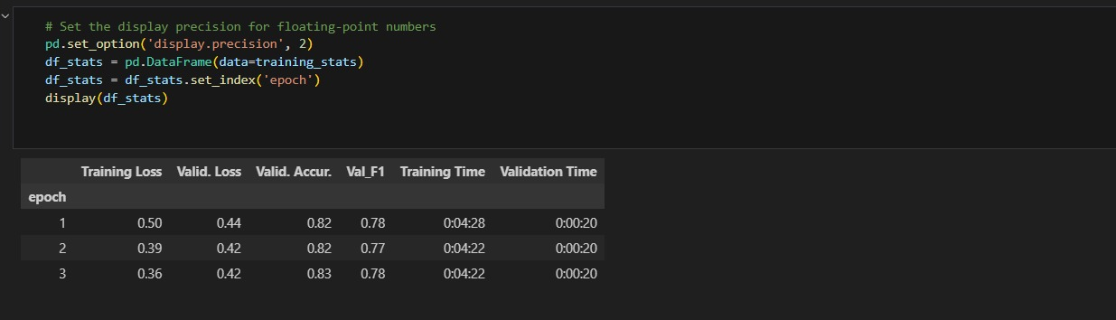
Model Stats

Slide 12
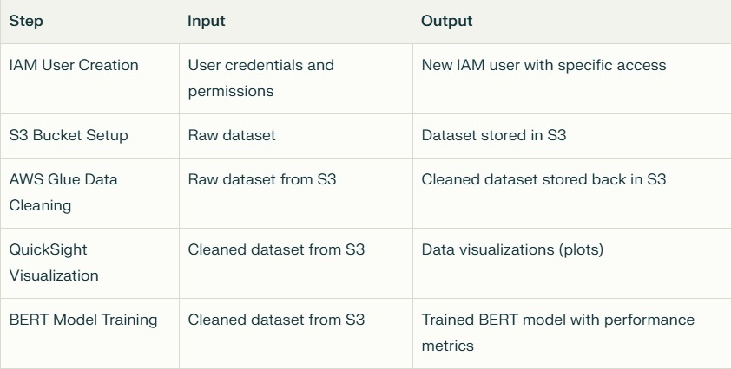
INPUTS AND OUTPUTS

Slide 13
THANK YOU

