Slide 1


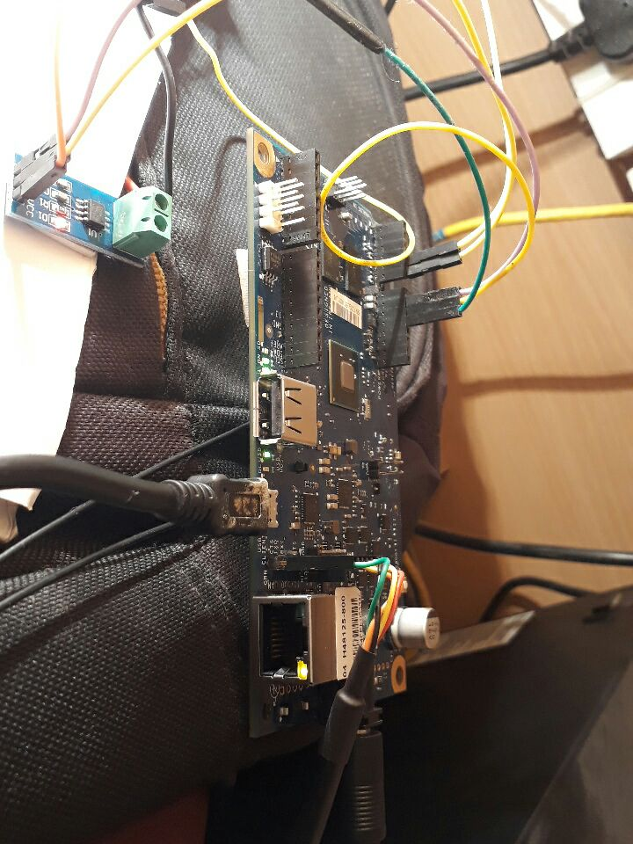
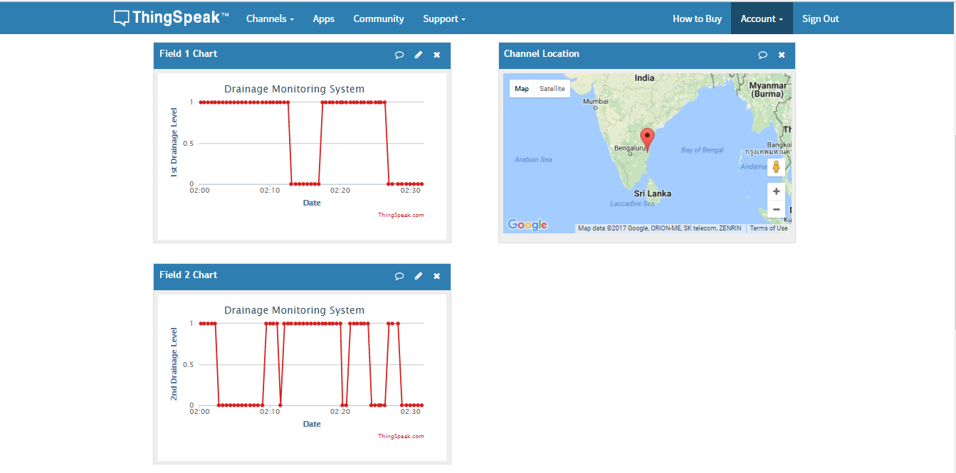
Drainage Monitoring System
Using IoT
ABSTRACT
The Internet of Things (IoT) consists of real life objects, communication devices attached to sensor networks in order to provide communication and automated actions between real world and information world. The proposed model provides a system of monitoring the water level inside a Drainage to Monitor the clogs. It also monitors underground installed electric power lines. In real time it can remotely monitor current states of the Drainage.
OBJECTIVE
The Theme of this project is to design a Drainage monitoring System to reduce the effect caused by water logging during floods.
HARDWARE / SOFTWARE USED
Intel Galelio Gen 2
UltraSonic Sensors
Arduino
WiFi Module
GSM Sheild
Antennas
Output
CONCLUSION
Thus the clogs in the drainage gets identified using the Ultrasonic Sensors and the concerned authorities notified from the cloud and GSM. So that the early action will be taken to prevent from heavy Flood Effects.
Lazarescu, M.T., "Design of a WSN Platform for Long-Term Environmental Monitoring for IoT Applications," Emerging and Selected Topics in Circuits and Systems, IEEE Journal on , vol.3, no.1, pp.45,54, March 2013.
Kelly, S.D.T.; Suryadevara, N.K.; Mukhopadhyay, S.C., "Towards the Implementation of IoT for Environmental Condition Monitoring in Homes," Sensors Journal, IEEE, vol.13, no.10, pp.3846,3853, Oct. 2013.
Romer, K.; Mattern, F., "The design space of wireless sensor networks," Wireless Communications, IEEE , vol.11, no.6, pp.54,61, Dec. 2004
Sriram venkata Sai Bharath, T.Sidhartha, K.Sravani
Ms. B.Bhuvaneswari

