Slide 1
Hindi POS Tagger
N.s.s.l. Sri Ramya (421249)
V.Pravallika (421270)

Slide 2
Part-of-Speech Tagging
Part-of-speech tagging is the process of assigning a part-of-speech to each word in part-of-speech tagging a text. The input is a sequence x1, x2,..., xn of (tokenized) words and a tagset, and the output is a sequence y1, y2,..., yn of tags, each output yi corresponding exactly to one input xi.
Tagging is a disambiguation task; words are ambiguous —have more than one possible part-of-speech—and the goal is to find the correct tag for the situation.

Slide 3
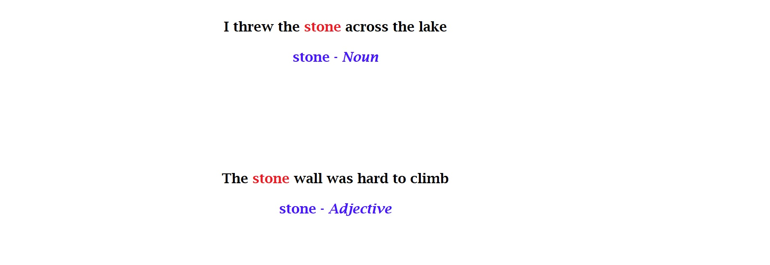

Slide 4
Steps in POS Tagging
Collect a dataset of annotated text: This dataset will be used to train and test the POS tagger. The text should be annotated with the correct POS tags for each word.
Preprocess the text: This may include tasks such as tokenization (splitting the text into individual words), lowercasing, and removing punctuation.
Divide the dataset into training and testing sets: The training set will be used to train the POS tagger, and the testing set will be used to evaluate its performance.
Train the POS tagger: This may involve building a statistical model, such as a hidden Markov model (HMM), or defining a set of rules for a rule-based or transformation-based tagger. The model or rules will be trained on the annotated text in the training set.

Slide 5

Test the POS tagger: Use the trained model or rules to predict the POS tags of the words in the testing set. Compare the predicted tags to the true tags and calculate metrics such as precision and recall to evaluate the performance of the tagger . Fine-tune the POS tagger: If the performance of the tagger is not satisfactory, adjust the model or rules and repeat the training and testing process until the desired level of accuracy is achieved. Use the POS tagger: Once the tagger is trained and tested, it can be used to perform POS tagging on new, unseen text. This may involve preprocessing the text and inputting it into the trained model or applying the rules to the text. The output will be the predicted POS tags for each word in the text.

Slide 6
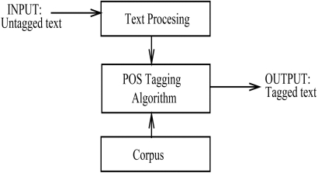

Slide 7
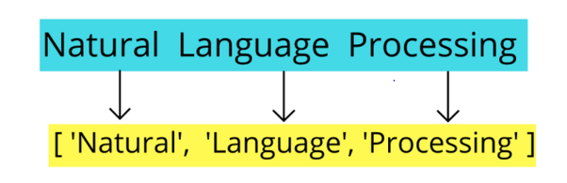
Tokenization
Tokenization is the process of breaking down the given text in natural language processing into the smallest unit in a sentence called a token.
Tokenization is done to find the frequencies of the words in the entire text by dividing the given text into tokens.

Slide 8
Steps to be implemented
Obtain a tagged data set for training.
Use Hidden Markov Model to identity Transmission and Emission probabilities.
Apply Viterbi Algorithm on Testing Data set
Output the tagged sequence with the highest probability.

Slide 9
Hidden Markov Model
The HMM is based on augmenting the Markov chain.
A Morkov model is a stochastic model used to model randomly changing systems. It is assumed that future states depend on the current state not on the events that occur before it.
In our project, Hindi sentences are observable states, and the hidden states are its POS Tags.
Transition Probability: Probability related to the hidden states
Emission Probability: Probability related to the visible states

Slide 10
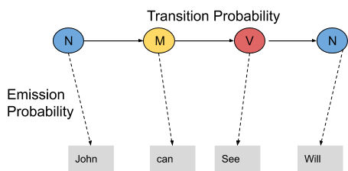

Slide 11
The transition probability is the likelihood of a particular sequence for example, how likely is that a noun is followed by a model and a model by a verb and a verb by a noun. This probability is known as Transition probability. It should be high for a particular sequence to be correct. Now, what is the probability that the word John is a noun, can is a model, see is a verb and Will is a noun. These sets of probabilities are Emission probabilities and should be high for our tagging to be likely.

Slide 12
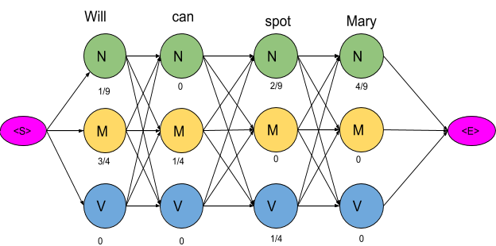

Slide 13
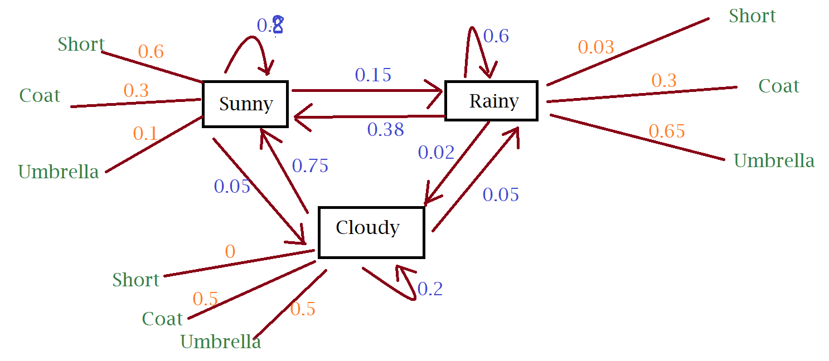

Slide 14
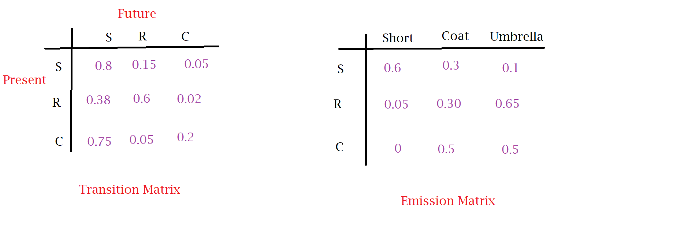

Slide 15
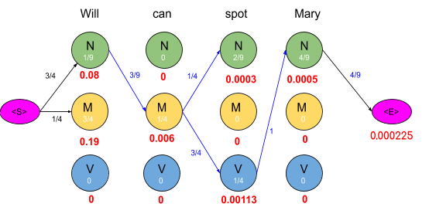
Viterbi Algorithm
The Viterbi algorithm is a dynamic programming algorithm for finding the most likely sequence of hidden states—called the Viterbi path—that results in a sequence of observed events

Slide 16
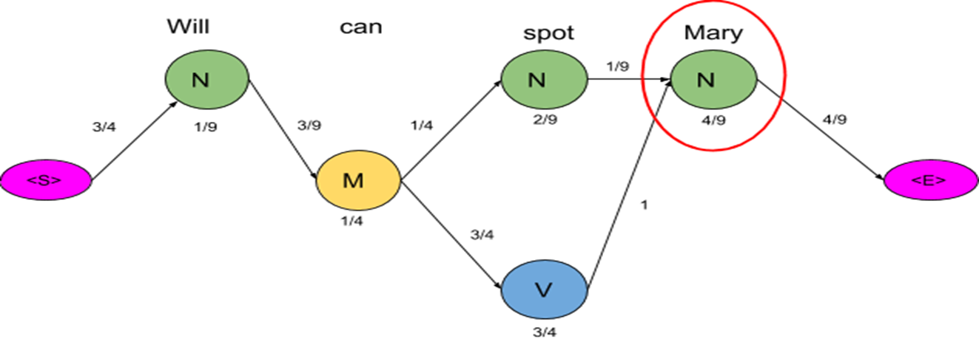
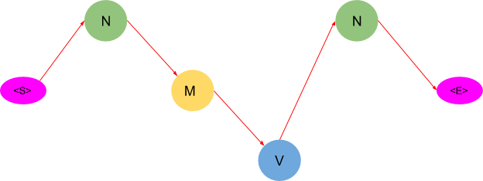

Slide 17
This algorithm returns only one path as compared to the previous method which suggested two paths. Thus by using this algorithm, we saved us a lot of computations. After applying the Viterbi algorithm the model tags the sentence as following- Will as a noun Can as a model Spot as a verb Mary as a noun These are the right tags so we conclude that the model can successfully tag the words with their appropriate POS tags.

Slide 18
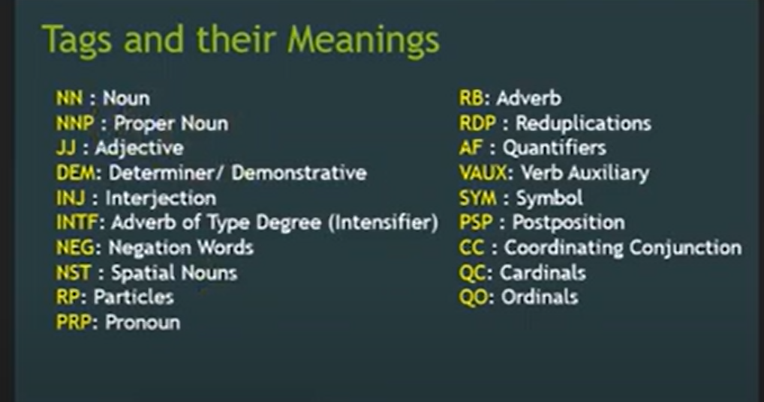

Slide 19
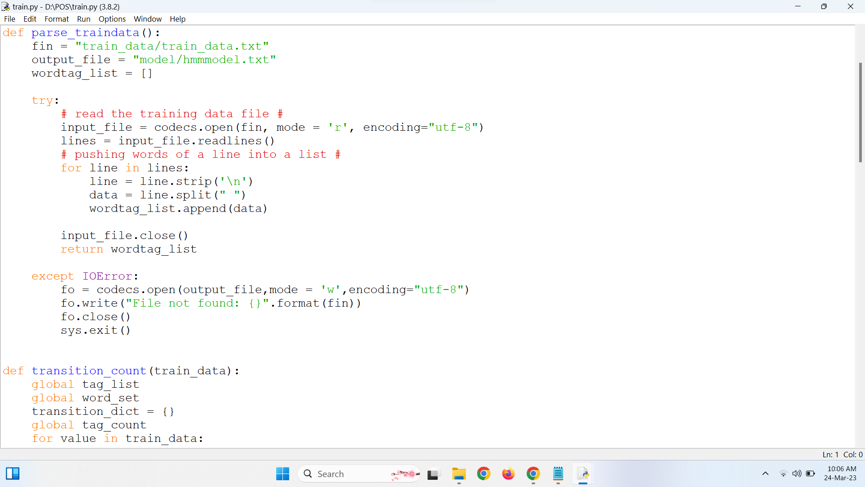

Slide 20
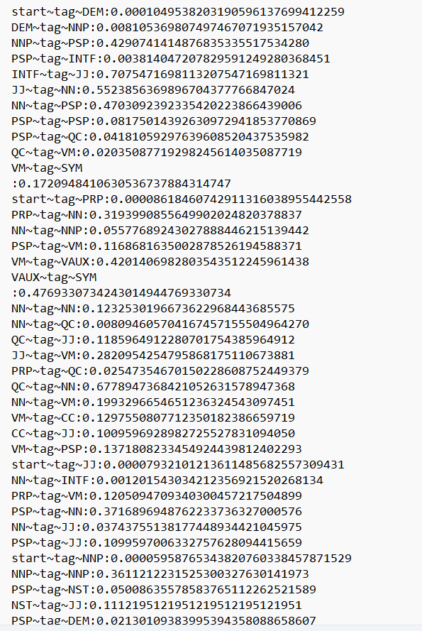
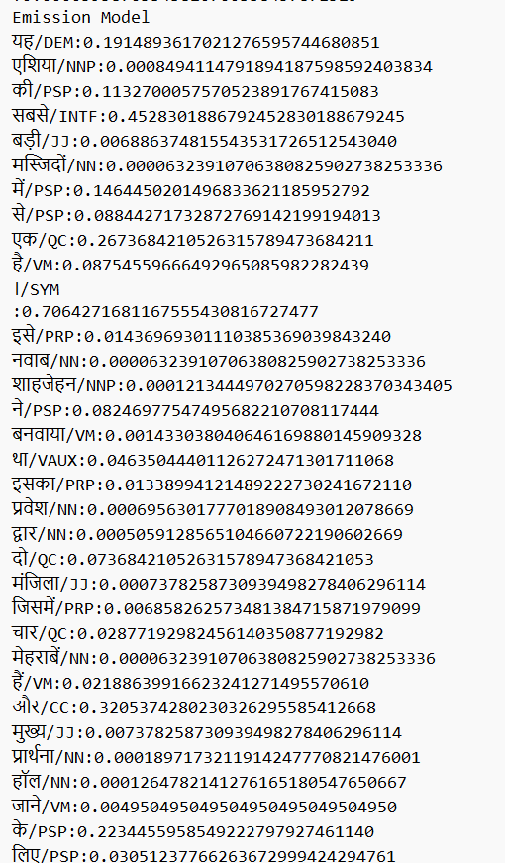

Slide 21


