Slide 1
Open Pose Multi Person Key point Detection by Prudhvi Kishan, Sri Ranga Department of Computer Science, The University of Akron

Slide 2
Introduction to Open Pose
Human 2D pose estimation is the problem of localizing human body parts such as the shoulders, elbows and ankles from an input image or video. In most of today’s real-world application of human pose estimation, a high degree of accuracy as well as “real-time” inference is required.
Open pose has represented the first real-time multi-person system to jointly detect human body, hand, facial, and foot key points on single images. It was proposed by researchers at Carnegie Mellon University.
Open pose is originally written in C++ and Caffe.
It is currently available as open source under the OpenCV library.

Slide 3
Architecture
In first step the image is passed through baseline CNN network to extract the feature maps of the input.
The feature map is then process in a multi-stage CNN pipeline to generate the Part Confidence Maps and Part Affinity Field
Part Confidence Maps
Part Affinity Field
In the last step, the Confidence Maps and Part Affinity Fields that are generated above are processed by a greedy bipartite matching algorithm to obtain the poses for each person in the image.

Slide 4
Confidence Maps and Part Affinity Fields
Confidence Maps: A Confidence Map is a 2D representation of the belief that a particular body part can be in any given pixel. Confidence Maps are described by following equation:
S = (S₁, S₂,.…., S_{J}) where S_{j} ε R^{w*h} , j ε 1…..J
where J is the number of body parts locations.
Part Affinity Fields: Part Affinity is a set of 2D vector fields that encodes location and orientation of limbs of different people in the image. It encodes the data in the form of pairwise connections between body parts.
L = (L_{1,}L₂…,L_{C)} where L_{c} ε R^{w*h*c} , c ε 1…..C

Slide 5
Model
Caffe is a deep learning framework developed by the Berkeley Vision and Learning Center (BVLC). It is written in C++ and has Python and MATLAB bindings.
There are 4 steps in training a CNN using Caffe:
Step 1 - Data preparation: In this step, we clean the images and store them in a format that can be used by Caffe. We will write a Python script that will handle both image pre-processing and storage.
Step 2 - Model definition: In this step, we choose a CNN architecture, and we define its parameters in a configuration file with extension .prototxt.
Step 3 - Solver definition: The solver is responsible for model optimization. We define the solver parameters in a configuration file with extension .prototxt.
Step 4 - Model training: We train the model by executing one Caffe command from the terminal. After training the model, we will get the trained model in a file with extension .caffemodel.

Slide 6
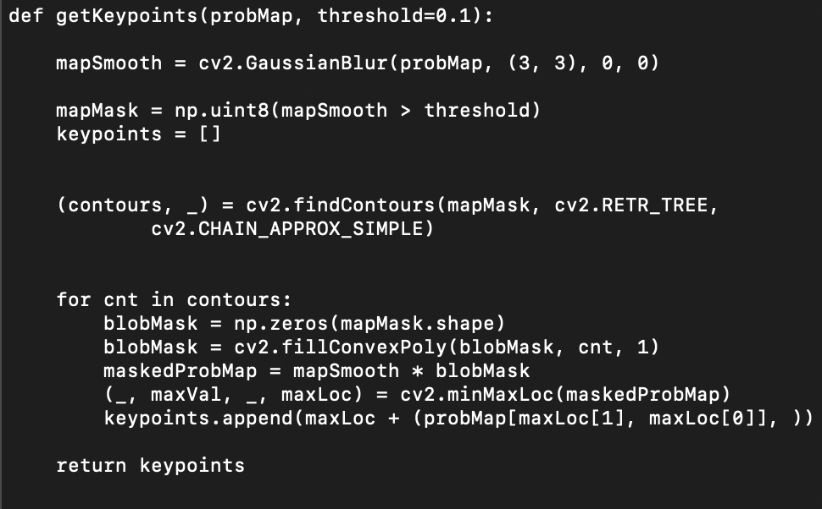
Key points function

Slide 7
Technologies used
Python
Trained Caffe Models
OpenCV
NumPy
The project is executed by taking the downloaded images and videos from the internet.
Types of Key Point Mapping is pre-defined in the Python code to understand each object of the human body.
Color coding is also implemented in the execution.

Slide 8
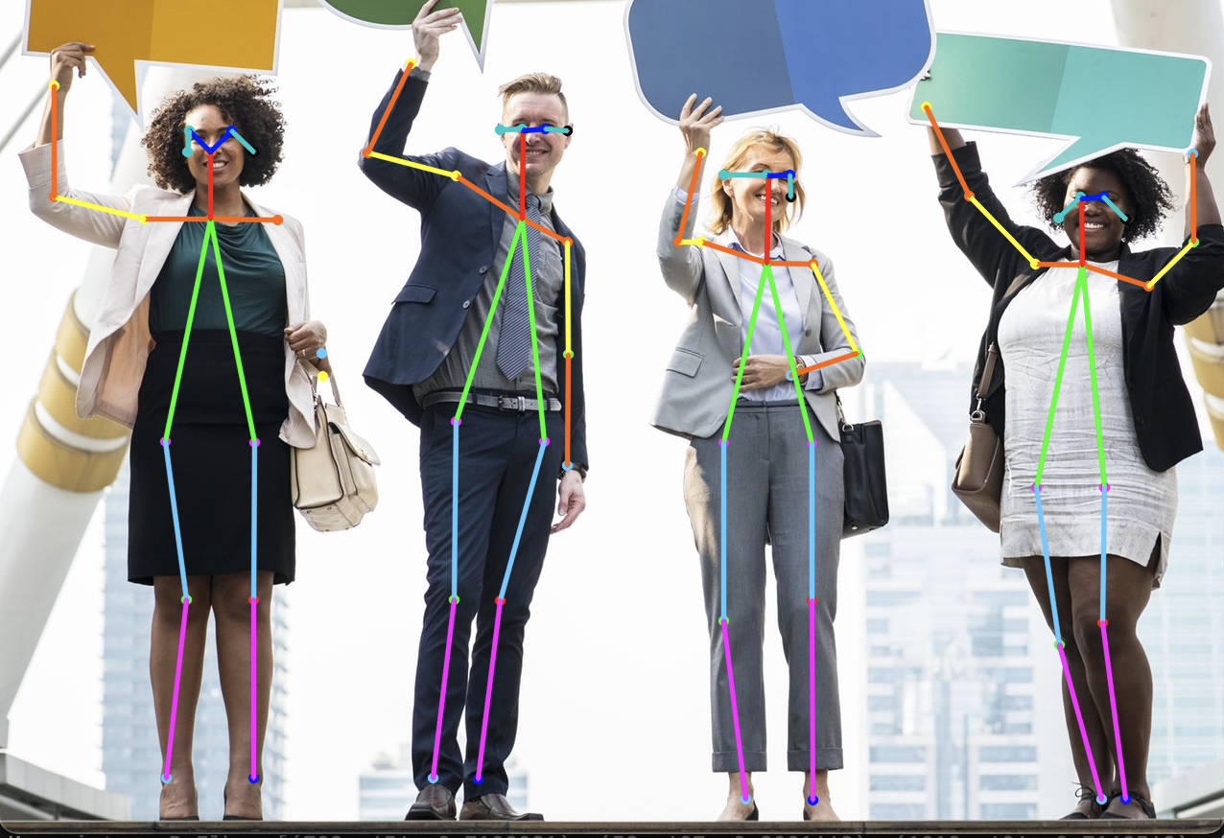
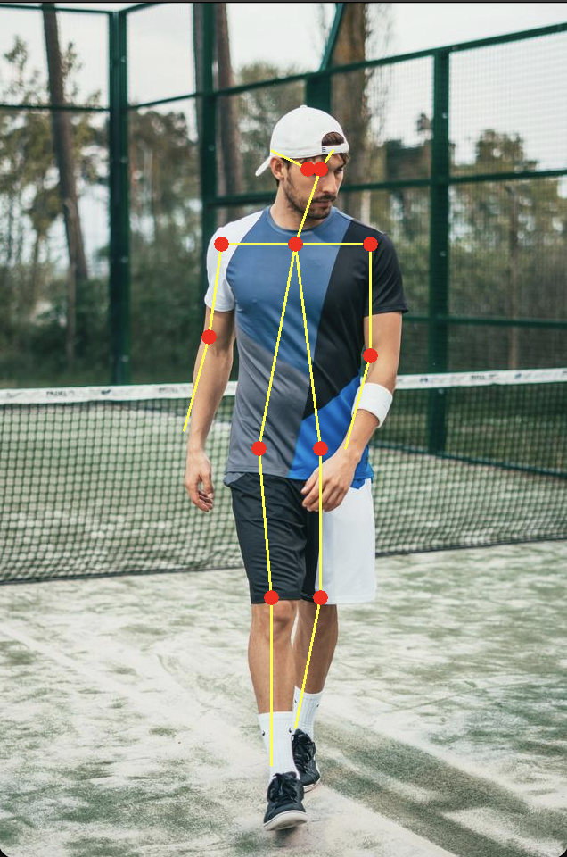
Results

Slide 9
Advantages of Open pose
Use of non-parametric color-coded PAFs creates greater accuracy for mapping
High accuracy without compromise on execution performance
Use of confidence maps to map individual body parts/regions (i.e. shoulder)
Greedy parsing algorithm is effective in terms of runtime
Scales well to GPU over CPU

Slide 10
Disadvantages
Slight trade off between speed and accuracy (i.e. R-CNN runs faster)
Current human pose performance metrics are based on key point accuracy
Not a completely fair comparison
Failure cases still exist (i.e. foot and leg occluded, rare joint position, etc.)

Slide 11
Future Work
A calibrated, multi-view imaging setup is needed to maximize the estimation accuracy. For this reason, a set of cameras will be placed in precise locations and will be calibrated, in order to better account for the effects of varying scale due to lens distortion. These cameras will be used to simultaneously capture different views of the body pose.
The model preparation, code execution and the image pixel division can be done more accurately and precisely on a GPU device.

Slide 12
References
Maithani, M. (2021, January 12). Guide to OpenPose for Real-time Human Pose Estimation. Analytics India Magazine. https://analyticsindiamag.com/guide-to-openpose-for-real-time-human-pose-estimation/
Tanugraha, P. (2019, September 20). Understanding OpenPose (with code reference)— Part 1. Medium. https://medium.com/analytics-vidhya/understanding-openpose-with-code-reference-part-1-b515ba0bbc73
Sharma, S. (2020, April 6). A Short Guide to Pose Estimation in Computer Vision. Medium. https://medium.com/@siddrrsh/a-short-guide-to-pose-estimation-in-computer-vision-3ea708dd9155

