Slide 1
Image Compression Using SVD and Dimensionality Reduction Using PCA
Presented by: Sri Gorantla and Mohan Chimata

Slide 2
Overview
What is SVD
Steps done
SVD Compressed Images
Observations
Demo
PCA
Dataset
Data Processing
Results of PCA

Slide 3
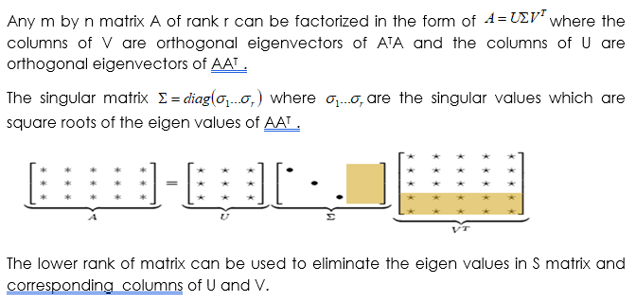
SVD

Slide 4
Steps Followed
Step1: Converted the ASCII image into Binary
Step2: Stored the U ,V and singular values in binary format after eliminating the singular values using rank approximation
Comparing the sizes of images obtained in step1 and 2 using the ROC
Rate of Compression (ROC)=(Original Image size-Approx Image Size)/ Original Image size
Getting the original Image back from step 1 and approximated image from step2

Slide 5
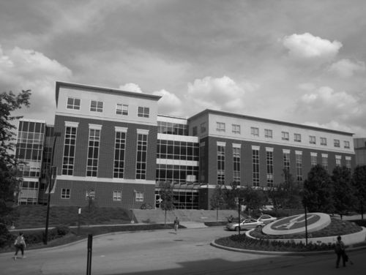
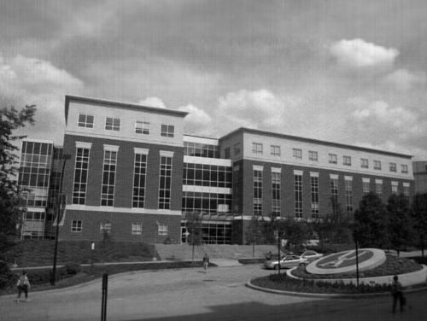
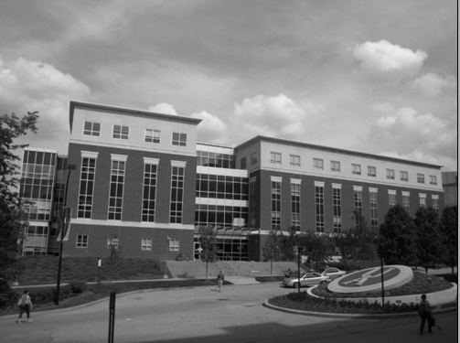
SVD compressed images for diﬀerent values of k
Original Image
Rank 100
Rank 200

Slide 6
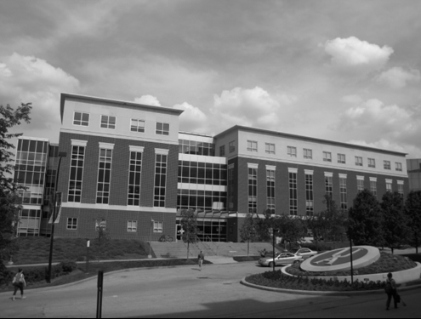
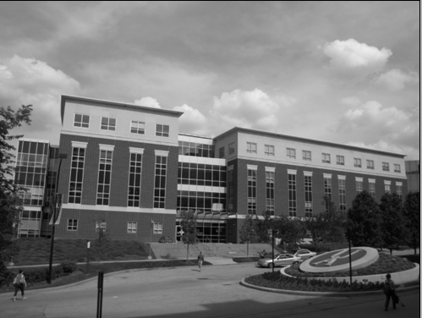
Rank 250
Rank 300

Slide 7
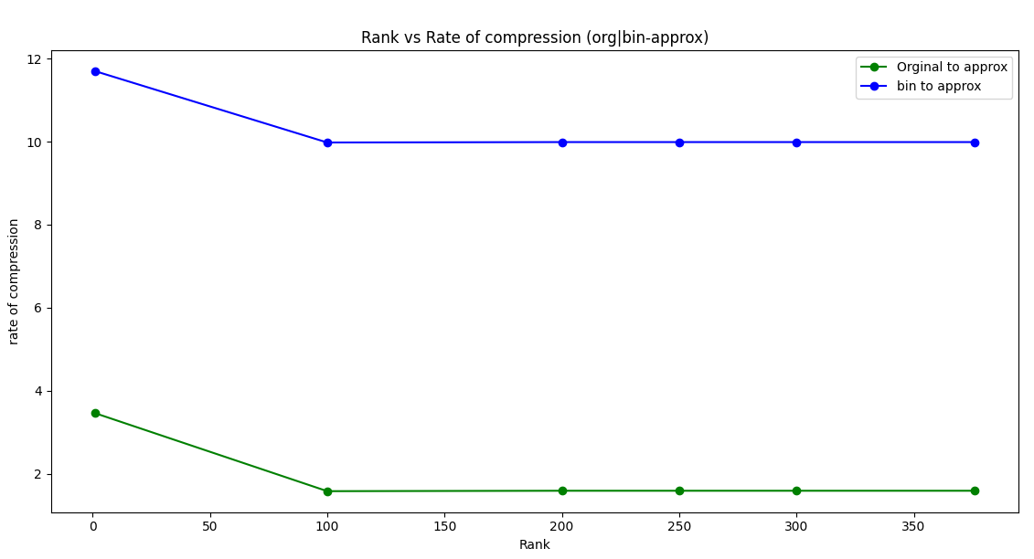
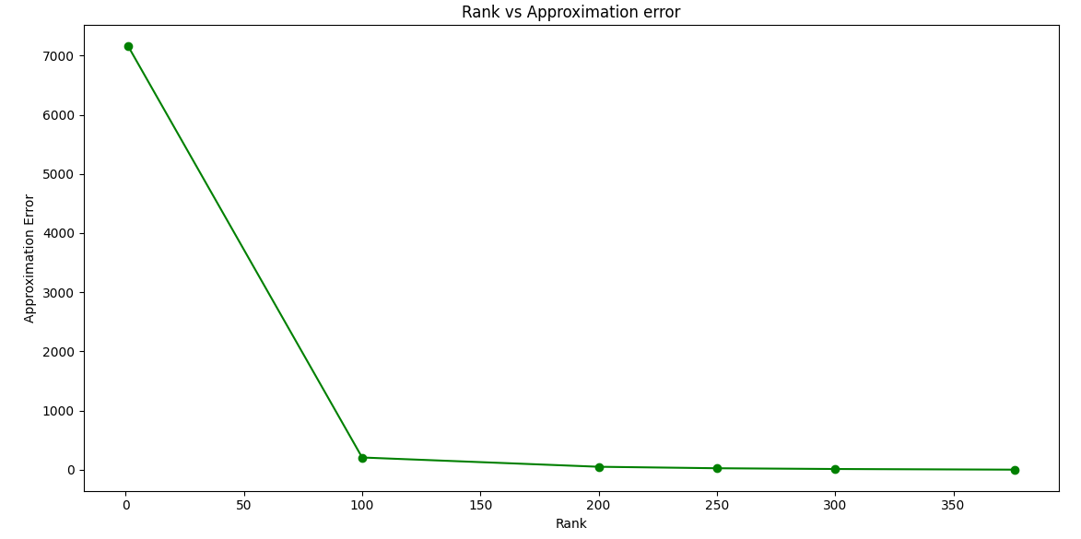
Observations

Slide 8
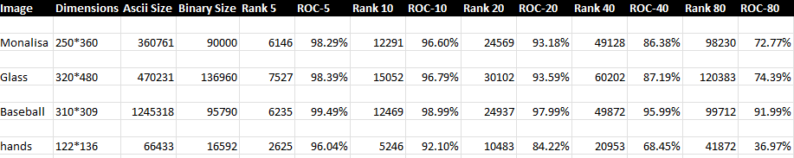
Observations
Rates of Compression and Sizes for Different Test Cases with different ranks

Slide 9
PCA
Principal Component Analysis (PCA) is a dimension-reduction tool that can be used to reduce a large set of variables to a small set that still contains most of the information in the large set.
Principal component analysis (PCA) is a mathematical procedure that transforms a number of (possibly) correlated variables into a (smaller) number of uncorrelated variables called principal components.
The first principal component accounts for as much of the variability in the data as possible, and each succeeding component accounts for as much of the remaining variability as possible.
PCA simply performs a coordinate rotation that aligns the transformed axes with the directions of maximum variance.
PCA can help find underlying structure of the data. It selects a rotation such that most of the variability within the data set is represented in the first few dimensions of the rotated data.
PCA tries to find a lower dimensional surface so the sum of squares onto that surface is minimized.
PCA tries to find the surface which has the minimum projection error.

Slide 10
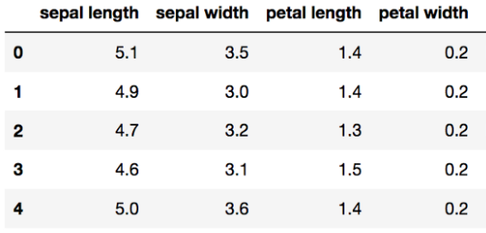
Data Set- Iris Dataset
The considered Dataset has 4 attributes sepal and petal lengths and sepal and petal widths.
Three Classes Iris-setosa, Iris-virginica, Iris-versicolor

Slide 11
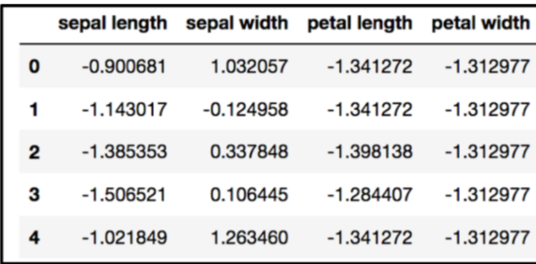
Data Processing
The next step is to standardize the data

Slide 12
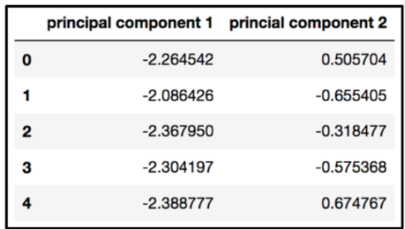
Principal Components
First principal component contains 72.77% of the variance and the second principal component contains 23.03% of the variance.
Together, the two components contain 95.80% of the information.

Slide 13
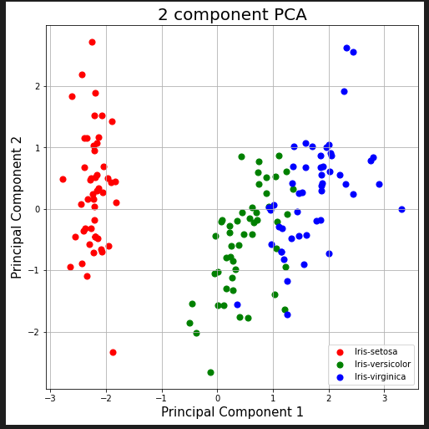
Results after adding targets

