Slide 1
WORDIFY
sri gorantLa

Slide 2
Languages used
Java Script
Html
CSS

Slide 3
API’s USED
WebGL
three.js
BJSpell.js
stats.min.js
Jquery.js

Slide 4
Game Info
Basically, it’s selecting words from a bunch of letters.
If the word you selected exists, you get a point.
The more complex the word, the more points you get.
I added a prompt sound when you enter a word that doesn’t exist.
I used BJSpell library for checking the word.
I set a time limit of 2 minutes.

Slide 5
Key Map
Z:submit word
X:undoselection
R:Reset View

Slide 6
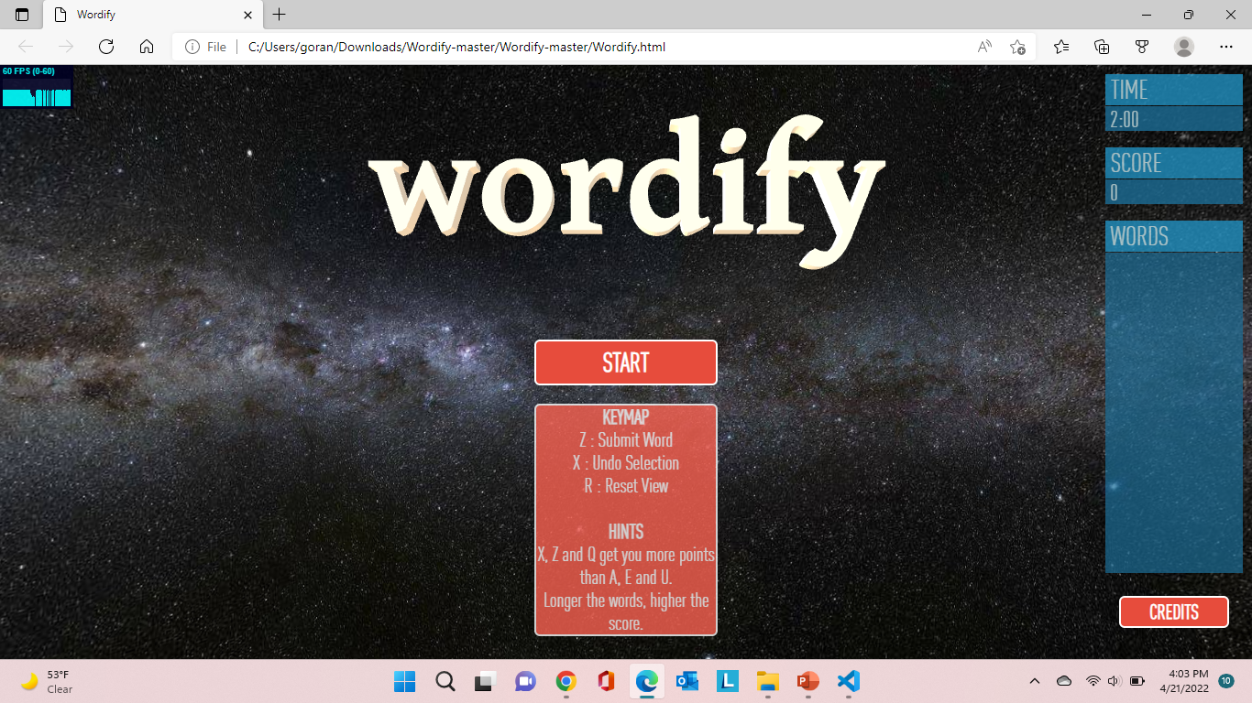
Demo

