Slide 1
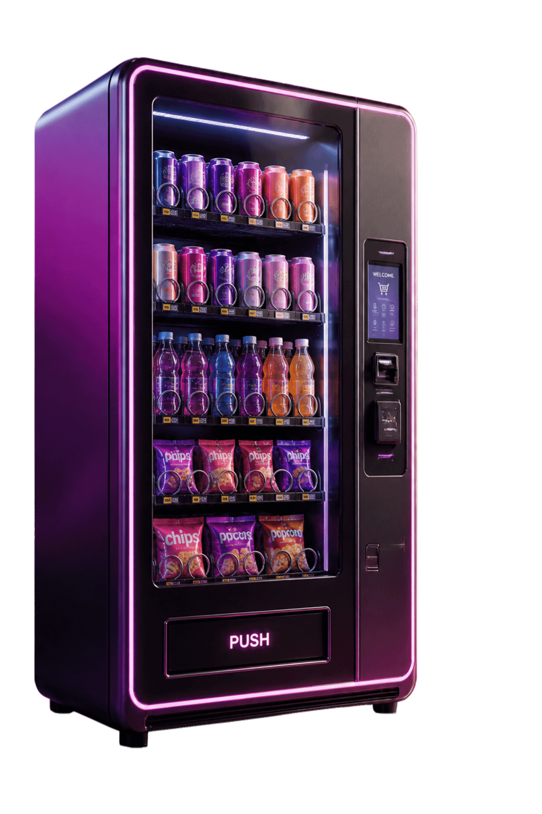

Capstone Project
Java-Based Vending Machine Controller Simulator
An introductory Java case study — from real-world transaction to working console simulator.
Team members:
2620030508--G NAVADEEP REDDY
2620030454 --S SRI TEJA SECTION 2

Slide 2
Abstract
The Vending Machine Controller Simulator is a simple Java-based project that demonstrates the basic working of a vending machine. The system allows a user to view available products, select a product, enter the required amount, and complete the purchase. It also checks whether the selected product is available and whether the user has entered enough money. If the amount entered is more than the product price, the system calculates and displays the change.
This project is mainly developed to understand and apply basic Java programming and Object-Oriented Programming (OOP) concepts. It provides a simple simulation of a real-world vending machine without requiring any physical hardware.

Slide 3
Introduction
What you will learn
Why this project matters
What the simulator demonstrates
Connection to course outcomes
Java fundamentals
Object-oriented programming
Control flow and decision-making
Real-world relevance
Practical problem solving
Easy to understand, but rich in logic
Applies coding concepts in a structured system
Builds confidence for larger Java projects
Reinforces computational thinking
Transaction logic
State management
Interactive user decisions

Slide 4

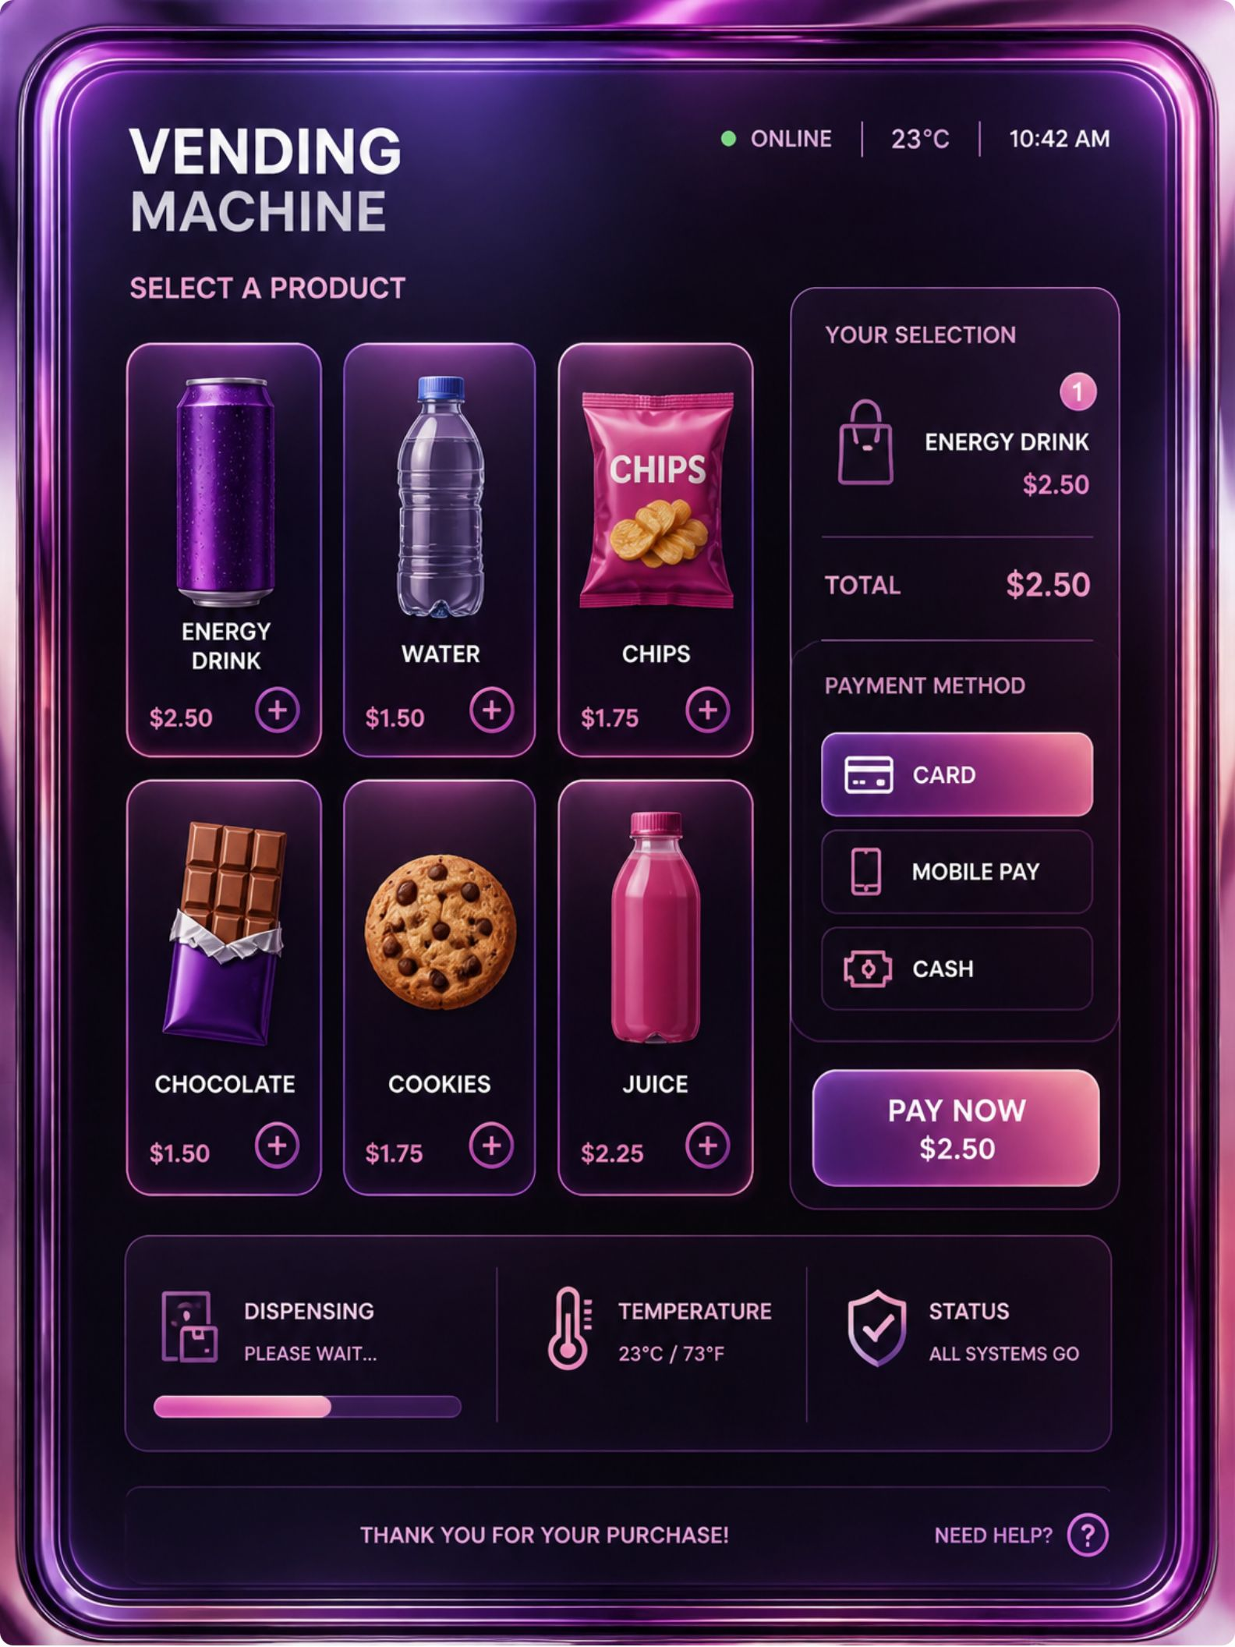




From Everyday Transaction to Java Simulator
Display
Show available products and prices
Select
Read user choice from console
Validate
Check stock and payment
Dispense
Calculate change and confirm
This console-based simulator models controller logic — no physical hardware required. It integrates algorithms, Java fundamentals, and control flow in one compact, teachable case study.

Slide 5
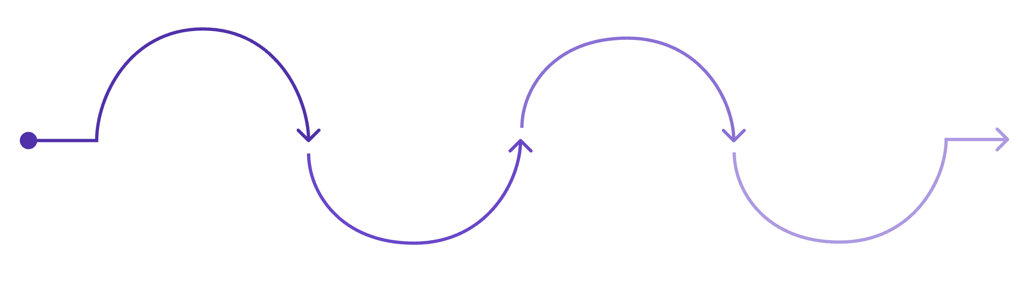
Computational Thinking: Model the Vending Process
Decomposition
Break the problem into parts: products, prices, quantities, selection, payment, change
Validate Selection
Pattern Recognition
Show Menu
Accept Payment
Dispense or Decline
System confirms the user's choice is valid.
Every sale follows the same rule — validation must succeed before completion
User is presented with available options.
The final outcome is determined.
Payment information is processed securely.
Key Decisions
"Valid selection?", "quantity > 0?", "money ≥ price?" — three gates every transaction passes

Slide 6
Java Foundations and Console Interaction
Data Types
Constants
int choice, int[] stock, double payment — meaningful camelCase names reflect real-world roles
final int PRODUCT_COUNT = 4; ensures safe, readable, tamper-proof program state
Console I/O
OOP Extension
Scanner reads selections; System.out.printf("Price: $%.2f%n", price) formats currency output
A Product class encapsulates name, price, and stock; a controller class coordinates the sale

Slide 7
Transaction Decisions and Accurate Change
Conditional Logic
1
2
Layered if/else-if/else guards every transaction step — rejecting invalid items, checking stock, then validating payment in sequence.
Combine Rules
Calculate Change
payment >= price && stock > 0 — operators &&, ||, >=, == compose compound conditions
Subtraction after validation: change = payment - prices[selected]
if (stock[s] == 0) {
System.out.println("Out of stock.");
} else if (payment >= prices[s]) {
double change = payment - prices[s];
int cents = (int) Math.round(change * 100);
stock[s]--;
} else {
System.out.println("Insufficient funds.");
}
3
Numeric Precision
Math.round(change * 100) converts to integer cents — avoids floating-point drift

Slide 8
Keeping the Controller Running: Loops and Program Flow
while (running)
do { } while (invalid)
Main loop displays the menu and processes one full transaction per iteration
Guarantees at least one prompt before re-validating input — ideal for user entry retry
1
2
3
4
Exit Design
for + continue
Choice 0 sets running = false — a clean, controlled exit with no infinite loop risk
For loops print products and availability; continue restarts the menu cleanly after a failed sale
while (running) {
displayMenu();
int choice = scanner.nextInt();
if (choice == 0) { running = false; continue; }
processTransaction(choice);
}

Slide 9

Conclusion: A Complete Learning Outcome
CO1 ACHIEVED
Clear Outcomes
Next Steps
Problem-Solving & Java Fundamentals
Every run ends in either a successful purchase with change or a specific, informative rejection message
Extend with a Product class, multiple payment methods, receipt output, or persistent inventory storage
Computational decomposition and algorithm design
Java data types, expressions, and formatted I/O
CO2,CO3 ACHIEVED
Decisions, Loops & Arrays
Built for the real world. A vending machine simulator teaches you how everyday software handles choices, payments, inventory, and feedback—skills you can carry into any practical Java project.
if/else, switch with break/default
while, do-while, for loops
1D and 2D arrays with index-linked data

