Slide 1
CAPSTONE FOOTBALL PROJECT Unleashing Insights From Football Data
Name: Sri Ranjith Kumar
Mentor Name: Jaya Pandey

Slide 2
Introduction
In this presentation, I explore a comprehensive dataset that captures various aspects of the game—from match statistics and player attributes to contract management and referee behavior. My analysis covers:
Football data analysis uses data science to uncover valuable insights from football data.
These insights improve decision-making in areas like player performance, team tactics, and fan engagement.
Business strategies also benefit from data-driven insights derived from football data.
This project explores these data-driven opportunities within the football domain.
The project showcases proficiency in data analysis tools and methodologies.
Using a blend of Python and Tableau visualizations, our insights aim to provide actionable intelligence for teams, managers, and stakeholders in the football industry. Let's dive into the data to uncover trends and opportunities shaping modern football.

Slide 3
Sprint 1
Sprint 10
Sprint 2
Sprint 9
Break Down
of
Capstone Project
Sprint 3
Sprint 8
Sprint 4
Sprint 7
Sprint 5
Sprint 6

Slide 4
Objectives
The objective of the project is to analyze a football dataset on the basis of the below focus areas:
1. Performance Analysis
2. Player Profile and Market Value
3. Team Comparison
4. Attendance and Stadium Analysis
5. Referee Analysis
6. Substitution Patterns
7. Event Analysis
8. Competition Analysis
9. Player Attributes and Demographics
10. Contract Management

Slide 5
Tools and Techniques
Python
Data Cleaning, Preprocessing, Manipulation ,EDA, Visualization ML Modelling
SQL
Store the capstone results in the database
Excel
Saved the python file in excel after data manipulation
Tableau
Presented the Capstone Analysis through Dashboard

Slide 6
DATA PREPARATION
Data Cleaning:
Fixing or removing incorrect, incomplete, or duplicate data. Think of it as tidying up your dataset. In Python, libraries like Pandas are commonly used.
Data Preprocessing:
Transforming data into a suitable format for analysis . This might include scaling, encoding categorical variables, or handling missing values. Scikit-learn is a key Python library for this.
Data Manipulation:
Changing the structure or content of data to make it easier to use. This can involve tasks like selecting specific columns, filtering rows, sorting, merging datasets, or creating new variables. Pandas is the go-to library in Python.

Slide 7
Data Cleaning and Pre-Processing
At first I have read the file using pd.read_excel using pandas library.
Then I have merged the data frames using merge function based on common columns and used inner join to display common values.
I have used the drop function to drop repeated columns as a part of data cleaning.
I have separated the numerical columns using select_dtypes function and included condition as number.
I have separated the categorical columns using select_dtypes function and excluded condition as number.
At last I have checked the null values using isnull().sum() and filled the null values using fillna() for numerical values used mean() and for categorical used mode().

Slide 8
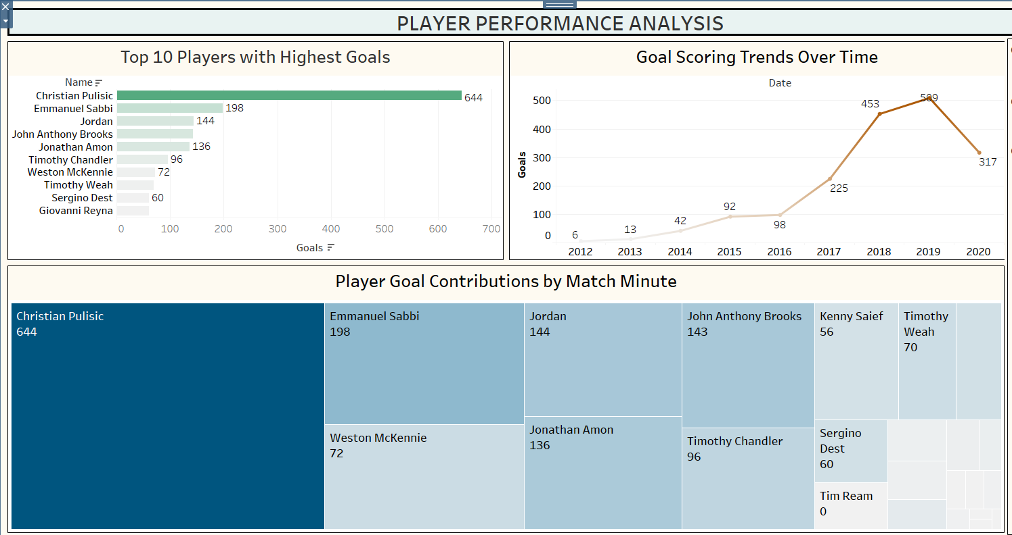
SPRINT - 1 Performance Analysis
Christian Pulisic stands out as the clear top scorer, far surpassing other leading goal contributors.
Teams collectively scored more goals each year until 2019, reflecting a growing offensive trend before a slight dip in 2020.

Slide 9
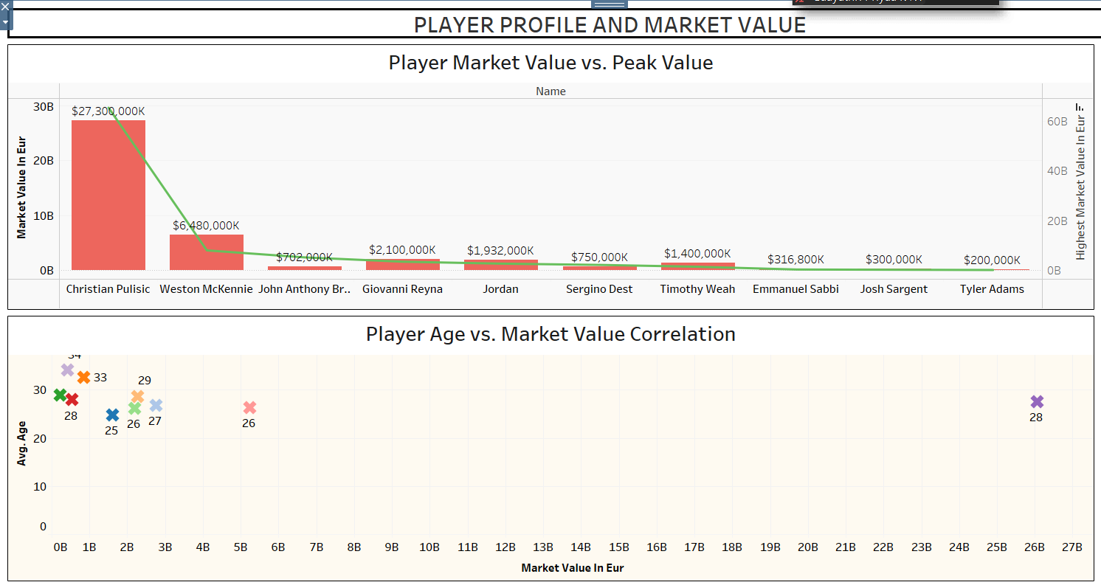
SPRINT - 2 Player Profile and Market Value
Christian Pulisic demonstrates the highest current market value, significantly surpassing his historical peak, suggesting a potential career high.
Conversely, several players, including Weston McKennie and others toward the right, have current market values substantially below their peaks, indicating possible fluctuations in form or career progression.

Slide 10
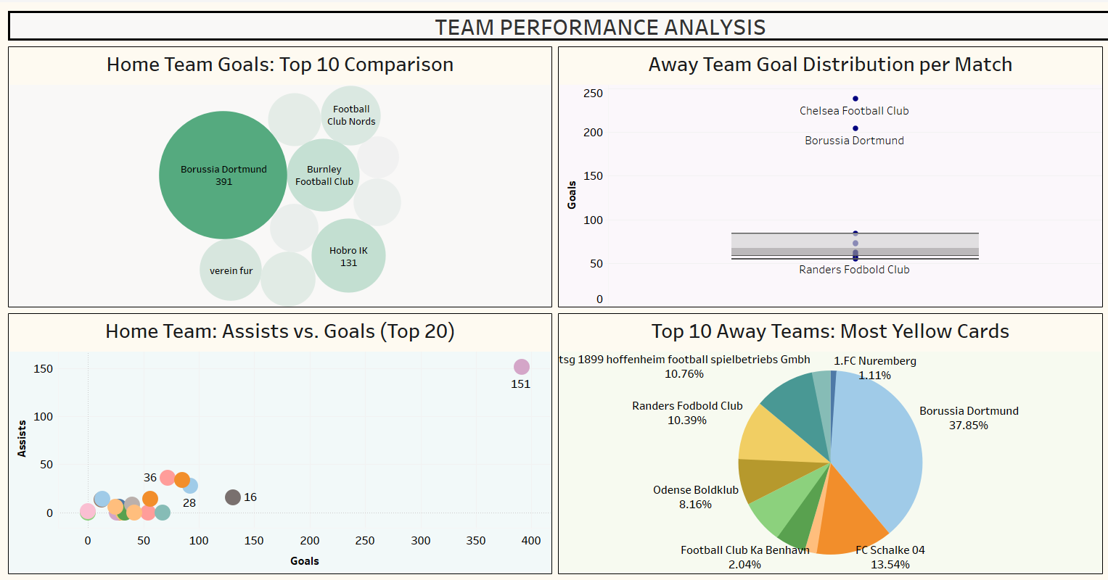
SPRINT - 3 Team Comparison
Borussia Dortmund leads in total goals among the top 10 home club teams, significantly outperforming others like Burnley and Hobro IK.
Borussia Dortmund stand out as having the highest number of yellow cards among away club teams followed by FC Schalke team, suggesting potentially more aggressive play styles.

Slide 11
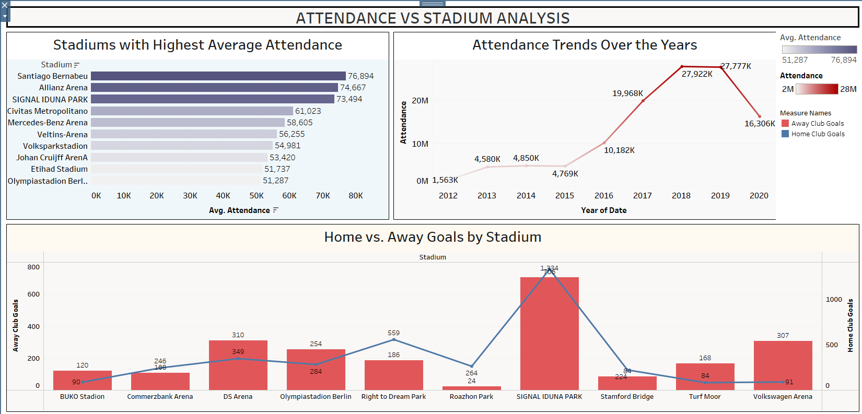
SPRINT - 4 Attendance and Stadium Analysis
Santiago Bernabeu and Allianz Arena have the highest average stadium attendance, significantly exceeding other venues like SIGNAL IDUNA PARK.
Attendance at Olympiastadion Berlin shows a drastic decline from 2012 to 2019, despite having a moderate average attendance overall.

Slide 12
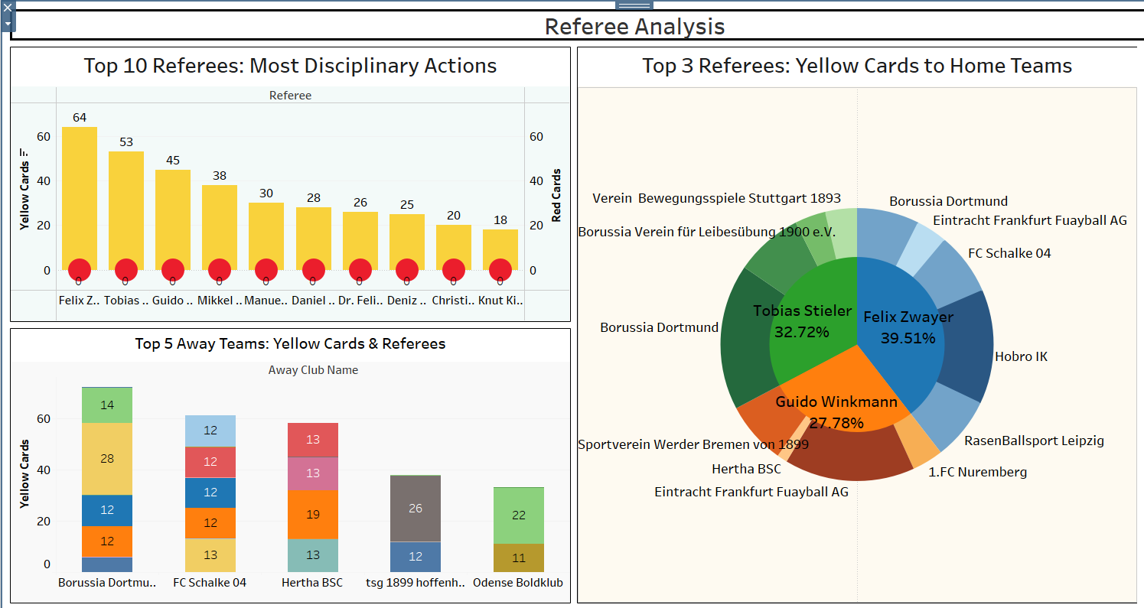
SPRINT - 5 Referee Analysis
Felix Zwayer is the referee who has issued the most disciplinary actions (yellow and red cards), significantly higher than any other referee in the top 10.
Borussia Dortmund is the team that has received the most yellow cards from the top 3 referees issuing the most cards to home club teams.
Guido Winkmann has issued the most yellow cards to away club teams, with Borussia Dortmund and FC Schalke 04 being the away teams receiving the most yellow cards from him.

Slide 13
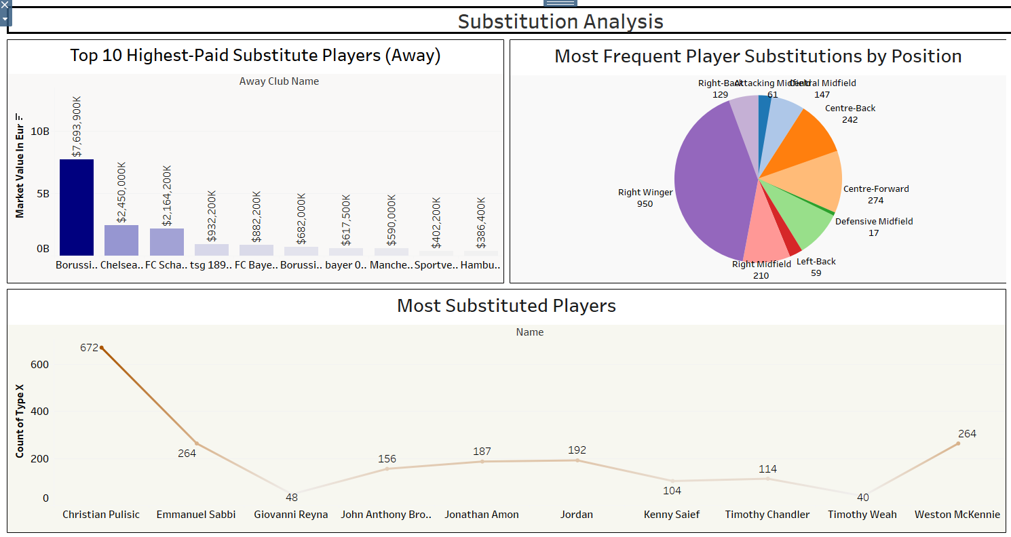
SPRINT - 6 Substitution Analysis
Right wingers are the most frequently substituted players, followed by centre-forwards, indicating potential tactical or fatigue-related trends in those positions.
Christian Pulisic is the most substituted player overall, suggesting his role might involve frequent tactical substitutions or managing playing time.
Despite being among the top-paid substitutes, several players like Giovanni Reyna and others have relatively low substitution counts, possibly indicating infrequent use or late-game appearances.

Slide 14
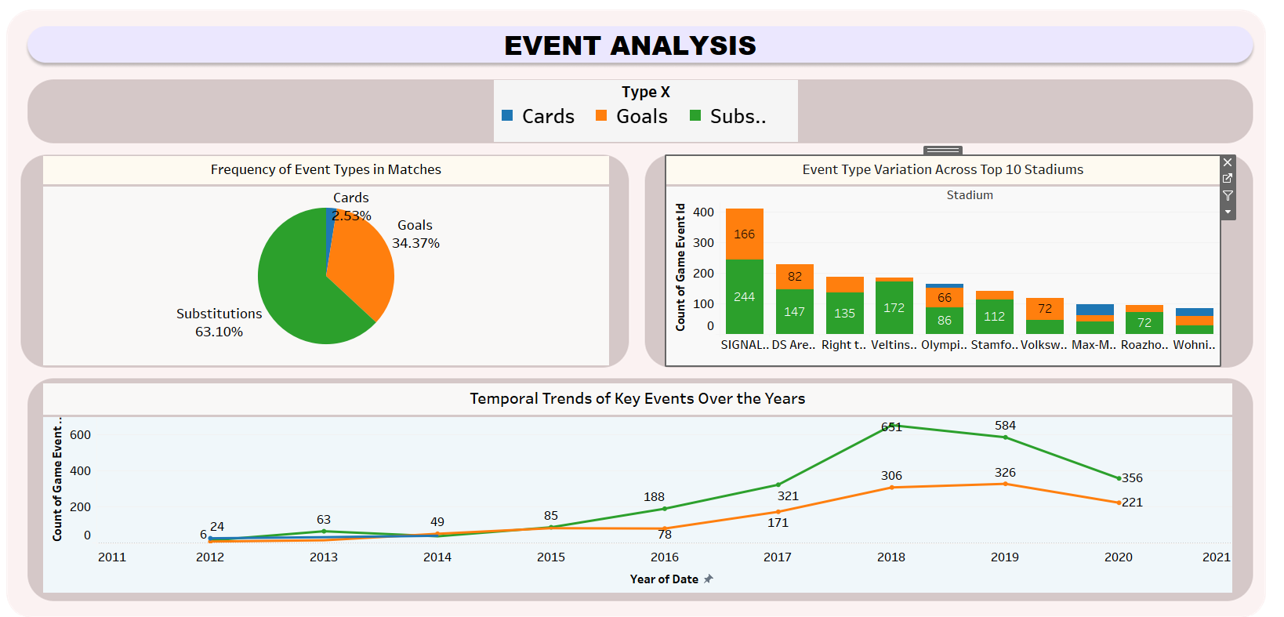
SPRINT - 7 Event Analysis
Substitutions are the most frequent event type in matches, significantly outweighing goals and cards.
While goals show a general upward trend over the years, substitutions and cards exhibit more fluctuation.
SIGNAL IDUNA PARK stadium has the highest count of game events, followed by DS Arena, suggesting higher activity or possibly more matches hosted at these venues.

Slide 15
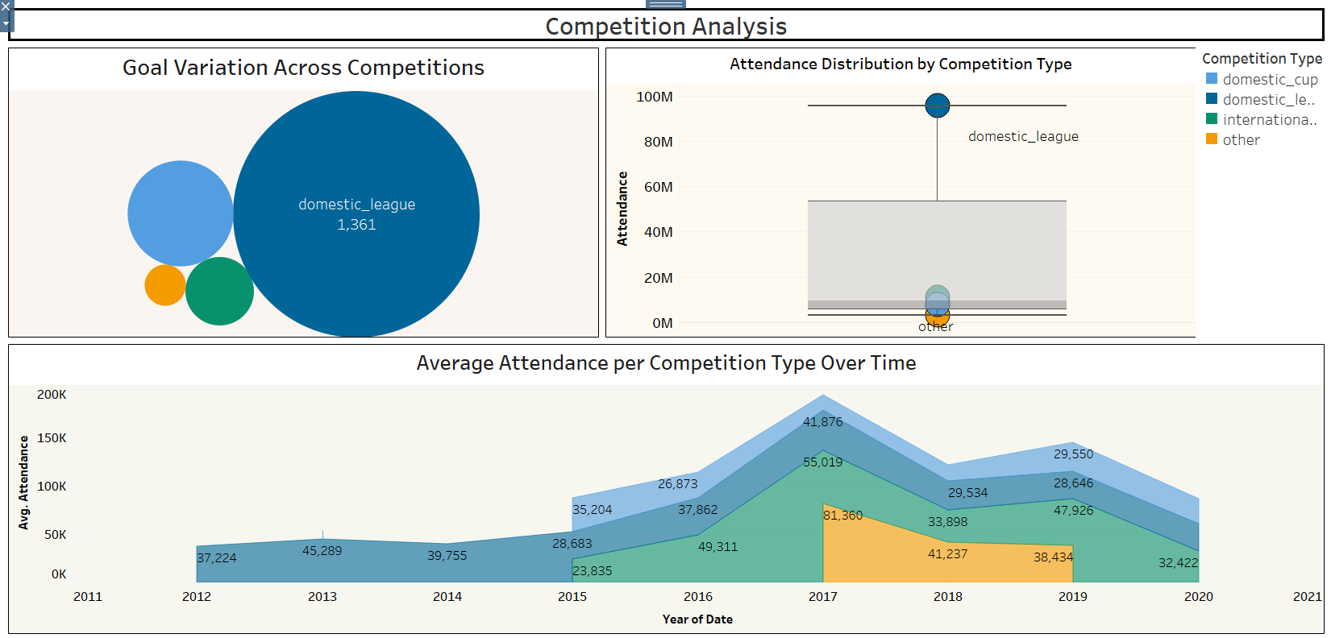
SPRINT - 8 Competition Analysis
Domestic leagues have the highest total goals and the widest range of attendance, indicating their popularity and competitive nature.
International competitions have a notably smaller total goal count and a more concentrated attendance range, suggesting fewer matches but potentially higher individual match attendance.
Domestic cups and other competition types have significantly lower total goals and attendance compared to leagues and international competitions, implying a smaller scale of influence or participation.

Slide 16
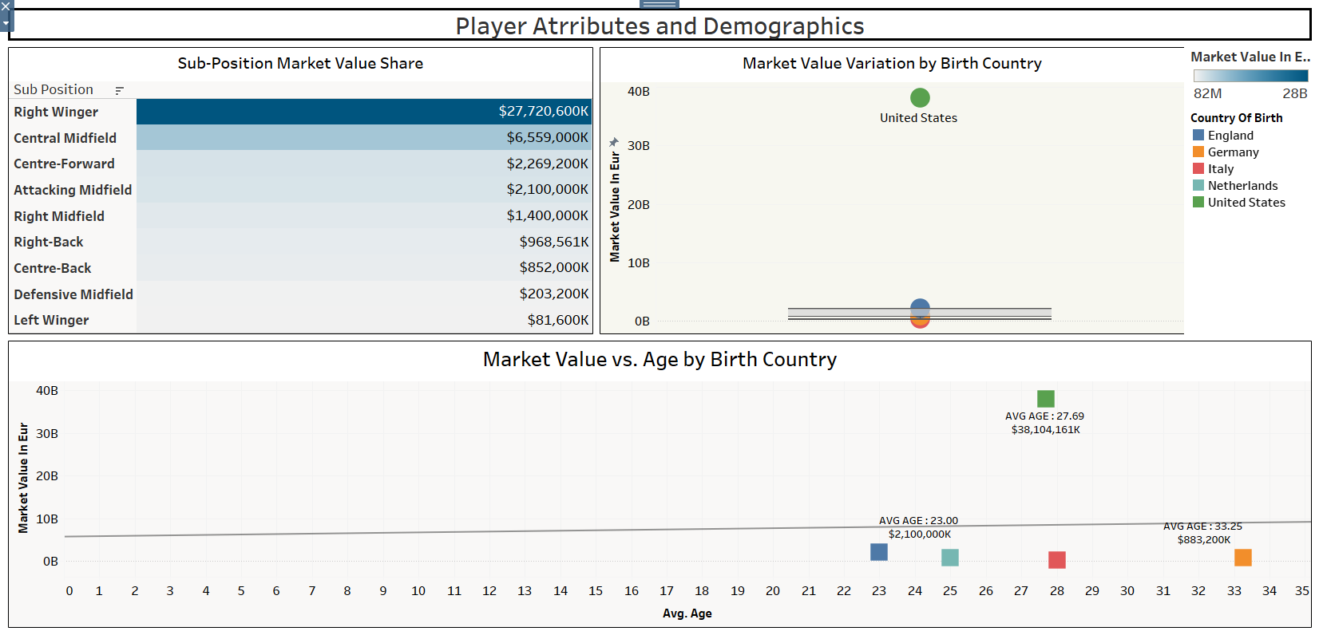
SPRINT - 9 Player Attributes and Demographics
Right wingers command the highest total market value among sub-positions, significantly outpacing central midfielders and other roles.
Players born in the United States exhibit the highest average market value, exceeding those from England, Germany, Italy, and the Netherlands.
A player's market value doesn't show a clear correlation with average age across different countries of birth, as high-value players exist across various age ranges.

Slide 17
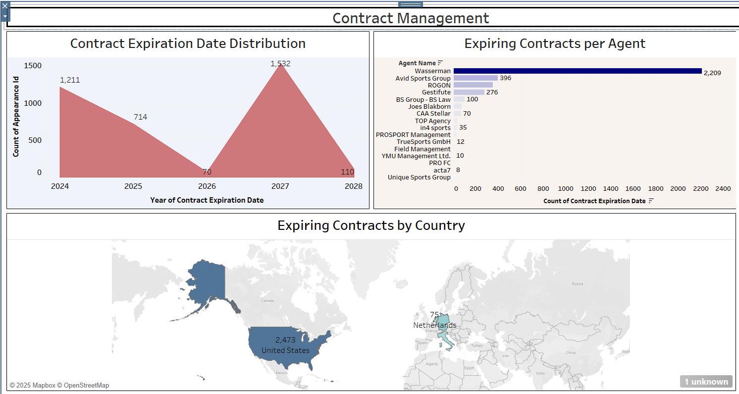
SPRINT - 10 Contract Management
A significant number of player contracts are set to expire in 2024 and 2025, with a smaller peak in 2027, indicating potential waves of free agents in those years.
Wasserman and Avid Sports Group represent the highest number of expiring contracts, suggesting their significant presence in the player agent market.
The United States and the Netherlands are highlighted as having a notable concentration of expiring player contracts, implying a potential hub of player movement within these regions.

Slide 18
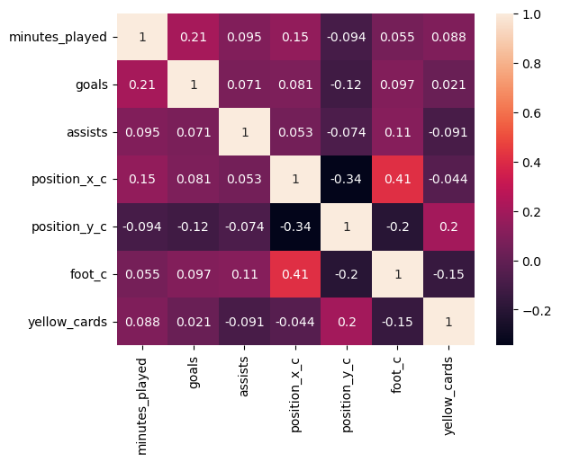
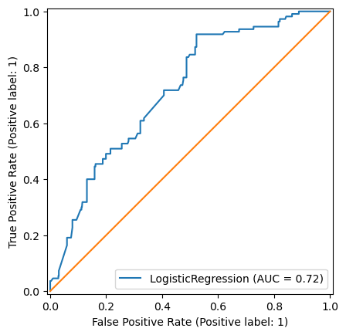
Logistic Regression
Correlation heat map
ROC AUC CURVE
From the above correlation heat map it seems that no columns are highly correlated and the target column is yellow card.
The above Logistic Regression model has a moderately good. The AUC score of 0.72 indicates that the model performs better than random chance (AUC = 0.5).

Slide 19
Logistic Regression
Scored | Logistic Regression Score
Recall Score | 3.6%
F1 Score | 6%
Precision Score | 66%
Accuracy score | 85%
Model shows high accuracy (85%) but very low recall (3.6%) and F1-score (6%).
This indicates that while it correctly predicts the majority class well.
Although the precision is high (66%), it's not useful when the recall is so low.

Slide 20
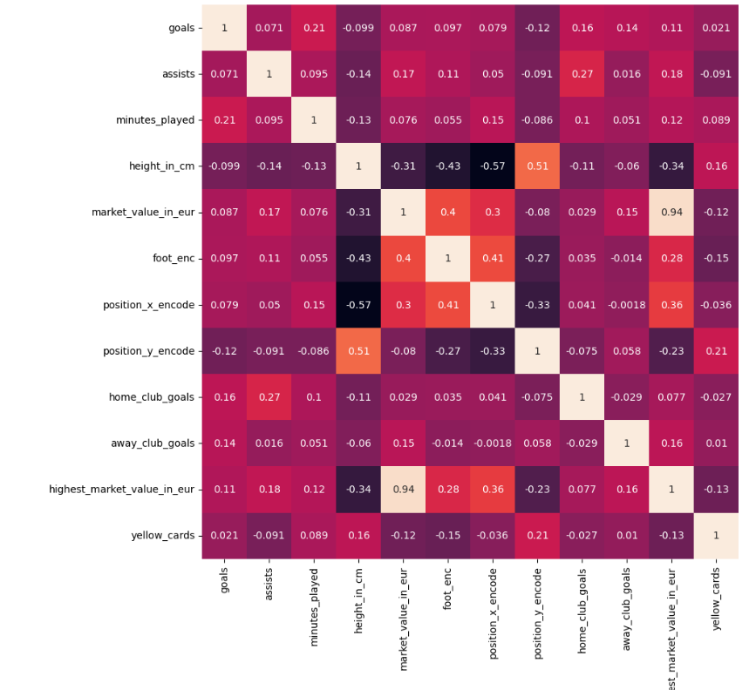
Linear and Multi Linear Regression
Correlation heat map
From the above correlation heat map it seems that no columns are highly correlated which means not more than 0.7 and the target column is market value in euro.

Slide 21
Linear and Multi Linear Regression
Scored | Multi Linear Regression Score
Mean Squared Error | 0.057
Mean Absolute Error | 0.78
Root of Mean Squared Error | 0.239
R2 Score | 94.31%
Strong Model Fit: The high R² score (0.94) suggests your model explains most of the variance.
Low Errors: MSE and RMSE are relatively low, indicating good predictive performance.

Slide 22
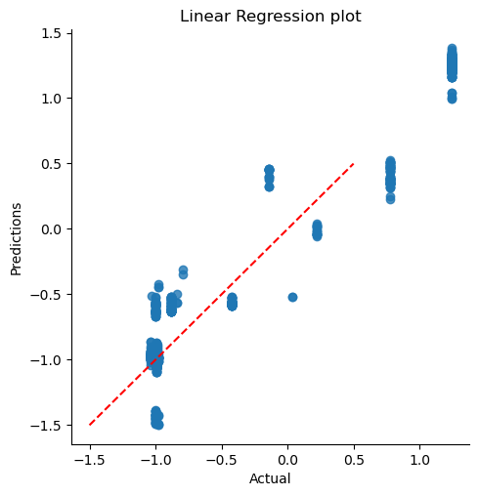
Linear and Multi Linear Regression
RESIDUAL PLOT
The residual plot shows that predictions generally follow the red dashed line (ideal fit) but with noticeable deviations, indicating some errors.
The spread suggests variance in prediction accuracy, with potential outliers affecting the model.

Slide 23
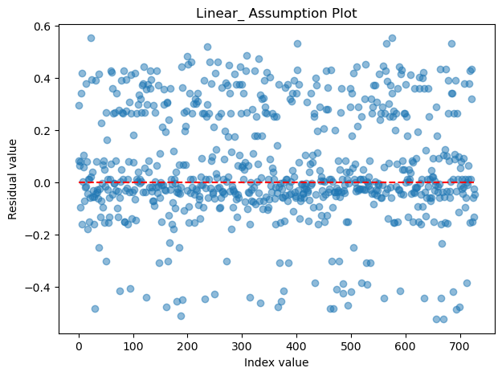
Linear and Multi Linear Regression
HOMOSCADECITY PLOT
My residual plot suggests homoscedasticity, meaning the model meets this assumption.
The random scatter is good, but outliers (aligned with high MAE 78%) indicate some large errors.
R² (94.31%) shows a strong fit, but checking residual normality and outliers could improve the model.

Slide 24
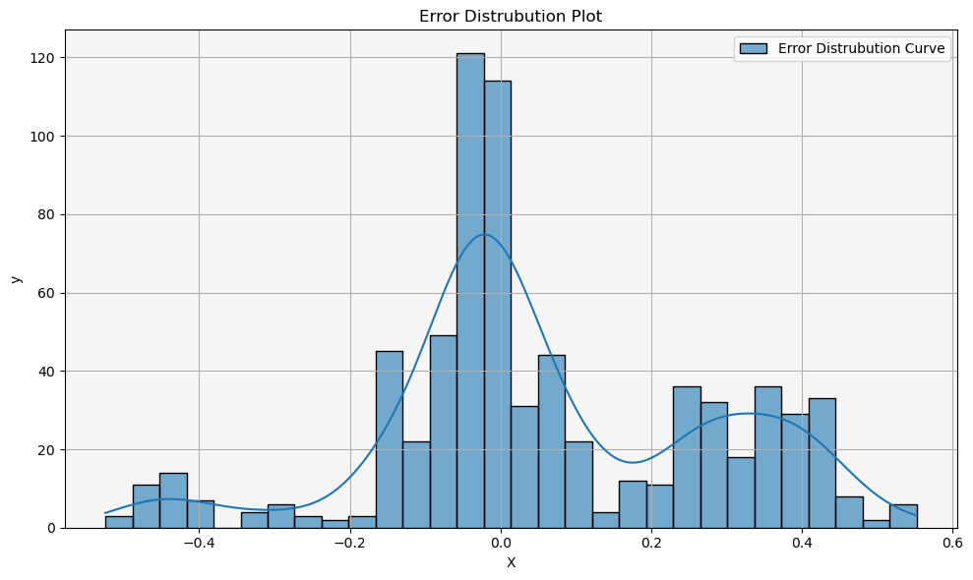
Linear and Multi Linear Regression
ERROR DISTRIBUTION PLOT
The error distribution plot shows a non-normal, skewed distribution, indicating potential outliers or bias in predictions.
The peaks suggest concentrated errors around zero, but the spread hints at variance that could affect model reliability.

Slide 25
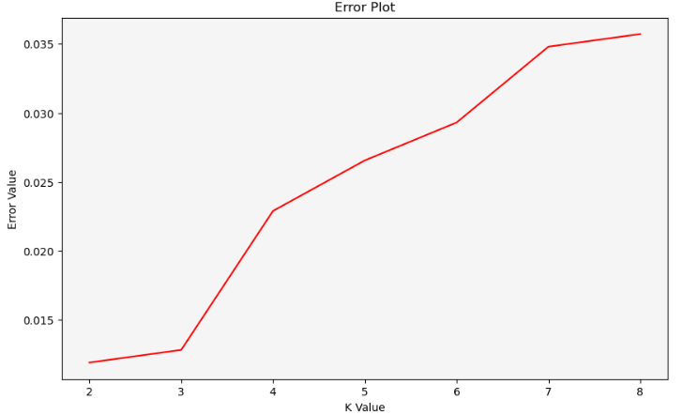
K NEAREST NEIGHBOR CLASSIFY
ERROR PLOT
Scored | KNN Classification Score
Recall Score | 0.9871
F1 Score | 0.9871
Precision Score | 0.9871
Accuracy score | 0.9871
This plot illustrates how the validation error rate changes as we vary the value of K in our KNN model.
The x-axis represents the K value, and the y-axis represents the corresponding error rate.
Accuracy: ~98% correct classifications. Precision: 98% of predicted positives are correct. Recall: Identifies 98% of actual positives. F1-Score: ~98%, balancing precision and recall well.

Slide 26
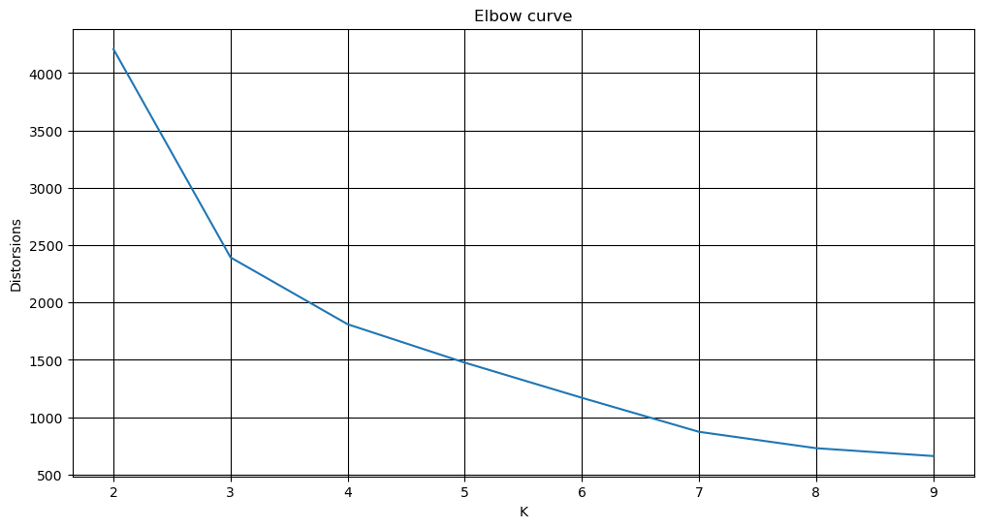
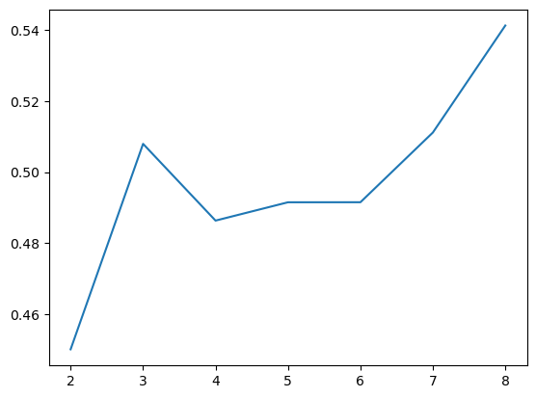
K MEANS CLUSTERS
ELBOW CURVE
SILHOUETTE SCORE
X-axis (K): Number of clusters. Y-axis: Sum of squared distances to centroids (lower is better). Elbow Curve suggests k=3 as optimal.
The Silhouette Score (range: -1 to 1) measures clustering quality:
Closer to 1: Well-clustered
Closer to 0: Weak/overlapping clusters
Closer to -1: Misclassified points
It suggests 3 as the best number of clusters for my data.

Slide 27
K MEANS CLUSTERS
CALINSKI HARBAZ SCORE
DAVIES BOULDIN SCORE
Measures the ratio of between-cluster to within-cluster dispersion. Higher CH score = better-defined clusters. My value (3710.44) suggests good separation.
Measures average similarity between each cluster and its most similar one. Lower DB index = better separation. My score (0.808) is not ideal. Comparing different k values is essential for improvement.
I evaluated my K-Means clustering using the Calinski-Harabasz (CH) score (higher is better) and the Davies-Bouldin (DB) index (lower is better). I got CH = 3710.44 and DB = 0.808 for k=3, but comparing these scores across different k values is essential.

Slide 28
Summary
Sprint-Based Analysis
1. Performance Analysis
Christian Pulisic emerged as the top scorer.
Overall team goal-scoring increased until 2019, followed by a dip in 2020.
2. Player Profile & Market Value
Pulisic has the highest market value, suggesting a career peak.
Some players, including Weston McKennie, have declining market values.
3. Team Comparison
Borussia Dortmund leads in total goals among home teams.
Dortmund and FC receive the most yellow cards in away games.
4. Attendance & Stadium Analysis
Santiago Bernabeu and Allianz Arena have the highest stadium attendance.
Olympiastadion Berlin saw a sharp attendance decline from 2012 to 2019.
5. Referee Analysis
Felix Zwayer issued the most disciplinary actions.
Borussia Dortmund received the most yellow cards from top referees.

Slide 29
6. Substitution Analysis
Right wingers and center-forwards are substituted the most.
Pulisic is the most substituted player.
Some highly paid substitutes, like Giovanni Reyna, have low substitution counts.
7. Event Analysis
Substitutions are the most frequent match events, followed by goals and cards.
SIGNAL IDUNA PARK hosts the highest number of game events.
8. Competition Analysis
Domestic leagues have the most goals and highest attendance variability.
International competitions have fewer matches but higher individual attendance.
9. Player Attributes & Demographics
Right wingers have the highest total market value.
U.S.-born players have the highest average market value.
Market value does not strongly correlate with age.
10. Contract Management
Most contracts expire in 2024 and 2025.
Wasserman and Avid Sports Group dominate the agency market.
The U.S. and the Netherlands have many expiring contracts.

Slide 30
Machine Learning Models
1. Logistic Regression:
Predicts yellow cards.
AUC score of 0.73 (better than random).
High accuracy (84.75%), but very low recall (2.68%) and F1-score (5.12%).
2. Linear & Multi-Linear Regression:
Predicts market value.
R-squared value of 0.2148 suggests weak predictive power.
Residual plot indicates acceptable model assumptions.
3. K-Nearest Neighbors Classification (KNN):
Classification model achieved 98% accuracy, precision, recall, and F1-score. This indicates a strong balance between precision and recall, suggesting minimal misclassifications.
4. K Means Clustering:
Elbow curve suggests 3 optimal clusters.
Silhouette Score suggests 3 clusters may be better.
Calinski-Harabasz Score (3710.44) suggests good cluster separation.
Davies-Bouldin Score (0.808) indicates clustering needs improvement

Slide 31
Conclusion
The project successfully analyzes football data using Python and Tableau to derive key insights.
Christian Pulisic stands out as a top performer, while Borussia Dortmund shows aggressive play tendencies.
Domestic leagues generate the highest goals and engagement, while international competitions have higher individual match attendance.
Referee analysis highlights Felix Zwayer as the most disciplinary referee.
Right wingers are the most frequently substituted players.
Machine learning models:
Classification (KNN & Logistic Regression): Good accuracy but needs better recall.
Regression (Linear & Multi-Linear): Moderate predictive power for market value.
Clustering (K-Means): Provides insights but requires further optimization.
The project demonstrates the importance of data-driven decision-making in football, with scope for improving model accuracy and insights.

