Slide 1
Amazon Sales Analysis
Key Metrics, Trends, and Insights
By- Sri Ratna Chinthapalli

Slide 2
Project Detail
Project Title | Analysing Amazon Sales data
Technologies | Data Science
Domain | E-Commerce
Project Difficulties Level | Advanced

Slide 3
Problem Statement
Sales management has gained importance to meet increasing competition and the need for improved methods of distribution to reduce cost and to increase profits. Sales management today is the most important function in a commercial and business enterprise.
Do ETL: Extract-Transform-Load some Amazon dataset and find for me Sales-Trend > month wise, year wise, yearly_month wise.
Find key metrics and factors and show the meaningful relationships between attributes.

Slide 4
Objective
This analysis aims to uncover sales trends, identify key metrics, and understand the factors driving sales performance on Amazon.

Slide 5
Dataset Overview
Dataset Description:
The dataset includes the following headings:
Region, Country, Item Type, Sales Channel, Order Priority, Order Date, Order ID, Ship Date, Units Sold, Unit Price, Unit Cost, Total Revenue, Total Cost, Total Profit.
Data Source:
The data was sourced from Amazon's sales records.

Slide 6
ETL Process
Extract: Data was extracted and exported as a CSV file.
Transform: Data was cleaned to remove duplicates, handle missing values, and standardize formats.
Load: The cleaned and transformed data was loaded into the code.

Slide 7
Sales Metrics
Total Revenue:
$137,348,768.31
Total Profit:
$44,168,198.40
Total Units Sold:
512,871
Average Order Value:
$13,734.88
Profit Margin:
36.21%

Slide 8
Regional and Country Performance
Top 3 Regions by Revenue:
Sub-Saharan Africa: $39,672,031.43
Europe: $33,368,932.11
Asia: $21,347,091.02
Top 3 Countries by Profit:
Djibouti: $2,425,317.87
Myanmar: $1,802,771.70
Pakistan: $1,719,922.04

Slide 9
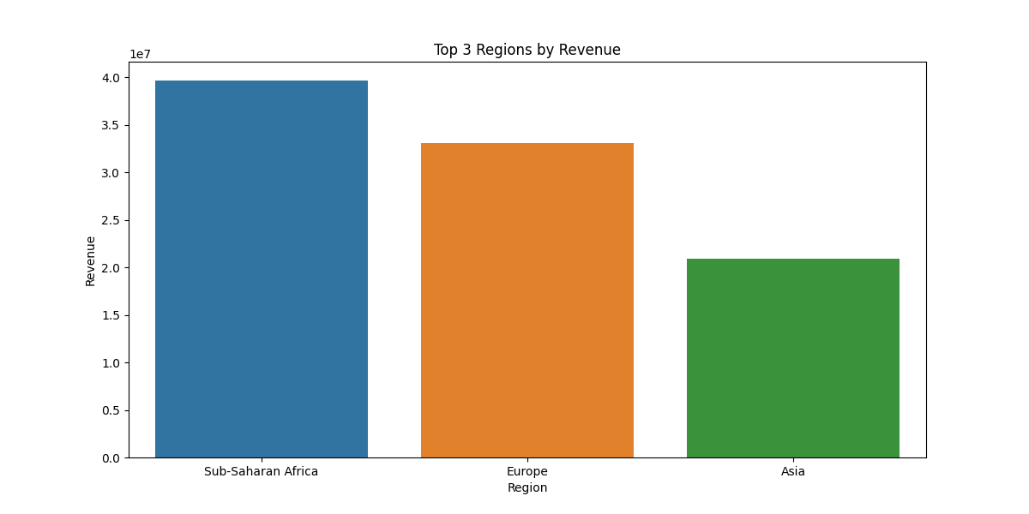

Slide 10
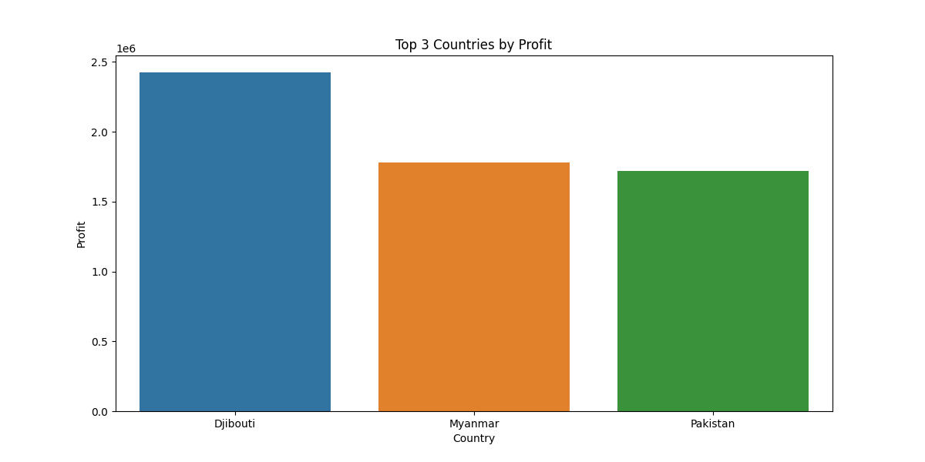

Slide 11
Product and Sales Channel
Best Selling Item Types:
Cosmetics: 83,718 units
Clothes: 71,260 units
Beverages: 56,708 units
Revenue by Sales Channel:
Offline: $79,094,809.20
Online: $58,253,959.11

Slide 12
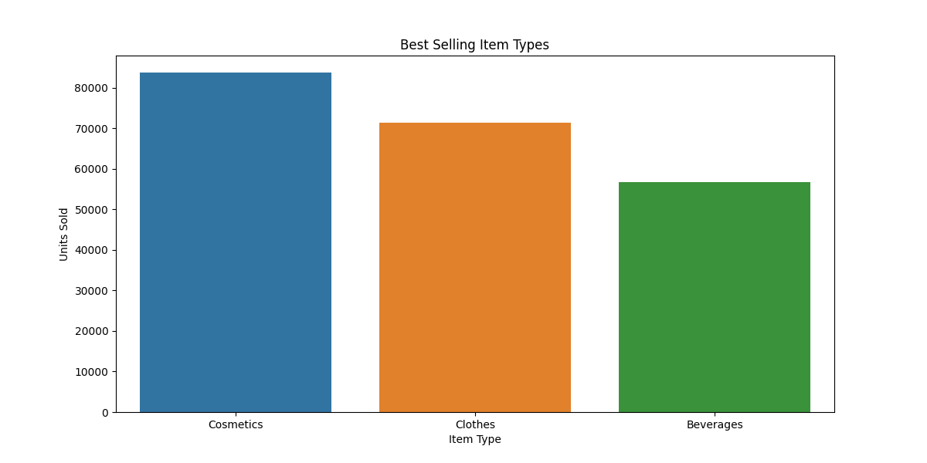

Slide 13
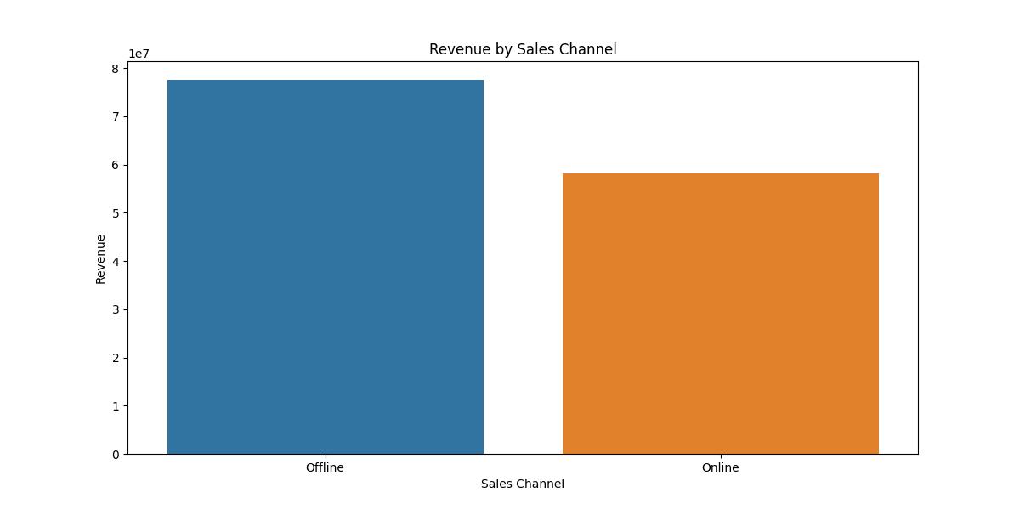

Slide 14
Order and Shipping Efficiency
Order Priority Impact on Revenue:
Critical: $18,855,063.05
High: $48,749,546.05
Low: $36,628,127.46
Medium: $33,116,031.75
Average Shipping Time:
23.36 Days

Slide 15
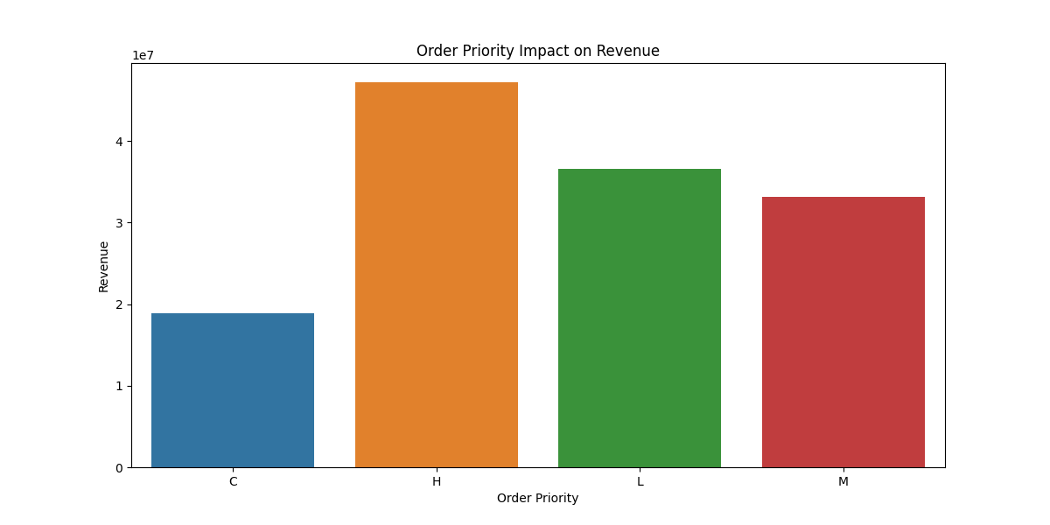

Slide 16
Sales Trends
Monthly Growth Rate:
85.06%
Yearly Growth Rate:
10.36%

Slide 17
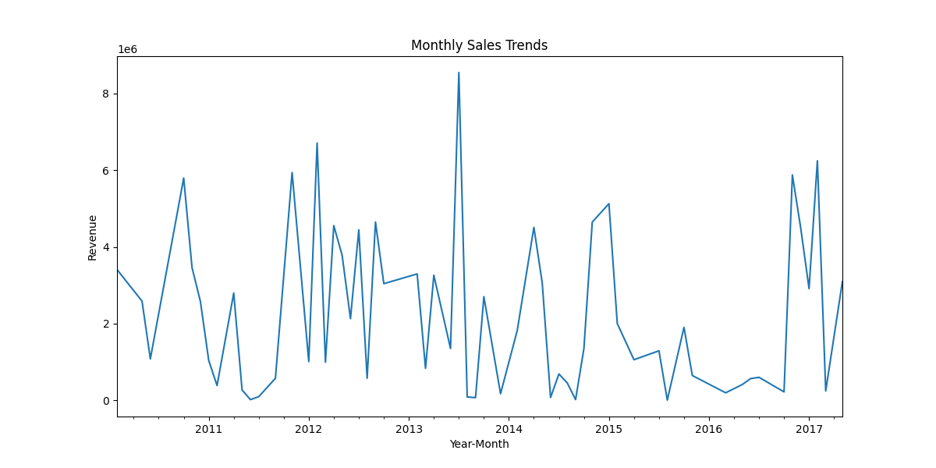

Slide 18
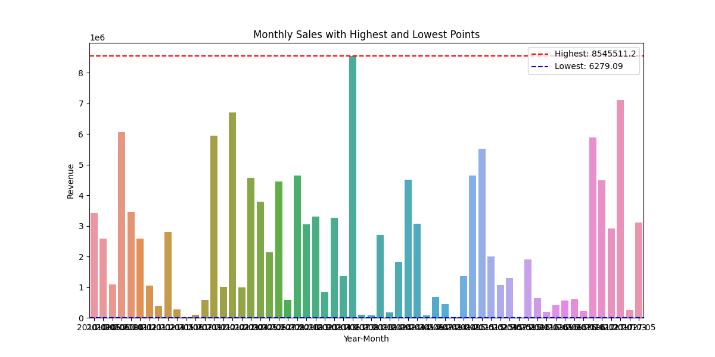

Slide 19
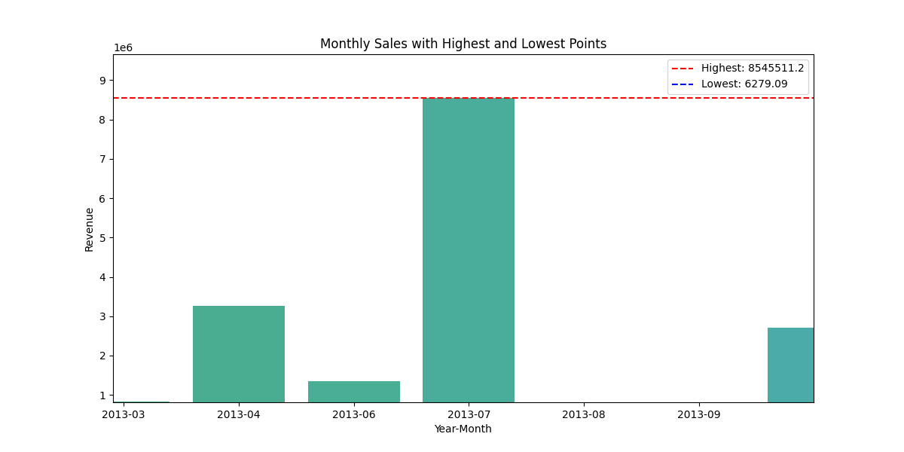

Slide 20
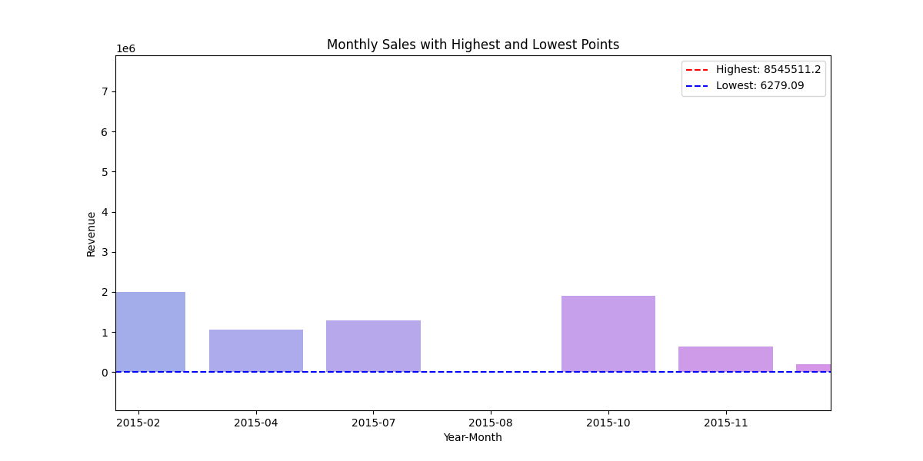

Slide 21
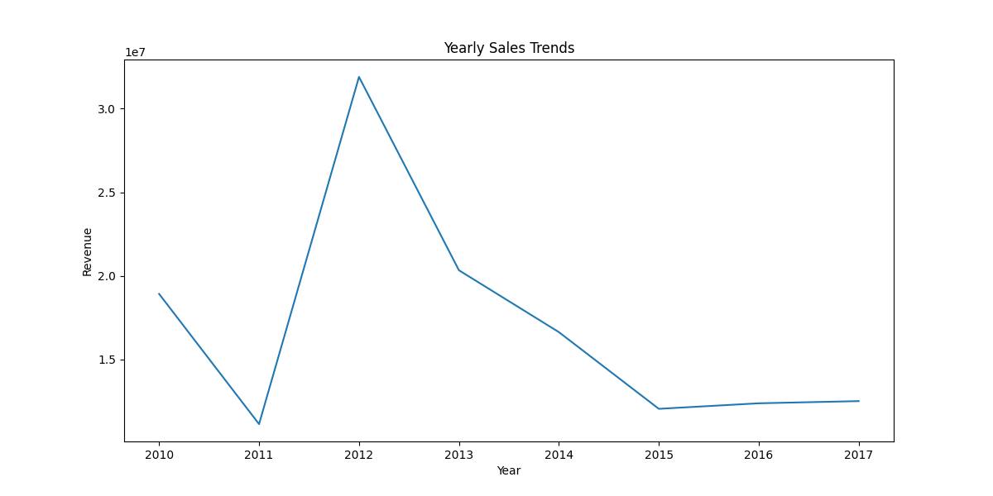

Slide 22
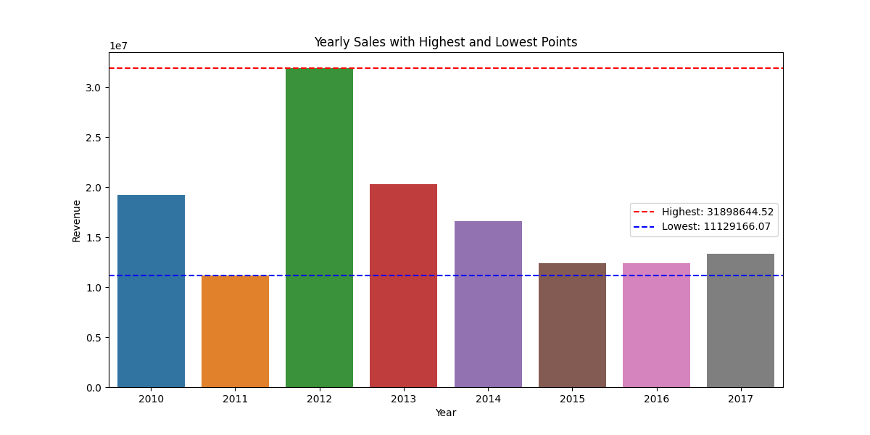

Slide 23
Conclusion
Summary of Findings:
The total revenue generated over the analyzed period is $137,348,768.31.
The total profit earned is $44,168,198.40, indicating a profit margin of 36.21%.
A total of 512,871 units were sold, demonstrating strong sales volume.
The highest monthly sales occurred in Month 7 of Year 2013.
The lowest monthly sales were recorded in Month 8 of Year 2015.
The overall trend shows a significant increase in sales year-over-year, with Year 2012 having the highest revenue.
The overall trend describe that, Year 2011 having the lowest revenue declares downfall in sales.

Slide 24
Thank You

