Slide 1
Data Analysis of Big Game Census
A Data-Driven Exploration
By- Sri Ratna Chintapalli

Slide 2
Project Details
Project Title | Data Analysis of Big Game Census
Technologies | Data Science
Domine | Sports
Project Difficulties level | Advance

Slide 3
Problem Statement
This Big Game Census data visualization takes a fun look at where Super Bowl 52
players come from, the related population figures, and opens up pathways (via
embedded links) to additional census data points. The dataset came about when two hapless data nerds had their teams eliminated from the playoffs, thus turning to data to try to find more rooting interests for Super Bowl 52. The rosters for both, competing teams are included, with the corresponding roster information and birthplace and state population information. The developers utilized census data pulled from census.gov, and roster information from Yahoo Sports, and designed the data visualization within the Tableau platform. Identify fun facts you've found within this data and/or data visualization, and has that swayed your rooting interest in the game? Share your ideas for a fun data visualization involving interesting data points.

Slide 4
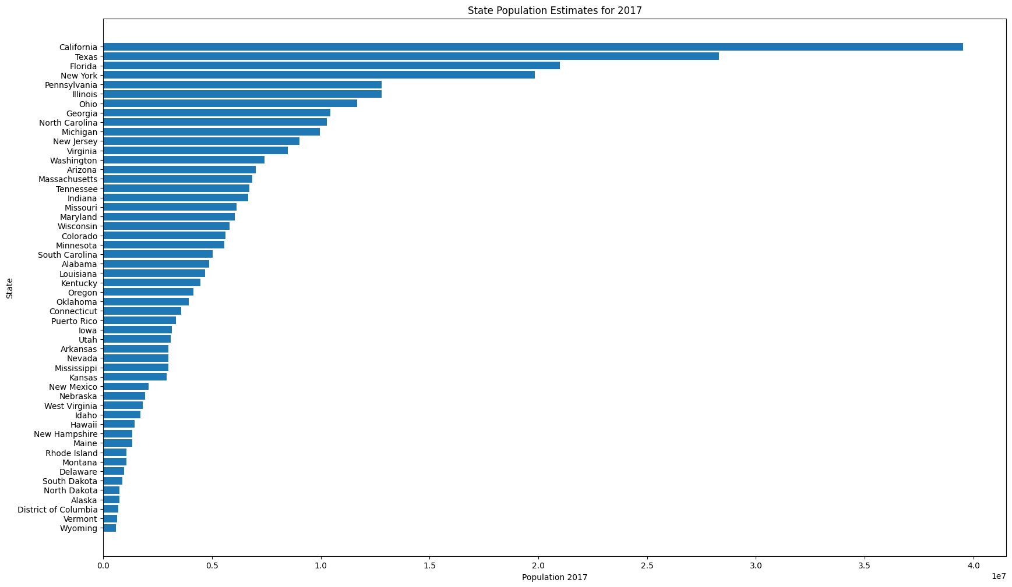
Extract 2017 population data using the correct column name for states

Slide 5
Extract 2017 population data using the correct column name for states
Visualization: Bar chart showing the population of each state in 2017.
Key Insights:
California, Texas, and Florida are the most populous states.
Smaller states like Wyoming and Vermont have the lowest populations.

Slide 6
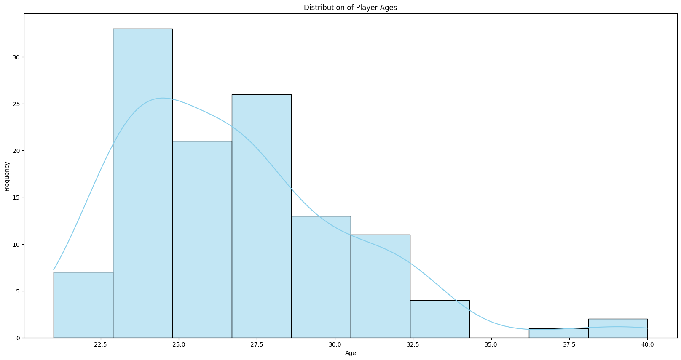
Distribution of Player Ages

Slide 7
Distribution of Player Ages
Visualization: Bar chart showing the distribution of players ages.
Key Insights:
The plot shows that most of the players average age is 25.
Very low member of players who are belong to age 35.

Slide 8
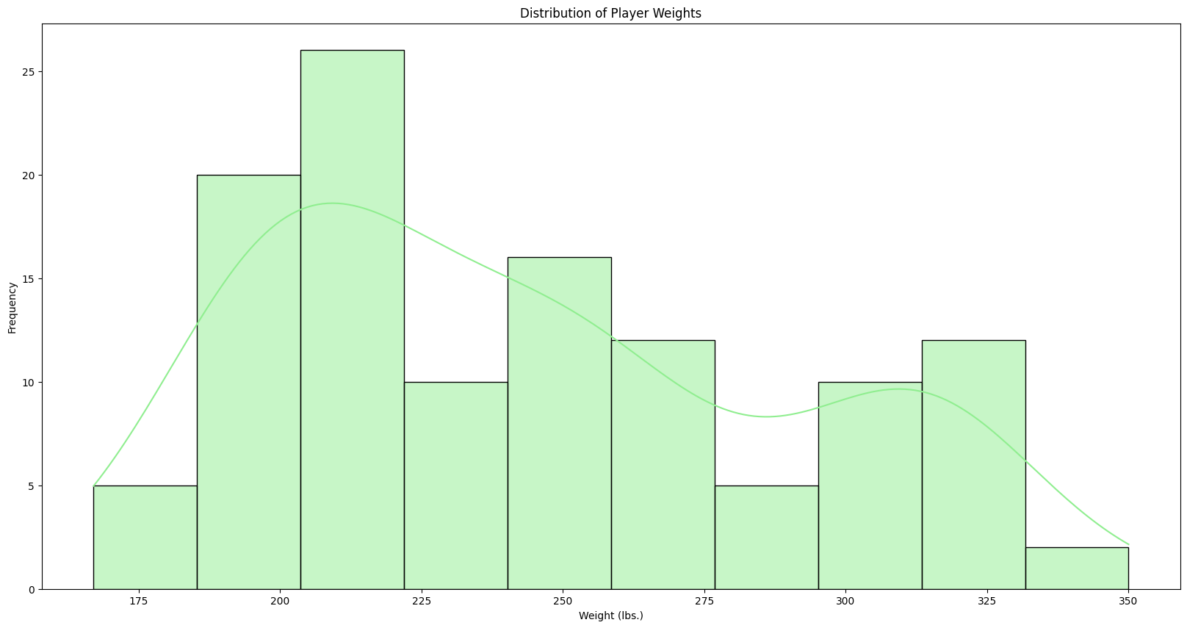
Distribution of Player Weights

Slide 9
Distribution of Player Weights
Visualization: Bar chart showing the distribution of players weights.
Key Insights:
Most of the players having 200 to 225 weight(lbs.)
Very least players have 350 weight(lbs.)

Slide 10
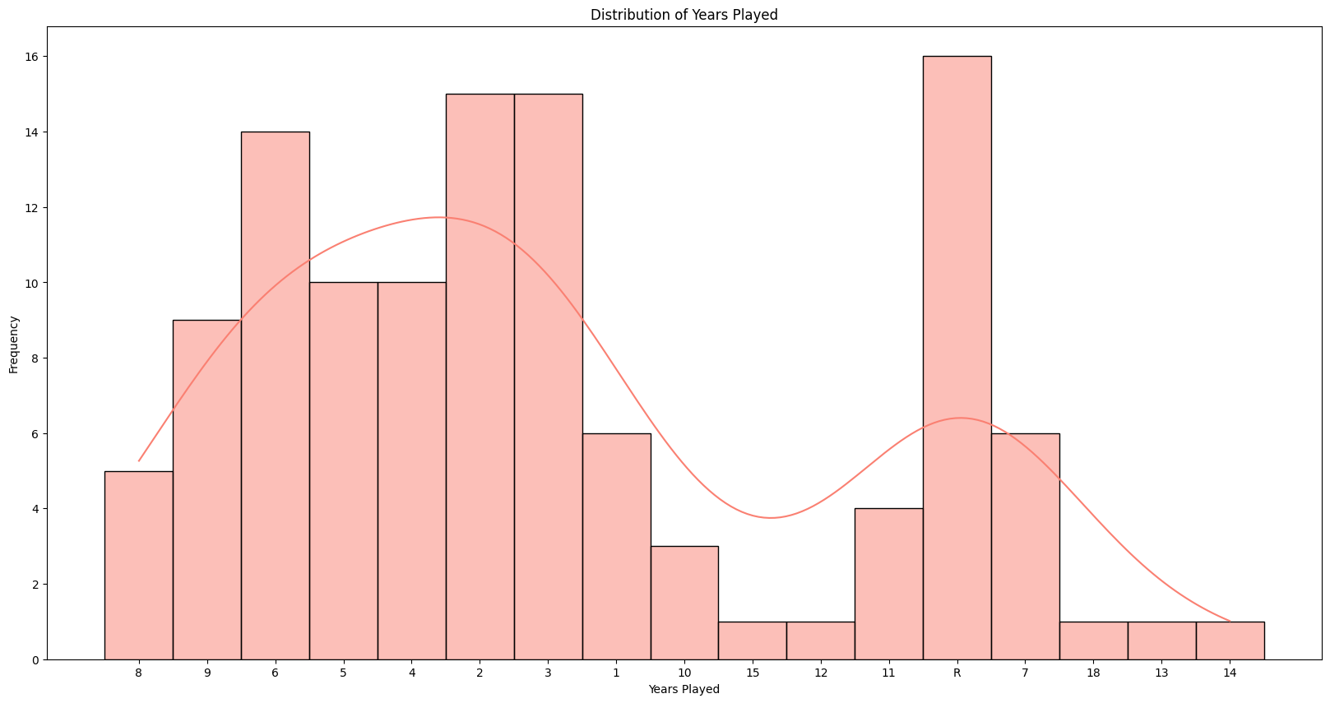
Distribution of Years Played

Slide 11
Distribution of Years Played
Visualization: Bar chart showing the distribution of years played by players.
Key Insights:
The most players played approxmetly 19 years.
Michigan and LSU players have higher average years played.

Slide 12
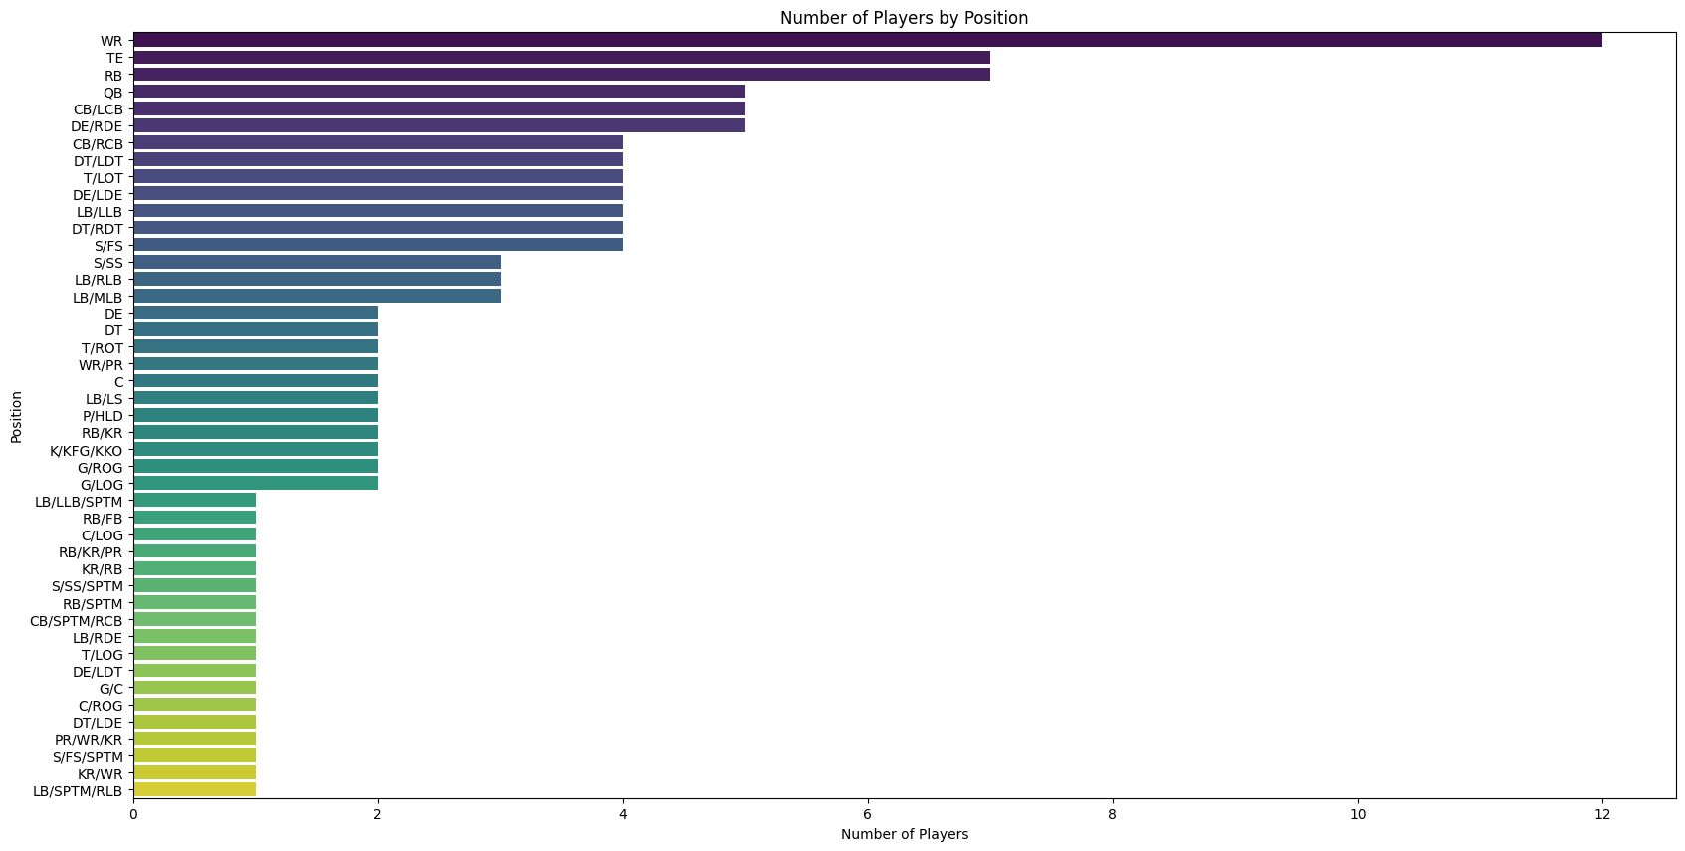
Position-wise Analysis

Slide 13
Position-wise Analysis
Visualization: Bar chart showing the position- wise analysis.
- Key Insights:
WR(Wide Receiver) has the highest number positions by players.

Slide 14
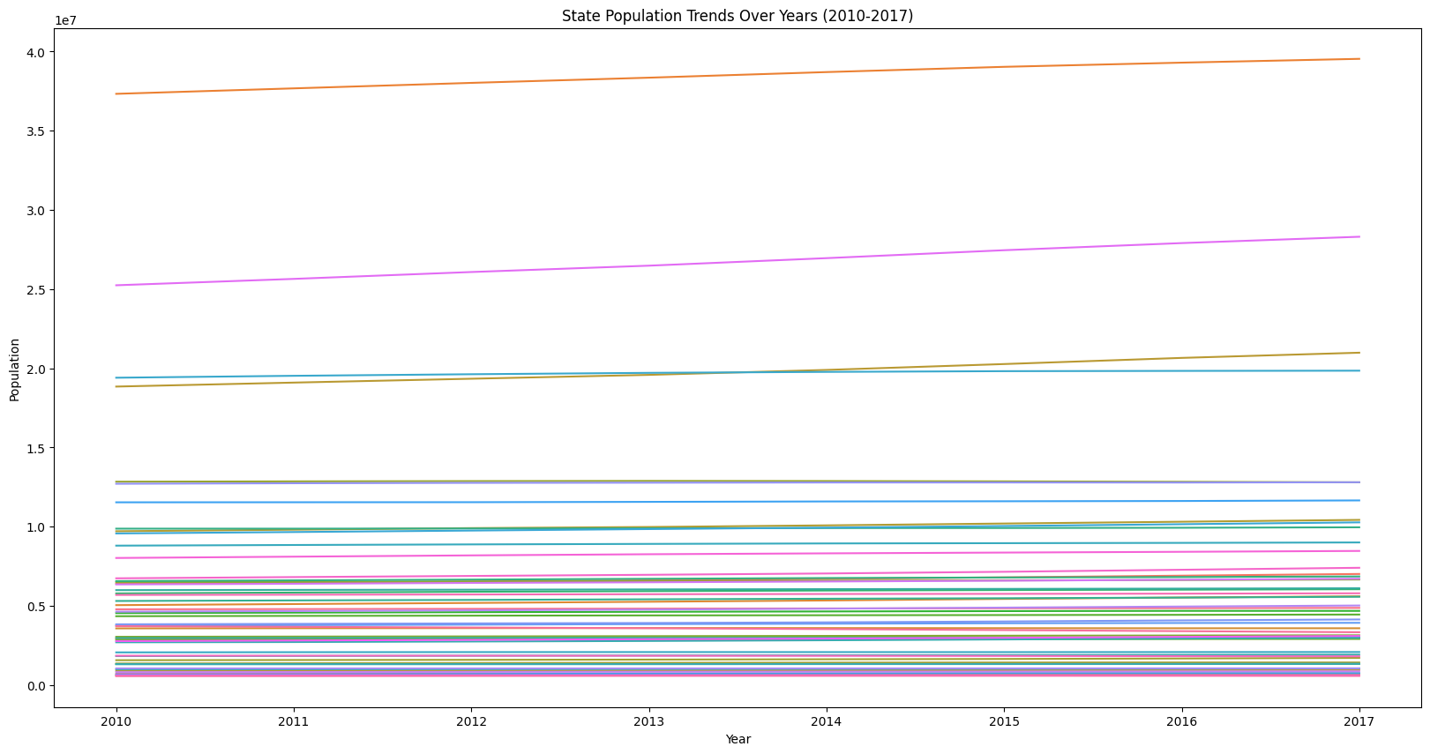
Plotting state population trends over the years

Slide 15
Plotting state population trends over the years
Visualization: Line plot showing population changes for all states between 2010 to 2017.
Key Insights:
Steady population growth across most states.
Highlighting states with significant population changes.

Slide 16
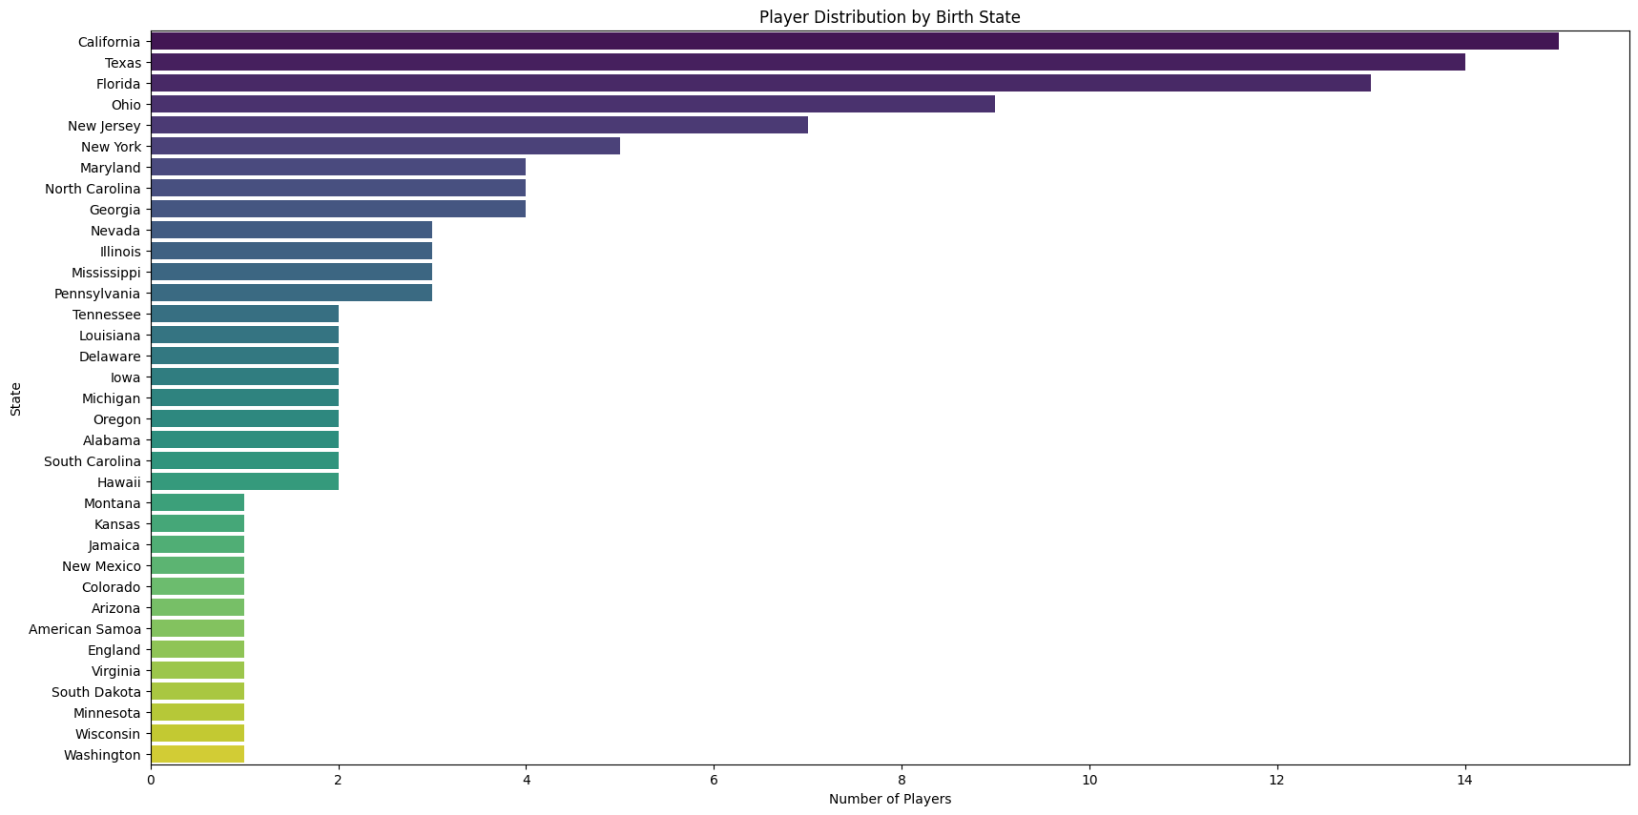
Analyzing player distribution by state

Slide 17
Analyzing player distribution by state
Visualization: Bar chart showing the number of players from each region.
Key Insights:
California, Taxes has the highest number of players.
Washington in descending order.

Slide 18
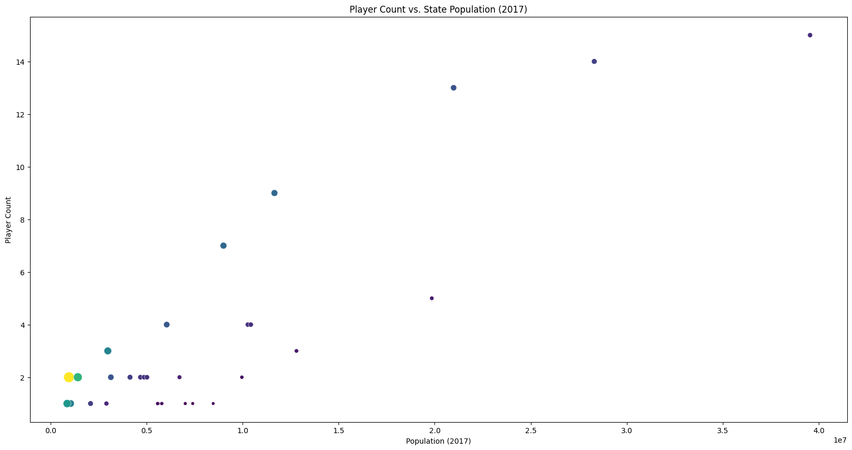
Comparing player count with state population

Slide 19
Comparing player count with state population
Visualization: Scatter plot comparing player count with state population.
Key Insights:
States with larger populations tend to produce more players.
High players per million residents in states like Ohio and New Jersey.

Slide 20
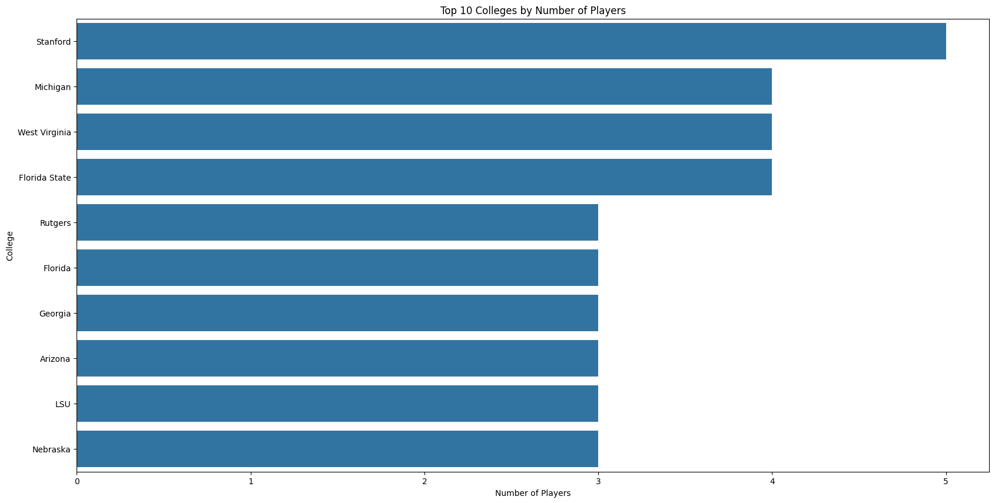
Analyzing players by college

Slide 21
Analyzing players by collages
Visualization: Bar chart showing number of players by each collages
Key Insights:
Stanford, Michigan students were higher number of players

Slide 22
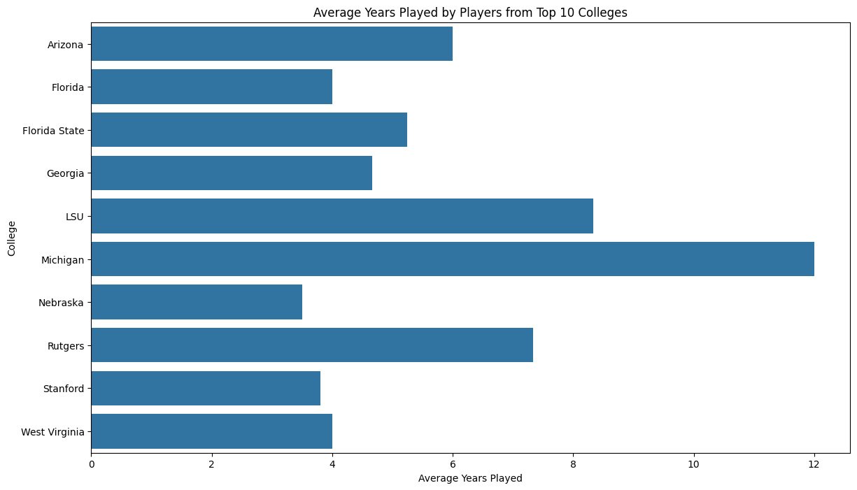
Average years played players from top 10 college

Slide 23
Average years played players from top 10 college
Visualization: Bar chart showing the average years played by players from the top 10
colleges.
Key Insights:
Michigan and LSU players have higher average years played.
Consistent performance from players across these colleges.

Slide 24
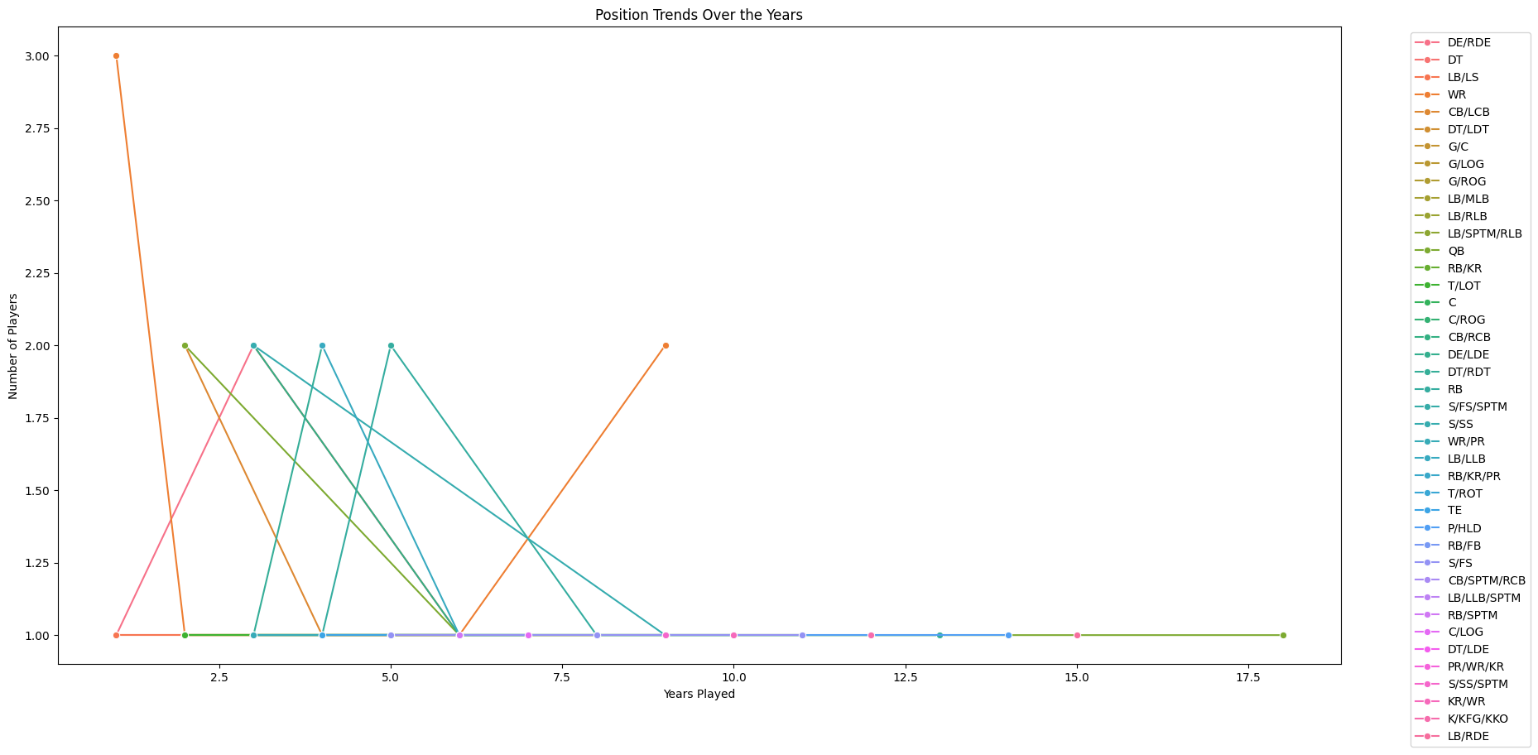
Analyzing position trends over the years

Slide 25
Analyzing position trends over the years
Visualization: Line plot showing the trends in player positions over the years.
Key Insights:
Wide Receiver (WR) consistently has high representation.
Variability in other positions like Cornerback (CB) and Safety (S).

Slide 26
Conclusion:
The importance of regional and state contributions to player pools.
The impact of population size on player production.
Perspectives on college connections and player performance.
Fun fact:
We'll identify interesting patterns such as which states or regions produce the most players, or whether certain states have higher player representation relative to their population.

