Slide 1
Crop Production Analysis in India
State-wise insights
By- Sri Ratna Chintapalli

Slide 2
Project Details
Project Title | Crop Production Analysis in India
Technologies | Data Science
Domine | Agriculture
Project difficulties level | Advance

Slide 3
Problem Statement
The Agriculture business domain, as a vital part of the overall supply chain, is expected to highly evolve in the upcoming years via the developments, which are taking place on the side of the Future Internet.
This paper presents a novel Business-to-Business collaboration platform from the agri-food sector perspective, which aims to facilitate the collaboration of numerous stakeholders belonging to associated business domains, in an effective and flexible manner.
This dataset provides a huge amount of information on crop production in India ranging from several years. Based on the Information the ultimate goal would be to predict crop production and find important insights highlighting key indicators and metrics that influence crop production.
Make views and dashboards first and also make a story out of it.

Slide 4
Objectives
This analysis aims to find out the crop productions in India by state-wise ,and type of crops which gives higher production , and future prediction for top 10 crops.

Slide 5
Dataset Overview
Dataset Description:
The dataset includes the following headings:
State Name, District Name , Crop Year ,Season ,Crop , Area ,Production
Data Source:
The data was sourced from crop production in India’s data records.

Slide 6
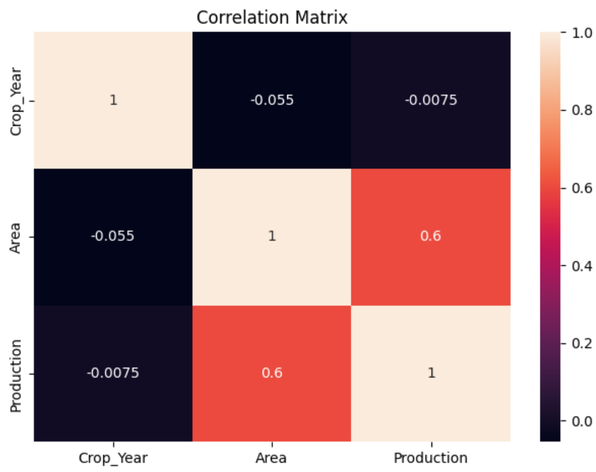
Correlation matrix

Slide 7
Correlation matrix
There is no variable showing high correlation with any other variable in the dataset

Slide 8
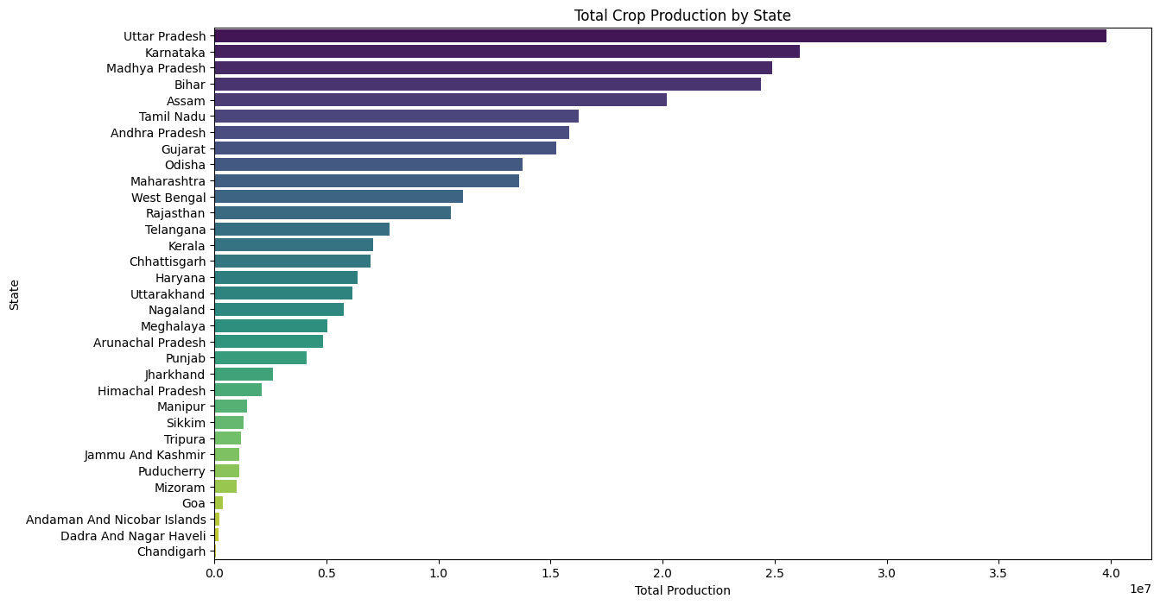
State-wise Crop Production(Stacked bar chart)

Slide 9
State-wise Crop Production
Stacked Bar plot showing total crop production by state-wise.
Key findings: Top producing states, regional variations.
The above plot declares that Uttar Pradesh have highest crop production in India.
And the least production comes from Chandigarh.

Slide 10
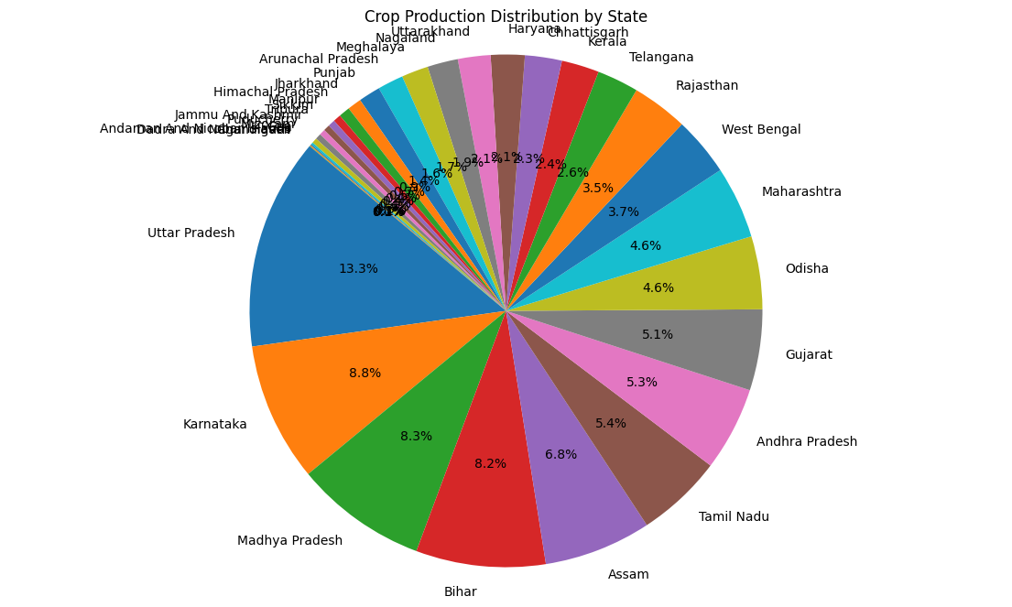
State-wise Crop Production(pie chart)

Slide 11
State-wise Crop Production(pie chart)
Showing crop production distribution through pie chart.
Uttar Pradesh got 13.3% production value, which is the highest production.
The least production state Chandigarh got 0.03% value.

Slide 12
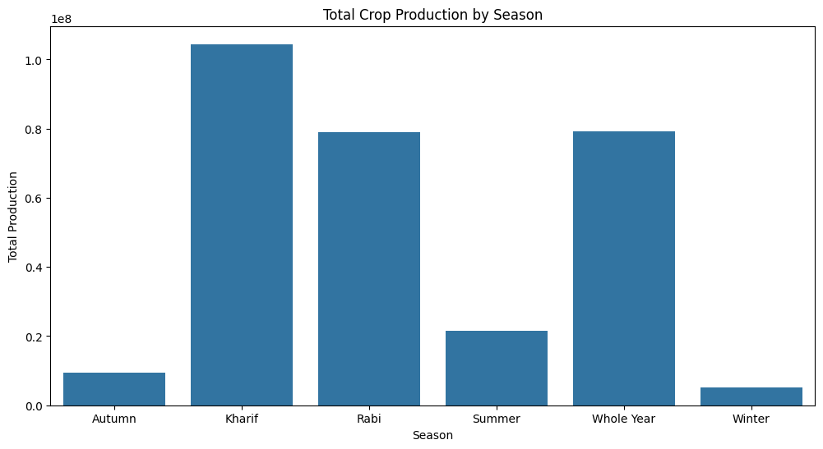
Season Wise Crop Production

Slide 13
Season Wise Crop Production
The above plot describes the crop productions in seasons.
Key findings: Top season which gives high production.
Kharif is the season which gives high crop production.
The least crop production occurs in winter season.

Slide 14
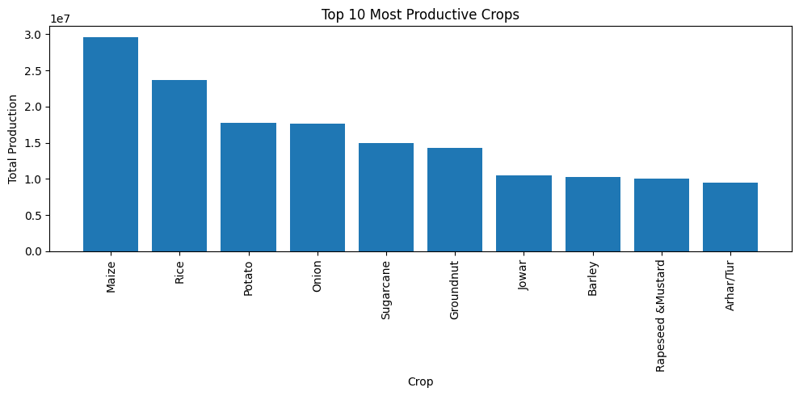
Top 10 Crops Production

Slide 15
Top 10 Crops Production
Key findings: Top 10 types crops which gives good production.
Maize produce highest value of production in overall India 29625129.27.
Arhar dal /Tur 9498057.33 produce least production in India.

Slide 16
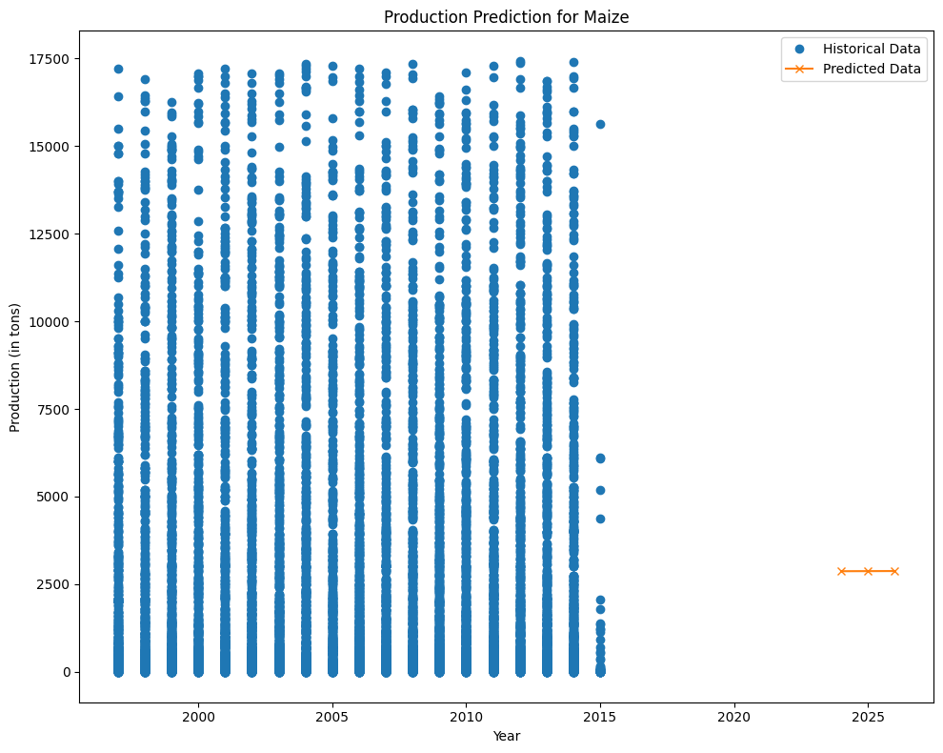
Future Predictions of Top 10 Crops

Slide 17
Future Predictions of Top 10 Crops
The plot is for displaying future predictions for Maize Crop.
The future prediction could be 2868.40194508, 2870.89558231,2873.38921954.
This much of productions could be expected in upcoming years.

Slide 18
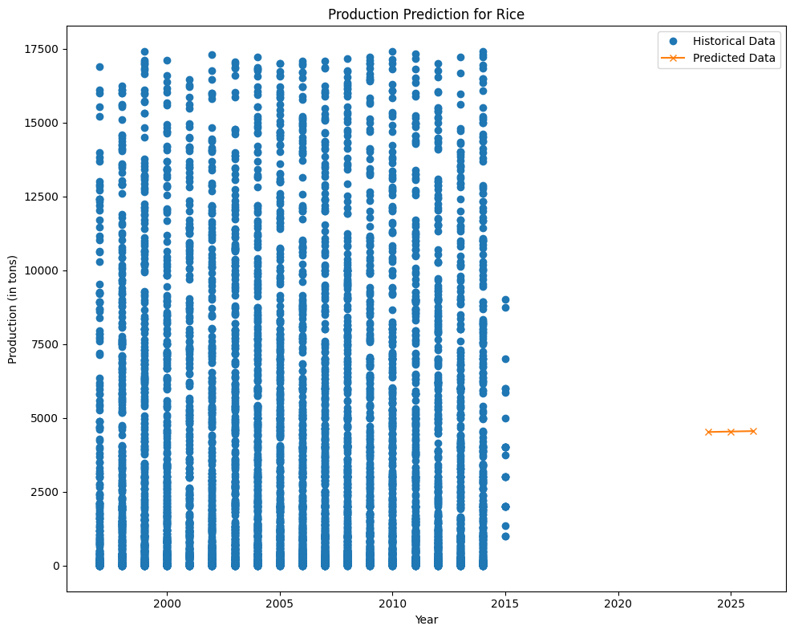
Future Predictions of Top 10 Crops

Slide 19
Future Predictions of Top 10 Crops
The plot is for displaying future predictions for Rice Crop.
The future prediction could be 4521.55625035, 4537.53123661, 4553.50622288.
This much of productions could be expected in upcoming years.

Slide 20

Future Predictions of Top 10 Crops

Slide 21
Future Predictions of Top 10 Crops
The plot is for displaying future predictions for Potato Crop.
The future prediction could be 3077.81247847, 3028.97323433, 2980.13399019.
This much of productions could be expected in upcoming years.

Slide 22

Future Predictions of Top 10 Crops

Slide 23
Future Predictions of Top 10 Crops
The plot is for displaying future predictions for Onion Crop.
The future prediction could be 1697.02042097,1632.9441819, 1568.86794282.
This much of productions could be expected in upcoming years.

Slide 24
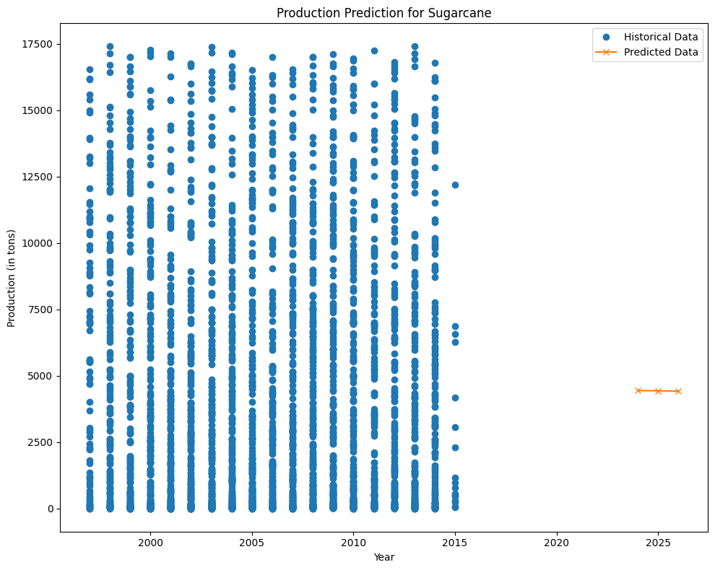
Future Predictions of Top 10 Crops

Slide 25
Future Predictions of Top 10 Crops
The plot is for displaying future predictions for Sugarcane Crop.
The future prediction could be 4442.47207773, 4431.12981108, 4419.78754444.
This much of productions could be expected in upcoming years.

Slide 26
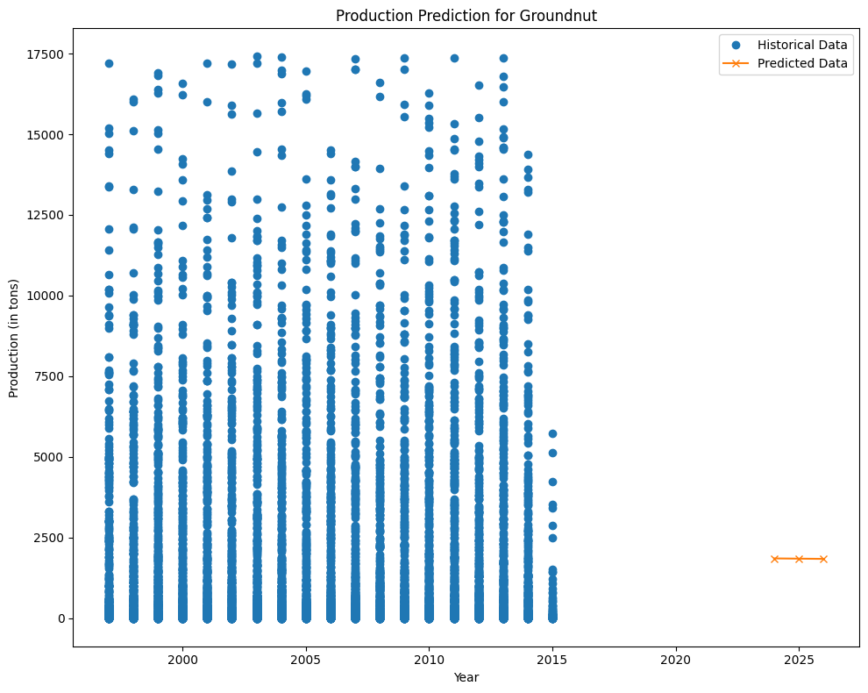
Future Predictions of Top 10 Crops

Slide 27
Future Predictions of Top 10 Crops
The plot is for displaying future predictions for Ground nut Crop.
The future prediction could be 1852.72291776,1845.27687227,1837.83082677.
This much of productions could be expected in upcoming years.

Slide 28
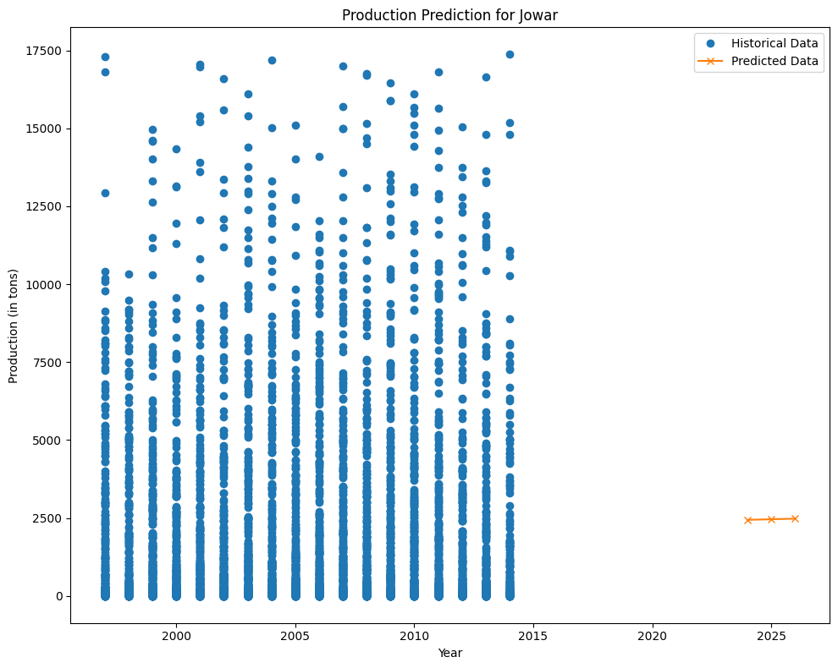
Future Predictions of Top 10 Crops

Slide 29
Future Predictions of Top 10 Crops
The plot is for displaying future predictions for Jowar Crop.
The future prediction could be 2439.08104278, 2458.60911921,2478.13719564.
This much of productions could be expected in upcoming years.

Slide 30
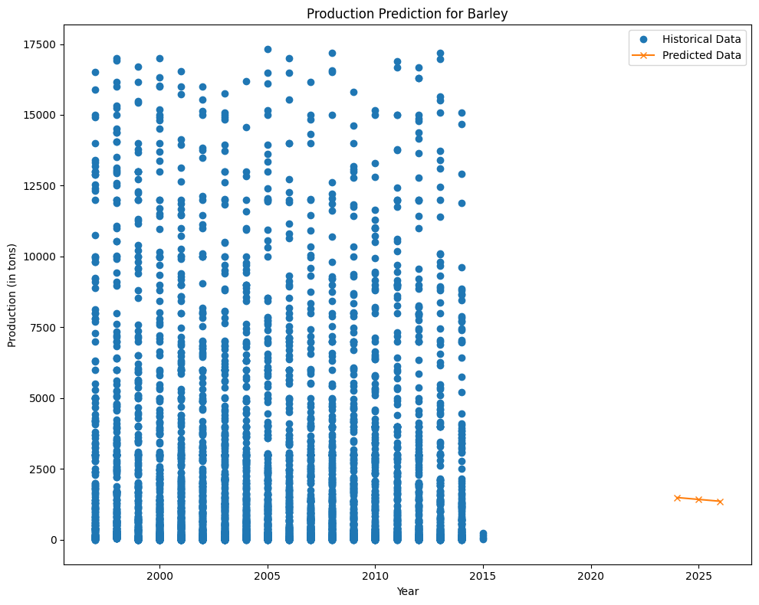
Future Predictions of Top 10 Crops

Slide 31
Future Predictions of Top 10 Crops
The plot is for displaying future predictions for Barley Crop.
The future prediction could be 1487.93079163, 1422.51722079, 1357.10364996.
This much of productions could be expected in upcoming years.

Slide 32
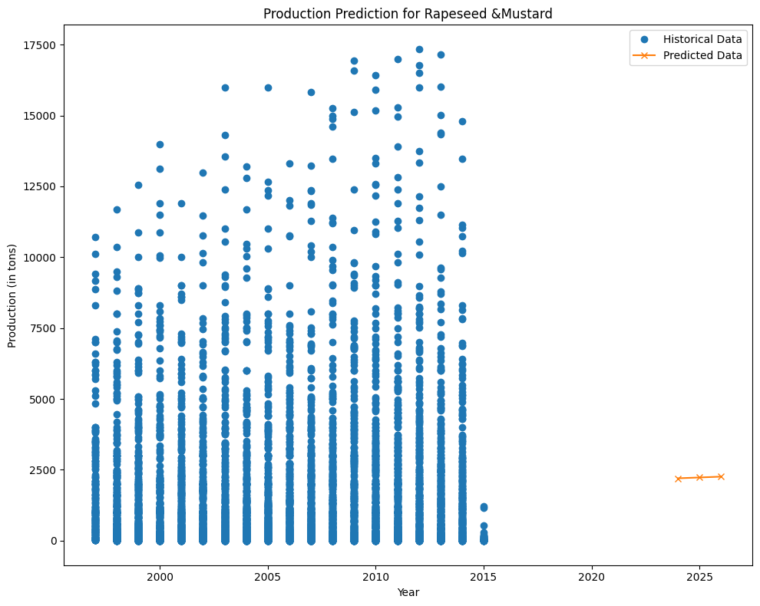
Future Predictions of Top 10 Crops

Slide 33
Future Predictions of Top 10 Crops
The plot is for displaying future predictions for Mustard Crop.
The future prediction could be 2197.83772634, 2227.02541918, 2256.21311203.
This much of productions could be expected in upcoming years.

Slide 34
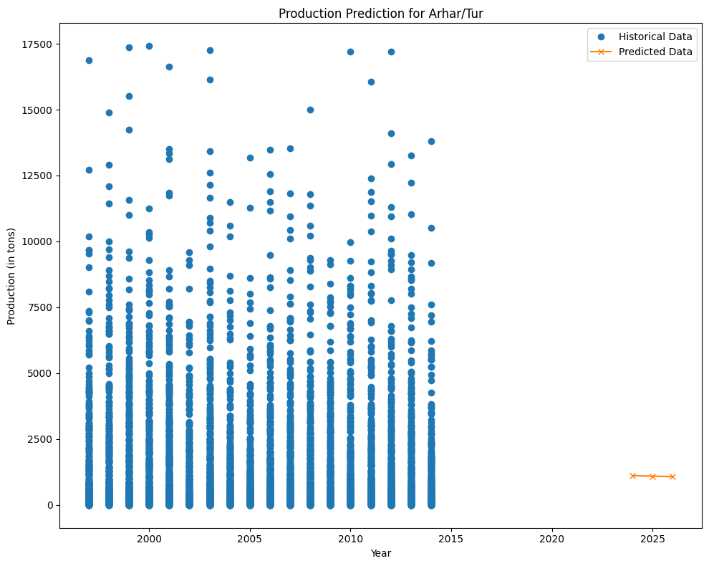
Future Predictions of Top 10 Crops

Slide 35
Future Predictions of Top 10 Crops
The plot is for displaying future predictions for Arhar Dal Crop
The future prediction could be 1110.55774179, 1089.91022549, 1069.2627092.
This much of productions could be expected in upcoming years.

Slide 36
Conclusion:
Conclusions from Yearly Production:
There is a general increasing trend in crop production from 1997 to 2015.
Noticeable fluctuations are observed in certain years, possibly due to varying climatic conditions, agricultural practices, or policy changes.
Significant increases or decreases in certain years warrant further investigation.
The Year-over-Year growth rate highlights periods of rapid growth or decline, providing insights into potential factors affecting production.

Slide 37
Conclusion:
Conclusions from State-wise Production:
States like Uttar Pradesh, Punjab, Madhya Pradesh, and West Bengal are top contributors to total crop production.
There is considerable variation in production across different states, highlighting the importance of regional factors such as soil quality, climate, and available resources.
The contribution percentage plot shows each state's relative contribution to the overall crop production.

Slide 38
Conclusion:
Conclusions from Seasonal Production:
The Kharif season (monsoon) has the highest total production, indicating significant contributions from crops grown during this period such as rice and maize.
Other seasons like Rabi (winter) and Whole Year production also contribute significantly, reflecting the diversity of crops and farming practices in India.
The contribution percentage plot highlights the relative importance of each season to total crop production.

Slide 39
Conclusion:
Conclusions from Crop-specific Analysis:
Major crops like rice, wheat, sugarcane, and maize are the top producers, aligning with their importance in the Indian diet and economy.
The diversity in the top 10 crops highlights the adaptability of Indian farmers to different climatic and soil conditions.
The contribution percentage plot shows the relative importance of each crop in the top 10.

